Slide 1

4 Multi-PDF with LangChain/Gemini
Peter H. Chen

Slide 2
4 Multi-PDF with LangChain/Gemini
https://www.youtube.com/watch?v=uus5eLz6smA&list=PLZoTAELRMXVNbDmGZlcgCA3a8mRQp5axb&index=6
Multi-PDF with LangChain/Gemini (00:00-00:50/29:20)
We create a chatBot with multiple PDF documents with Google Gemini.
We also use LangChain.
We will understand how LangChain integrate the Google Gemini-Pro.
We will use two important features:
1. Vector Embedding Technique: We will use Faiss (Facebook AI similarity Search) library.
2. LangChain integration.

Slide 3
4.01 PDF with Gemini Demo

Slide 4
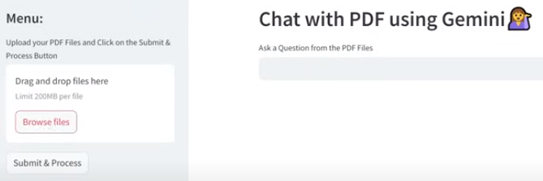
4.01 PDF with Gemini Demo
https://www.youtube.com/watch?v=uus5eLz6smA&list=PLZoTAELRMXVNbDmGZlcgCA3a8mRQp5axb&index=6
PDF with Gemini Demo (00:51-01:52/29:20)
We will develop the application as below:
1. Drag and Drop files on the left.
2. Ask a Question for PDF files
3. Click “Submit & Process” Button.

Slide 5
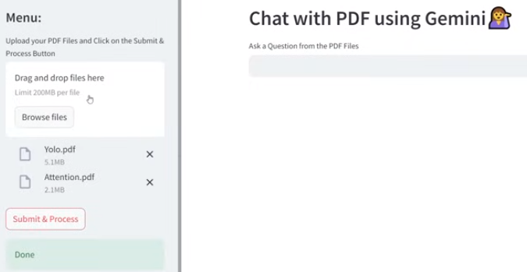
4.01 PDF with Gemini Demo
https://www.youtube.com/watch?v=uus5eLz6smA&list=PLZoTAELRMXVNbDmGZlcgCA3a8mRQp5axb&index=6
PDF with Gemini Demo (01:53-02:30/29:20)
Below, we have downloaded the Yolo.pdf and Attention.pdf

Slide 6
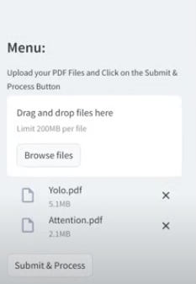
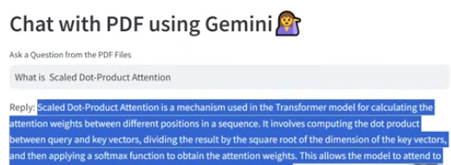
4.01 PDF with Gemini Demo
https://www.youtube.com/watch?v=uus5eLz6smA&list=PLZoTAELRMXVNbDmGZlcgCA3a8mRQp5axb&index=6
PDF with Gemini Demo (00:51-02:00/29:20)
Below, we ask question:
1. “What is Scaled Dot-Product Attention”
2. Click “Submit & Process”.

Slide 7
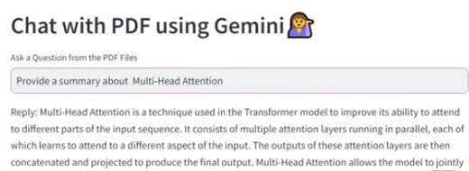
4.01 PDF with Gemini Demo
https://www.youtube.com/watch?v=uus5eLz6smA&list=PLZoTAELRMXVNbDmGZlcgCA3a8mRQp5axb&index=6
PDF with Gemini Demo (02:01-03:00/29:20)
Below, we ask question:
1. “Provide me a summary of Multi-Head Attention”
2. Click “Submit & Process”.

Slide 8
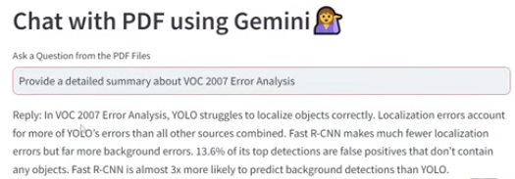
4.01 PDF with Gemini Demo
https://www.youtube.com/watch?v=uus5eLz6smA&list=PLZoTAELRMXVNbDmGZlcgCA3a8mRQp5axb&index=6
PDF with Gemini Demo (03:01-04:20/29:20)
Below, we ask question:
1. “Provide a detailed Summary about VOC 2007 End Analysis”
2. Click “Submit & Process”.

Slide 9
End

