Slide 1

1.05 Simple Sequential Chain
Peter H. Chen

Slide 2

1.05 Simple Sequential Chain
https://www.youtube.com/watch?v=nAmC7SoVLd8&list=PLeo1K3hjS3uu0N_0W6giDXzZIcB07Ng_F&index=1
Simple Sequential Chain (11:51-11:55/46:07)
Simple Sequential Chain has only one input and one output at each tool.

Slide 3
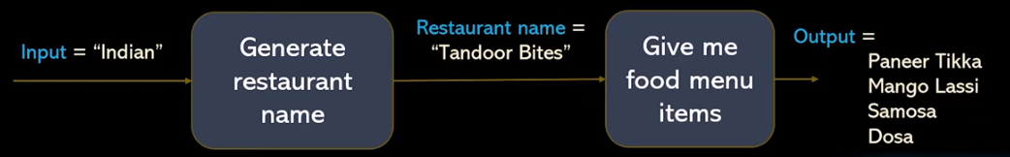
1.05 Simple Sequential Chain
https://www.youtube.com/watch?v=nAmC7SoVLd8&list=PLeo1K3hjS3uu0N_0W6giDXzZIcB07Ng_F&index=1
Simple Sequential Chain (11:56-12:30/46:07)
These are the sequences of chains:
1. Generate Restaurant Name: From input = “Indian” to output Restaurant name = “Tandoor Bites”,
2. Give me food menu items: Restaurant name = “Tandoor Bites” to output “Paneer Tikka, Mango Lassi, Samosa, Dosa”
This is called “Simple Sequential Chain”.

Slide 4
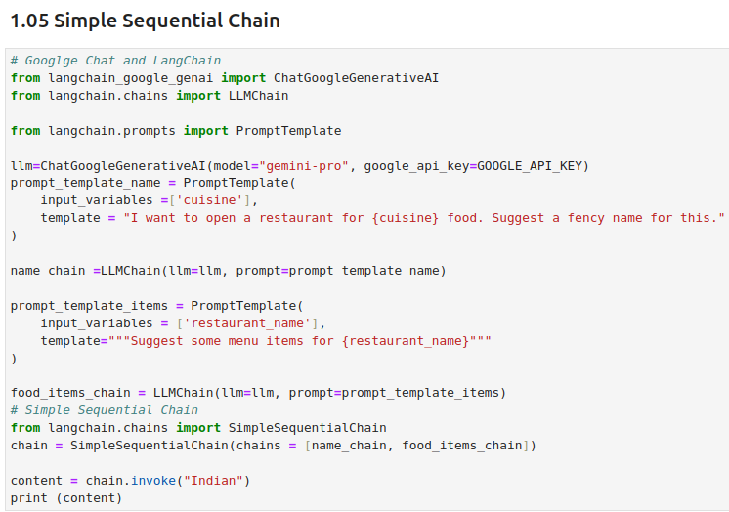
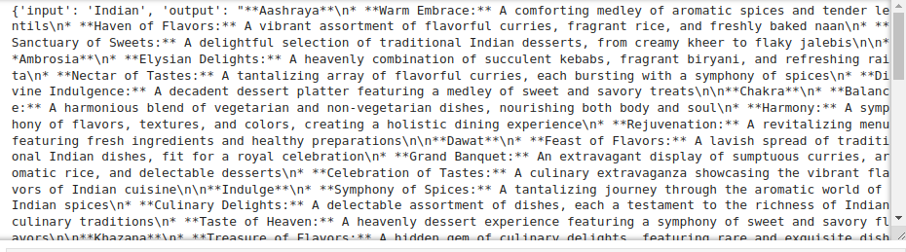
1.05 Simple Sequential Chain
https://www.youtube.com/watch?v=nAmC7SoVLd8&list=PLeo1K3hjS3uu0N_0W6giDXzZIcB07Ng_F&index=1
Simple Sequential Chain (12:31-15:00/46:07)
Previously, we have the two chains: name_chain and food_items_chain.
We use SimpleSequentialChain () to connect name_chain and food_items_chain together.

Slide 5
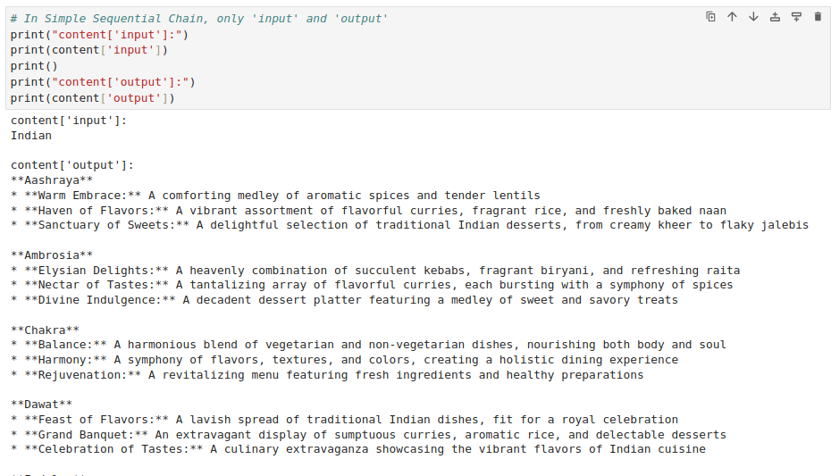
1.05 Simple Sequential Chain
https://www.youtube.com/watch?v=nAmC7SoVLd8&list=PLeo1K3hjS3uu0N_0W6giDXzZIcB07Ng_F&index=1
Simple Sequential Chain (15:01-15:10/46:07)
Result:

Slide 6
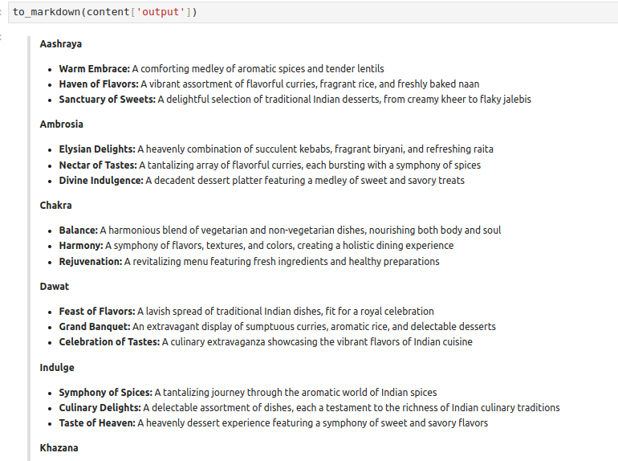
1.05 Simple Sequential Chain
https://www.youtube.com/watch?v=nAmC7SoVLd8&list=PLeo1K3hjS3uu0N_0W6giDXzZIcB07Ng_F&index=1
Simple Sequential Chain (15:11-15:20/46:07)
Format Result:

Slide 7
1.06 Sequential Chain

Slide 8

1.06 Sequential Chain
https://www.youtube.com/watch?v=nAmC7SoVLd8&list=PLeo1K3hjS3uu0N_0W6giDXzZIcB07Ng_F&index=1
Sequential Chain (15:31-15:40/46:07)
Sequential Chain can have multiple inputs (agents/chains) and multiple outputs (agents/chains).

Slide 9
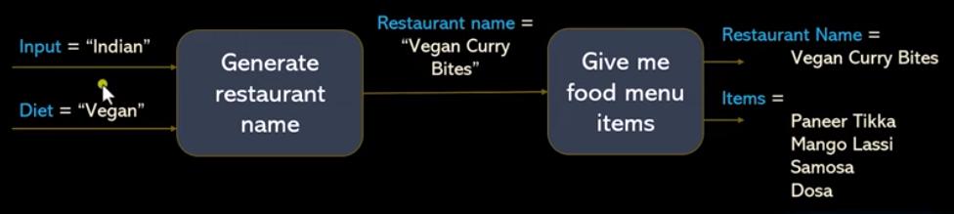

1.06 Sequential Chain
https://www.youtube.com/watch?v=nAmC7SoVLd8&list=PLeo1K3hjS3uu0N_0W6giDXzZIcB07Ng_F&index=1
Sequential Chain (15:21-15:40/46:07)
Sequential Chain can have multiple inputs (agents/chains) and multiple outputs (agents/chains).

Slide 10
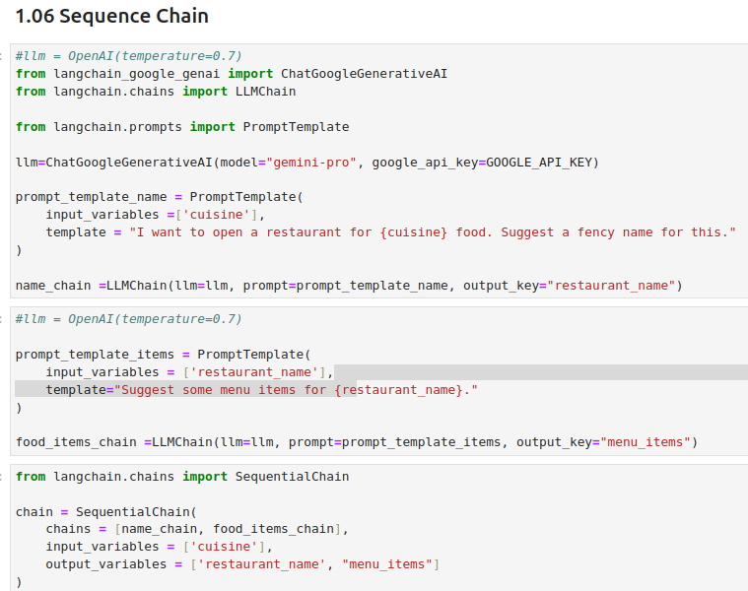
1.06 Sequential Chain
https://www.youtube.com/watch?v=nAmC7SoVLd8&list=PLeo1K3hjS3uu0N_0W6giDXzZIcB07Ng_F&index=1
Sequential Chain (15:41-17:00/46:07)

Slide 11
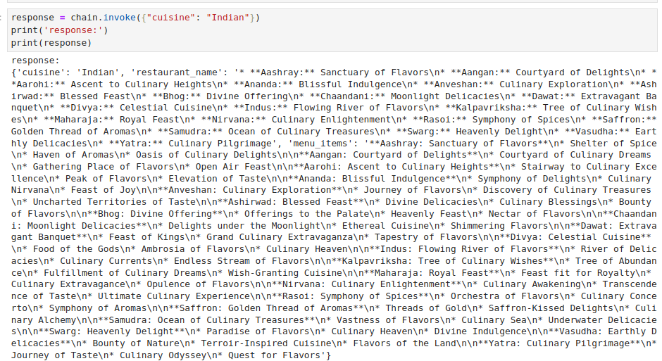
1.06 Sequential Chain
https://www.youtube.com/watch?v=nAmC7SoVLd8&list=PLeo1K3hjS3uu0N_0W6giDXzZIcB07Ng_F&index=1
Sequential Chain (17:01-17:30/46:07)
Run chain and Result

Slide 12
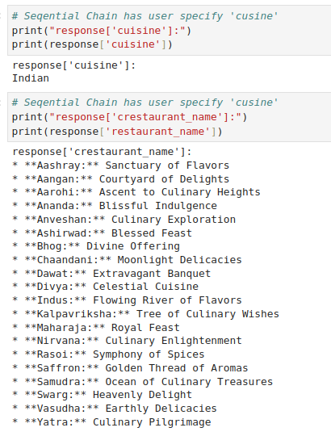
1.06 Sequential Chain
https://www.youtube.com/watch?v=nAmC7SoVLd8&list=PLeo1K3hjS3uu0N_0W6giDXzZIcB07Ng_F&index=1
Sequential Chain (17:31-18:00/46:07)
Result

Slide 13
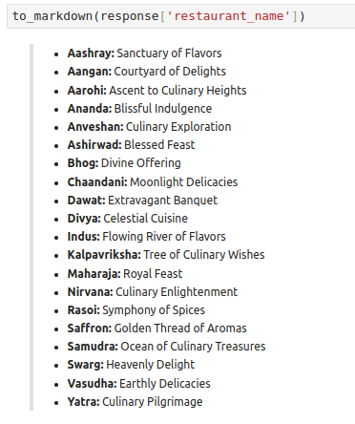
1.06 Sequential Chain
https://www.youtube.com/watch?v=nAmC7SoVLd8&list=PLeo1K3hjS3uu0N_0W6giDXzZIcB07Ng_F&index=1
Sequential Chain (18:01-18:30/46:07)
Format Result

Slide 14
End

