Slide 1

7.05.02 Install Requirements
Peter H. Chen

Slide 2
7.05.02 Install Requirements
https://www.youtube.com/watch?v=1ICRLYtkmNU&list=PLZoTAELRMXVNbDmGZlcgCA3a8mRQp5axb&index=7
Install Requirements (1:41:21-1:42:30/2:16:34)
1. Create the conda environment
> conda create --name gemini
2. Activate the conda environment
> conda activate gemini

Slide 3
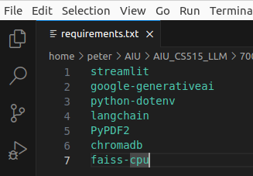
7.05.02 Install Requirements
https://www.youtube.com/watch?v=1ICRLYtkmNU&list=PLZoTAELRMXVNbDmGZlcgCA3a8mRQp5axb&index=7
Install Requirements (1:42:31-1:42:40/2:16:34)
Check the packages requirements.
1. streamlit: GUI
2. google generative AI: Gemini-pro-vision
3. python_dotenv: Load the environment variable GOOGLE_APP_KEY
4. langchain: Integrate multiple libraries
5. PyPDF2: Python read PDF.
6. chromdb: Store vector database
7. faiss-cpu: Vector database (embeddings) with FAISS (Facebook AI Similarity Search). For small vector database, we use with CPU mode (faiss-cpu). For Large vector database, we use GPU mode (faiss-gpu).

Slide 4
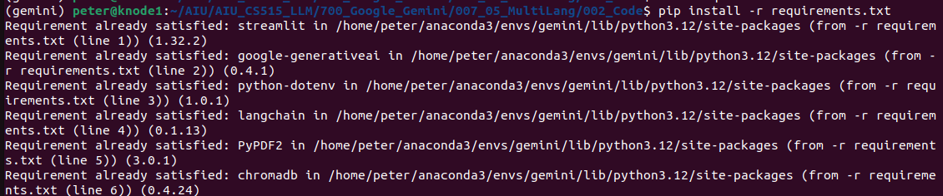
7.05.02 Install Requirements
https://www.youtube.com/watch?v=1ICRLYtkmNU&list=PLZoTAELRMXVNbDmGZlcgCA3a8mRQp5axb&index=7
Install Requirements (1:43:41-1:42:30/2:16:34)
Install all packages:
> pip install -r requirements.txt

Slide 5
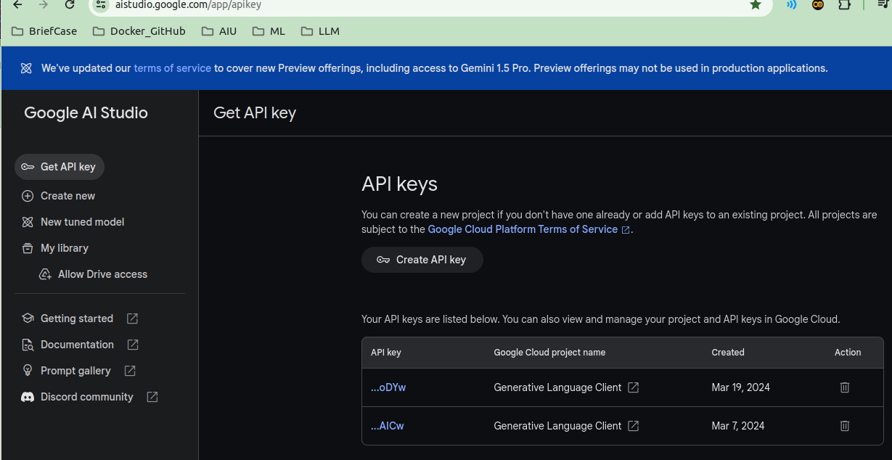
7.05.02 Install Requirements
https://www.youtube.com/watch?v=1ICRLYtkmNU&list=PLZoTAELRMXVNbDmGZlcgCA3a8mRQp5axb&index=7
Install Requirements (1:42:31-1:43:30/2:16:34)
We create the Google APP Key for Gemini Model.
https://aistudio.google.com/app/apikey

Slide 6
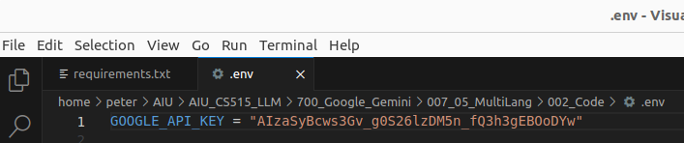
7.05.02 Install Requirements
https://www.youtube.com/watch?v=1ICRLYtkmNU&list=PLZoTAELRMXVNbDmGZlcgCA3a8mRQp5axb&index=7
Install Requirements (1:43:31-1:44:30/2:16:34)
Copy the Google APP Key in “.env” file.

Slide 7
End

