Slide 1

7.05.03 Create API Key
Peter H. Chen

Slide 2
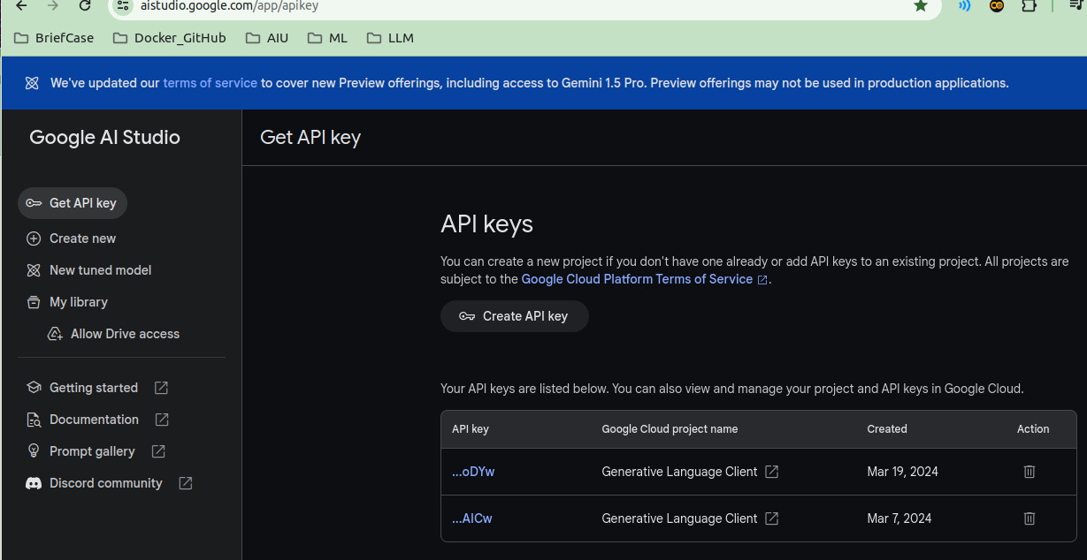
7.05.03 Create API Key
https://www.youtube.com/watch?v=1ICRLYtkmNU&list=PLZoTAELRMXVNbDmGZlcgCA3a8mRQp5axb&index=7
Create API Key (1:42:31-1:43:30/2:16:34)
We create the Google APP Key for Gemini Model.
https://aistudio.google.com/app/apikey

Slide 3
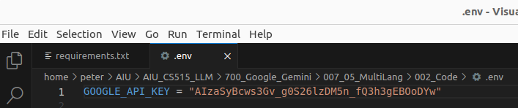
7.05.03 Create API Key
https://www.youtube.com/watch?v=1ICRLYtkmNU&list=PLZoTAELRMXVNbDmGZlcgCA3a8mRQp5axb&index=7
Create API Key (1:43:31-1:44:30/2:16:34)
Copy the Google APP Key in “.env” file.

Slide 4
End

