Slide 1

07.05.11 Test Taiwan Invoice
Peter H. Chen

Slide 2
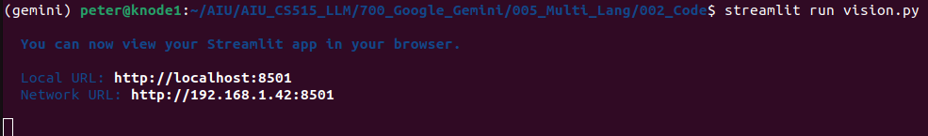
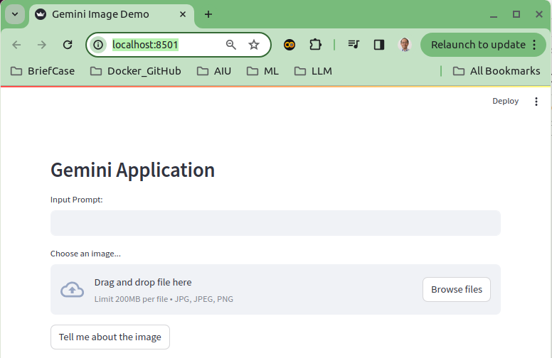
07.05.11 Test Taiwan Invoice
https://www.youtube.com/watch?v=1ICRLYtkmNU&list=PLZoTAELRMXVNbDmGZlcgCA3a8mRQp5axb&index=7
Test Taiwan Invoice (1:58:31-1:59:00/2:16:34)
Test MLIE (Multi-Language Invoice Extractor):
1. > streamlit run vision.py

Slide 3
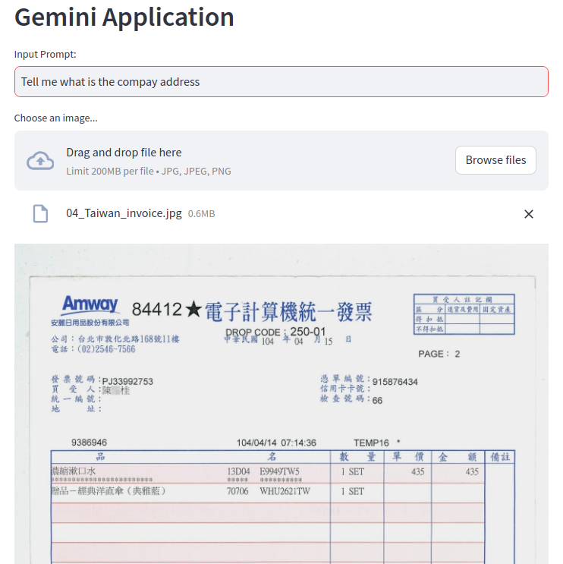
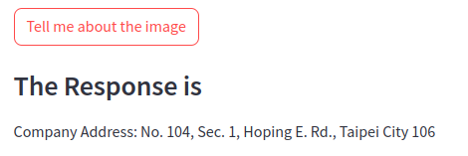
07.05.11 Test Taiwan Invoice
https://www.youtube.com/watch?v=1ICRLYtkmNU&list=PLZoTAELRMXVNbDmGZlcgCA3a8mRQp5axb&index=7
Test Taiwan Invoice (1:59:01-1:59:30/2:16:34)
Input: What is the company name?

Slide 4
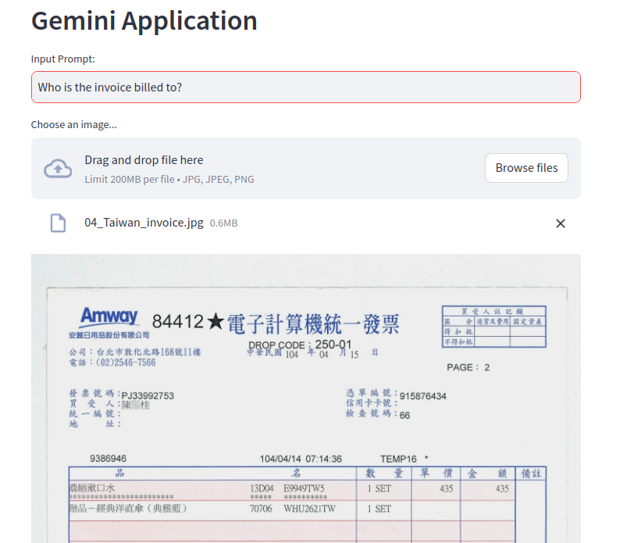
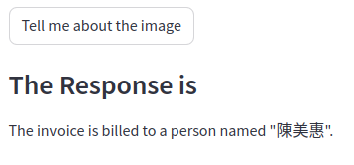
07.05.11 Test Taiwan Invoice
https://www.youtube.com/watch?v=1ICRLYtkmNU&list=PLZoTAELRMXVNbDmGZlcgCA3a8mRQp5axb&index=7
Test Taiwan Invoice (1:59:31-2:00:30/2:16:34)
Who is the invoice billed to?

Slide 5
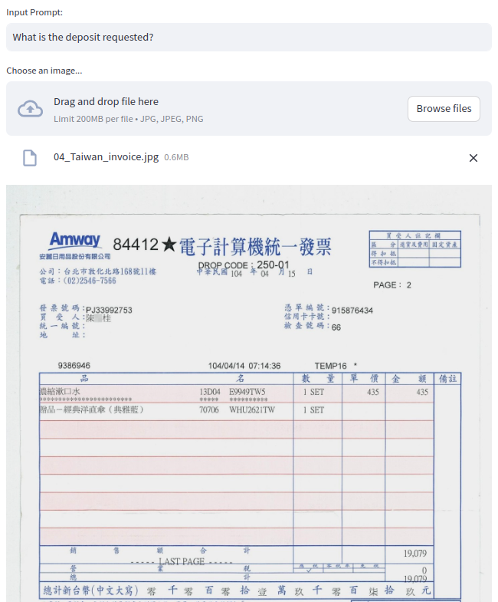
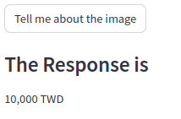
07.05.11 Test Taiwan Invoice
https://www.youtube.com/watch?v=1ICRLYtkmNU&list=PLZoTAELRMXVNbDmGZlcgCA3a8mRQp5axb&index=7
Test Taiwan Invoice (2:00:31-2:01:00/2:16:34)
What is the deposit requested?

Slide 6
07.05.12 Test Japan Invoice

Slide 7
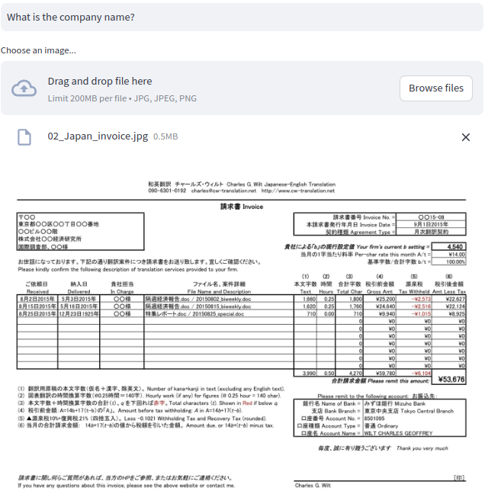
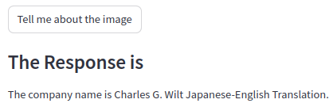
07.05.12 Test Japan Invoice
https://www.youtube.com/watch?v=1ICRLYtkmNU&list=PLZoTAELRMXVNbDmGZlcgCA3a8mRQp5axb&index=7
Test Japan Invoice (2:01:01-2:01:30/2:16:34)
What is company name?

Slide 8
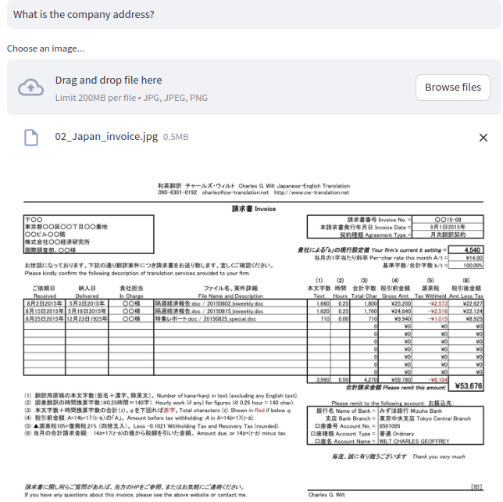

07.05.12 Test Japan Invoice
https://www.youtube.com/watch?v=1ICRLYtkmNU&list=PLZoTAELRMXVNbDmGZlcgCA3a8mRQp5axb&index=7
Test Japan Invoice (2:01:31-2:02:10/2:16:34)
What is company address?

Slide 9
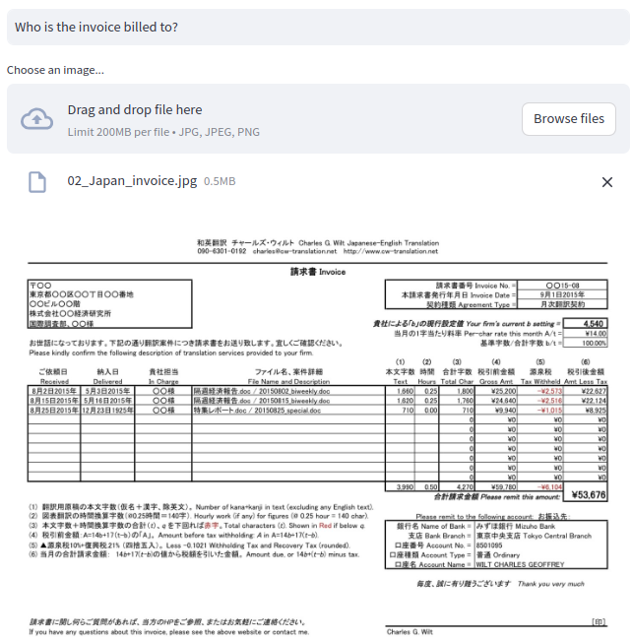

07.05.12 Test Japan Invoice
https://www.youtube.com/watch?v=1ICRLYtkmNU&list=PLZoTAELRMXVNbDmGZlcgCA3a8mRQp5axb&index=7
Test Japan Invoice (2:02:11-2:02:20/2:16:34)
Who is the invoice billed to?

Slide 10

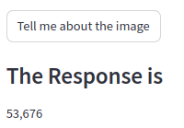
07.05.12 Test Japan Invoice
https://www.youtube.com/watch?v=1ICRLYtkmNU&list=PLZoTAELRMXVNbDmGZlcgCA3a8mRQp5axb&index=7
Test Japan Invoice (2:02:21-2:02:30/2:16:34)
How much of the deposit request?

Slide 11
07.05.13 Test India Invoice

Slide 12
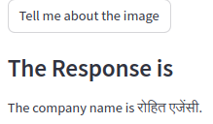
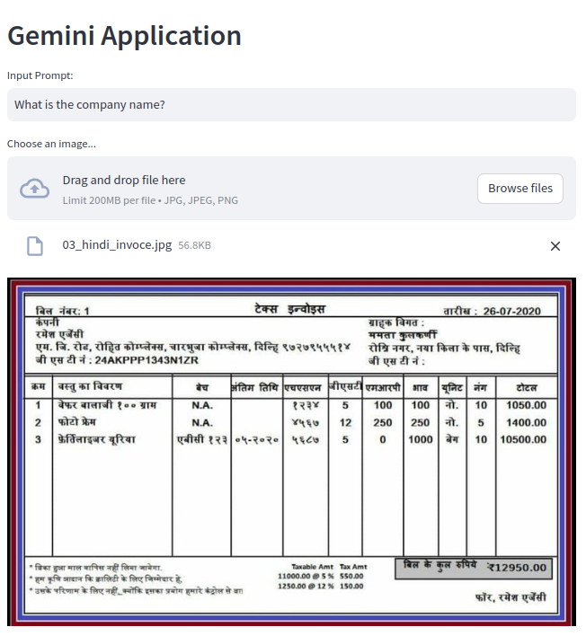
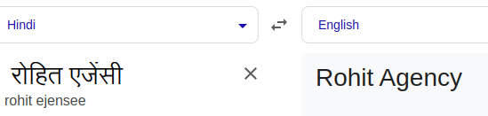
07.05.13 Test India Invoice
https://www.youtube.com/watch?v=1ICRLYtkmNU&list=PLZoTAELRMXVNbDmGZlcgCA3a8mRQp5axb&index=7
Test India Invoice (2:02:31-2:02:40/2:16:34)
What is company name? रोहित एजेंसी

Slide 13
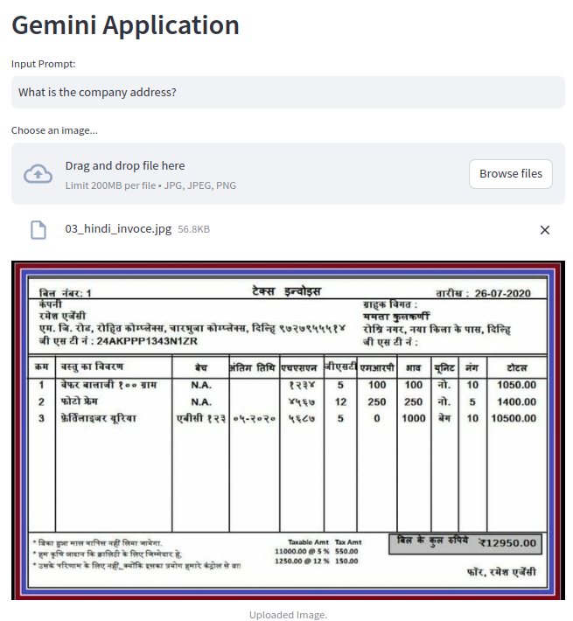

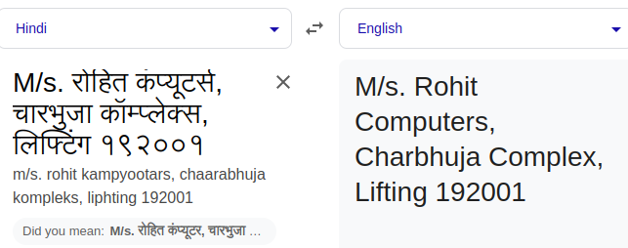
07.05.13 Test India Invoice
https://www.youtube.com/watch?v=1ICRLYtkmNU&list=PLZoTAELRMXVNbDmGZlcgCA3a8mRQp5axb&index=7
Test India Invoice (2:02:41-2:02:50/2:16:34)
What is company address?
M/s. रोहित कंप्यूटर्स, चारभुजा कॉम्प्लेक्स, लिफ्टिंग १९२००१

Slide 14
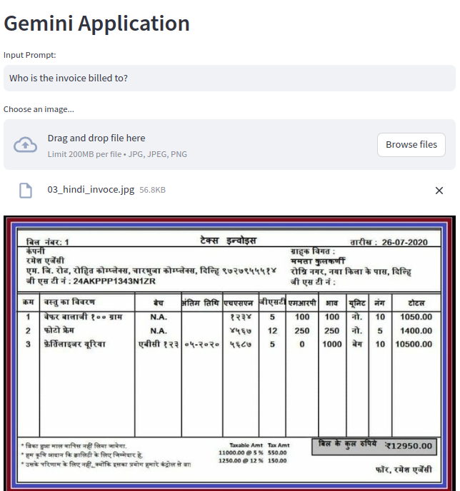
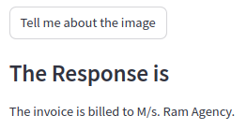
07.05.13 Test India Invoice
https://www.youtube.com/watch?v=1ICRLYtkmNU&list=PLZoTAELRMXVNbDmGZlcgCA3a8mRQp5axb&index=7
Test India Invoice (2:02:51-2:03:00/2:16:34)
Who is the invoice billed to?

Slide 15
07.05.13 Test India Invoice
https://www.youtube.com/watch?v=1ICRLYtkmNU&list=PLZoTAELRMXVNbDmGZlcgCA3a8mRQp5axb&index=7
Test India Invoice (02:03:01-02:03:25/2:16:34)
How much of the deposit request?

Slide 16
End

