Slide 1

7.03 Q&A
Peter H. Chen

Slide 2
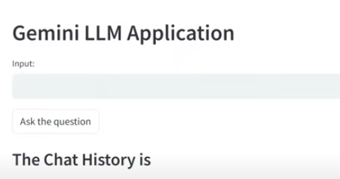
7.03 Q&A
https://www.youtube.com/watch?v=1ICRLYtkmNU&list=PLZoTAELRMXVNbDmGZlcgCA3a8mRQp5axb&index=7
Q&A (0:54:01-0:54:40/2:16:34)
We are going to build Gemini Project 3: Q&A.
Project 3 “Q&A” is a conversational Q&A chatBot with the help of Gemini-pro API.
We display the chat history with all the results of conversation.

Slide 3
7.03.01 Q&A Demo

Slide 4
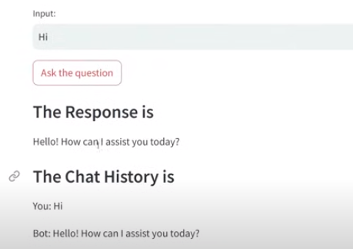
7.03.01 Q&A Demo
https://www.youtube.com/watch?v=1ICRLYtkmNU&list=PLZoTAELRMXVNbDmGZlcgCA3a8mRQp5axb&index=7
Q&A Demo (0:54:47-0:55:00/2:16:34)
Q&A Demo:
1. Input: Hi
2. Response: Hello! How can I assist you today?
3. Chat History:
You: Hi
Bot: Hello! How can I assist you today?

Slide 5
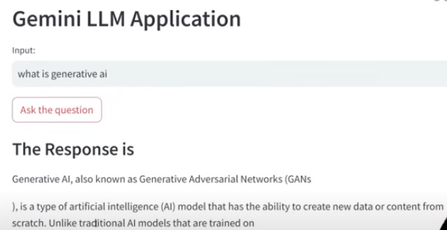
7.03.01 Q&A Demo
https://www.youtube.com/watch?v=1ICRLYtkmNU&list=PLZoTAELRMXVNbDmGZlcgCA3a8mRQp5axb&index=7
Q&A Demo (0:54:47-0:55:40/2:16:34)
Q&A Demo:
1. Input: What is generative ai
2. Response: Generative AI, also known as GAN (Generative Adversarial Networks). Traditional AI is training based. GANs has two neural network oppose each other.
Adversarial means “oppose each other”.
3. Chat History:
You: What is generative ai
Bot: Generative AI, also known as GAN (Generative Adversarial Networks)...

Slide 6
End

