Slide 1

7.03.02 API Key
Peter H. Chen

Slide 2

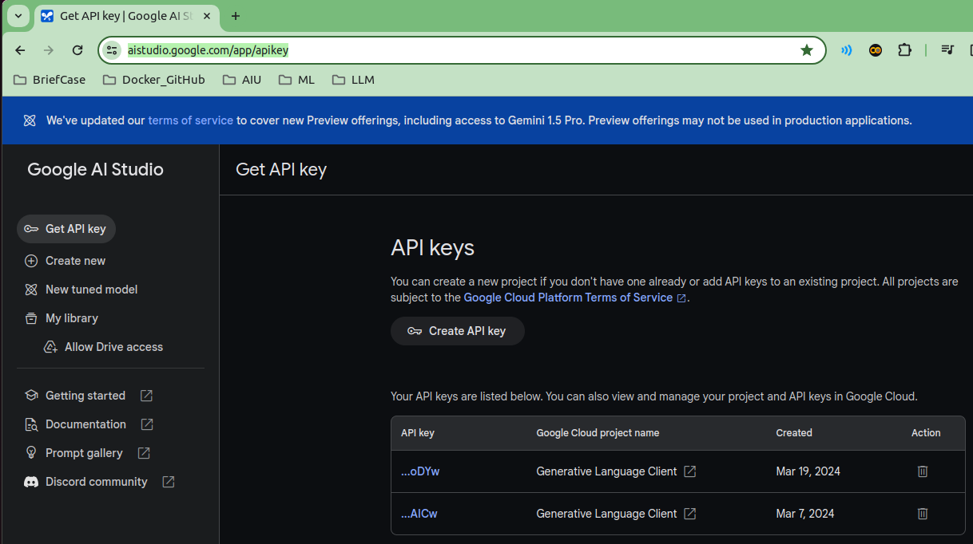
7.03.02 API Key
https://www.youtube.com/watch?v=1ICRLYtkmNU&list=PLZoTAELRMXVNbDmGZlcgCA3a8mRQp5axb&index=7
API Key (0:54:01-0:56:40/2:16:34)
First, we need to define GOOGLE_API_KEY = “…” inside the “.env” file.
We can get the Google API key from Google AI Studio.
https://aistudio.google.com/app/apikey

Slide 3
7.03.03 Load Environment Variable

Slide 4
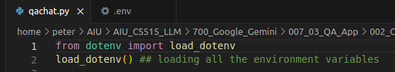
7.03.03 Load Environment Variable
https://www.youtube.com/watch?v=1ICRLYtkmNU&list=PLZoTAELRMXVNbDmGZlcgCA3a8mRQp5axb&index=7
Load Environment Variable (0:56:47-0:56:50/2:16:34)
We load all the environment variables for Google API Key.

Slide 5
7.03.04 Import Library

Slide 6
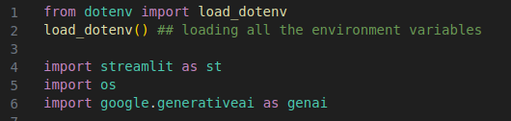
7.03.04 Import Library
https://www.youtube.com/watch?v=1ICRLYtkmNU&list=PLZoTAELRMXVNbDmGZlcgCA3a8mRQp5axb&index=7
Import Library (0:56:51-0:57:30/2:16:34)
We import libraries.
1. Streamlit: GUI
2. os: Get environment variable GOOGLE_API_KEY
3. google.generativeai: Gemini Model

Slide 7
7.03.05 Configure Gemini API Key

Slide 8
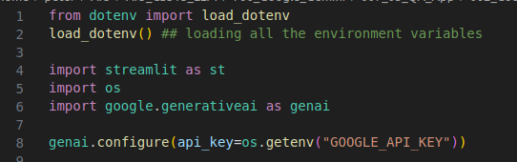
7.03.05 Configure Gemini API Key
https://www.youtube.com/watch?v=1ICRLYtkmNU&list=PLZoTAELRMXVNbDmGZlcgCA3a8mRQp5axb&index=7
Configure Gemini API Key (0:57:58-0:58:10/2:16:34)
Configure Gemini API Key with load environment API Key.
Genai.configure (api_key = os.getenv(“GOOGLE_API_KEY”))

Slide 9
7.03.06 Create Gemini Model Chat

Slide 10
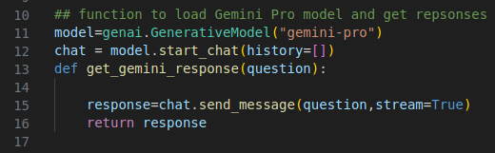
7.03.06 Create Gemini Model Chat
https://www.youtube.com/watch?v=1ICRLYtkmNU&list=PLZoTAELRMXVNbDmGZlcgCA3a8mRQp5axb&index=7
Create Gemini Model Chat (0:57:58-1:00:30/2:16:34)
We create a function to load gemini model.
1. Load Gemini Model: Gemini-pro
2. Create Gemini chat
3. Get Gemini response

Slide 11
7.03.07 Streamlit GUI

Slide 12
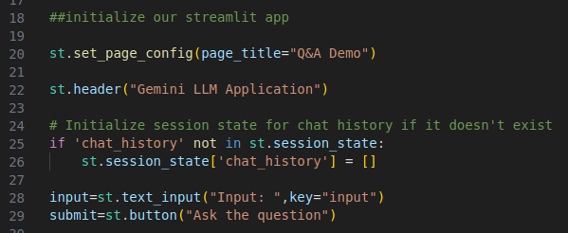
7.03.07 Streamlit GUI
https://www.youtube.com/watch?v=1ICRLYtkmNU&list=PLZoTAELRMXVNbDmGZlcgCA3a8mRQp5axb&index=7
Streamlit GUI (1:00:31-1:02:00/2:16:34)
Create
1. Page title
2. Header
3. Append chat history to session state.
4. Create text input fields.
5. Create submit button: “Ask the quesiton”

Slide 13
7.03.08 Process Submission

Slide 14
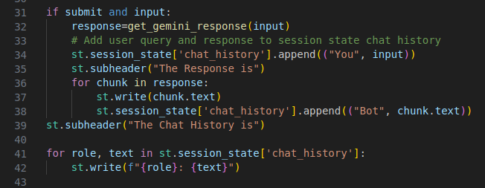
7.03.08 Process Submission
https://www.youtube.com/watch?v=1ICRLYtkmNU&list=PLZoTAELRMXVNbDmGZlcgCA3a8mRQp5axb&index=7
Process Submission (1:02:11-1:06:50/2:16:34)
1. If submit is clicked and has input
1.1 Get response = get_gemini_response (input)
1.2 Display the input and response: “The response is”
1.3 Store input and response in session state: for chunk in response.
2. Display chat history: “The chat history is”
2.1 get chat history (input and response) from session state
2.2 Display the chat History: role (“You”, “Bot”) and text (input, response)

Slide 15
End

