Slide 1

7.03.09 Test QA
Peter H. Chen

Slide 2
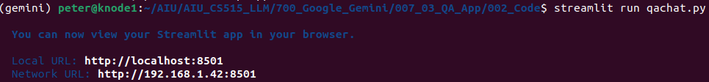
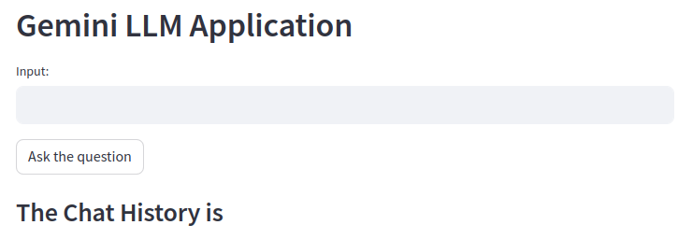
7.03.09 Test QA
https://www.youtube.com/watch?v=1ICRLYtkmNU&list=PLZoTAELRMXVNbDmGZlcgCA3a8mRQp5axb&index=7
Test QA (1:06:51-1:07:00/2:16:34)
Now, we test the for the QA chatBot.
> streamlit run qachat.py

Slide 3
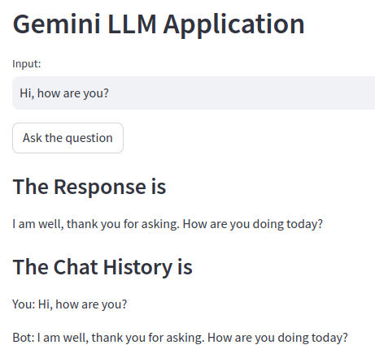
7.03.09 Test QA
https://www.youtube.com/watch?v=1ICRLYtkmNU&list=PLZoTAELRMXVNbDmGZlcgCA3a8mRQp5axb&index=7
Test QA (1:07:01-1:07:20/2:16:34)
Input: Hi, how are you?
Response: I am well, …
The chat History is:
You: Hi, how are you?
Bot: I am well, …

Slide 4
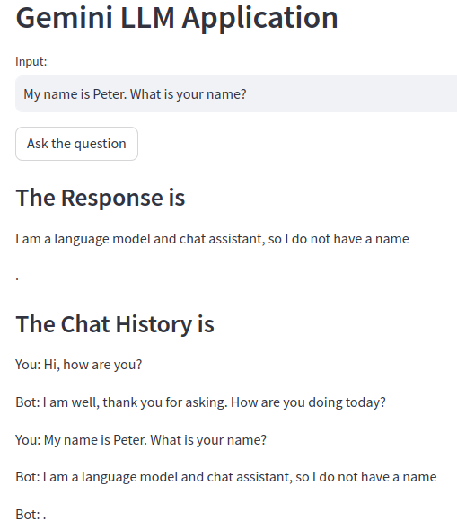
7.03.09 Test QA
https://www.youtube.com/watch?v=1ICRLYtkmNU&list=PLZoTAELRMXVNbDmGZlcgCA3a8mRQp5axb&index=7
Test QA (1:07:21-1:08:20/2:16:34)
Input: My name is Peter. What is your name?
Response: …
The chat History is:
You: Hi, how are you?
Bot: …
You: Hi, how are you?
Bot: …
You: My name is Peter. What is your name?
Bot: …

Slide 5
End

