Slide 1
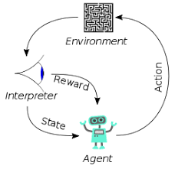
3.4 LLM: Text Splitter
Peter H. Chen

Slide 2
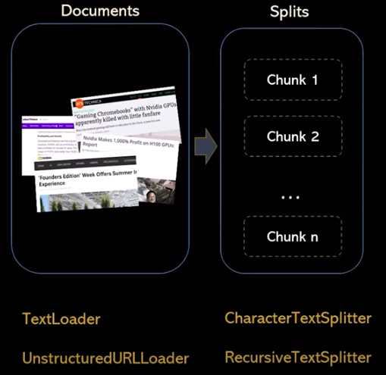

3.4 LLM: Text Splitter
https://www.youtube.com/watch?v=MoqgmWV1fm8&list=PLeo1K3hjS3uu0N_0W6giDXzZIcB07Ng_F&index=3
LLM: Text Splitter (21:37-21:40/1:14:33)
After the Text Loaders, we need to do the Text Splitter.

Slide 3
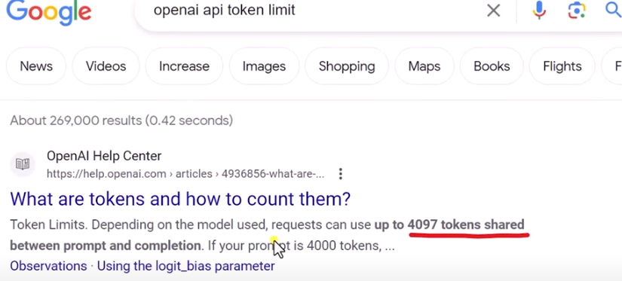
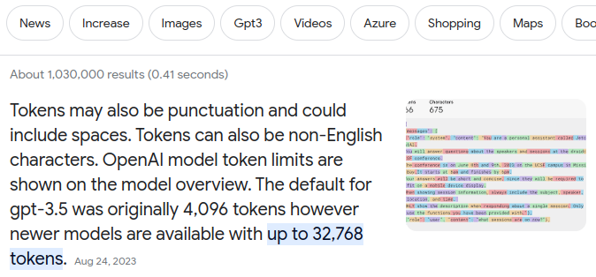
3.4 LLM: Text Splitter
https://www.youtube.com/watch?v=MoqgmWV1fm8&list=PLeo1K3hjS3uu0N_0W6giDXzZIcB07Ng_F&index=3
LLM: Text Splitter (21:47-22:10/1:14:33)
OpenAI GPT-3.5 LLM token limit 4096.
OpenAI GPT-4.0 LLM token limit 32,768.

Slide 4
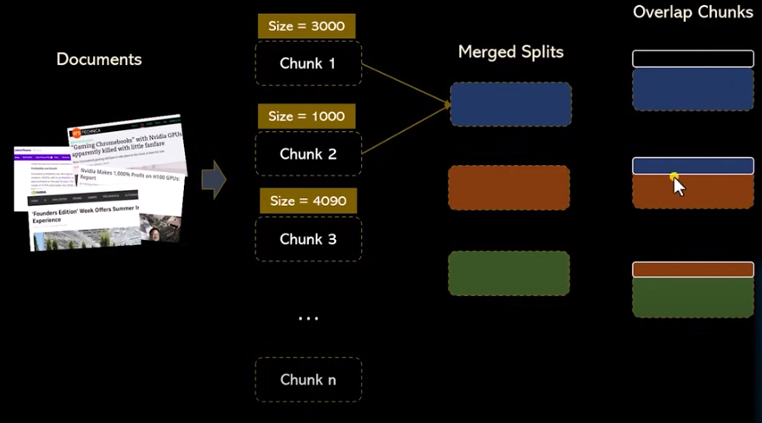
3.4 LLM: Text Splitter
https://www.youtube.com/watch?v=MoqgmWV1fm8&list=PLeo1K3hjS3uu0N_0W6giDXzZIcB07Ng_F&index=3
LLM: Text Splitter (22:11-22:30/1:14:33)
The token size we split maybe 3000, 1000, 4090.
Then, we do the merge splits. We may have overlap tokens.

Slide 5
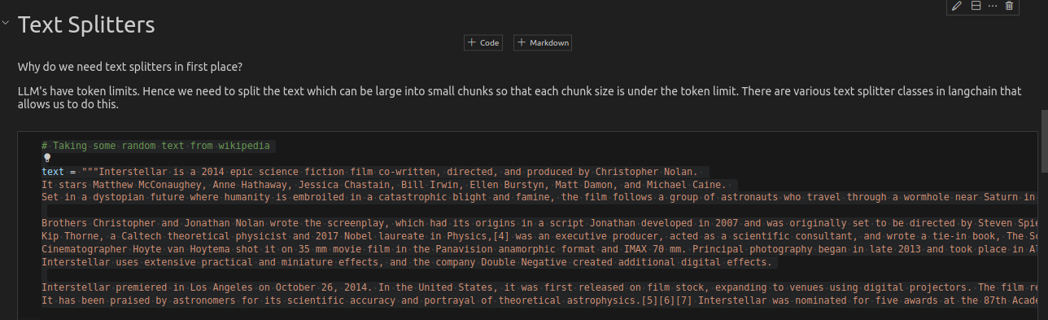
3.4 LLM: Text Splitter
https://www.youtube.com/watch?v=MoqgmWV1fm8&list=PLeo1K3hjS3uu0N_0W6giDXzZIcB07Ng_F&index=3
LLM: Text Splitter (22:30-22:40/1:14:33)
Why do we need text splitter?
LLM have token limits. We need to split the text.
The text can be large. We split into smaller chunk below the 4096 size limit.
There are many text splitter in langchain.
We can use to split the text into smaller chunk.

Slide 6
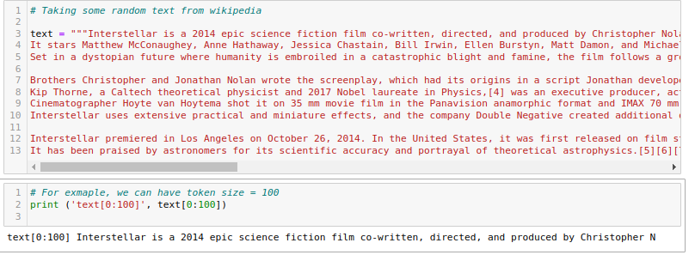
3.4 LLM: Text Splitter
https://www.youtube.com/watch?v=MoqgmWV1fm8&list=PLeo1K3hjS3uu0N_0W6giDXzZIcB07Ng_F&index=3
LLM: Text Splitter (22:41-22:50/1:14:33)
For example, we can have token size = 100
Text[0:100]

Slide 7
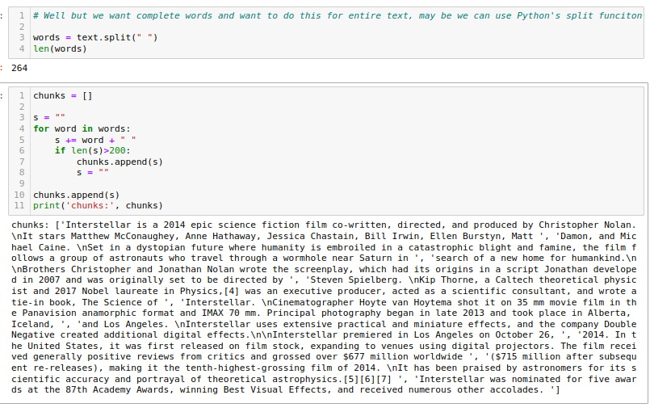
3.4 LLM: Text Splitter
https://www.youtube.com/watch?v=MoqgmWV1fm8&list=PLeo1K3hjS3uu0N_0W6giDXzZIcB07Ng_F&index=3
LLM: Text Splitter (22:51-23:00/1:14:33)
We split the text into words by “ “.
Then, we put words into into list chunk.
We keep add the string s, if string s is bigger than 200, then we append string into a new chunk.

Slide 8
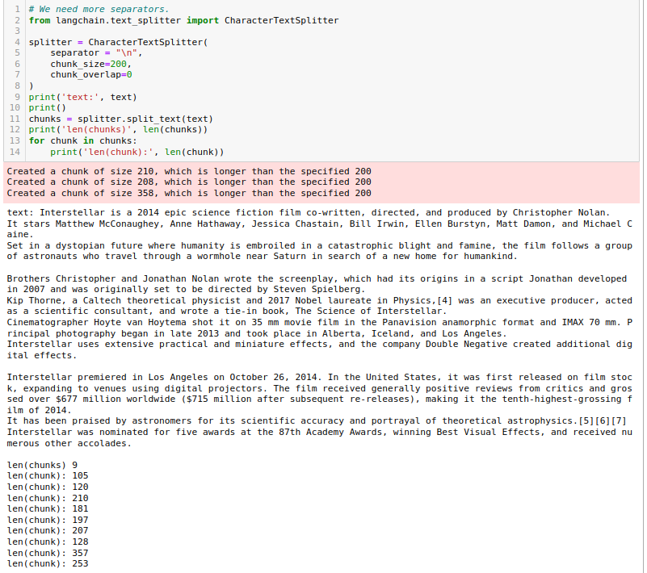
3.4 LLM: Text Splitter
https://www.youtube.com/watch?v=MoqgmWV1fm8&list=PLeo1K3hjS3uu0N_0W6giDXzZIcB07Ng_F&index=3
LLM: Text Splitter (23:01-25:00/1:14:33)
The sentences are too long.
We use text splitter to split with chunk size = 200.
All of the texts are less than 200.

Slide 9
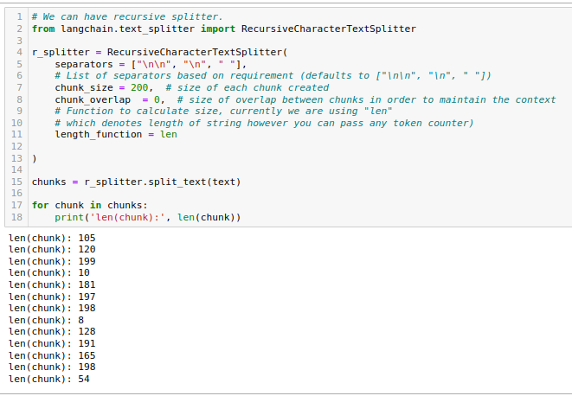
3.4 LLM: Text Splitter
https://www.youtube.com/watch?v=MoqgmWV1fm8&list=PLeo1K3hjS3uu0N_0W6giDXzZIcB07Ng_F&index=3
LLM: Text Splitter (25:11-30:04/1:14:33)
Recursive text splitter.

Slide 10
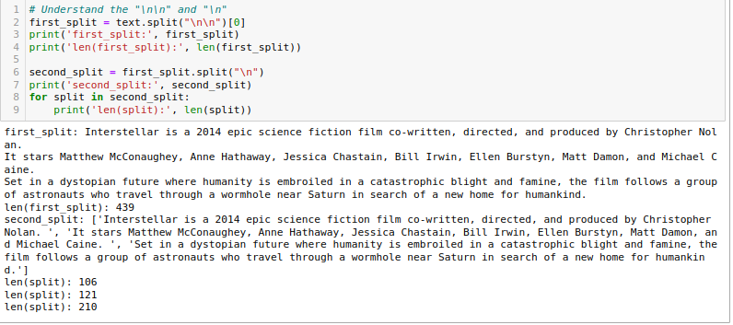
3.4 LLM: Text Splitter
https://www.youtube.com/watch?v=MoqgmWV1fm8&list=PLeo1K3hjS3uu0N_0W6giDXzZIcB07Ng_F&index=3
LLM: Text Splitter (30:05-33:27/1:14:33)
Understand “\n” and “\n\n”.

Slide 11
End

