Slide 1
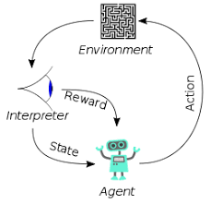
3.5 LLM: FAISS
Peter H. Chen

Slide 2
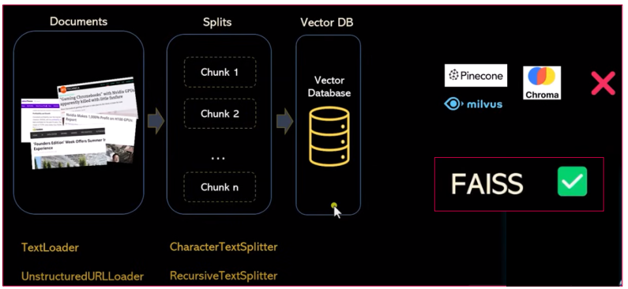
3.5 LLM: FAISS
https://www.youtube.com/watch?v=MoqgmWV1fm8&list=PLeo1K3hjS3uu0N_0W6giDXzZIcB07Ng_F&index=3
LLM: FAISS (33:31-33:40/1:14:33)
After Text Splitter, we do the vector database.
There are a lot of open source tools: Pinecone, milvus, Chroma, etc. for vector database.
Here, we use FAISS (Facebook AI Similarity Search) from Facebook

Slide 3
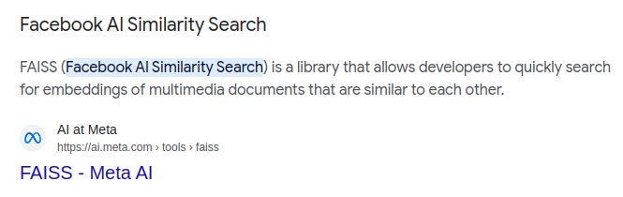
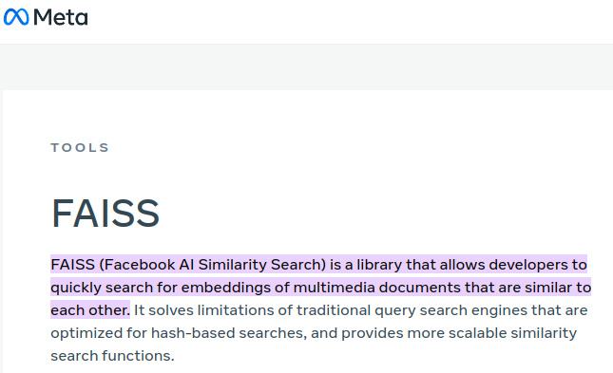
3.5 LLM: FAISS
https://www.youtube.com/watch?v=MoqgmWV1fm8&list=PLeo1K3hjS3uu0N_0W6giDXzZIcB07Ng_F&index=3
LLM: FAISS (33:41-34:00/1:14:33)
FAISS (Facebook AI Similarity Search) from Facebook.

Slide 4
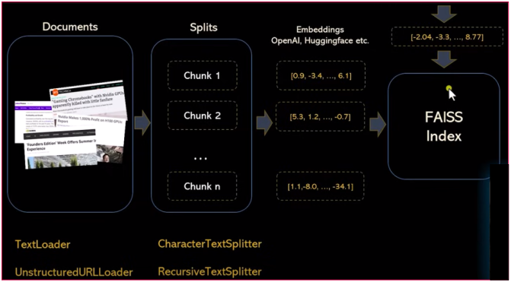
3.5 LLM: FAISS
https://www.youtube.com/watch?v=MoqgmWV1fm8&list=PLeo1K3hjS3uu0N_0W6giDXzZIcB07Ng_F&index=3
LLM: FAISS (34:10-35:20/1:14:33)
Once we have embeddings, we are ready to save them into the Vector Database, there are lot of tools (Open AI, Pinecone, Milvus, Chroma, FAISS, etc.) to do that.
FAISS (Facebook AI Similarity Search) is one of the tools and has the best performance and lightweight in-memory structure.

Slide 5

3.5 LLM: FAISS
https://www.youtube.com/watch?v=MoqgmWV1fm8&list=PLeo1K3hjS3uu0N_0W6giDXzZIcB07Ng_F&index=3
LLM: FAISS (35:30-35:33/1:14:33)
We will see how FAISS work.

Slide 6
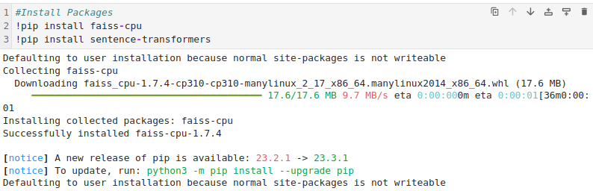

3.5 LLM: FAISS
https://www.youtube.com/watch?v=MoqgmWV1fm8&list=PLeo1K3hjS3uu0N_0W6giDXzZIcB07Ng_F&index=3
LLM: FAISS (35:38-35:50/1:14:33)
We will see how FAISS work.

Slide 7
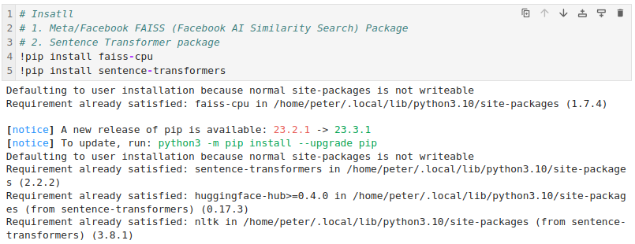
3.5 LLM: FAISS
https://www.youtube.com/watch?v=MoqgmWV1fm8&list=PLeo1K3hjS3uu0N_0W6giDXzZIcB07Ng_F&index=3
LLM: FAISS (35:38-35:50/1:14:33)
We install the
1. Meta/Facebook FAISS (Facebook AI Similarity Search) Framework.
2. Transformers: use “!conda install transformers” if there is “tokenizer dependencies problem” caused by SentenceTransformer and “pip install transformers”.

Slide 8
3.5 LLM: FAISS
https://www.youtube.com/watch?v=MoqgmWV1fm8&list=PLeo1K3hjS3uu0N_0W6giDXzZIcB07Ng_F&index=3
LLM: FAISS (35:50-35:59/1:14:33)
Conda vs pip install:
1. Conda installs binary packages, which means the packages include compiled code.
This can make the installation process faster and more reliable, especially for packages with complex dependencies.
2. Pip, by contrast, often installs packages from source, which means the code is compiled during the installation process.

Slide 9
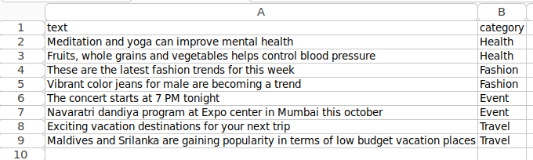
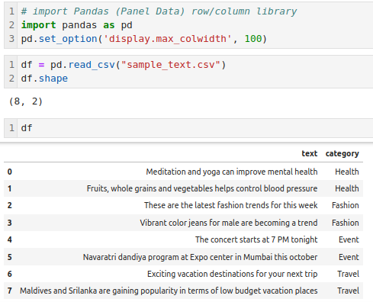
3.5 LLM: FAISS
https://www.youtube.com/watch?v=MoqgmWV1fm8&list=PLeo1K3hjS3uu0N_0W6giDXzZIcB07Ng_F&index=3
LLM: FAISS (36:01-36:10/1:14:33)
1. Install Pandas Row/Column Library
2. Set display with to 100.
3. read in sample dataset.
Note:
We can browse the data but do not overwrite the csv (text format). It will change to other binary format and not readable from panda readers.

Slide 10
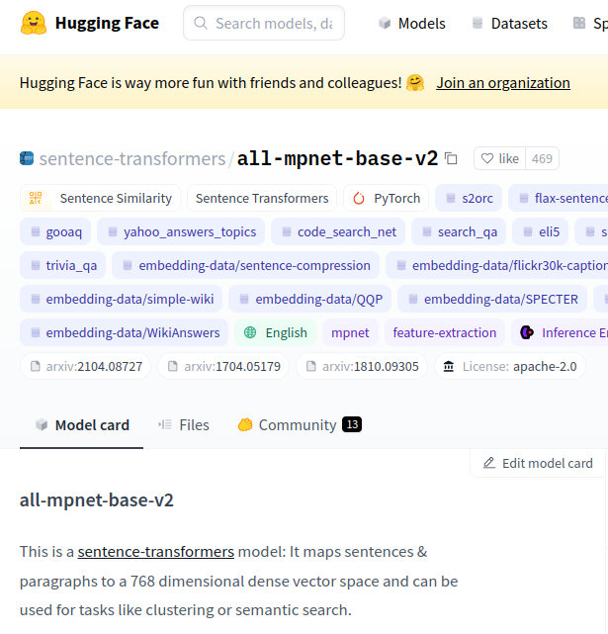
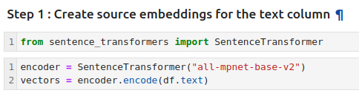
3.5 LLM: FAISS
https://www.youtube.com/watch?v=MoqgmWV1fm8&list=PLeo1K3hjS3uu0N_0W6giDXzZIcB07Ng_F&index=3
LLM: FAISS (36:20-36:40/1:14:33)
Now, we have the sample dataset.
Step 1: Create Embedding
1. We are going to use sentence_transformer to transform the sample text into Vector Database.
HuggingFace implement the “all-mpnet-base-v2” encoder.
MPNet (Mask Language Model and Permuted Language Model) Pre-Train Method.
2. We are going to use the model “all-mpnent-based-v2” for sentence transformer to encode the sentence from dataset.
3. We use sentence transformer to encode the Pandas data frame to generate the index vector.

Slide 11
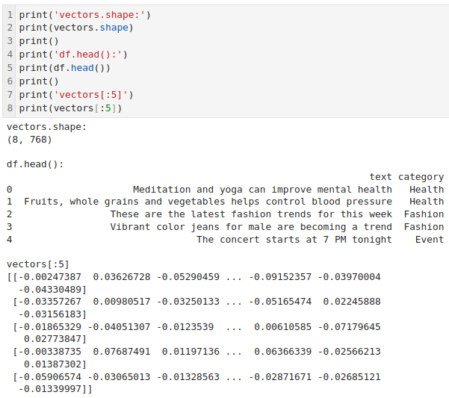
3.5 LLM: FAISS
https://www.youtube.com/watch?v=MoqgmWV1fm8&list=PLeo1K3hjS3uu0N_0W6giDXzZIcB07Ng_F&index=3
LLM: FAISS (36:50-37:00/1:14:33)
1. Check the data frame header
2. Transform numpy vector[:5].

Slide 12
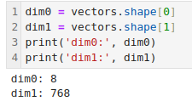
3.5 LLM: FAISS
https://www.youtube.com/watch?v=MoqgmWV1fm8&list=PLeo1K3hjS3uu0N_0W6giDXzZIcB07Ng_F&index=3
LLM: FAISS (38:30-39:00/1:14:33)
1. Check vector dimension 0.
2. Check vector dimension 1.

Slide 13
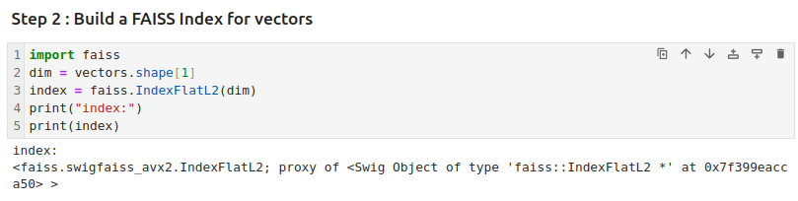
3.5 LLM: FAISS
https://www.youtube.com/watch?v=MoqgmWV1fm8&list=PLeo1K3hjS3uu0N_0W6giDXzZIcB07Ng_F&index=3
LLM: FAISS (38:30-39:00/1:14:33)
Step 2: Create a FAISS index for vector database.
Build FAISS Index for vectors:

Slide 14
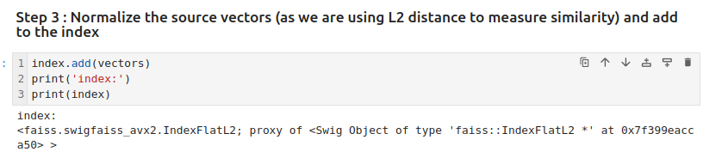
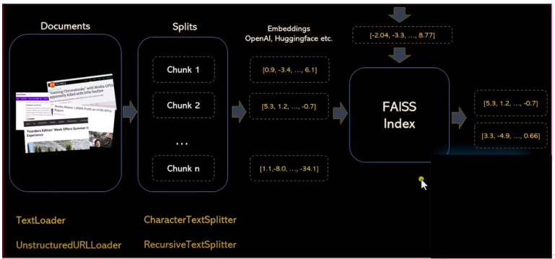
3.5 LLM: FAISS
https://www.youtube.com/watch?v=MoqgmWV1fm8&list=PLeo1K3hjS3uu0N_0W6giDXzZIcB07Ng_F&index=3
LLM: FAISS (39:31-39:55/1:14:33)
Step 3: Normalize the vectors and add into the index vector database.
https://github.com/facebookresearch/faiss/wiki/Getting-started

Slide 15
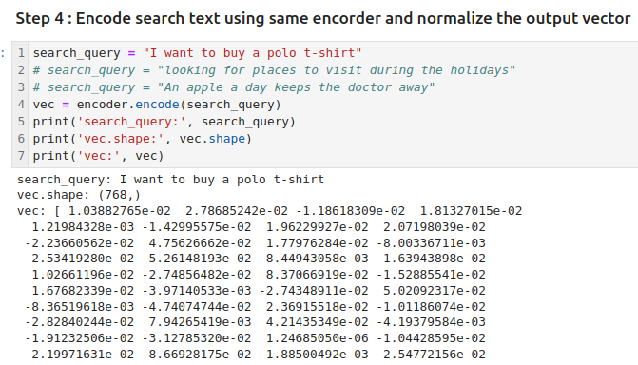
3.5 LLM: FAISS
https://www.youtube.com/watch?v=MoqgmWV1fm8&list=PLeo1K3hjS3uu0N_0W6giDXzZIcB07Ng_F&index=3
LLM: FAISS (39:31-39:55/1:14:33)
Step 4: Encode and Normalized Search Text.
https://github.com/facebookresearch/faiss/wiki/Getting-started

Slide 16
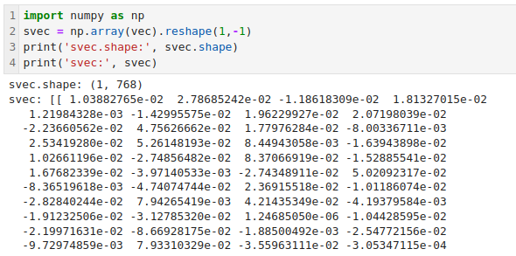
3.5 LLM: FAISS
https://www.youtube.com/watch?v=MoqgmWV1fm8&list=PLeo1K3hjS3uu0N_0W6giDXzZIcB07Ng_F&index=3
LLM: FAISS (40:01-41:30/1:14:33)
We add addition dimension for the index search string. This is the requirement for search string.
https://github.com/facebookresearch/faiss/wiki/Getting-started

Slide 17
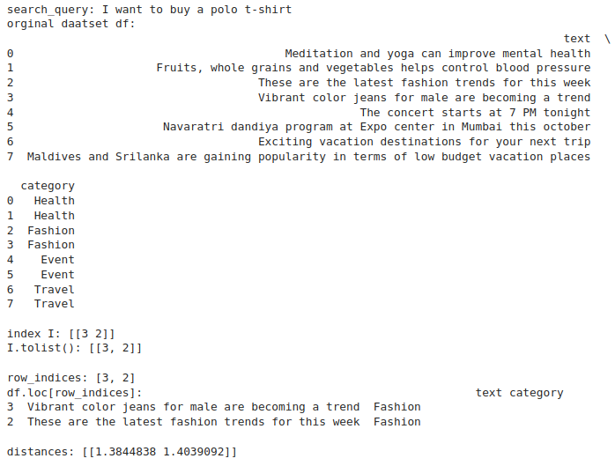
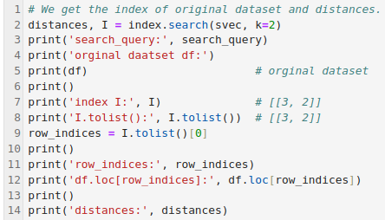
3.5 LLM: FAISS
https://www.youtube.com/watch?v=MoqgmWV1fm8&list=PLeo1K3hjS3uu0N_0W6giDXzZIcB07Ng_F&index=3
LLM: FAISS (41:31-42:00/1:14:33)
Now, we want to find
1. the location of search string in the dataset.
2. how much similarities between the found location of dataset and the search string.
https://github.com/facebookresearch/faiss/wiki/Getting-started

Slide 18
3.5 LLM: FAISS
https://www.youtube.com/watch?v=MoqgmWV1fm8&list=PLeo1K3hjS3uu0N_0W6giDXzZIcB07Ng_F&index=3
LLM: FAISS (42:01-44:50/1:14:33)
Some important notes:
1. search_query = "I want to buy a polo t-shirt"
The search_query does not contain any match keyword in the dataset.
2. This query is a semantic query.
Therefore, row 2, 3 is the semantic matched results, no the key words matched results.

Slide 19
End

