Slide 1
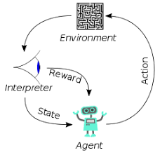
3.6 LLM: Retrieval
Peter H. Chen

Slide 2
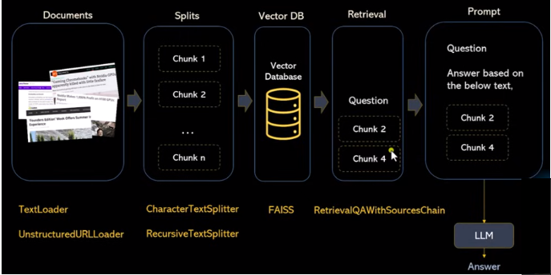
3.6 LLM: Retrieval
https://www.youtube.com/watch?v=MoqgmWV1fm8&list=PLeo1K3hjS3uu0N_0W6giDXzZIcB07Ng_F&index=3
LLM: Retrieval (44:57-45:30/1:14:33)
Now, we talk about the Retrieval Query.
Retrieval Query will get the answer in chunk 2 and 4.
The answer of prompt will based on chunk 2 and 4.
The LLM will generate the answer.

Slide 3
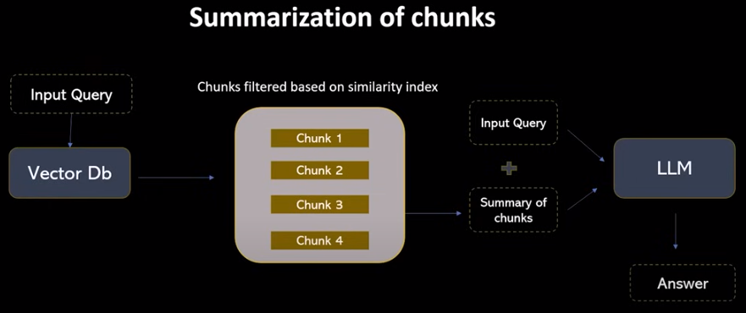
3.6 LLM: Retrieval
https://www.youtube.com/watch?v=MoqgmWV1fm8&list=PLeo1K3hjS3uu0N_0W6giDXzZIcB07Ng_F&index=3
LLM: Retrieval (45:36-46:00/1:14:33)

Slide 4
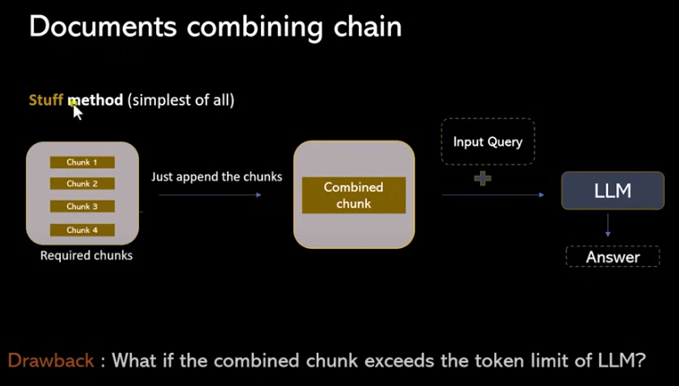
3.6 LLM: Retrieval
https://www.youtube.com/watch?v=MoqgmWV1fm8&list=PLeo1K3hjS3uu0N_0W6giDXzZIcB07Ng_F&index=3
LLM: Retrieval (46:01-46:20/1:14:33)

Slide 5
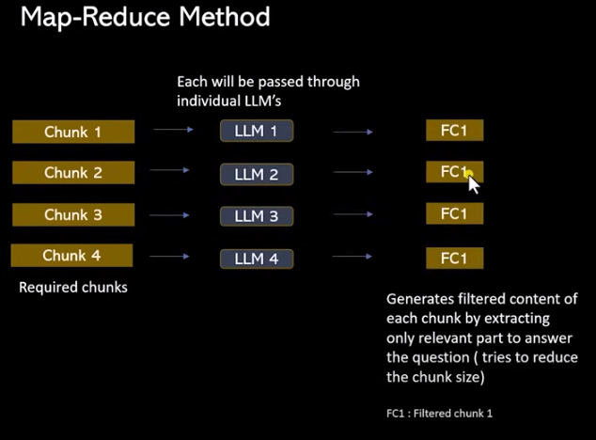
3.6 LLM: Retrieval
https://www.youtube.com/watch?v=MoqgmWV1fm8&list=PLeo1K3hjS3uu0N_0W6giDXzZIcB07Ng_F&index=3
LLM: Retrieval (45:36-46:30/1:14:33)

Slide 6
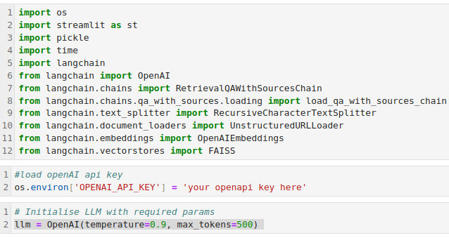
3.6 LLM: Retrieval
https://www.youtube.com/watch?v=MoqgmWV1fm8&list=PLeo1K3hjS3uu0N_0W6giDXzZIcB07Ng_F&index=3
LLM: Retrieval (46:31-47:00/1:14:33)
Jupyter notebook has dependencies problem with langchain and interactive python 3.11.
I change to python script mode.

Slide 7
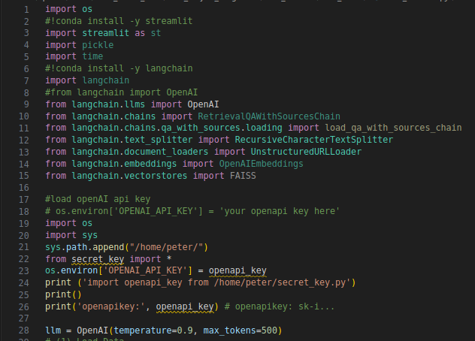
3.6 LLM: Retrieval
https://www.youtube.com/watch?v=MoqgmWV1fm8&list=PLeo1K3hjS3uu0N_0W6giDXzZIcB07Ng_F&index=3
LLM: Retrieval (47:01-47:30/1:14:33)
We register opeAI with key.
> python 0306_retrieval.py

Slide 8
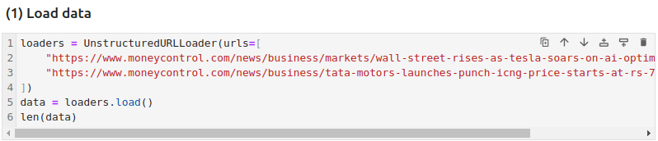
3.6 LLM: Retrieval
https://www.youtube.com/watch?v=MoqgmWV1fm8&list=PLeo1K3hjS3uu0N_0W6giDXzZIcB07Ng_F&index=3
LLM: Retrieval (47:31-48:00/1:14:33)
We add web site for the UnstructuredURLLoader()
> pip install unstructured

Slide 9
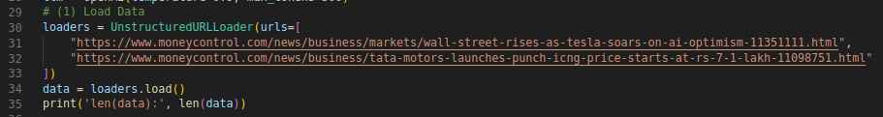
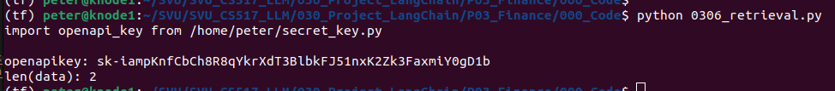
3.6 LLM: Retrieval
https://www.youtube.com/watch?v=MoqgmWV1fm8&list=PLeo1K3hjS3uu0N_0W6giDXzZIcB07Ng_F&index=3
LLM: Retrieval (48:01-48:50/1:14:33)
Due to jupyter notebook dependencies issues, use python script mode to compile.
> python 0306_retrieval.py

Slide 10
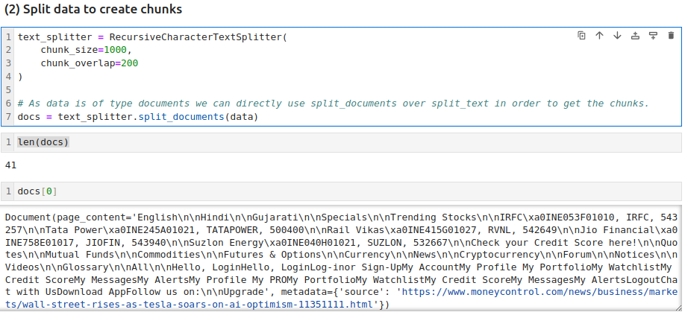
3.6 LLM: Retrieval
https://www.youtube.com/watch?v=MoqgmWV1fm8&list=PLeo1K3hjS3uu0N_0W6giDXzZIcB07Ng_F&index=3
LLM: Retrieval (48:51-49:00/1:14:33)
We use RecursiveCharacterTextSplitter() and split_document (data) to split data into chunks.
Jupyter notebook:

Slide 11
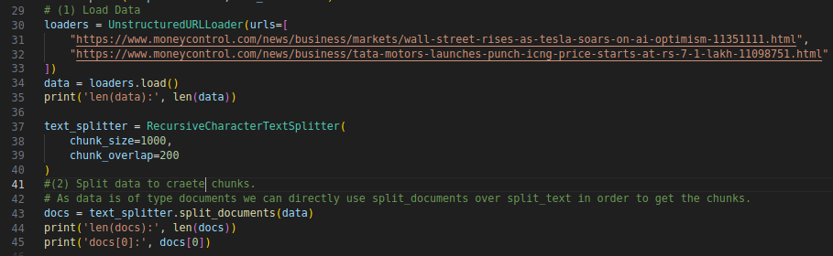
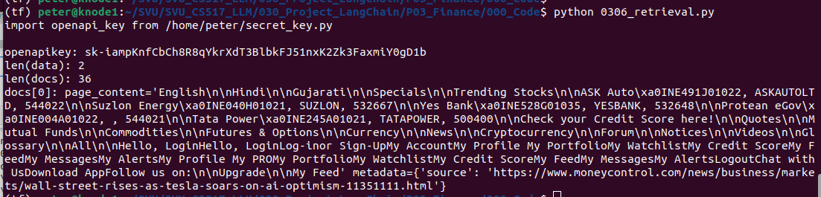
3.6 LLM: Retrieval
https://www.youtube.com/watch?v=MoqgmWV1fm8&list=PLeo1K3hjS3uu0N_0W6giDXzZIcB07Ng_F&index=3
LLM: Retrieval (49:01-49:30/1:14:33)
python script:

Slide 12
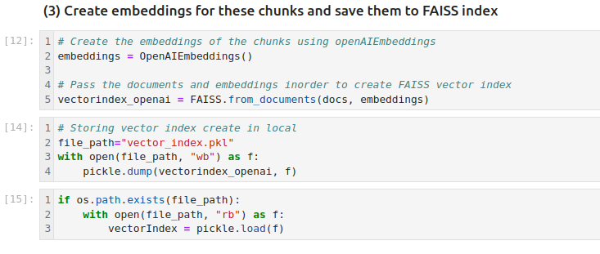
3.6 LLM: Retrieval
https://www.youtube.com/watch?v=MoqgmWV1fm8&list=PLeo1K3hjS3uu0N_0W6giDXzZIcB07Ng_F&index=3
LLM: Retrieval (49:01-49:30/1:14:33)
Jupyter notebook:

Slide 13
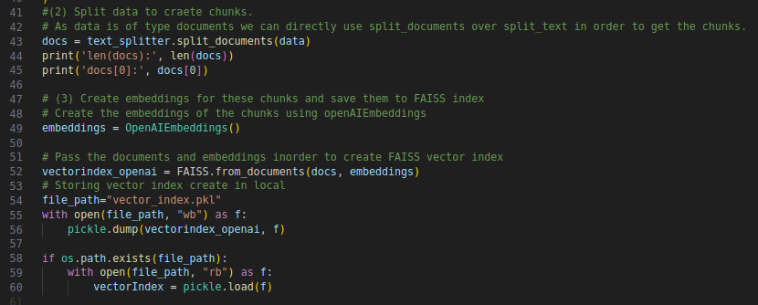
3.6 LLM: Retrieval
https://www.youtube.com/watch?v=MoqgmWV1fm8&list=PLeo1K3hjS3uu0N_0W6giDXzZIcB07Ng_F&index=3
LLM: Retrieval (49:01-49:30/1:14:33)
Python script:
OpenAI need pay credit to run OpenAIEmbedding().

Slide 14
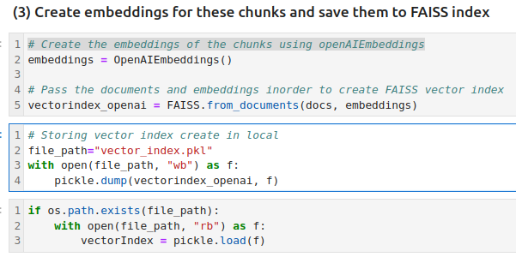
3.6 LLM: Retrieval
https://www.youtube.com/watch?v=MoqgmWV1fm8&list=PLeo1K3hjS3uu0N_0W6giDXzZIcB07Ng_F&index=3
LLM: Retrieval (49:30-51:30/1:14:33)
Python script:
OpenAI need pay credit to run OpenAIEmbeddings().
Put your docs into embeddings and generate the vectorindex_openai database.

Slide 15
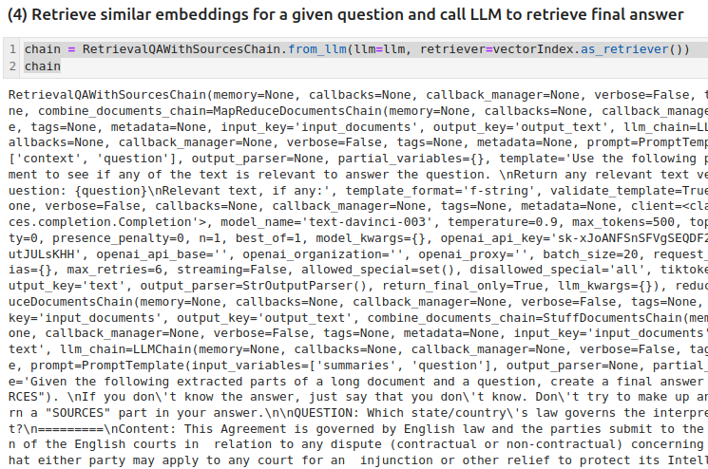
3.6 LLM: Retrieval
https://www.youtube.com/watch?v=MoqgmWV1fm8&list=PLeo1K3hjS3uu0N_0W6giDXzZIcB07Ng_F&index=3
LLM: Retrieval (51:46-52:30/1:14:33)
Retrieve the answer from LLM.

Slide 16
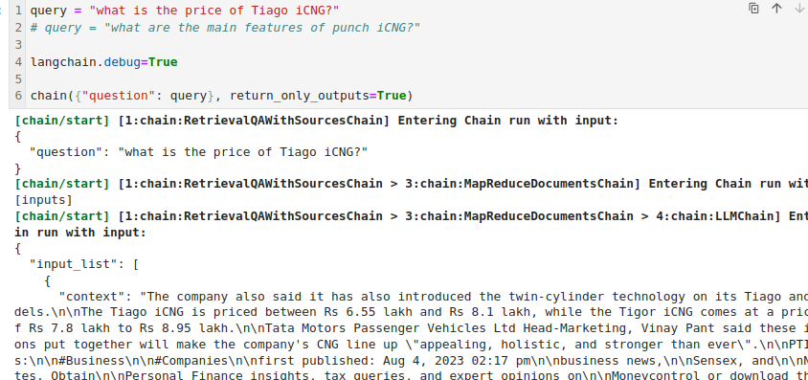
3.6 LLM: Retrieval
https://www.youtube.com/watch?v=MoqgmWV1fm8&list=PLeo1K3hjS3uu0N_0W6giDXzZIcB07Ng_F&index=3
LLM: Retrieval (51:46-52:30/1:14:33)
You give LLM the question and read the answer.

Slide 17
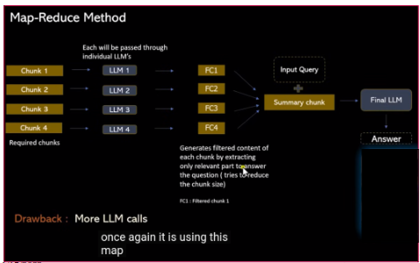
3.6 LLM: Retrieval
https://www.youtube.com/watch?v=MoqgmWV1fm8&list=PLeo1K3hjS3uu0N_0W6giDXzZIcB07Ng_F&index=3
LLM: Retrieval (51:46-57:39/1:14:33)
The overall flow of the LLM.

Slide 18
End

