Slide 1

1 RAG: Gemini, FAISS, and PDF
Peter H. Chen

Slide 2
1 RAG: Gemini, FAISS, and PDF
https://www.youtube.com/watch?v=MoqgmWV1fm8&list=PLeo1K3hjS3uu0N_0W6giDXzZIcB07Ng_F&index=3
RAG: Gemini, FAISS, and PDF (05:31-08:30/1:14:33)
RAG (Retrieval Augmented Generative) is a fine-tune (Transfer Learning) for LLM (Google Gemini and OpenAI). We will use LangChain to integrate
1. Get PDF into texts
2. Text Split: Text split into tokens.
  2.1 Each chunk is 10,000 tokens
  2.2 There are 200 overlapped tokens overlapped between chunks.
3. Store FAISS vector Database:
  3.1 Gemini Embedding: Semantic dimension reduction.
  3.2 Create FAISS (Facebook AI Similarity Search): Efficient On-Hot Encoding Vector
  3.3 Store FAISS Vector Database
4. Get Q&A (Question and Answer) Chain: Chain will perform individual Q&A and merger for final Q&A for final LLM.
5. Get User input and prompt for Q&A Chain.
https://medium.com/@akash.hiremath25/unlocking-the-power-of-intelligence-building-an-application-with-gemini-python-and-faiss-for-eb9a055d2429

Slide 3
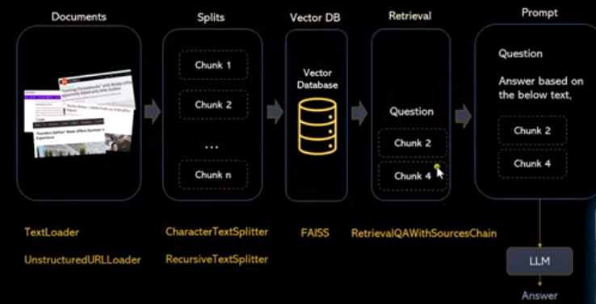
1 RAG: Gemini, FAISS, and PDF
https://www.youtube.com/watch?v=MoqgmWV1fm8&list=PLeo1K3hjS3uu0N_0W6giDXzZIcB07Ng_F&index=3
RAG: Gemini, FAISS, and PDF (05:31-08:30/1:14:33)
Below the the overall flow for RAG (Retrieval Augmented Generative).
1. The LLM can be Google Gemini (Gemini-pro), Meta Llama, openAI GPT, etc.
2. LangChain to integrate HuggingFace tools, such as, PDF, private SQL, URL, serp (google search engine platform), etc.
3. We will use LangChain for the prompting engineering in between the tools.
https://deepmind.google/technologies/gemini/#introduction

Slide 4
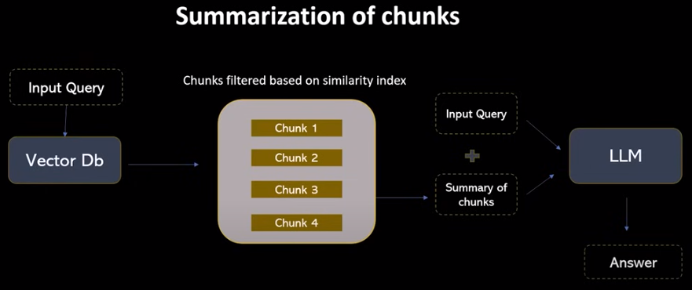
1 RAG: Gemini, FAISS, and PDF
https://www.youtube.com/watch?v=MoqgmWV1fm8&list=PLeo1K3hjS3uu0N_0W6giDXzZIcB07Ng_F&index=3
RAG: Gemini, FAISS, and PDF (05:31-08:30/1:14:33)
We ask question merged from individual quesiton and get the answer from the final LLM.

Slide 5
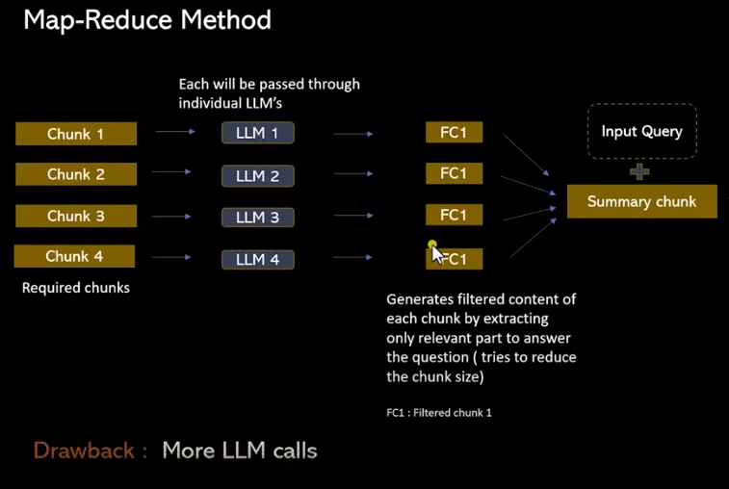
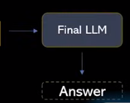
1 RAG: Gemini, FAISS, and PDF
https://www.youtube.com/watch?v=MoqgmWV1fm8&list=PLeo1K3hjS3uu0N_0W6giDXzZIcB07Ng_F&index=3
RAG: Gemini, FAISS, and PDF (05:31-08:30/1:14:33)
For example, if four chunk combined together into one chunk (summary) is more than LLM token limit. That is the drawback of this method.
We are getting all the similarity chunks from our vector database, then we are forming a prompt.
1. If the combined chunk not exceed the LLM token limit, that is fine.
2. If the combined chunk exceed the LLM token limit, it will not work.
We need the better way to handle this situation.
FC1
FC2
FC3
FC4

Slide 6
1.1 API Key

Slide 7
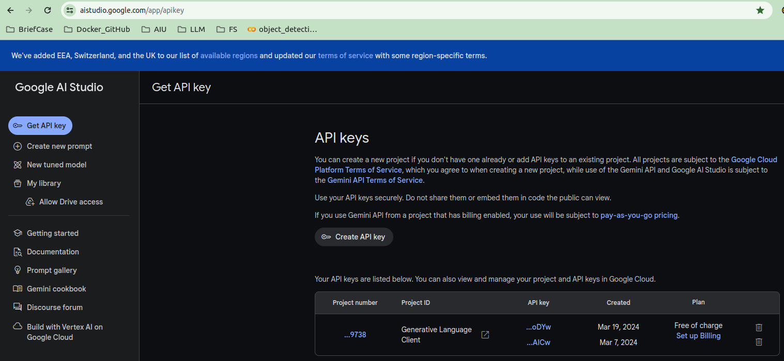
1.1 API Key
https://www.youtube.com/watch?v=MoqgmWV1fm8&list=PLeo1K3hjS3uu0N_0W6giDXzZIcB07Ng_F&index=3
API Key (08:31-09:30/1:14:33)
Google API Key for LLM Gemini.
https://aistudio.google.com/app/apikey

Slide 8
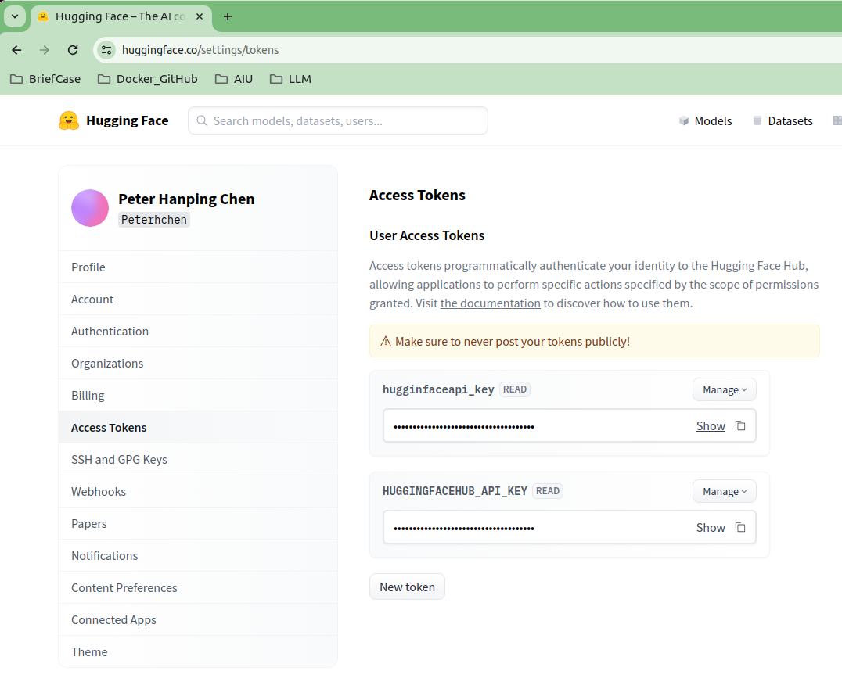
1.1 API Key
https://www.youtube.com/watch?v=MoqgmWV1fm8&list=PLeo1K3hjS3uu0N_0W6giDXzZIcB07Ng_F&index=3
API Key(10:31-11:30/1:14:33)
HuggingFace API Key is LangChain community, such as, HuggingFace Models, FAISS, transformers, etc.
https://huggingface.co/settings/tokens

Slide 9
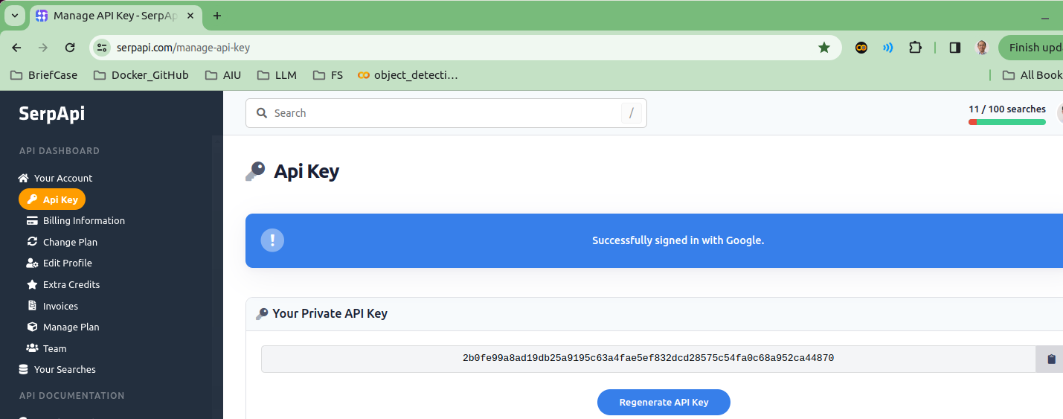
1.1 API Key
https://www.youtube.com/watch?v=MoqgmWV1fm8&list=PLeo1K3hjS3uu0N_0W6giDXzZIcB07Ng_F&index=3
API Key(10:31-11:30/1:14:33)
Google Search Platform API Key: for Google search platform/engine.
Gemini Agent will automatically call serp for real-time answer.
https://serpapi.com/manage-api-key

Slide 10
1.1 API Key
https://www.youtube.com/watch?v=MoqgmWV1fm8&list=PLeo1K3hjS3uu0N_0W6giDXzZIcB07Ng_F&index=3
API Key(10:31-11:30/1:14:33)
Copy and Paste the API Key into the “.env” file.
Below shows my API Key.
1. Google API Key: Google Gemini Model
2. HuggingFace Hub API Key: for HuggingFace Space Host and some tools (Not every tools need) in LangChain Community.
3. Serp API Key: Google Search Platform API Key for Gemini Agent.

Slide 11
1.2 Requirement Packages

Slide 12
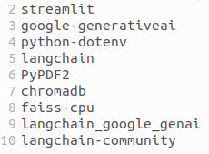
1.2 Requirement Packages
https://www.youtube.com/watch?v=MoqgmWV1fm8&list=PLeo1K3hjS3uu0N_0W6giDXzZIcB07Ng_F&index=3
Requirement Packages (08:31-09:30/1:14:33)
> conda create --name RAG
> conda activate RAG
Install the requirement packages.
(RAG) > pip install -r requirements.txt
1. streamlit: GUI
2. google-generativeai: Gemini Model
3. python-dotenv: read define API Key (Google API and HuggingFace API Key for LangChain tools) from “.env” file.
4. langchain: LangChain functions.
5. PyPAF2: PDF parser into texts.
6. chromadb: Embedding for Sentence transformer for semantic grouping of tokens for dimension reduction.
7. faiss-cpu (Facebook AI Similarity Search): Efficient search for Vector Database
8. langchain_google_genai: LangChain interface for Google Gemini Generative AI Model.
9. langchain-community: LangChain community tools for third party interfaces.

Slide 13
1.3 Import Library

Slide 14
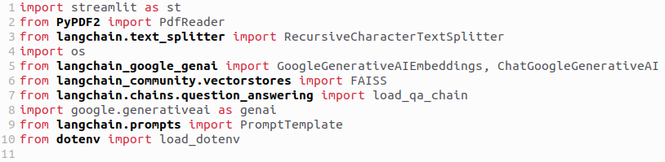
1.3 Import Library
https://www.youtube.com/watch?v=MoqgmWV1fm8&list=PLeo1K3hjS3uu0N_0W6giDXzZIcB07Ng_F&index=3
Import Library (08:31-09:30/1:14:33)
1. streamlit: GUI
5. PyPAF2: PDF parser into texts.
2. google-generativeai: Gemini Model
3. RecursiveCharacterTextSplitter: langchain text splitter
4. os: Python OS environment
5. GoogleGenerativeAIEmbeddings: Google Embedding (Semantic grouping/dimension reduction.
6. ChatGoogleGenerativeAI: Google Generative AI for chat.
7. FAISS (Facebook AI Similarity Search): Efficient one-hot-encoding vector database.
8.load_qa_chain: Question and Answer chain.
9. genai: Gemini Model
10. PromptTemplate: Input Prompt Format.
11. load_dotenv: Load defined API Key from “.env” file.

Slide 15
1.4 Load API Key

Slide 16

1.4 Load API Key
https://www.youtube.com/watch?v=MoqgmWV1fm8&list=PLeo1K3hjS3uu0N_0W6giDXzZIcB07Ng_F&index=3
Load API Key (08:31-09:30/1:14:33)

Slide 17
1.4 Load API Key and Configuration

Slide 18
1.4 Load API Key and Configuration
https://www.youtube.com/watch?v=MoqgmWV1fm8&list=PLeo1K3hjS3uu0N_0W6giDXzZIcB07Ng_F&index=3
Load API Key and Configuration (08:31-09:30/1:14:33)
1. Load API Key
2. LLM Model (Gemini Model) Configuration

Slide 19
1.5 Extract Text from PDF

Slide 20
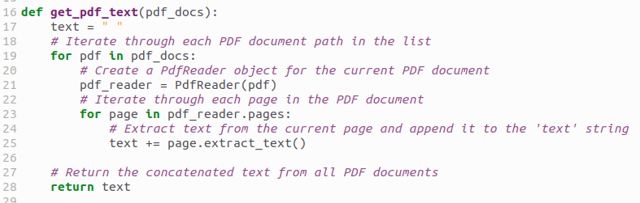
1.5 Extract Text from PDF
https://www.youtube.com/watch?v=MoqgmWV1fm8&list=PLeo1K3hjS3uu0N_0W6giDXzZIcB07Ng_F&index=3
Extract Text from PDF (08:31-09:30/1:14:33)
PDF reader: Read several pages of PDF file and convert them into texts.

Slide 21
1.5 Extract Text from PDF

Slide 22
1.5 Extract Text from PDF
https://www.youtube.com/watch?v=MoqgmWV1fm8&list=PLeo1K3hjS3uu0N_0W6giDXzZIcB07Ng_F&index=3
Extract Text from PDF (08:31-09:30/1:14:33)

Slide 23
1.6 Split Text into Chunks

Slide 24
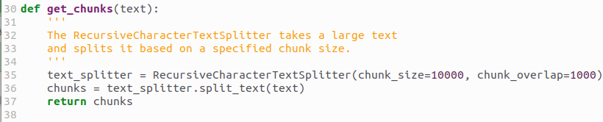
1.6 Split Text into Chunks
https://www.youtube.com/watch?v=MoqgmWV1fm8&list=PLeo1K3hjS3uu0N_0W6giDXzZIcB07Ng_F&index=3
Split Text into Chunks (08:31-09:30/1:14:33)
Gemini cannot process very huge text.
We split into several chunks and ask quesiton one chunk by another chunk.
Each chunk size is 10000 characters and chunk overlap is 1000.

Slide 25
1.7 Vector Database

Slide 26
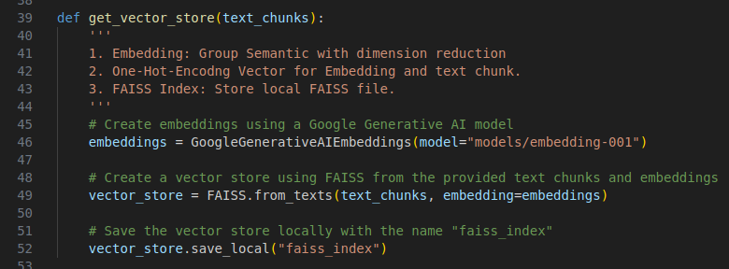
1.7 Vector Database
https://www.youtube.com/watch?v=MoqgmWV1fm8&list=PLeo1K3hjS3uu0N_0W6giDXzZIcB07Ng_F&index=3
Vector Database (08:31-09:30/1:14:33)
1. Embedding: We use Google Chromadb to create Group Semantic with dimension reduction.
2. Create one-hot-encoding vector.
3. Store FAISS File.

Slide 27
1.8 Question and Answer Chain

Slide 28
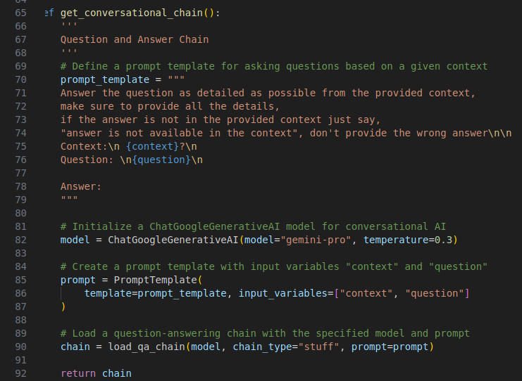
1.8 Question and Answer Chain
https://www.youtube.com/watch?v=MoqgmWV1fm8&list=PLeo1K3hjS3uu0N_0W6giDXzZIcB07Ng_F&index=3
Question and Answer Chain (08:31-09:30/1:14:33)
1. Individual Question and Answer
2. Merge individual Question and Answer into Final Answer.

Slide 29
1.9 Get User Input

Slide 30
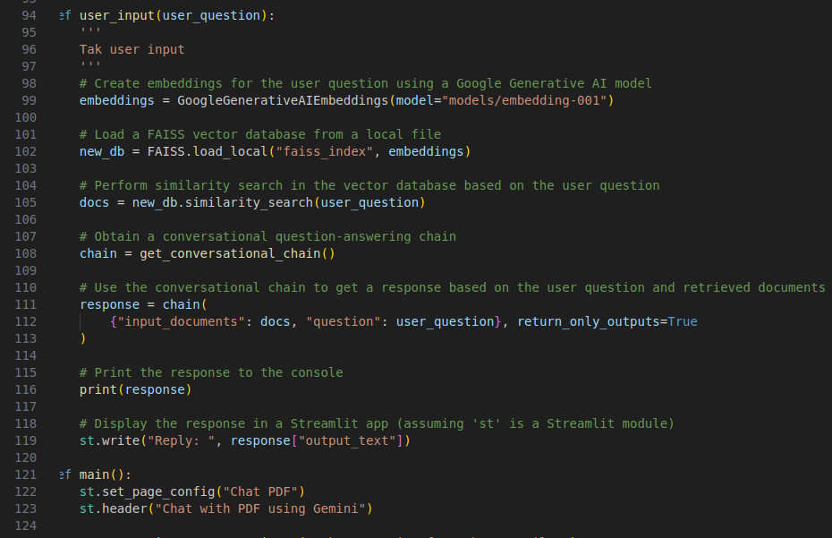
1.9 Get User Input
https://www.youtube.com/watch?v=MoqgmWV1fm8&list=PLeo1K3hjS3uu0N_0W6giDXzZIcB07Ng_F&index=3
Get User Input (08:31-09:30/1:14:33)
1. Get PDF into texts
2. Text Split: Text split into tokens.
3. Store Vector Database
4. Get Q&A (Question and Answer) Chain: Chain will perform individual Q&A and merger for final Q&A for final LLM.
5. Get User input and prompt for Q&A Chain.

Slide 31
1.10 GUI

Slide 32
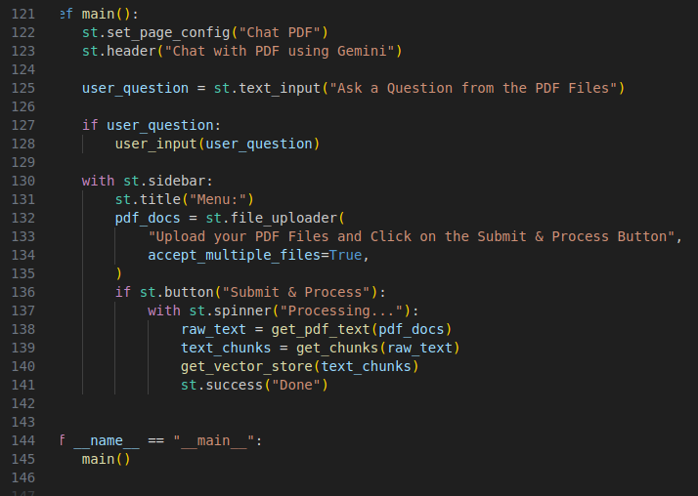
1.10 GUI
https://www.youtube.com/watch?v=MoqgmWV1fm8&list=PLeo1K3hjS3uu0N_0W6giDXzZIcB07Ng_F&index=3
GUI (08:31-09:30/1:14:33)

Slide 33
1.11 Verify Test

Slide 34
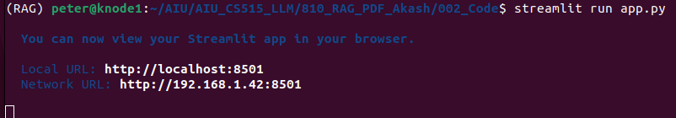
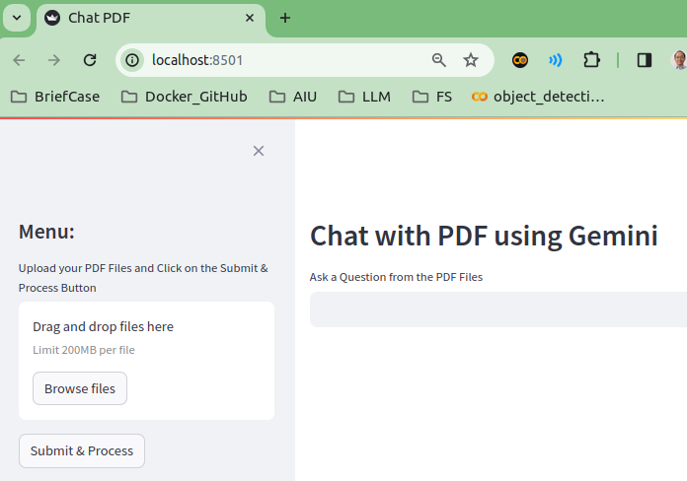
1.11 Verify Test
https://www.youtube.com/watch?v=MoqgmWV1fm8&list=PLeo1K3hjS3uu0N_0W6giDXzZIcB07Ng_F&index=3
Verify Test (08:31-09:30/1:14:33)
1. Start app.py
> streamlit run app.py
2. Check individual chunk Q&A and Final LLM Q&A

Slide 35
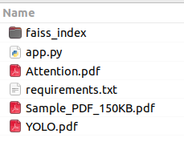
1.11 Verify Test
https://www.youtube.com/watch?v=MoqgmWV1fm8&list=PLeo1K3hjS3uu0N_0W6giDXzZIcB07Ng_F&index=3
Verify Test (08:31-09:30/1:14:33)
Drag and drop the file “Sample_PDF_150KB.pdf”

Slide 36
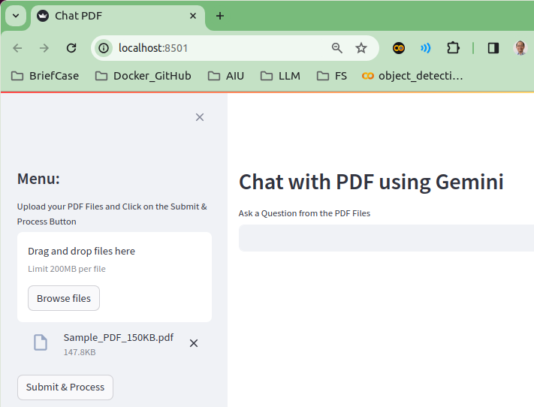
1.11 Verify Test
https://www.youtube.com/watch?v=MoqgmWV1fm8&list=PLeo1K3hjS3uu0N_0W6giDXzZIcB07Ng_F&index=3
Verify Test (08:31-09:30/1:14:33)
Click button “Submit & Process”

Slide 37
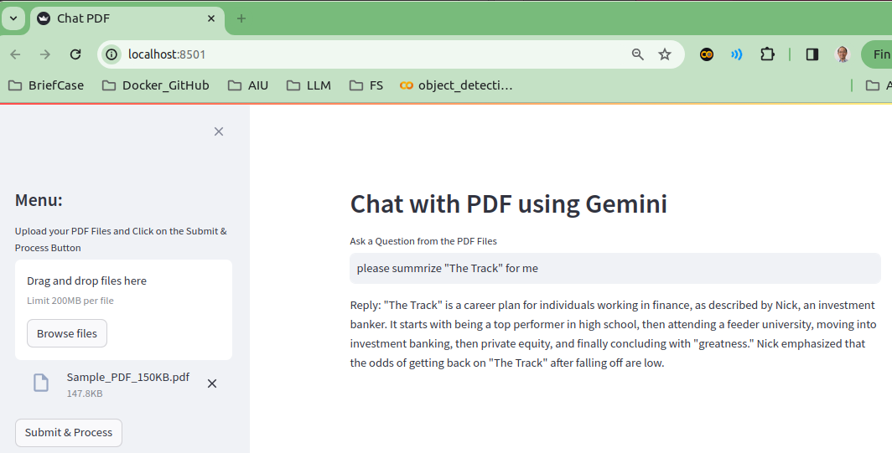
1.11 Verify Test
https://www.youtube.com/watch?v=MoqgmWV1fm8&list=PLeo1K3hjS3uu0N_0W6giDXzZIcB07Ng_F&index=3
Verify Test (08:31-09:30/1:14:33)
> Please summarize “The Track” for me
Type <Enter> to process

Slide 38
End

