Slide 1

1 LLM App by LangChain
Peter H. Chen

Slide 2

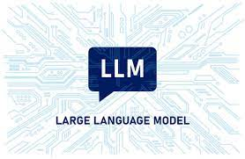
1 LLM App by LangChain
https://www.youtube.com/watch?v=nAmC7SoVLd8&list=PLeo1K3hjS3uu0N_0W6giDXzZIcB07Ng_F&index=1
LLM App by LangChain (00:00-00:05/46:07)
LangChain is a a framework that allow you to build application on top of LLM (Large Language Model).
We will use Open-Source Google Gemini instead of OpenAI GPT.

Slide 3
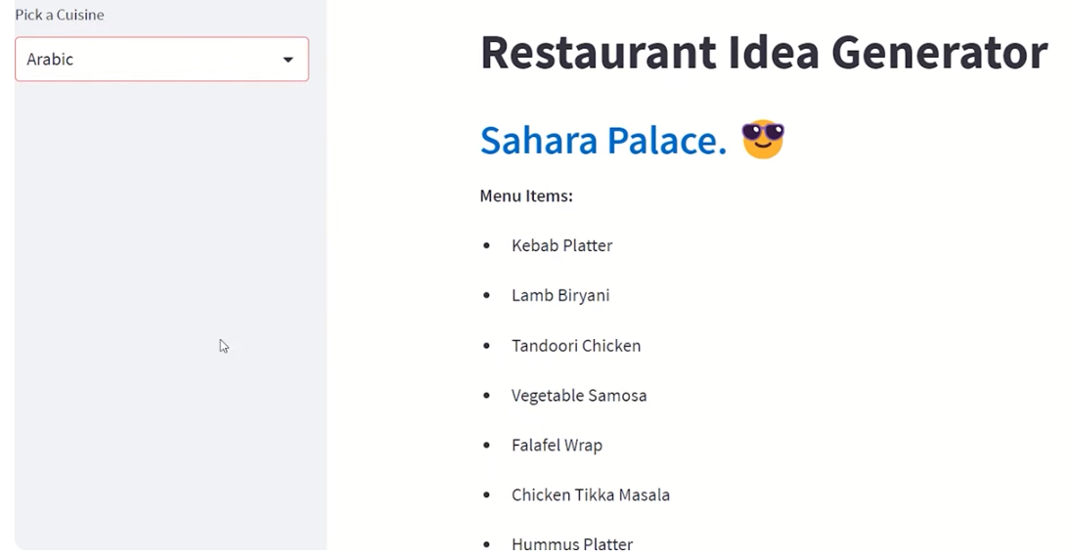
1 LLM App by LangChain
https://www.youtube.com/watch?v=nAmC7SoVLd8&list=PLeo1K3hjS3uu0N_0W6giDXzZIcB07Ng_F&index=1
LLM App by LangChain (00:06-00:10/46:07)
We will go over all the basic topics of LangChain
We will use LangChain to build a Restaurant application.

Slide 4
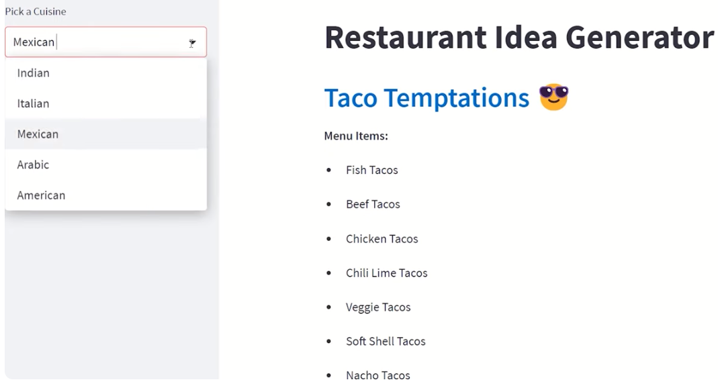
1 LLM Apps by LangChain
https://www.youtube.com/watch?v=nAmC7SoVLd8&list=PLeo1K3hjS3uu0N_0W6giDXzZIcB07Ng_F&index=1
LLM App by LangChain (00:11-00:15/46:07)
We are going to
1. Use LangChain and
2. Use streamlit (or ReactJS) for GUI where you can input any cuisine (recipe), such as, Indian, Italian, Mexican, Arabic, American, etc.

Slide 5
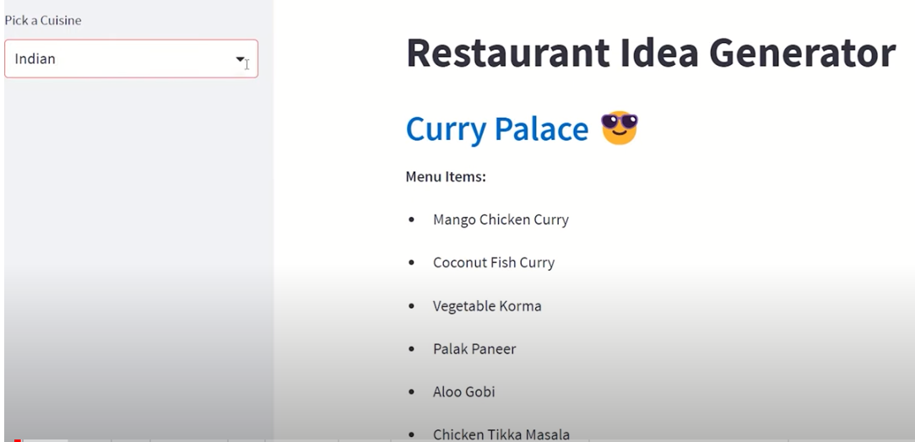
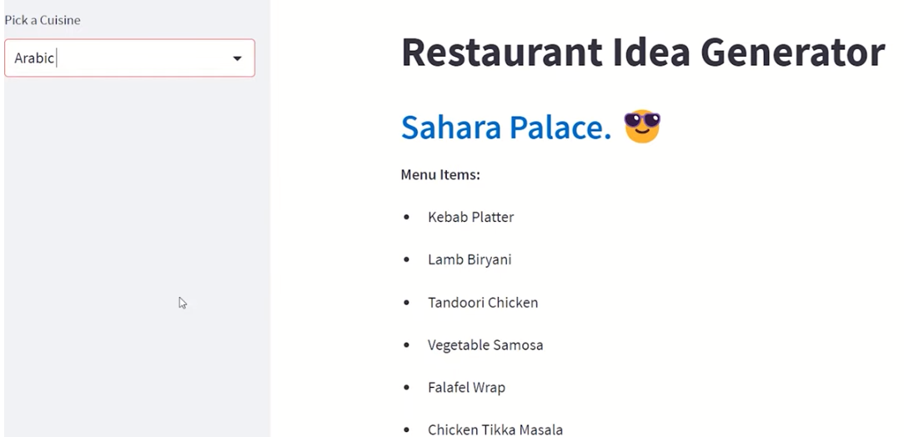
1 LLM Apps by LangChain
https://www.youtube.com/watch?v=nAmC7SoVLd8&list=PLeo1K3hjS3uu0N_0W6giDXzZIcB07Ng_F&index=1
LLM App by LangChain (00:11-00:20/46:07)
We display the menu items: Indian, Italian, Mexican, Arabic, American, etc., based on the input selection.

Slide 6
1.01 LangChain

Slide 7
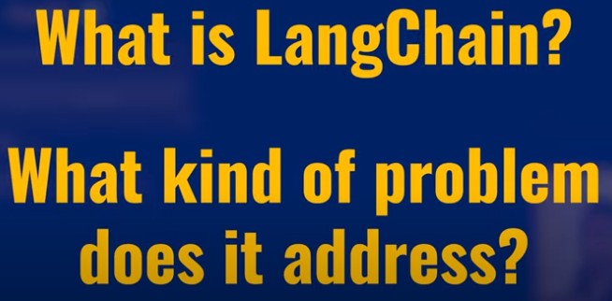
1.01 LangChain
https://www.youtube.com/watch?v=nAmC7SoVLd8&list=PLeo1K3hjS3uu0N_0W6giDXzZIcB07Ng_F&index=1
LangChain (00:26-00:27/46:07)
We want to know:
1. What is LangChain and
2. what kind of problem that LangChain solve??

Slide 8
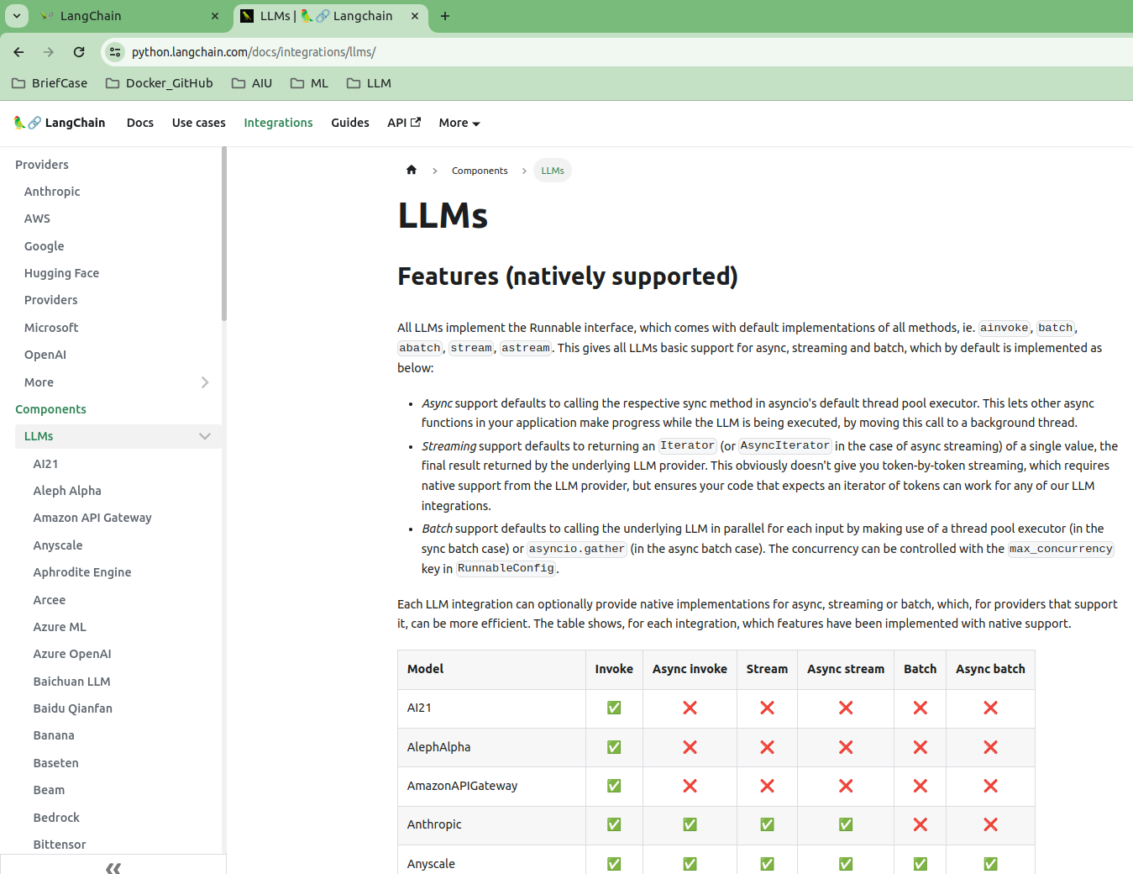
1.01 LangChain
https://www.youtube.com/watch?v=nAmC7SoVLd8&list=PLeo1K3hjS3uu0N_0W6giDXzZIcB07Ng_F&index=1
LangChain (00:28-00:30/46:07)
LangChain integrate more than 77+ Language Models, such as, Google PaLM 2 (Pathway Language Model version 2), Meta LlaMa 2 (Large Language Model for Meta AI), HuggingFace Masked/Causal Language Model, Microsoft chatGPT (Chat Generative Pre-trained Transformer), etc.

Slide 9
End

