Slide 1

1.02 LC and Gemini/GPT
Peter H. Chen

Slide 2
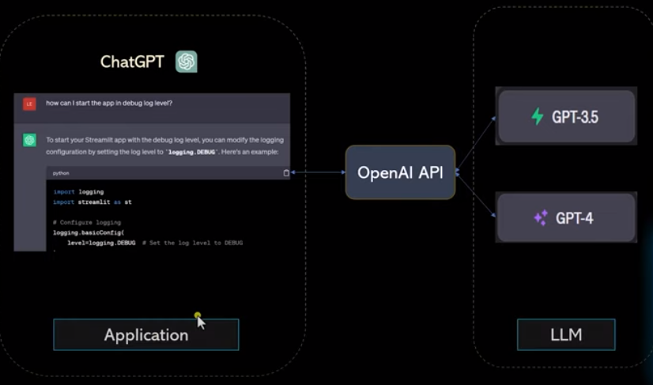
1.02 LC and Gemini/GPT
https://www.youtube.com/watch?v=nAmC7SoVLd8&list=PLeo1K3hjS3uu0N_0W6giDXzZIcB07Ng_F&index=1
LC and Gemini/GPT (00:30-01:00/46:07)
LC (LangChain) is a framework for chatGPT (can be Google chatbot or Meta chatbot):
1. We have application: Google chatbot, Meta chatbot, or OpenAI chatGPT, etc.
2. LC internally call LLM: GPT-3.5/4 (can be Google Gemini (or PaLM), Meta Llama, etc)
Note:
1. Google Gemini is free open-source and free.
2. OpenAI GPT is not open source and charged to use.

Slide 3
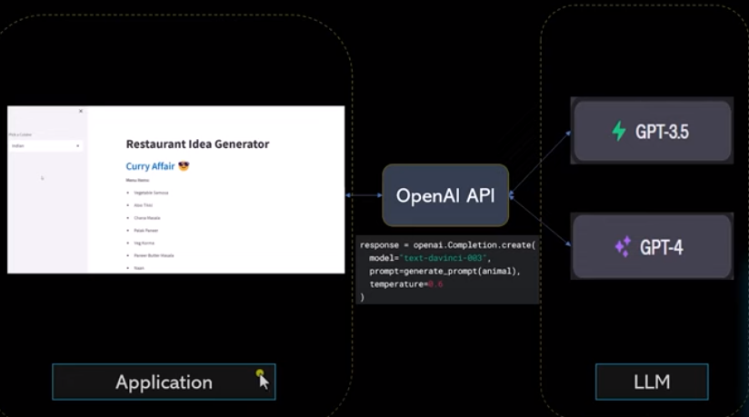
1.02 LC and Gemini/GPT
https://www.youtube.com/watch?v=nAmC7SoVLd8&list=PLeo1K3hjS3uu0N_0W6giDXzZIcB07Ng_F&index=1
LC and Gemini/GPT (01:19-02:00/46:07)
LangChain is a tool to integrate LLM for application. With the same LangChain Architecture, we can directly call Google Gemini API, OpenAI GPT API, or Meta Llama API. Internally, Gemini API will call Gemini-1.0/2.0, OpenAI API will call GPT-3.5/GPT4, or Llama 1.0/2.0/3.0.

Slide 4
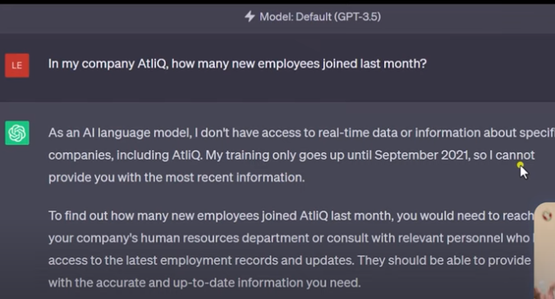
1.02 LC and Gemini/GPT
https://www.youtube.com/watch?v=nAmC7SoVLd8&list=PLeo1K3hjS3uu0N_0W6giDXzZIcB07Ng_F&index=1
LC and Gemini/GPT (02:50-03:10/46:07)
How many AtliQ employees last month?
ChatGPT do not have real-time information after September, 2021.
ChatGPT cannot answer.

Slide 5
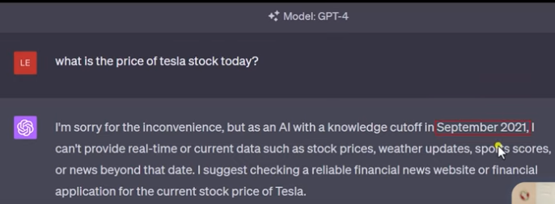
1.02 LC and Gemini/GPT
https://www.youtube.com/watch?v=nAmC7SoVLd8&list=PLeo1K3hjS3uu0N_0W6giDXzZIcB07Ng_F&index=1
LC and Gemini/GPT (02:21-02:50/46:07)
Why we use LangChain instead of Google chatbot, ChatGPT, or Meta chatbot.
1. Google Gemini is free, ChatGPT charge service, Llama is free.
2. Gemini/GPT/Llama does not have real-time data. The are trained by the dataset in specific date, e.g., Gemini knowledge is before March 2023, GPT knowledge limit to September 2021.
If you want to have today data of Google and wiki. We cannot get their data from Gemini, GPT, or Llama.
LangChain connect many LLM, real-time tools, many data sources, private database, Gemini, GPT, Llama are just some of them.
LangChain offers API to call Gemini, GPT, Llama Model, real-time search, etc.

Slide 6
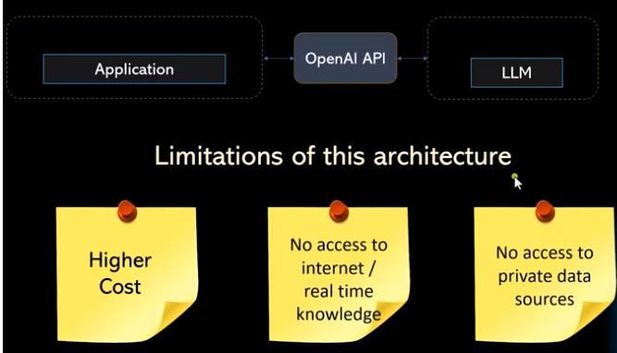
1.02 LC and Gemini/GPT
https://www.youtube.com/watch?v=nAmC7SoVLd8&list=PLeo1K3hjS3uu0N_0W6giDXzZIcB07Ng_F&index=1
LC and Gemini/GPT (03:15-03:30/46:07)
Below is the limitation of OpenAI.
1. High Cost
2. No real-time knowledge
3. No access to private data.

Slide 7
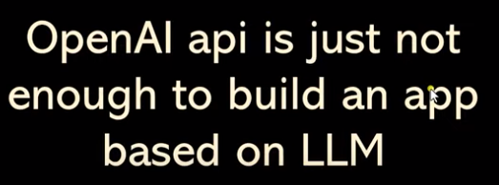
1.02 LC and Gemini/GPT
https://www.youtube.com/watch?v=nAmC7SoVLd8&list=PLeo1K3hjS3uu0N_0W6giDXzZIcB07Ng_F&index=1
LC and Gemini/GPT (03:31-03:37/46:07)
OpenAI API is based on chatGPT.
OpenAI is not enough to build an LLM app.
We need more data source.

Slide 8
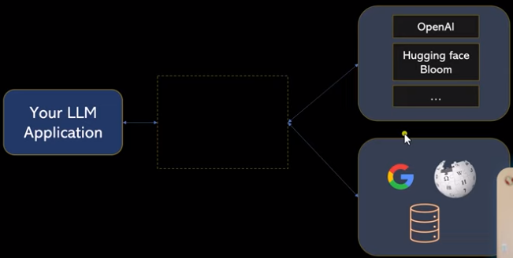
1.02 LC and Gemini/GPT
https://www.youtube.com/watch?v=nAmC7SoVLd8&list=PLeo1K3hjS3uu0N_0W6giDXzZIcB07Ng_F&index=1
LC and Gemini/GPT (03:42-03:50/46:07)
You do not have access to dataset of OpenAI which cost money.
We can only call OpenAI GPT3 and GPT4.
You can call Hugging face, Bloomberg, nasdaq, etc.
There are many open source models.
If you want to access GPT3 and GPT4, LangChain provides API for GPT3 and GPT4 model from chatGPT.

Slide 9
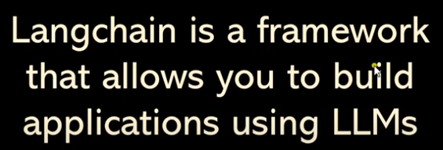
1.02 LC and Gemini/GPT
https://www.youtube.com/watch?v=nAmC7SoVLd8&list=PLeo1K3hjS3uu0N_0W6giDXzZIcB07Ng_F&index=1
LC and Gemini/GPT (04:00-04:33/46:07)
LangChain is a framework that allows you to build applications using LLMs.

Slide 10
End

