Slide 1

1.05 Import Library
Peter H. Chen

Slide 2
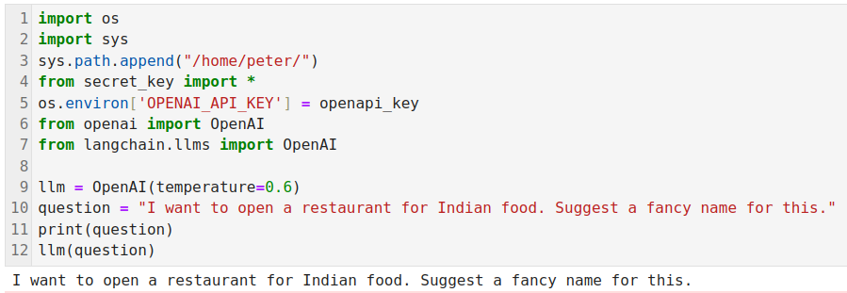
1.05 Import Library
https://www.youtube.com/watch?v=nAmC7SoVLd8&list=PLeo1K3hjS3uu0N_0W6giDXzZIcB07Ng_F&index=1
Import Library (05:01-11:58/46:07)
Import the libraries

Slide 3
1.06 Load LLM Model

Slide 4
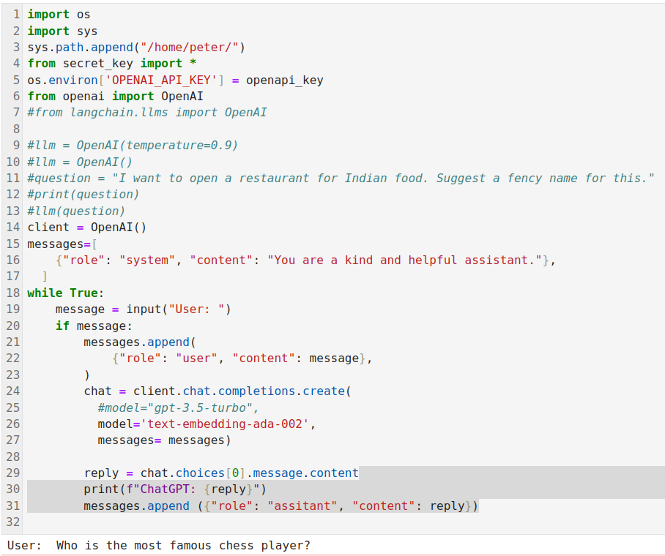
1.06 Load LLM Model
https://www.youtube.com/watch?v=nAmC7SoVLd8&list=PLeo1K3hjS3uu0N_0W6giDXzZIcB07Ng_F&index=1
Import Library (08:01-9:58/46:07)
Load Gemini LLM

Slide 5
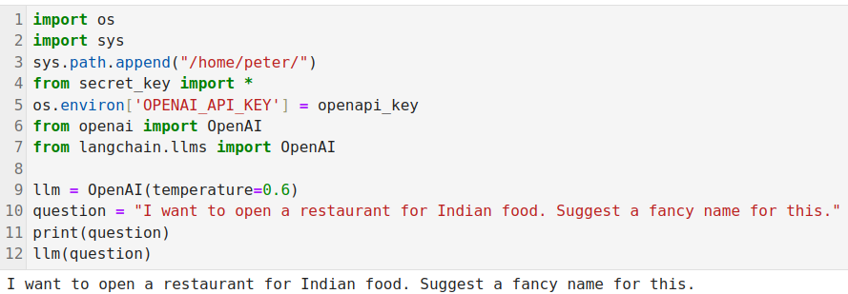
1.06 Load LLM Model
https://www.youtube.com/watch?v=nAmC7SoVLd8&list=PLeo1K3hjS3uu0N_0W6giDXzZIcB07Ng_F&index=1
Load LLM Model (08:01-9:58/46:07)
Quesiton and Answer

Slide 6
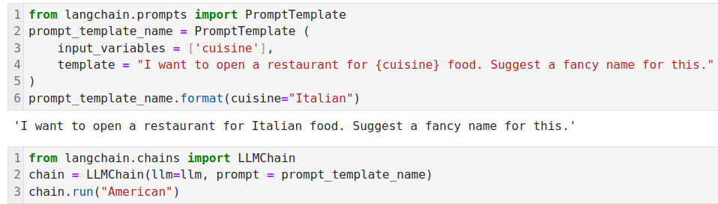
1.06 Load LLM Model
https://www.youtube.com/watch?v=nAmC7SoVLd8&list=PLeo1K3hjS3uu0N_0W6giDXzZIcB07Ng_F&index=1
Load LLM Model (08:01-9:58/46:07)
We install
> pip install langchain
> pip install openai
My openAI Account rate limit has exceed.

Slide 7
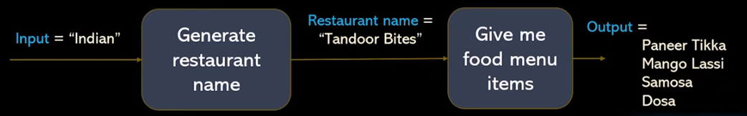

1.06 Load LLM Model
https://www.youtube.com/watch?v=nAmC7SoVLd8&list=PLeo1K3hjS3uu0N_0W6giDXzZIcB07Ng_F&index=1
Load LLM Model (12:19-12:26/46:07)
These are the simple sequential Chain.

Slide 8
End

