Slide 1

5.08 Prompt Template
Peter H. Chen

Slide 2
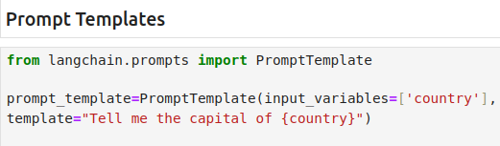
5.08 Prompt Template
https://www.youtube.com/watch?v=qMIM7dECAkc&list=PLZoTAELRMXVORE4VF7WQ_fAl0L1Gljtar&index=5
Prompt Template (26:51-29:00/1:18:23)
We discuss the prompt template for prompt engineering.
Whenever we use the LLM model, the LLM model expecting from the end user and what kind of the output LLM should give to end user.
We use prompt template to define what the input and output should be.
We use prompt template to restrict the input and output.

Slide 3
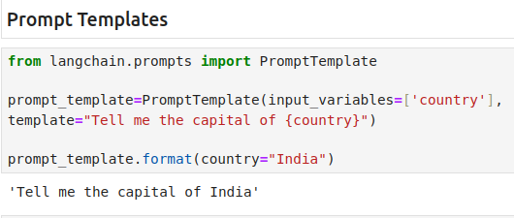
5.08 Prompt Template
https://www.youtube.com/watch?v=qMIM7dECAkc&list=PLZoTAELRMXVORE4VF7WQ_fAl0L1Gljtar&index=5
Prompt Template (29:01-30:00/1:18:23)
Below, we define the prompt template
1. input variables = [‘country’].
2. template=”Tell me the capital of this {country}”
{country} is the variable.
Whatever the input from user will replace the {country}.
The value ‘country’ inside {} is dynamic. We give the value {country} during the run time.

Slide 4
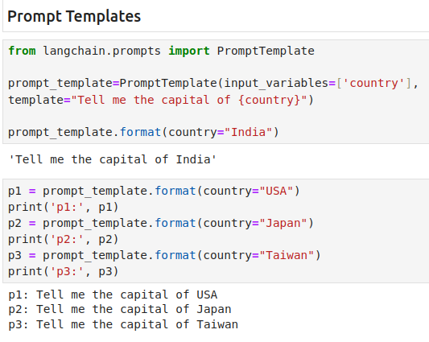
5.08 Prompt Template
https://www.youtube.com/watch?v=qMIM7dECAkc&list=PLZoTAELRMXVORE4VF7WQ_fAl0L1Gljtar&index=5
Prompt Template (30:01-31:00/1:18:23)
We can use
> prompt_template.format(country = “India”)
To change the input.
We can change variable country to others: USA, Japan, Taiwan, etc.

Slide 5
5.09 LLMChain

Slide 6
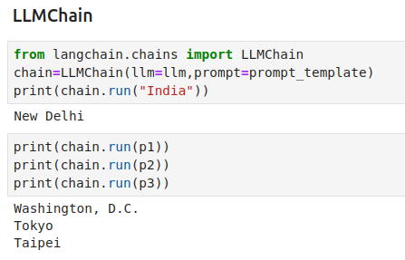
5.09 LLMChain
https://www.youtube.com/watch?v=qMIM7dECAkc&list=PLZoTAELRMXVORE4VF7WQ_fAl0L1Gljtar&index=5
LLMChain (31:01-33:00/1:18:23)
We should not use
> llm.predict (prompt=prompt_template, text=”USA”)
In stead, wee should use LLMChain to create the chain and use chain.run(text) to replace the define variable {country}.
> chain = LLMChain (llm = llm, prompt=prompt_template)
> chain.run (“USA”).
We can run several times, Mos of time, the answers are correct.
Sometimes, we get the wrong answers.

Slide 7
5.11 HF Transformer flan-t5

Slide 8
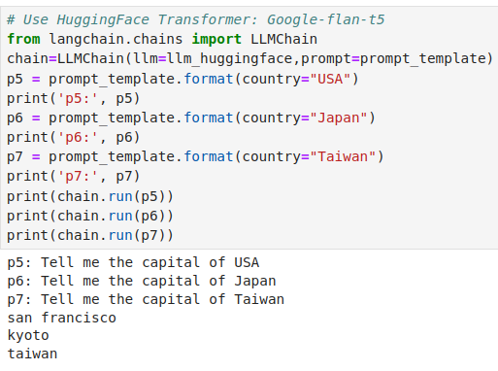
5.11 HF Transformer flan-t5
https://www.youtube.com/watch?v=qMIM7dECAkc&list=PLZoTAELRMXVORE4VF7WQ_fAl0L1Gljtar&index=5
HF Transformer flan-t5 (33:01-34:00/1:18:23)
We tried the HuggingFace transformer google-flan-t5.
Flan-t5 is not as reliable as gemini. It gets more wrong more answers than Gemini.
“san francisco”, “kyoto”, and “taiwan” are not capital of USA, Japan, Taiwan, respectively.
flan-t5 is a transformer for fine-tune custom application.
1. flan-t5 is fast and
2. need fine tune training by real-time search and private dataset.

Slide 9
End

