Slide 1

02 Tools and Chains
Peter H. Chen

Slide 2
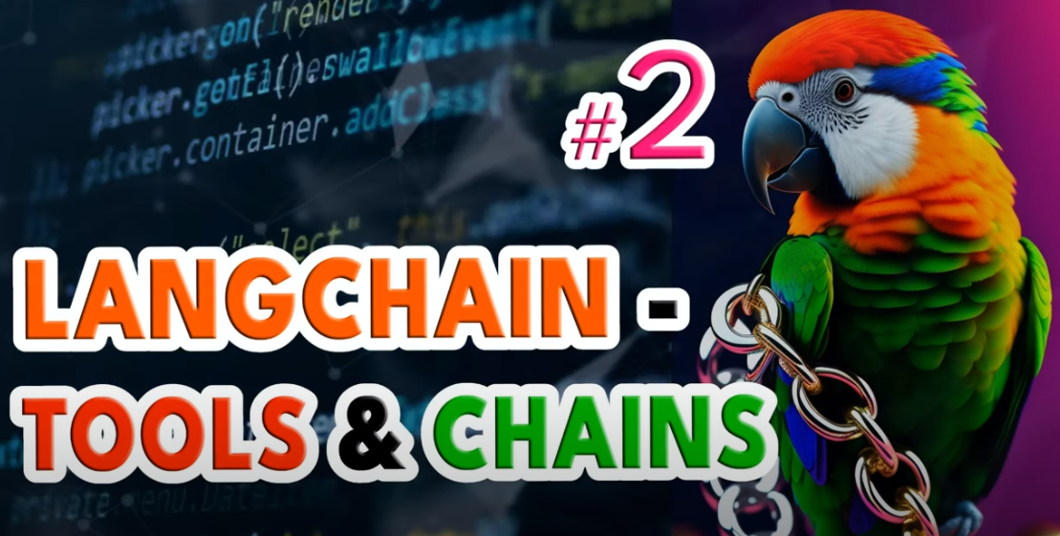
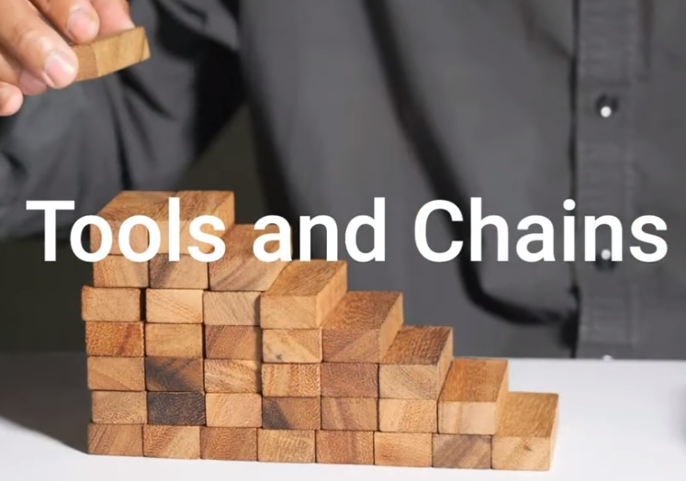
02 Tools and Chains
https://www.youtube.com/watch?v=hI2BY7yl_Ac&list=PL8motc6AQftk1Bs42EW45kwYbyJ4jOdiZ&index=2
Tools and Chains (00:00-00:10/17:41)
We discuss tools and chains.
In LangChain, tools are different components

Slide 3
02.01 Tools

Slide 4

02.01 Tools
https://www.youtube.com/watch?v=hI2BY7yl_Ac&list=PL8motc6AQftk1Bs42EW45kwYbyJ4jOdiZ&index=2
Tools (00:11-00:40/17:41)
Tools are individual components that LangChain uses.
Tools are links in the chain. These tools are a variety of sub-modules. You can combine these tools with a Language Model to do task.
These tools make a chain overall.

Slide 5
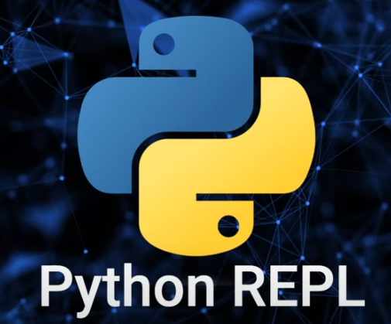
02.01 Tools
https://www.youtube.com/watch?v=hI2BY7yl_Ac&list=PL8motc6AQftk1Bs42EW45kwYbyJ4jOdiZ&index=2
Tools (00:41-00:50/17:41)
What make up a chain overall?
Some tools, such as, Python read, evaluate, print, loop, etc.
The tools output and than feedback into a model with a chain like that.

Slide 6
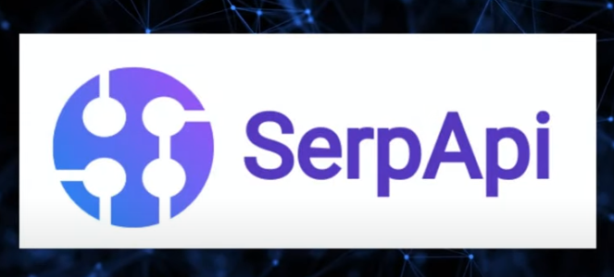
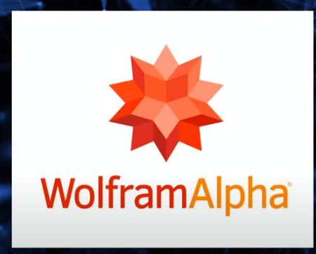
02.01 Tools
https://www.youtube.com/watch?v=hI2BY7yl_Ac&list=PL8motc6AQftk1Bs42EW45kwYbyJ4jOdiZ&index=2
Tools (00:51-01:10/17:41)
We have seen the tools, such as,
1. Google serp (Search Engine Result Pages) API: Google real-time search engine.
2. Wolfram Alpha: Wolfram Research online search engine. The result answer data can be brought back into the LLM (gemini) or other tools you used.

Slide 7

02.01 Tools
https://www.youtube.com/watch?v=hI2BY7yl_Ac&list=PL8motc6AQftk1Bs42EW45kwYbyJ4jOdiZ&index=2
Tools (01:16-01:30/17:41)
It is same as you do the google search and then News Api.
You search the Google results and then feed back to your app.

Slide 8
02.02 Chains

Slide 9
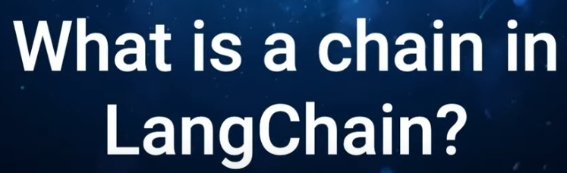
02.02 Chains
https://www.youtube.com/watch?v=hI2BY7yl_Ac&list=PL8motc6AQftk1Bs42EW45kwYbyJ4jOdiZ&index=2
Chains (01:31-01:40/17:41)
What is a Chain in LangChain​?
A Chain that made up of links of tools.

Slide 10
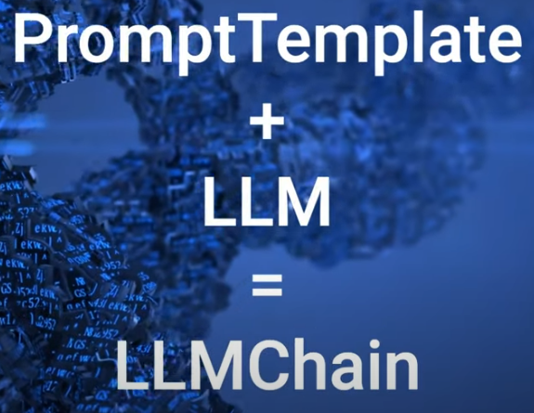
02.02 Chains
https://www.youtube.com/watch?v=hI2BY7yl_Ac&list=PL8motc6AQftk1Bs42EW45kwYbyJ4jOdiZ&index=2
Chains (01:41-02:00/17:41)
Each tool in the overall chain is called “Link”.
How many links in the below diagram?
Answer: 2
Link 1: PromptTemplate and
Link 2: LLM.
The chain can be very simple chain with one prompt template and one LLM (Large Language Model). This is the simplest chain and it is the most common chain that we saw in LangChain.
1
What is a link in LangChain?
1. In the LangChain framework, a link accepts input from the user and passes it to the LangChain libraries for processing.
2. LangChain also allows link reordering to create different AI workflows.
2

Slide 11
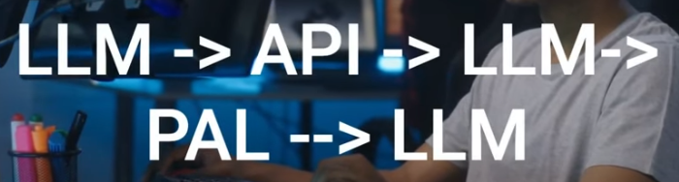
02.02 Chains
https://www.youtube.com/watch?v=hI2BY7yl_Ac&list=PL8motc6AQftk1Bs42EW45kwYbyJ4jOdiZ&index=2
Chains (02:01-02:10/17:41)
Below example is the more complicated chain. The chain with multiple links which go through multiple steps of the whole processes.
There are multiple links for tools: LLM, API, and PAL:
1. Link 1 (LLM): Input to LLM and output
2. Link 2 (API): input to API and output
3. Link 3 (LLM): input to LLM and output
4. Link 4 (PAL): input to PAL and output
5. Link 5 (LLM): input to LLM and final output
1
2
3
4
5

Slide 12
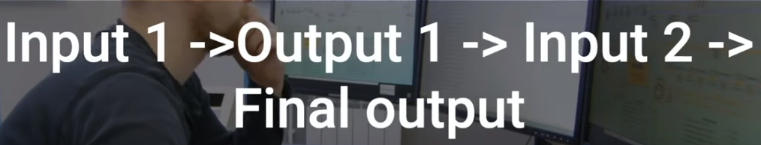
02.02 Chains
https://www.youtube.com/watch?v=hI2BY7yl_Ac&list=PL8motc6AQftk1Bs42EW45kwYbyJ4jOdiZ&index=2
Chains (02:11-02:30/17:41)
In the chains, the output of one link become the input of next link.
How many links in the below diagram:
Answer: 3
There are three tools (links) between the input and output.
1
2
3

Slide 13
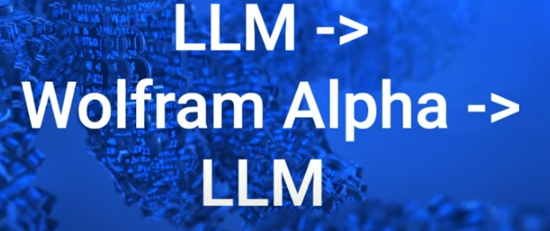
02.02 Chains
https://www.youtube.com/watch?v=hI2BY7yl_Ac&list=PL8motc6AQftk1Bs42EW45kwYbyJ4jOdiZ&index=2
Chains (02:31-02:40/17:41)
In the below diagram, how many links (tools)?
Answer: 3
1. the output of LLM generate a query for tool (Wolfram Alpha).
2. The output of Wolfram Alpha become the input of LLM again.
3. The output of LLM response to the user.
1
2
3

Slide 14
End

