Slide 1

02.07 Install LC, Gemini, and HF
Peter H. Chen

Slide 2
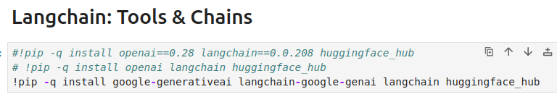
02.07 Install LC, Gemini, and HF
https://www.youtube.com/watch?v=hI2BY7yl_Ac&list=PL8motc6AQftk1Bs42EW45kwYbyJ4jOdiZ&index=2
Install LC, Gemini, and HF (05:41-06:00/17:41)
Our main focus is to use LangChain with Google/Gemini to extract the information with prompt.
1. LangChain + Google/Gemini
2. LangChain + OpenAI/GPT (for reference only): We comment it out.
2
1

Slide 3
02.08 Setup API Key

Slide 4
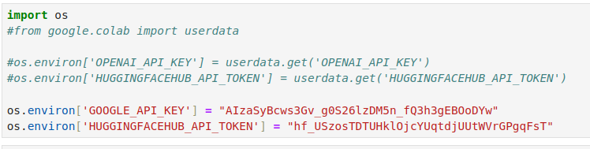
02.08 Setup API Key
https://www.youtube.com/watch?v=hI2BY7yl_Ac&list=PL8motc6AQftk1Bs42EW45kwYbyJ4jOdiZ&index=2
Setup API Key (06:01-06:05/17:41)
Setup API Key for Google Gemini.
1
2

Slide 5
02.09 Load Gemini-Pro

Slide 6
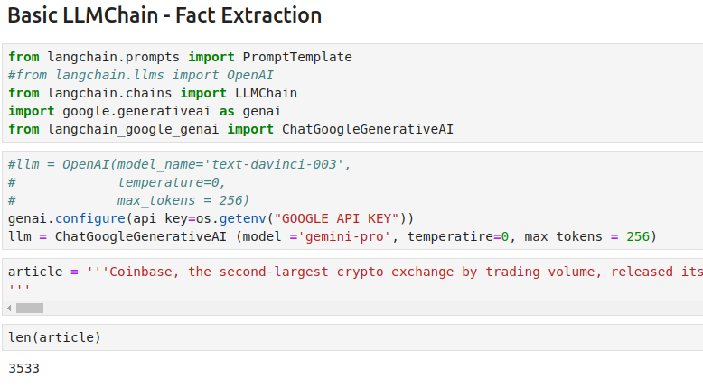
02.9 Load Gemini-pro
https://www.youtube.com/watch?v=hI2BY7yl_Ac&list=PL8motc6AQftk1Bs42EW45kwYbyJ4jOdiZ&index=2
Define Extraction Prompt (06:06-06:50/17:41)
1. We use model = ‘gemini-pro’, we set the temperature = 0 (select the highest probability for answer).
2. Define the article. The article has 3,533 characters about the coinbase company.

Slide 7
02.10 Define Extraction Prompt

Slide 8
02.10 Define Extraction Prompt
https://www.youtube.com/watch?v=hI2BY7yl_Ac&list=PL8motc6AQftk1Bs42EW45kwYbyJ4jOdiZ&index=2
Define Extraction Prompt (06:51-07:20/17:41)
We want to extract the fact fro the article.
We define the extraction prompt:
1. input variables = [“text_input”]
2. prompt template =“Extract the Key facts of the text… { text_input }”.

Slide 9
02.11 First: Basic Prompt + Gemini

Slide 10

02.11 First: Basic Prompt + Gemini
https://www.youtube.com/watch?v=hI2BY7yl_Ac&list=PL8motc6AQftk1Bs42EW45kwYbyJ4jOdiZ&index=2
First: Basic prompt + Gemini (06:51-07:30/17:41)
1. We pass in gemini-pro model and prompt, then we create LangChain fact_extraction_chain.
2. We pass in “article” to LangChain fact_extraction_chain to extract the facts.

Slide 11
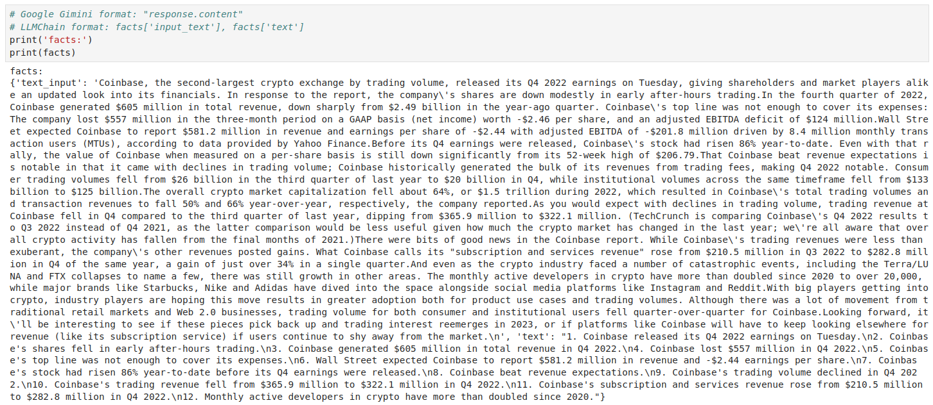
02.11 First: Basic Prompt + Gemini
https://www.youtube.com/watch?v=hI2BY7yl_Ac&list=PL8motc6AQftk1Bs42EW45kwYbyJ4jOdiZ&index=2
First: Basic prompt + Gemini (07:31-08:00/17:41)
Now, we want to see the result of extraction.
Here, Gemini put the result in the dictionary: input variables = “input_text” and output = ”text“

Slide 12
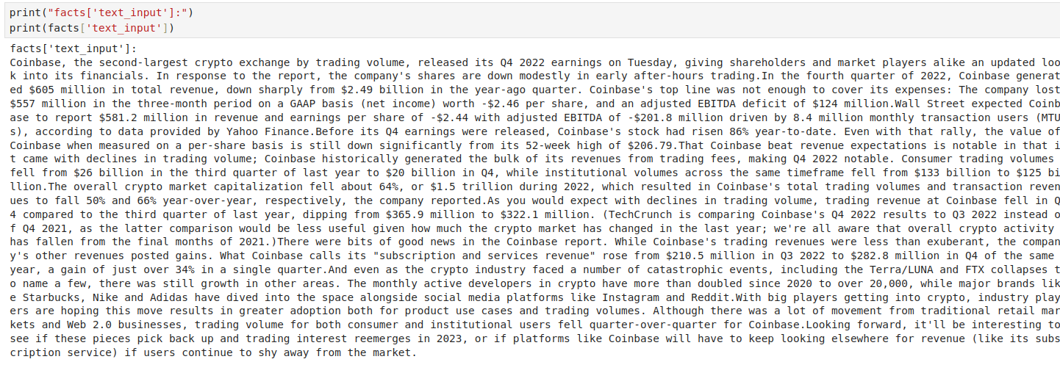
02.11 First: Basic Prompt + Gemini
https://www.youtube.com/watch?v=hI2BY7yl_Ac&list=PL8motc6AQftk1Bs42EW45kwYbyJ4jOdiZ&index=2
First: Basic prompt + Gemini (08:01-08:10/17:41)
Print the “input_text”

Slide 13
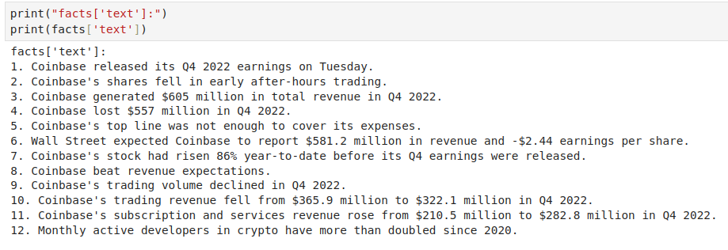
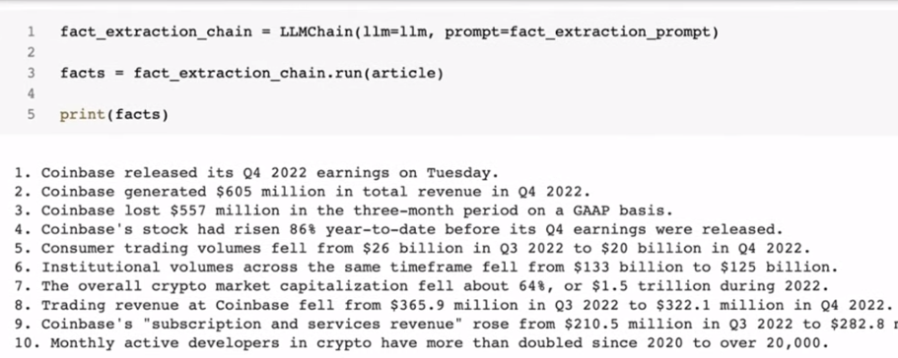
02.11 First: Basic Prompt + Gemini
https://www.youtube.com/watch?v=hI2BY7yl_Ac&list=PL8motc6AQftk1Bs42EW45kwYbyJ4jOdiZ&index=2
First: Basic prompt + Gemini (08:11-08:20/17:41)
Print the output “text”. 1. LangChain + Google/Gemini; 2. LangChain + OpenAI/GPT
Compare (1) and (2). Gemini extracts 12 facts. GPT extracts 10 facts.
1
2

Slide 14
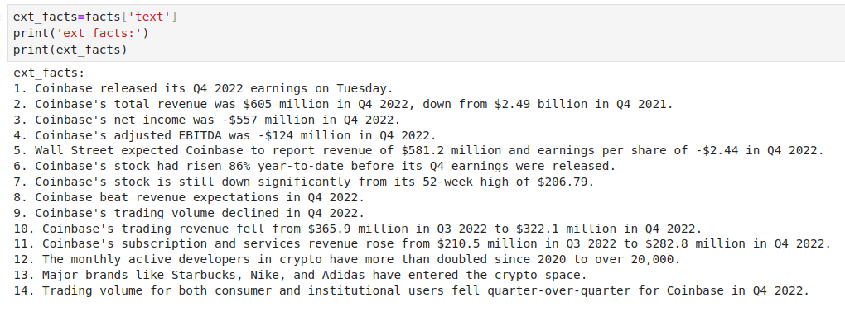
02.11 First: Basic Prompt + Gemini
https://www.youtube.com/watch?v=hI2BY7yl_Ac&list=PL8motc6AQftk1Bs42EW45kwYbyJ4jOdiZ&index=2
First: Basic prompt + Gemini (08:21-08:30/17:41)
We create a variable ext_facts to hold the prompt extraction from Gemini.

Slide 15
02.12 Second: GS Prompt + Gemini

Slide 16
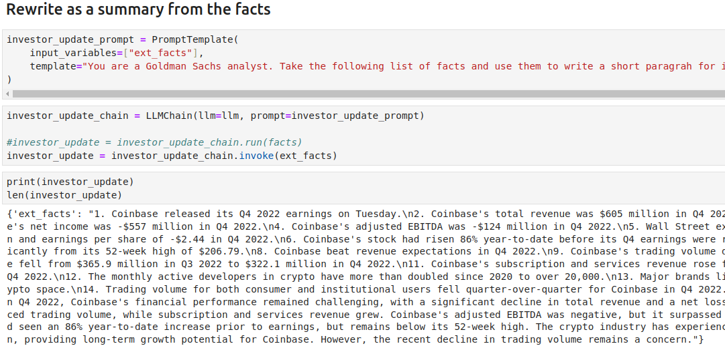
02.12 Second: GS Prompt + Gemini
https://www.youtube.com/watch?v=hI2BY7yl_Ac&list=PL8motc6AQftk1Bs42EW45kwYbyJ4jOdiZ&index=2
Second: GS Prompt + Gemini (08:31-08:40/17:41)
Now, we have the extract facts (in variable ext_facts)
1. We create investor chain (investor_update_chain): GS (Goldman Sachs) prompt + Gemini
2. We pass in extracted facts (ext_fact) to investor chain (investor_update_chain)

Slide 17
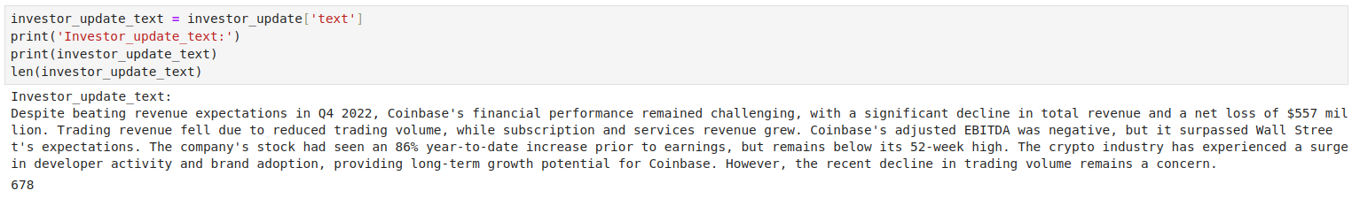
02.12 Second: GS Prompt + Gemini
https://www.youtube.com/watch?v=hI2BY7yl_Ac&list=PL8motc6AQftk1Bs42EW45kwYbyJ4jOdiZ&index=2
Second: GS Prompt + Gemini (08:41-08:50/17:41)
We have the extract facts (in variable ext_facts)
1. We create investor chain (investor_update_chain): Gemini + Goldman Sachs prompt
2. We pass in extracted facts (ext_fact) to investor chain (investor_update_chain)
We have the result from investor (Goldman Sachs) prompt. We put the result in the investor_update_text.

Slide 18
02.13 Third: Triple Prompt + Gemini

Slide 19
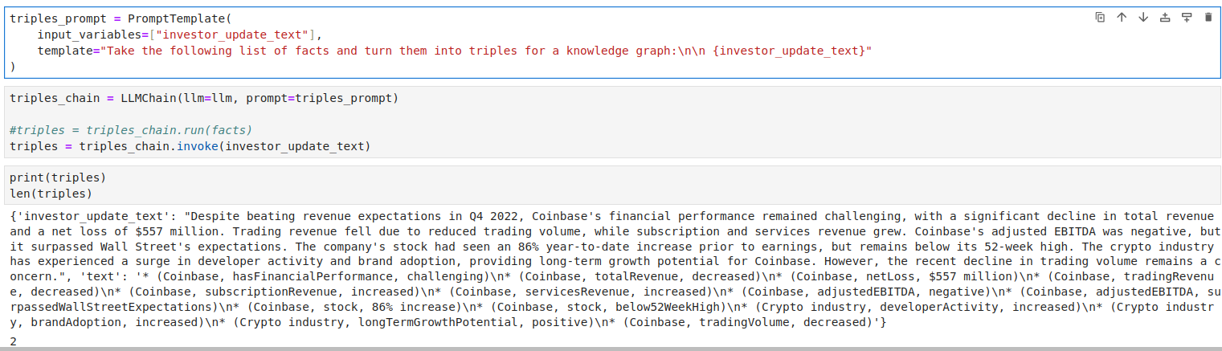
02.13 Third: Triple Prompt + Gemini
https://www.youtube.com/watch?v=hI2BY7yl_Ac&list=PL8motc6AQftk1Bs42EW45kwYbyJ4jOdiZ&index=2
Third: Triple Prompt + Gemini (08:51-09:00/17:41)
Now, we do the third extraction with triples_prompt
We pass variable {investor_update_text} in the input variable and triple_prompt.

Slide 20
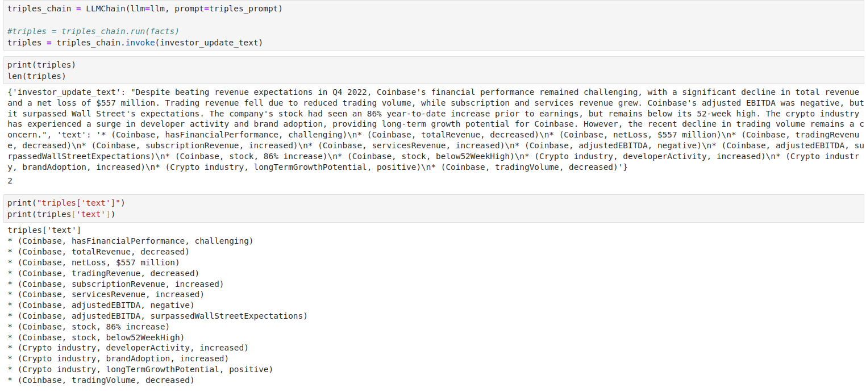
02.13 Third: Triple Prompt + Gemini
https://www.youtube.com/watch?v=hI2BY7yl_Ac&list=PL8motc6AQftk1Bs42EW45kwYbyJ4jOdiZ&index=2
Third: Triple Prompt + Gemini (09:01-09:20/17:41)
We have final result.

Slide 21
End

