Slide 1

02.14 Tool Chain Together
Peter H. Chen

Slide 2
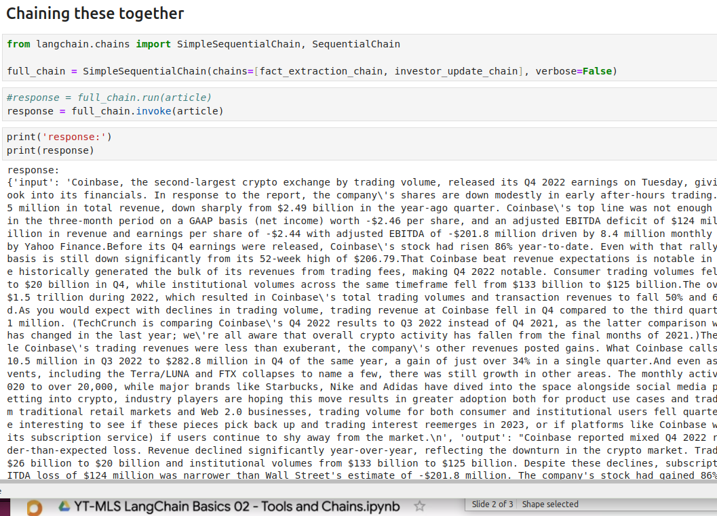
02.14 Tool Chain Together
https://www.youtube.com/watch?v=hI2BY7yl_Ac&list=PL8motc6AQftk1Bs42EW45kwYbyJ4jOdiZ&index=2
Tool Chain Together (09:01-11:30/17:41)
Now, we do the third extraction with triples_prompt
We pass variable {fact_extraction_chain, investor_update_text} in the input variable and triple_prompt.

Slide 3
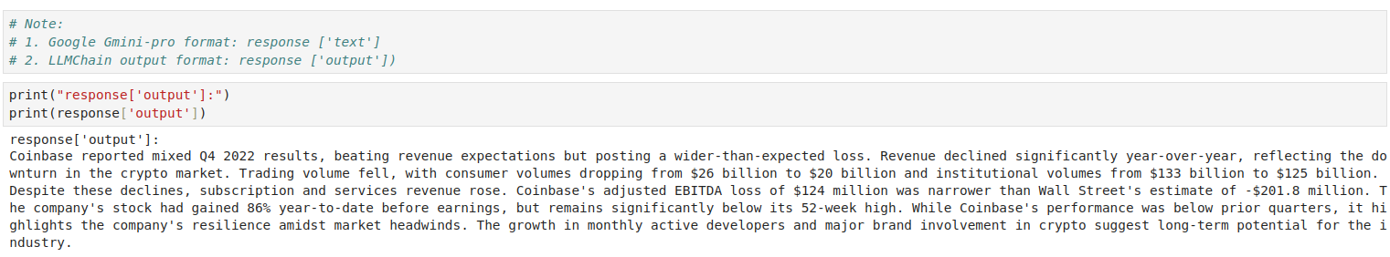
02.14 Tool Chain Together
https://www.youtube.com/watch?v=hI2BY7yl_Ac&list=PL8motc6AQftk1Bs42EW45kwYbyJ4jOdiZ&index=2
Tool Chain Together (11:31-13:30/17:41)
Now, we do the third extraction with triples_prompt
We pass variable {fact_extraction_chain, investor_update_text} in the input variable and triple_prompt.

Slide 4
End

