Slide 1

02.15 PAL Math Chain
Peter H. Chen

Slide 2
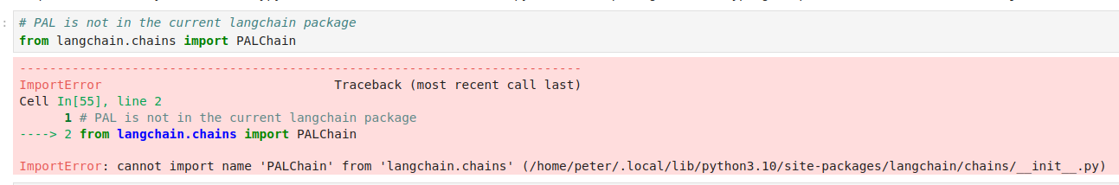
02.15 PAL Math Chain
https://www.youtube.com/watch?v=hI2BY7yl_Ac&list=PL8motc6AQftk1Bs42EW45kwYbyJ4jOdiZ&index=2
PAL Math Chain (13:31-15:30/17:41)
Not Ready
LangChain is under development.

Slide 3
02.16 API Chain

Slide 4
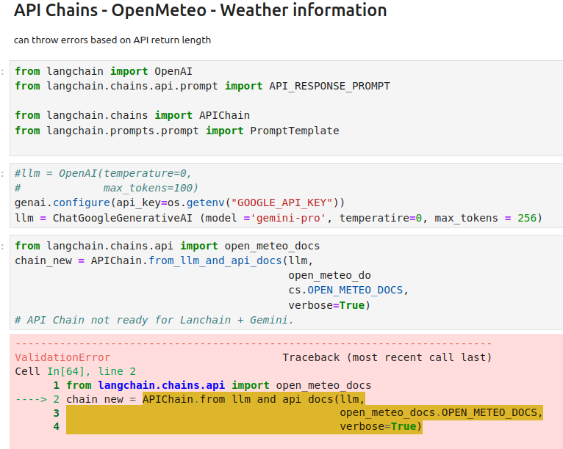
02.16 API Chain
https://www.youtube.com/watch?v=hI2BY7yl_Ac&list=PL8motc6AQftk1Bs42EW45kwYbyJ4jOdiZ&index=2
API Chain (15:31-17:41/17:41)
Not Ready for LangChain + API + Gemini not

Slide 5
End

