Slide 1

5.00 RAG/SQL Introduction
Peter H. Chen

Slide 2




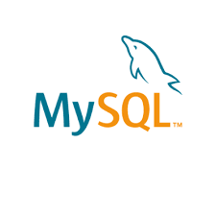
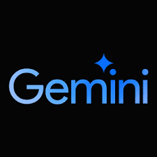

5.00 RAG/SQL Introduction
https://www.youtube.com/watch?v=4wtrl4hnPT8&list=PLeo1K3hjS3uu0N_0W6giDXzZIcB07Ng_F&index=5
RAG/SQL Introduction (00:00-00:10/50:59)
We are going to build RAG (Retrieval Augmented Generative)/SQL with LangChain, HuggingFace, Streamlit, Gemini Embedding (Word Grouping/Dimension Reduction), Chroma (One-Hot-Encoding/Vector Database), MySQL, Google Gemini (replace Google Gemini).
We are going to build a chatbot where you can ask question and answer.
We will use T-Shirt MySQL Database as an example.
Note that the database can be any Database.

Slide 3
5.00 RAG/SQL Introduction
https://www.youtube.com/watch?v=4wtrl4hnPT8&list=PLeo1K3hjS3uu0N_0W6giDXzZIcB07Ng_F&index=5
RAG/SQL Introduction (00:11-00:15/50:59)
With the information retrieval from Database
Question: “How much sales amount will be if we sell all small size Adidas T-Shirts after discounts?”
Answer: 3100
T-Shirt Database Q&A 👕
Question:
How much sales amount will be if we sell all small size Adidas T-Shirts after discounts
Answer:
3100

Slide 4
5.00 RAG/SQL Introduction
https://www.youtube.com/watch?v=4wtrl4hnPT8&list=PLeo1K3hjS3uu0N_0W6giDXzZIcB07Ng_F&index=5
RAG/SQL Introduction (00:16-00:18/50:59)
With the information retrieval from Database
Question: “How many T-Shirts left for Nike in XS size and white color?”
Answer: 91
T-Shirt Database Q&A 👕
Question:
How many T-Shirts left for Nike in small size and red color?
Answer:
50

Slide 5
5.00 RAG/SQL Introduction
https://www.youtube.com/watch?v=4wtrl4hnPT8&list=PLeo1K3hjS3uu0N_0W6giDXzZIcB07Ng_F&index=5
RAG/SQL Introduction (00:16-00:18/50:59)
With the information retrieval from Database
Question: “How many T-Shirts inventory for all small size T-Shirts??”
Answer: 22290
T-Shirt Database Q&A 👕
Question:
How many T-Shirts inventory for all small size T-Shirts?
Answer:
22290

Slide 6
5.01 Project Requirement

Slide 7

5.01 Project Requirement
https://www.youtube.com/watch?v=4wtrl4hnPT8&list=PLeo1K3hjS3uu0N_0W6giDXzZIcB07Ng_F&index=5
Project Requirement (00:29-00:30/50:59)
Let’s look at project requirements.

Slide 8
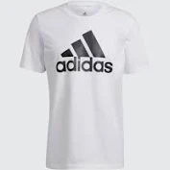
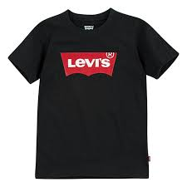
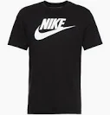
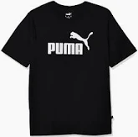

5.01 Project Requirement
https://www.youtube.com/watch?v=4wtrl4hnPT8&list=PLeo1K3hjS3uu0N_0W6giDXzZIcB07Ng_F&index=5
Project Requirement (00:33-00:40/50:59)
Our T-Shirt store sells five major brands, i.e., Adidas, Levi, Nike, Puma, and Van Heusen.

Slide 9
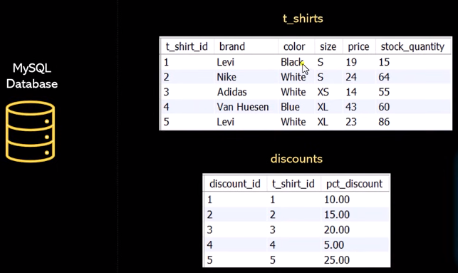
5.1 RAG/SQL Introduction
https://www.youtube.com/watch?v=4wtrl4hnPT8&list=PLeo1K3hjS3uu0N_0W6giDXzZIcB07Ng_F&index=5
RAG/SQL Introduction (02:22-02:00/50:59)
The MySQL database has first table: t_shirts, where we maintain the inventory count.
Levi: Black color, small size, t-short have 16 in stock quantity left.
The second table is discounts.
We only use two tables in this example.

Slide 10
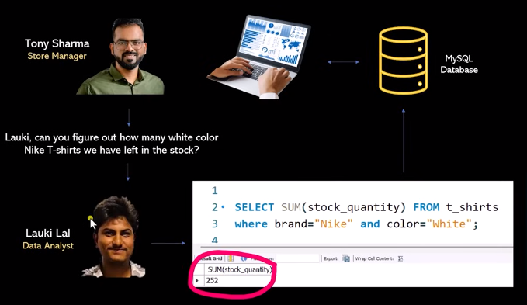
5.1 RAG/SQL Introduction
https://www.youtube.com/watch?v=4wtrl4hnPT8&list=PLeo1K3hjS3uu0N_0W6giDXzZIcB07Ng_F&index=5
RAG/SQL Introduction (02:01-03:00/50:59)
How many white color Nike T-shirts left?

Slide 11
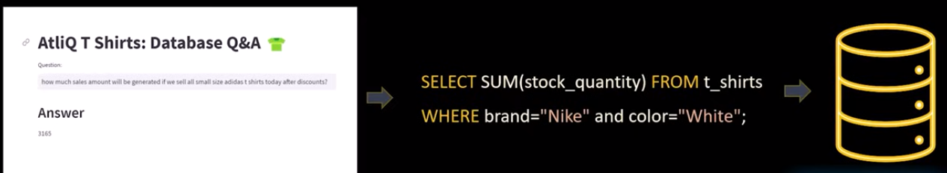
5.1 RAG/SQL Introduction
https://www.youtube.com/watch?v=4wtrl4hnPT8&list=PLeo1K3hjS3uu0N_0W6giDXzZIcB07Ng_F&index=5
RAG/SQL Introduction (03:11-03:22/50:59)
“How much sales amount will be if we sell all small size Adidas t-shirts today after discounts?”
This question need to convert into SQL and get data from database. The answer is “3165”
T-Shirt Database Q&A 👕
Question:
How much sales amount will be if we sell all small size Adidas T-Shirts after discounts
Answer:
3100

Slide 12
5.2 RAG/SQL Architecture

Slide 13
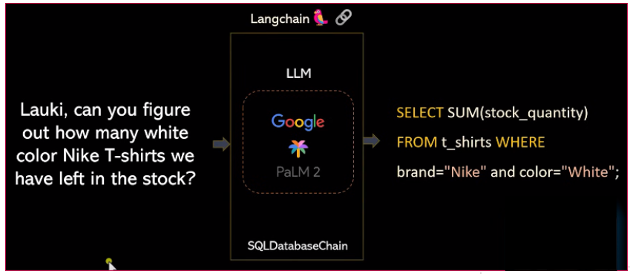
5.2 RAG/SQL Architecture
https://www.youtube.com/watch?v=4wtrl4hnPT8&list=PLeo1K3hjS3uu0N_0W6giDXzZIcB07Ng_F&index=5
RAG/SQL Architecture (03:23-03:40/50:59)
Tony ask question ”Can you figure out how many white color Nike T-shirts we have left in the stock?”
Convert the quesiton into SQL query.
Google Gemini 2 convert the Natural language into SQL.
We use google Gemini from LangChain framework.
Within the LangChain framework, we can use Google Gemini 2 and other types of LLM, such as Llama.
We will use SQL database chain class within the LangChain framework.
This work fine in simple query.

Slide 14
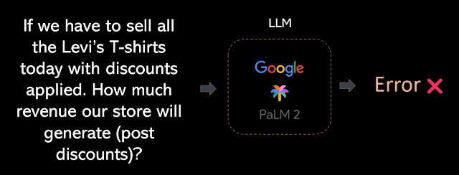
5.2 RAG/SQL Architecture
https://www.youtube.com/watch?v=4wtrl4hnPT8&list=PLeo1K3hjS3uu0N_0W6giDXzZIcB07Ng_F&index=5
RAG/SQL Architecture (03:47-03:50/50:59)
For complicated query, the Google Gemini model sometimes will fail.

Slide 15
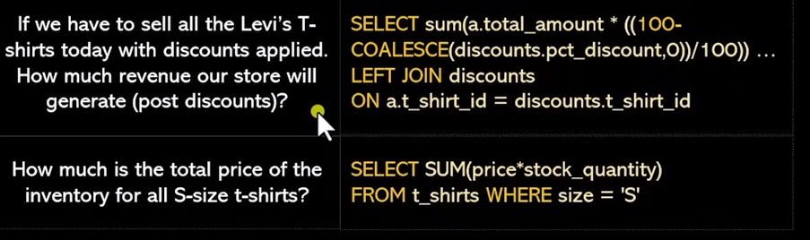
5.2 RAG/SQL Architecture
https://www.youtube.com/watch?v=4wtrl4hnPT8&list=PLeo1K3hjS3uu0N_0W6giDXzZIcB07Ng_F&index=5
RAG/SQL Architecture (04:03-04:30/50:59)
For complicated query, the Google Gemini model sometimes will fail.
We prepare the few-shot learning.
We prepare the sample quesiton and a corresponding SQL query.
We list out all the Google Model fail and prepare the dataset for few-shot learning.
Question:
What is Few-Shot Learning?
What is Few-Shot Learning? Few-Shot Learning is an example of meta-learning, where a learner is trained on several related tasks, during the meta-training phase, so that it can generalize well to unseen (but related) tasks with just a few examples in meta phase.

Slide 16
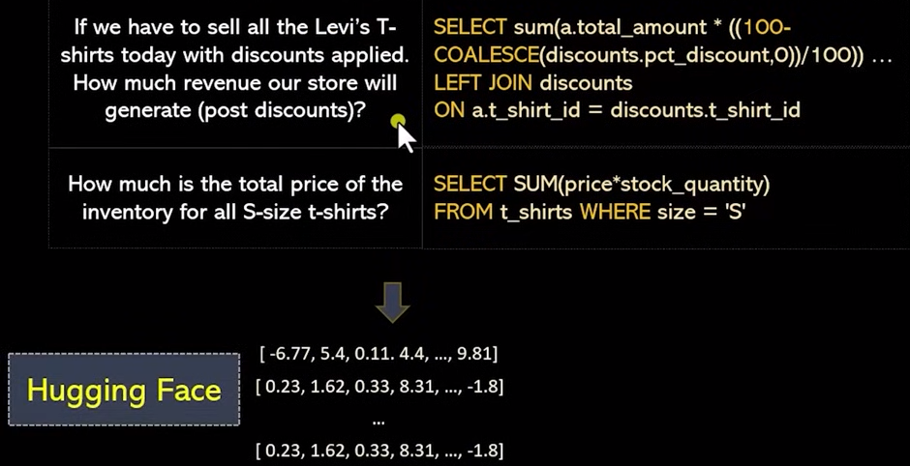
5.2 RAG/SQL Architecture
https://www.youtube.com/watch?v=4wtrl4hnPT8&list=PLeo1K3hjS3uu0N_0W6giDXzZIcB07Ng_F&index=5
RAG/SQL Architecture (04:31-04:50/50:59)
We can have few samples here to convert this training dataset into embedding vector.
Here, we use Hugging Face embeddings.
What is word embedding?
Word embedding (word vector) is defined as a numeric vector input that allows words with similar meanings to have the same representation. Tools, such as, word2vec, etc.
Sentence embedding refers to a numeric representation of a sentence in the form of a vector of real numbers, which encodes meaningful semantic information. It enables comparisons of sentence similarity by measuring the distance or similarity between these vectors.

Slide 17
5.2 RAG/SQL Architecture
https://www.youtube.com/watch?v=4wtrl4hnPT8&list=PLeo1K3hjS3uu0N_0W6giDXzZIcB07Ng_F&index=5
RAG/SQL Architecture (04:31-04:50/50:59)
We can have few samples here to convert this training dataset into embedding vector.
Here, we use Hugging Face embeddings.
What is word embedding?
Word embedding (word vector) is defined as a numeric vector input that allows words with similar meanings to have the same representation. Tools, such as, word2vec, etc.
Sentence embedding refers to a numeric representation of a sentence in the form of a vector of real numbers, which encodes meaningful semantic information. It enables comparisons of sentence similarity by measuring the distance or similarity between these vectors.

Slide 18
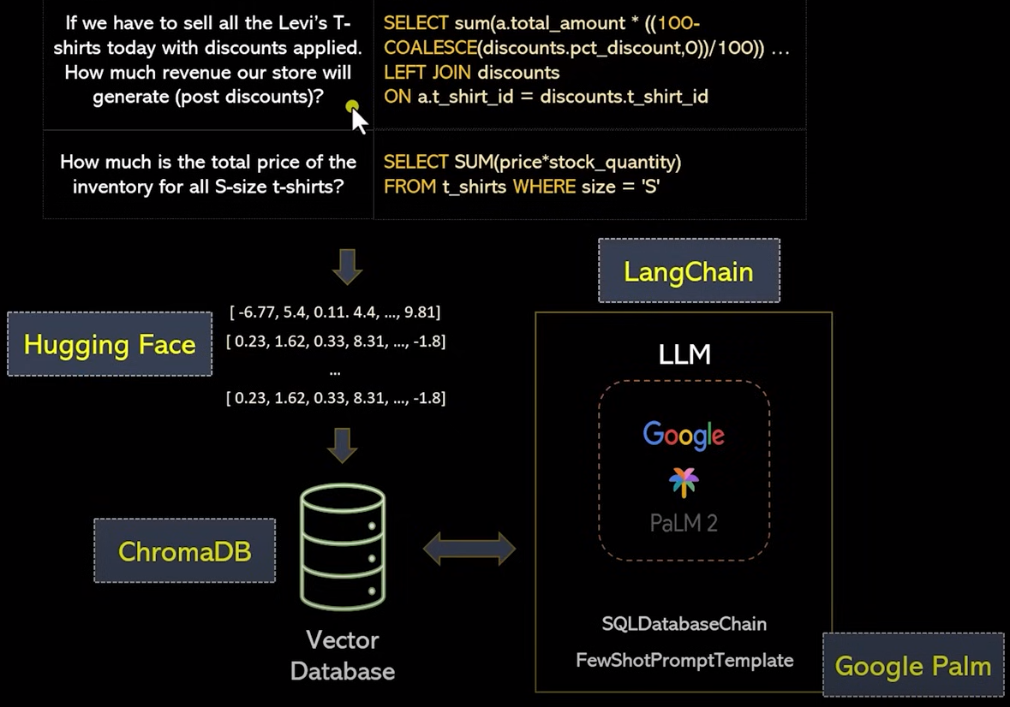
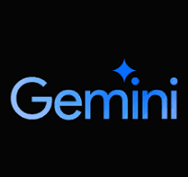
5.2 RAG/SQL Architecture
https://www.youtube.com/watch?v=4wtrl4hnPT8&list=PLeo1K3hjS3uu0N_0W6giDXzZIcB07Ng_F&index=5
RAG/SQL Architecture (04:53-05:10/50:59)
Once embeddings are created, we store them into a vector database.
Here, we use ChromeDB to store the vector database.
We retrieve database by Google Gemini LLM: We uses Hugging Face LangChain which provides FewShotPromptTemplate to create the SQLDatabaseChain.
Gemini

Slide 19
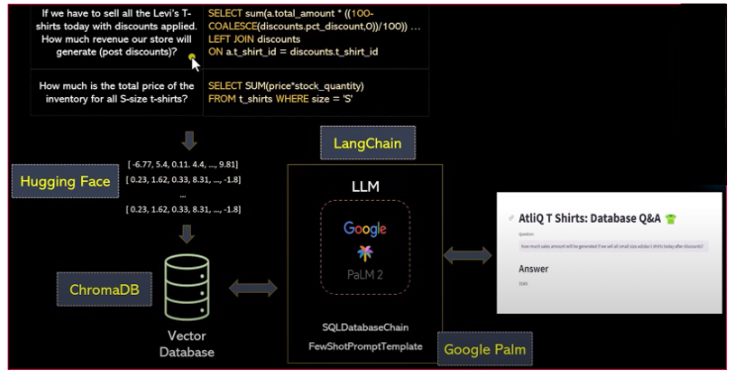
5.2 RAG/SQL Architecture
https://www.youtube.com/watch?v=4wtrl4hnPT8&list=PLeo1K3hjS3uu0N_0W6giDXzZIcB07Ng_F&index=5
RAG/SQL Architecture (04:53-05:30/50:59)
Lastly, we will build the GUI by streamlit.

Slide 20
5.3 Gemini API Key

Slide 21

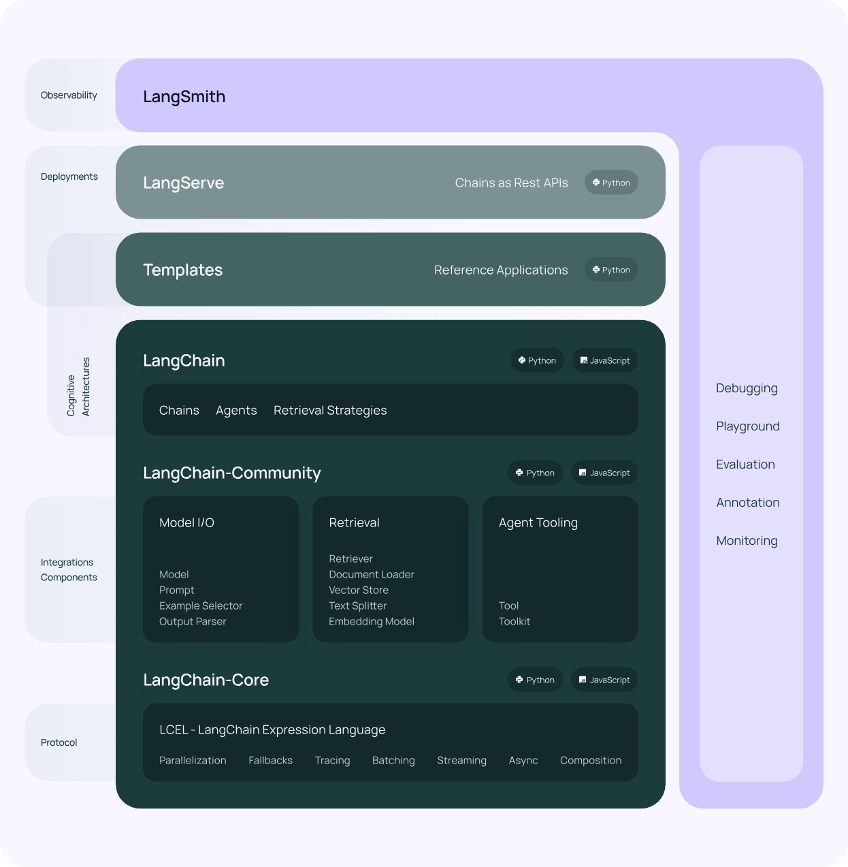
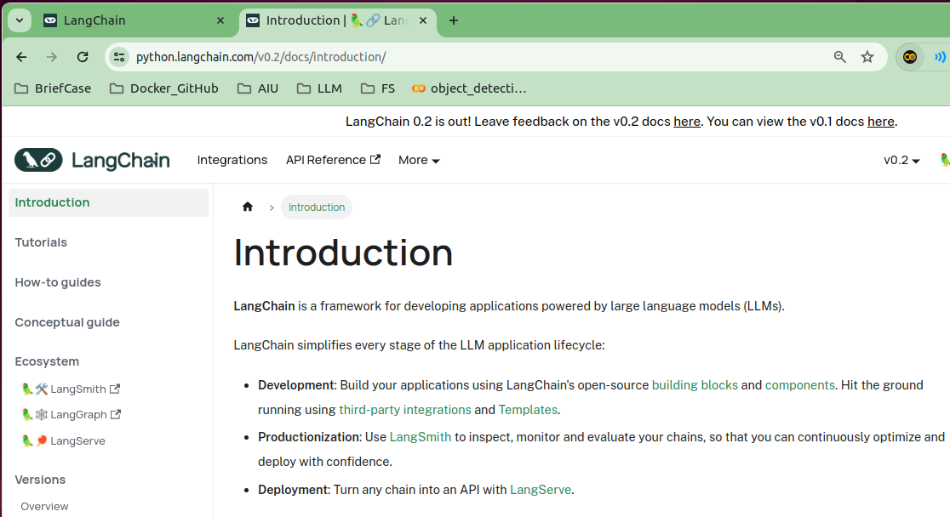
5.3 Gemini API Key
https://www.youtube.com/watch?v=4wtrl4hnPT8&list=PLeo1K3hjS3uu0N_0W6giDXzZIcB07Ng_F&index=5
Gemini API Key (05:31-06:30/50:59)
We talk Gemini API Key, LangChain Basics, Google Gemini API Key, and Vector Database.
LangChain is a framework for developing applications with LLMs (Large Language Models).

Slide 22
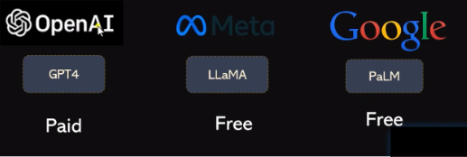
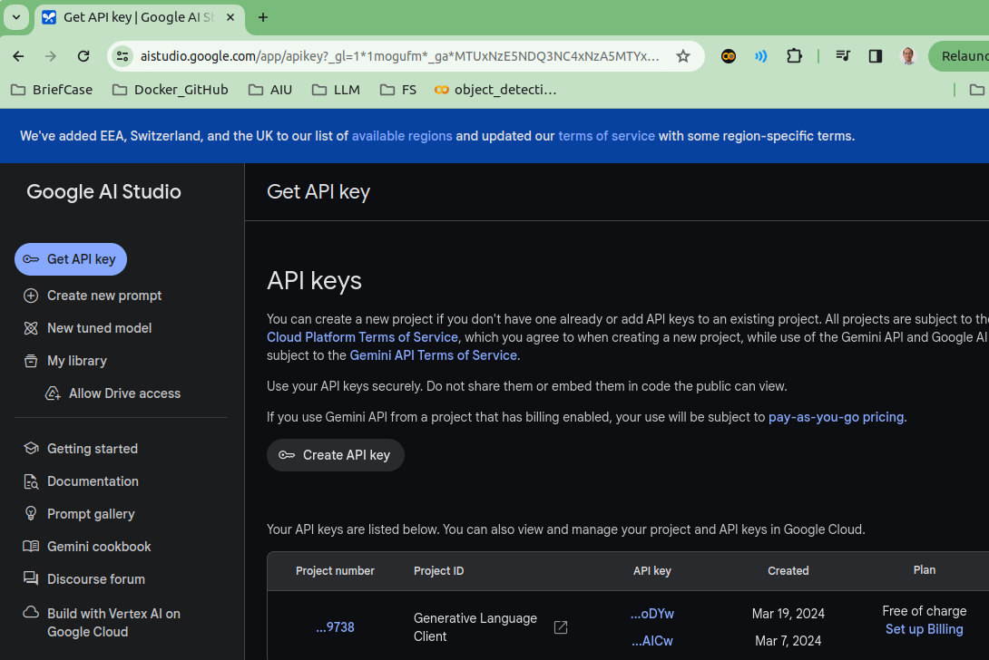

5.3 Gemini API Key
https://www.youtube.com/watch?v=4wtrl4hnPT8&list=PLeo1K3hjS3uu0N_0W6giDXzZIcB07Ng_F&index=5
Gemini API Key (06:31-07:30/50:59)
When we build LLM application, we have three popular options: OpenAI GPT4, Meta Llama, and Google Gemini.
GPT4 is charge, Llama is free but hard to setup and download, google server is free and easy to setup.
To use Google Gemini, you need to step google account and get the google API Key.
https://aistudio.google.com/app/apikey

Slide 23
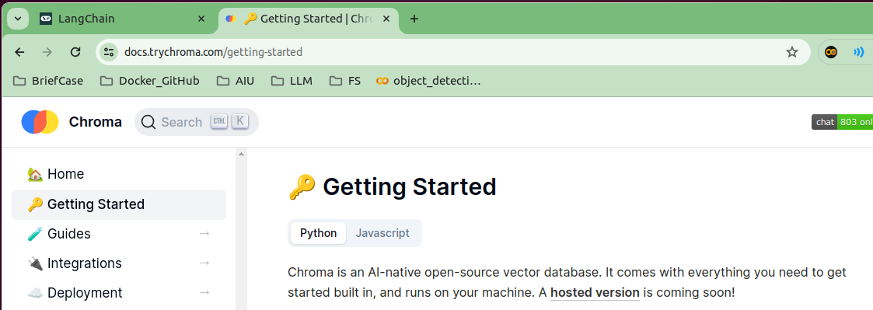
5.3 Gemini API Key
https://www.youtube.com/watch?v=4wtrl4hnPT8&list=PLeo1K3hjS3uu0N_0W6giDXzZIcB07Ng_F&index=5
Gemini API Key (07:31-08:00/50:59)
Chroma DB is mainly used in documents, i.e., NLP based database.
The NLP based Database required Vector Database (One-Hot-Encoding Vector Database) which is different from traditional SQL based Query.
https://docs.trychroma.com/getting-started

Slide 24
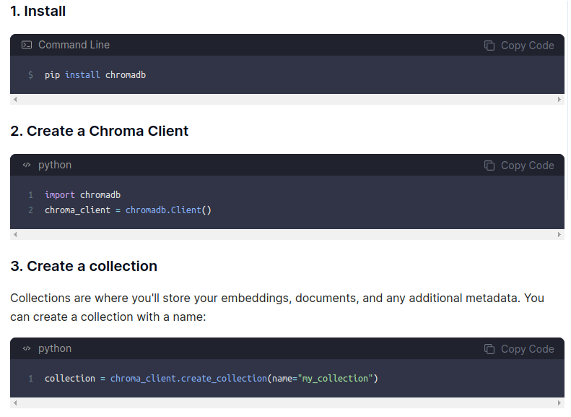
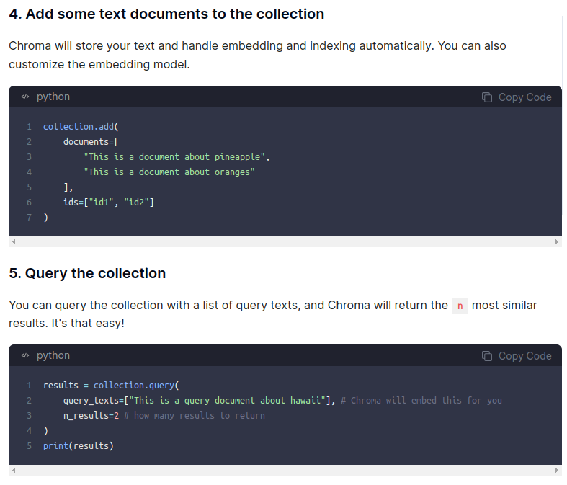
5.3 Gemini API Key
https://www.youtube.com/watch?v=4wtrl4hnPT8&list=PLeo1K3hjS3uu0N_0W6giDXzZIcB07Ng_F&index=5
Gemini API Key (08:01-08:15/50:59)
We can use chroma DB to create client, create collection, create documents, query, etc.
https://docs.trychroma.com/getting-started

Slide 25
End

