Slide 1

1.08 Agent
Peter H. Chen

Slide 2


1.08 Agent
https://www.youtube.com/watch?v=nAmC7SoVLd8&list=PLeo1K3hjS3uu0N_0W6giDXzZIcB07Ng_F&index=1
Agent (27:31-27:40/46:07)
Agent is very powerful concept in LangChain.
What is LangChain Agent?
1. The core idea of agents is to use a language model to choose a sequence of actions to take.
2. In chains, a sequence of actions is hard-coded (in code).
3. In agents, a language model is used as a reasoning engine to determine which actions to take and in which order.

Slide 3
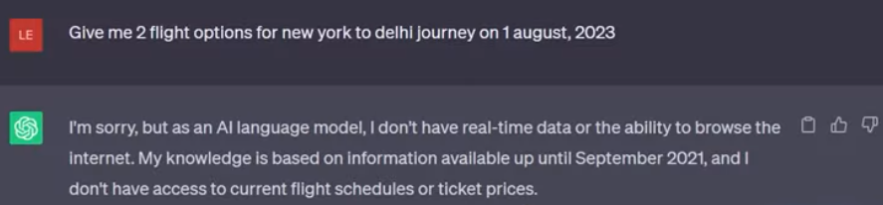
1.08 Agent
https://www.youtube.com/watch?v=nAmC7SoVLd8&list=PLeo1K3hjS3uu0N_0W6giDXzZIcB07Ng_F&index=1
Agent (27:47-27:50/46:07)
What happens to “Give me 2 flight options from New York to Delhi on August 1, 2023”?
Obviously, GPT does not have knowledge to answer. GPT does not have knowledge of September, 2021.

Slide 4


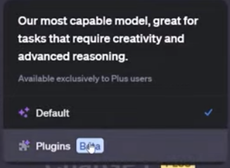
1.08 Agent
https://www.youtube.com/watch?v=nAmC7SoVLd8&list=PLeo1K3hjS3uu0N_0W6giDXzZIcB07Ng_F&index=1
Agent (27:51-28:00/46:07)
Let see how ChatGPT Plus solve the problem.
1. ChatGPT has plugins that you have to install first.
2. You can easily plugin the knowledge after September, 2021.
3. Here, we install the Expedia plugin.
1
3
2

Slide 5
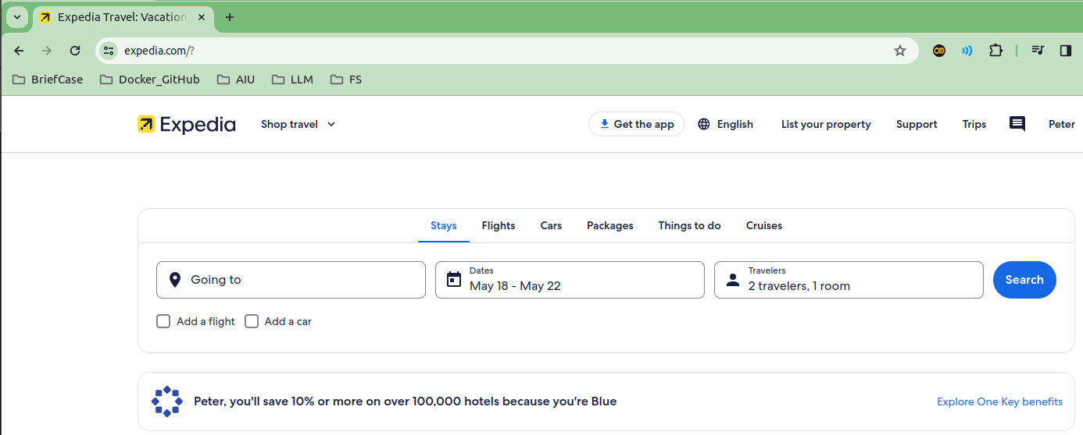
1.08 Agent
https://www.youtube.com/watch?v=nAmC7SoVLd8&list=PLeo1K3hjS3uu0N_0W6giDXzZIcB07Ng_F&index=1
Agent (28:01-28:10/46:07)
1. Expedia Inc. is an online travel agency owned by Expedia Group, based in Seattle.
2. The website and mobile app can be used to book airline tickets, hotel reservations, car rentals, cruise ships, and vacation packages.
3. Expedia.com was launched on October 22, 1996 by Microsoft.

Slide 6

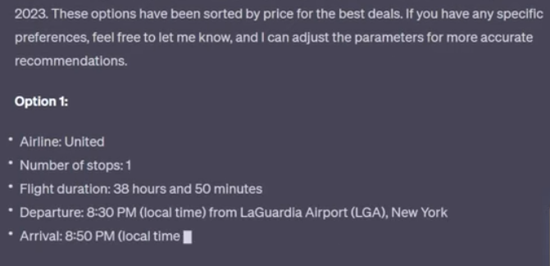
1.08 Agent
https://www.youtube.com/watch?v=nAmC7SoVLd8&list=PLeo1K3hjS3uu0N_0W6giDXzZIcB07Ng_F&index=1
Agent (28:11-28:30/46:07)
ChatGPT try to pull out the information from Expedia.

Slide 7
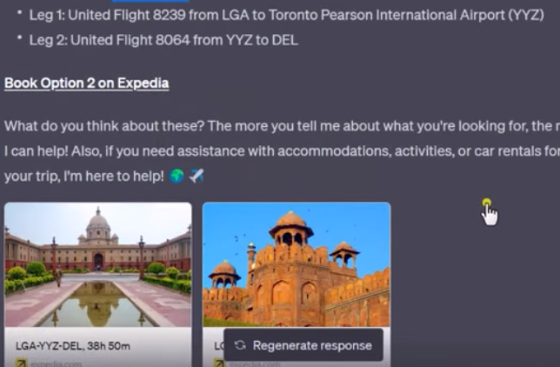
1.08 Agent
https://www.youtube.com/watch?v=nAmC7SoVLd8&list=PLeo1K3hjS3uu0N_0W6giDXzZIcB07Ng_F&index=1
Agent (28:51-29:10/46:07)
ChatGPT plus can acquire knowledge from Expedia.

Slide 8
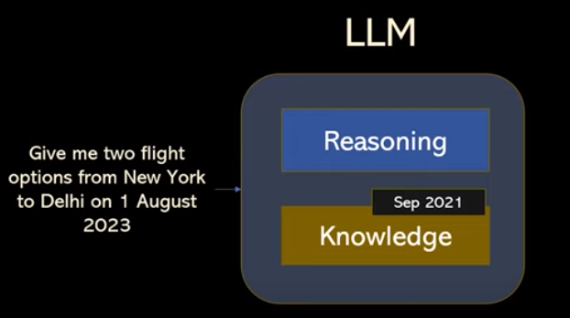
1.08 Agent
https://www.youtube.com/watch?v=nAmC7SoVLd8&list=PLeo1K3hjS3uu0N_0W6giDXzZIcB07Ng_F&index=1
Agent (29:11-29:50/46:07)
GPT Knowledge stops at September, 2021.
However, GPT has reasoning engine.
The reasoning engine let GPT figure out the data after he is train.
ChatGPT Agent has to go to Expedia to find out the answer of the trip.

Slide 9
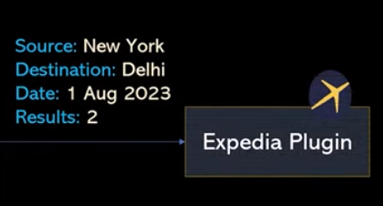
1.08 Agent
https://www.youtube.com/watch?v=nAmC7SoVLd8&list=PLeo1K3hjS3uu0N_0W6giDXzZIcB07Ng_F&index=1
Agent (29:51-30:10/46:07)
From the reasoning agent, ChatGPT Agent will figure it out the answer from Expedia.

Slide 10
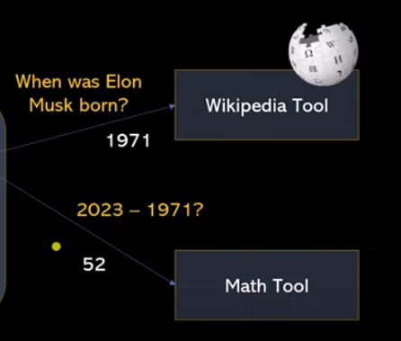
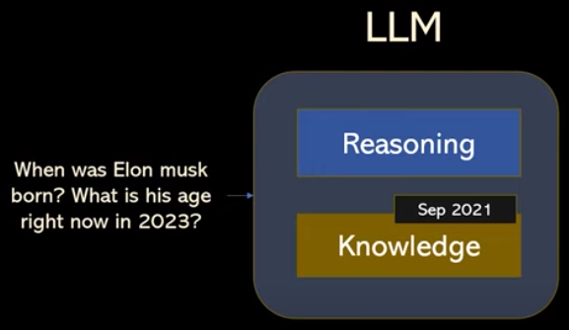
1.08 Agent
https://www.youtube.com/watch?v=nAmC7SoVLd8&list=PLeo1K3hjS3uu0N_0W6giDXzZIcB07Ng_F&index=1
Agent (30:11-31:10/46:07)
LLM does not have knowledge after September 2021.
1. ChatGPT uses agent to help and fetch data from Wikipedia tool to find out the Elon Musk age. Elon Musk is born in 1971.
2. There is another math tool to calculate “2023 – 1971 = 52”
The agent will connect to external tool. GPT uses LLM reasoning capabilities to perform the give task.

Slide 11
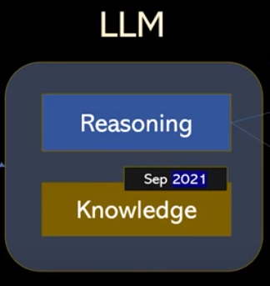
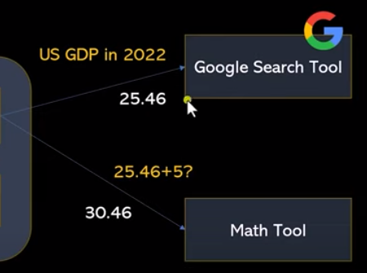

1.08 Agent
https://www.youtube.com/watch?v=nAmC7SoVLd8&list=PLeo1K3hjS3uu0N_0W6giDXzZIcB07Ng_F&index=1
Agent (31:11-31:50/46:07)
LLM does not have knowledge after September 2021.
1. GPT goes to google to find the answer (25.46).
2. Answer + 5 (= 30.46).
This google search tool is available in LangChain.
The LLM does not have answer. But agent can find the answer for us.

Slide 12
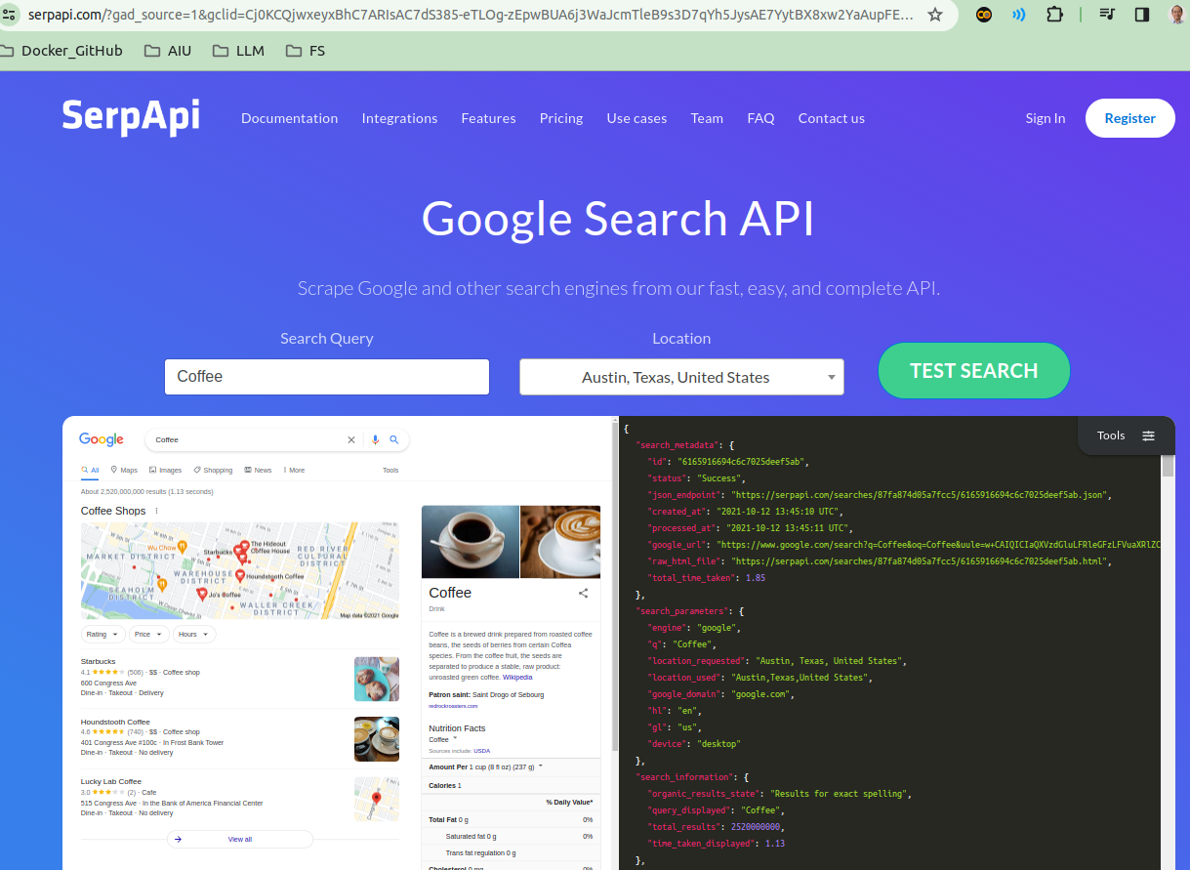
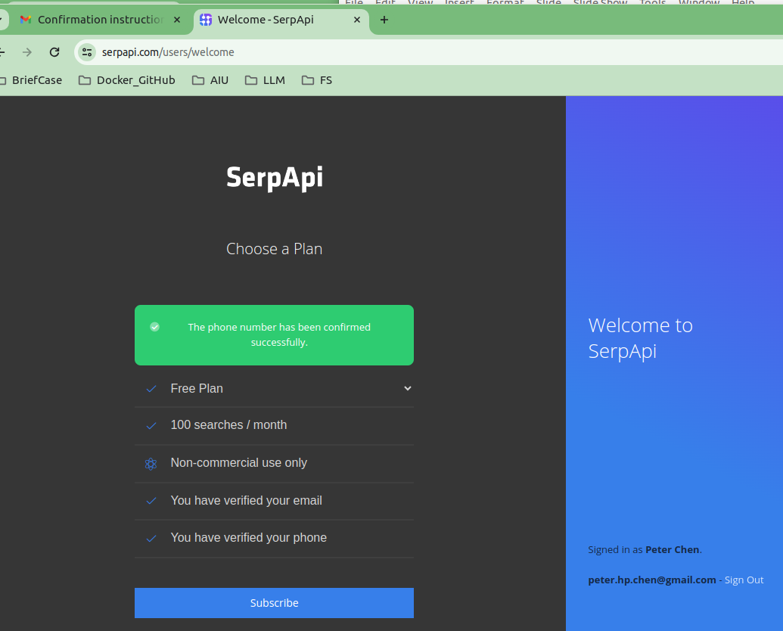
1.08 Agent
https://www.youtube.com/watch?v=nAmC7SoVLd8&list=PLeo1K3hjS3uu0N_0W6giDXzZIcB07Ng_F&index=1
Agent (31:51-31:52/46:07)
What is google SerpAPI?
You need to sign in google serpapi before you can use it.
1. Verify it with gmail and
2. Verify phone number.

Slide 13
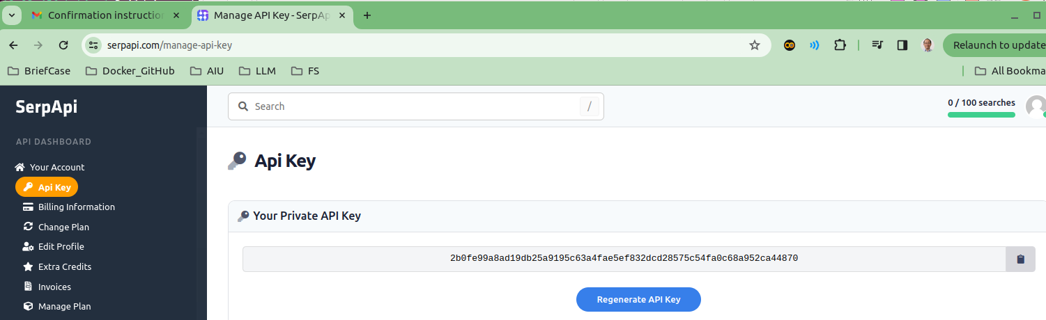
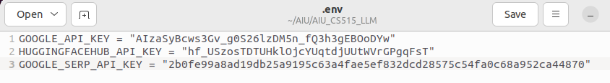
1.08 Agent
https://www.youtube.com/watch?v=nAmC7SoVLd8&list=PLeo1K3hjS3uu0N_0W6giDXzZIcB07Ng_F&index=1
Agent (31:53-31:54/46:07)
Generate Google serp API Key and put in GOOGLE_SERP_API_KEY the “env” file.

Slide 14
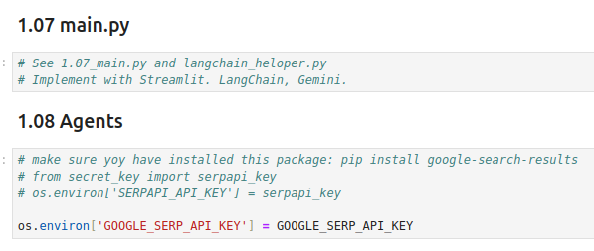
1.08 Agent
https://www.youtube.com/watch?v=nAmC7SoVLd8&list=PLeo1K3hjS3uu0N_0W6giDXzZIcB07Ng_F&index=1
Agent (31:56-32:10/46:07)
1. Assign GOOGLE_SERP_API_KEY
2. install google-search-results and numexp for LangChain math

Slide 15
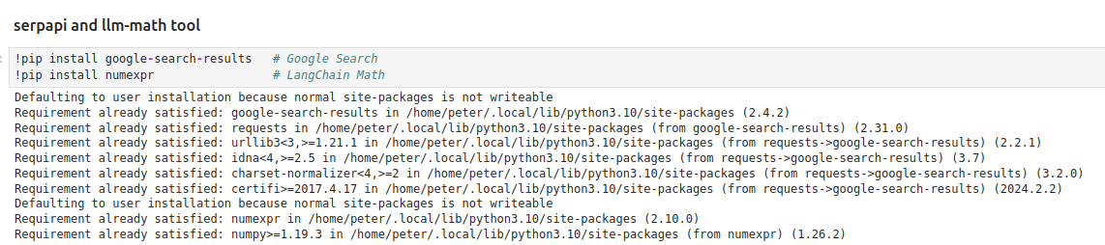
1.08 Agent
https://www.youtube.com/watch?v=nAmC7SoVLd8&list=PLeo1K3hjS3uu0N_0W6giDXzZIcB07Ng_F&index=1
Agent (32:11-33:30/46:07)
1. Install the Google Serp (Real-time Search Platform): Google Serp required API Key.
2. Install LangChain Math Tools: Math Tool uses HuggingFace API Key.

Slide 16
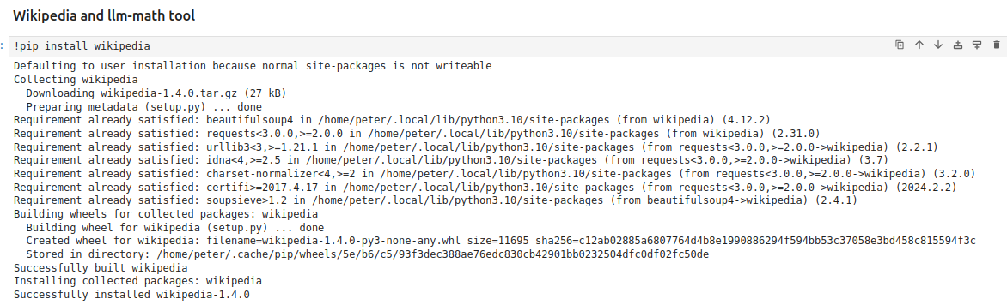
1.08 Agent
https://www.youtube.com/watch?v=nAmC7SoVLd8&list=PLeo1K3hjS3uu0N_0W6giDXzZIcB07Ng_F&index=1
Agent (33:31-34:30/46:07)
Install wikipedia to find “Elon Musk Age” with Agent.

Slide 17
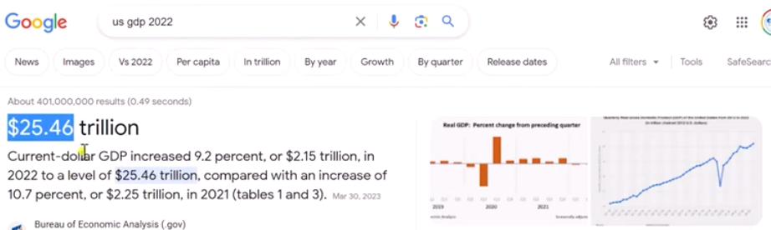
1.08 Agent
https://www.youtube.com/watch?v=nAmC7SoVLd8&list=PLeo1K3hjS3uu0N_0W6giDXzZIcB07Ng_F&index=1
Agent (34:31-35:30/46:07)
We google the answer.

Slide 18
1.08 Agent
https://www.youtube.com/watch?v=nAmC7SoVLd8&list=PLeo1K3hjS3uu0N_0W6giDXzZIcB07Ng_F&index=1
Agent (35:31-36:30/46:07)
We verify the GPT Agent answer get from Google Serp API.

Slide 19
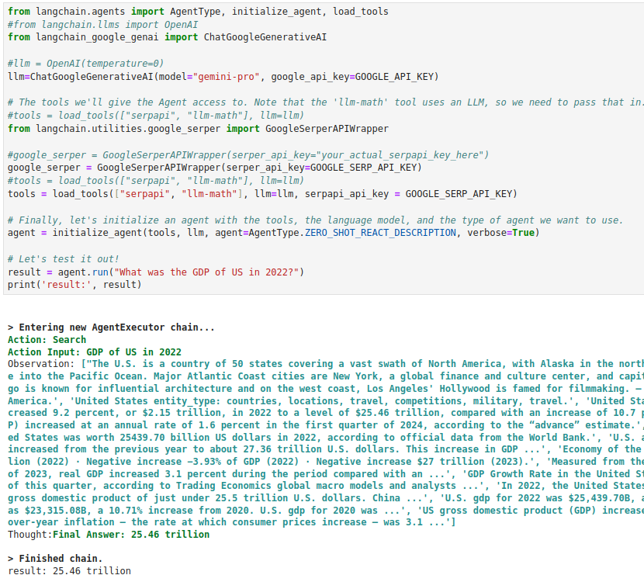
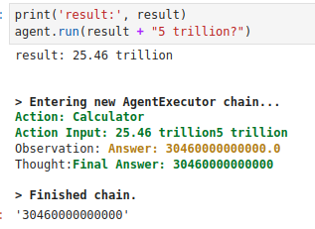
1.08 Agent
https://www.youtube.com/watch?v=nAmC7SoVLd8&list=PLeo1K3hjS3uu0N_0W6giDXzZIcB07Ng_F&index=1
Agent (33:31-34:30/46:07)
“USA 2022 GDP” + “5 trillion”
1. Google Serp (Google Real-Time Search Platform) to find US GDP 2022.
2. LangChain Math Tool: to do ”+5 Trillion” calculation.

Slide 20
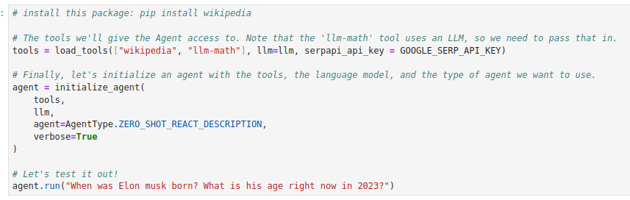
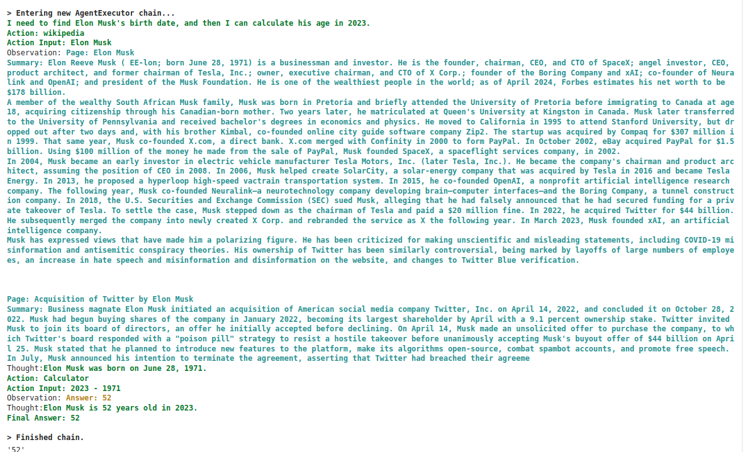
1.08 Agent
https://www.youtube.com/watch?v=nAmC7SoVLd8&list=PLeo1K3hjS3uu0N_0W6giDXzZIcB07Ng_F&index=1
Agent (34:31-35:20/46:07)
Find “Elon Musk Age” with Agent.

Slide 21
End

