Slide 1

5 Deploy LC on HF
Peter H. Chen

Slide 2
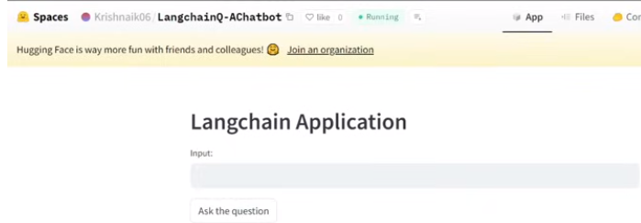
5 Deploy LC on HF
https://www.youtube.com/watch?v=qMIM7dECAkc&list=PLZoTAELRMXVORE4VF7WQ_fAl0L1Gljtar&index=5
Deploy LC on HF (00:00-01:30/1:18:23)
We discussed the important components in the LangChain.
We
1. Create projects and
2. deploy on HuggingFace Space.

Slide 3
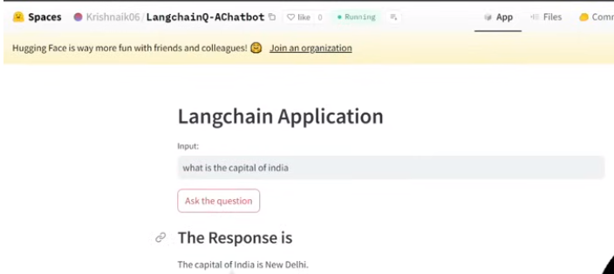
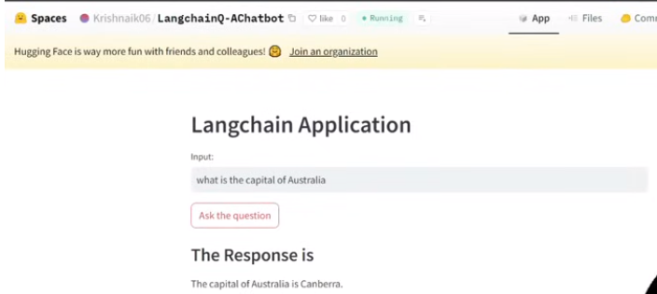
5 Deploy LC on HF
https://www.youtube.com/watch?v=qMIM7dECAkc&list=PLZoTAELRMXVORE4VF7WQ_fAl0L1Gljtar&index=5
Deploy LC on HF (01:31-02:20/1:18:23)
We hos the LangChain Application on the HuggingFace.
We ask the quesiton and answer chatbot and host on HuggingFace

Slide 4
5.01 Agenda: Host LC Q&A on HF

Slide 5
5.01 Agenda: Deploy LC on HF
https://www.youtube.com/watch?v=qMIM7dECAkc&list=PLZoTAELRMXVORE4VF7WQ_fAl0L1Gljtar&index=5
Agenda: Deploy LC on HF (02:21-03:50/1:18:23)
Agenda: Deploy LangChain on HuggingFace
1. Create Google API Key and Setup Environment
2. Build simple application with
2.1 LLM and Chat Model
2.2 Prompt Templates
2.3 Output Parser: PromptTemplate + LLM + OutputParser.

Slide 6
5.02 Create Google API Key

Slide 7
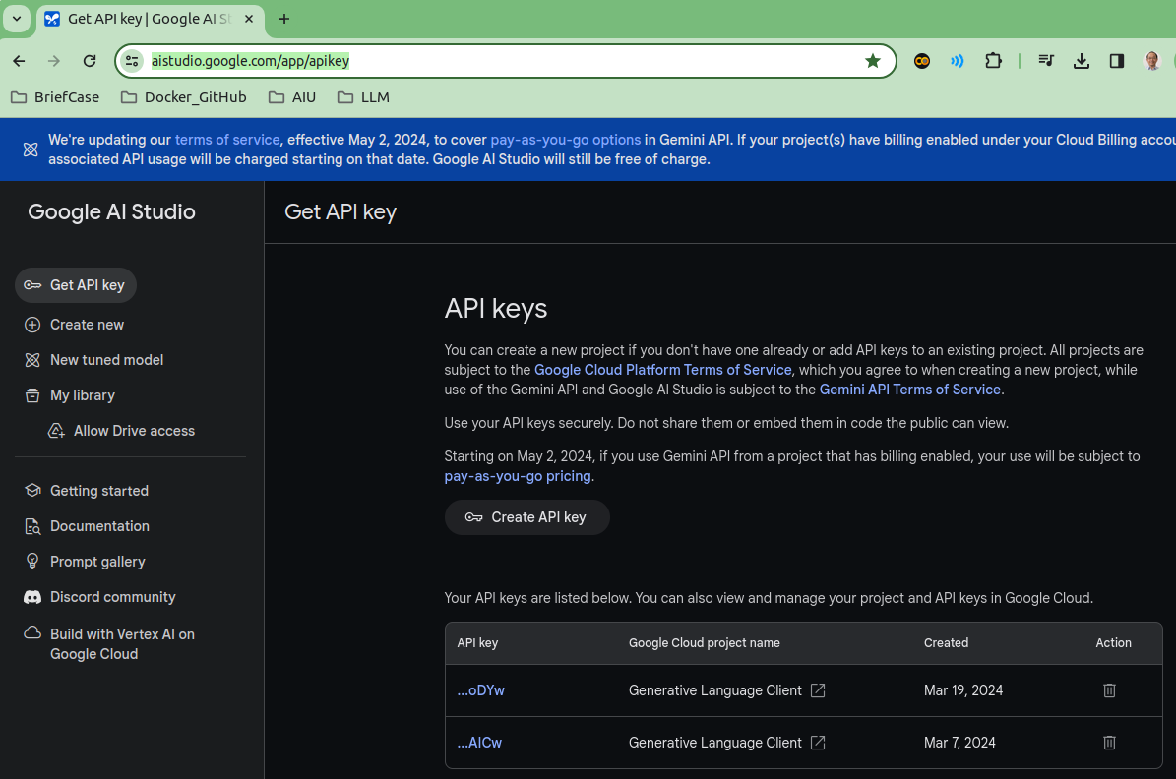
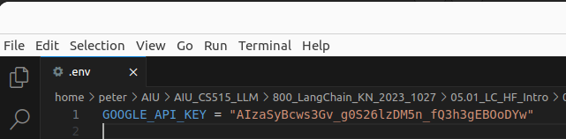
5.02 Create Google API Key
https://www.youtube.com/watch?v=qMIM7dECAkc&list=PLZoTAELRMXVORE4VF7WQ_fAl0L1Gljtar&index=5
Create Google API Key (03:51-05:30/1:18:23)
First, we create the Google API Key.
https://aistudio.google.com/app/apikey

Slide 8
5.03 Create Conda Environment

Slide 9

5.03 Create Conda Environment
https://www.youtube.com/watch?v=qMIM7dECAkc&list=PLZoTAELRMXVORE4VF7WQ_fAl0L1Gljtar&index=5
Create Conda Environment (05:31-06:30/1:18:23)
Create the conda environment
> conda create --name gemini
> conda activate gemini
> conda deactivate # exit conda environment

Slide 10
5.04 Install Requirements.txt

Slide 11
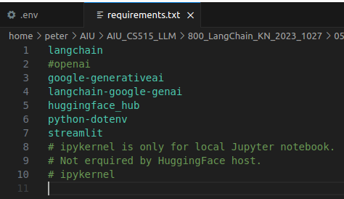
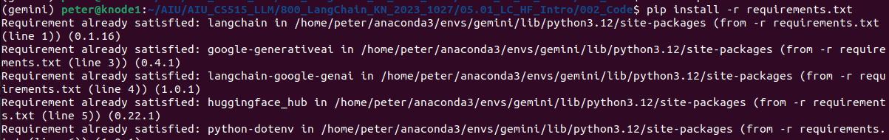
5.04 Install Requirements.txt
https://www.youtube.com/watch?v=qMIM7dECAkc&list=PLZoTAELRMXVORE4VF7WQ_fAl0L1Gljtar&index=5
Install Requirements.txt (06:31-09:30/1:18:23)
Now, we create the the requirements.txt
1. langchain
2. google-generativeai: Gemini
3. langchain-google-genai: LangChain functions for Gemini integration.
4. huggingface_hub: HuggingFace tools
5. python-dotenv: Python read environment variable from “.env” file.
6. streamlit: GUI
Install requirements.txt
> pip install -r requirements.txt

Slide 12
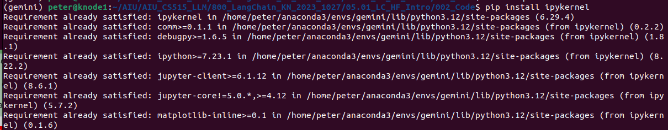
5.04 Install Requirements.txt
https://www.youtube.com/watch?v=qMIM7dECAkc&list=PLZoTAELRMXVORE4VF7WQ_fAl0L1Gljtar&index=5
Install Requirements.txt (09:31-10:10/1:18:23)
Install local Jupyter Notebook
> pip install ipykernel # for local jupyter notebook

Slide 13
5.05 LC Example: Gemini

Slide 14
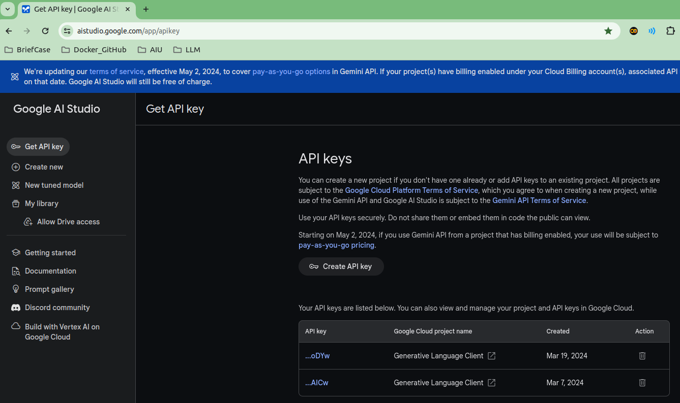
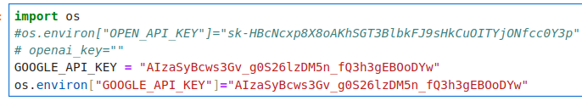
5.05 LC Example 1: Gemini
https://www.youtube.com/watch?v=qMIM7dECAkc&list=PLZoTAELRMXVORE4VF7WQ_fAl0L1Gljtar&index=5
Setup API Key (10:31-10:30/1:18:23)
Search “Setup Google API Key”. Copy and Paste the Google API Key.
https://aistudio.google.com/app/apikey

Slide 15
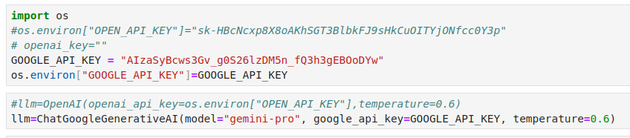
5.05 LC Example: Gemini
https://www.youtube.com/watch?v=qMIM7dECAkc&list=PLZoTAELRMXVORE4VF7WQ_fAl0L1Gljtar&index=5
Import Gemini (10:31-15:30/1:18:23)
Load Gemini Model and temperature = 0.6.
What is temperature for Gemini model?
1. The temperature parameter controls how creative Gemini is. The temperature must be between 0.0 and 1.0. A value closer to 1.0 will generate responses that are more creative, and a value closer to 0.0 will usually result in more standard responses.
2. By default the model values are temperature=0.9,

Slide 16
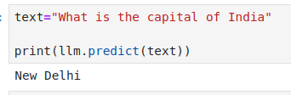
5.05 LC Example: Gemini
https://www.youtube.com/watch?v=qMIM7dECAkc&list=PLZoTAELRMXVORE4VF7WQ_fAl0L1Gljtar&index=5
Test LLM (15:31-17:00/1:18:23)

Slide 17
End

