Slide 1

03 LC: Prompt Engineering
Peter H. Chen

Slide 2
03 LC: Prompt Engineering
https://www.youtube.com/watch?v=t2bSApmPzU4&list=PLZoTAELRMXVORE4VF7WQ_fAl0L1Gljtar&index=3
LC: Prompt Engineering (0:00-00:30/17:18)
We discuss the prompt engineering using LangChain.
Prompt Engineering is very important for LLM Model.
Prompt helps us to design the input the model that you want to have a conversation with LLM Model.
In the previous discussion, we create a simple search application like a chatBot using LangChain.

Slide 3
03.01 LC: Prompt

Slide 4
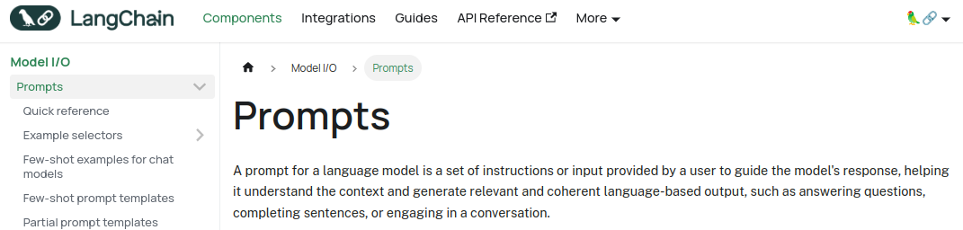
03.01 LC: Prompt
https://www.youtube.com/watch?v=t2bSApmPzU4&list=PLZoTAELRMXVORE4VF7WQ_fAl0L1Gljtar&index=3
LC: Prompt (0:31-01:00/17:18)
What is LangChain Prompt?
We design the prompt for LLM conversation.
LangChain defines Prompt:
A prompt for a language model is
1. A set of instructions or Input provided by a user to guide the model's response,
2. Help Language Model understand the context and
3. Generate relevant and coherent language-based output, such as answering questions, completing sentences, or engaging in a conversation.
https://python.langchain.com/docs/modules/model_io/prompts/

Slide 5
End

