Slide 1

03.02 Google API Key
Peter H. Chen

Slide 2
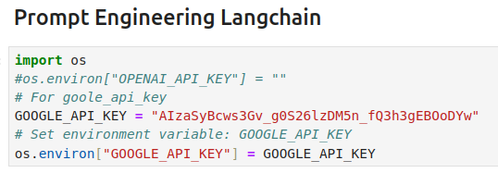
03.02 Google API Key
https://www.youtube.com/watch?v=t2bSApmPzU4&list=PLZoTAELRMXVORE4VF7WQ_fAl0L1Gljtar&index=3
Google API Key (1:11-01:50/17:18)
First, we assign the GOOGLE_API_KEY.
Later on, we may need other key, such as, GOOGLE_SERP_KEY for other projects.

Slide 3
03.03 Import Libraries

Slide 4
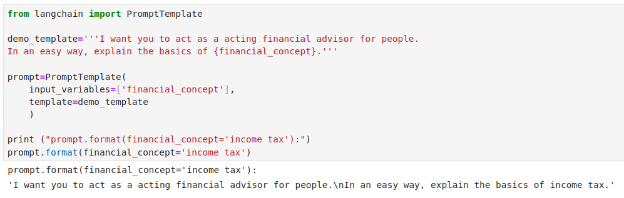
03.03 Import Libraries
https://www.youtube.com/watch?v=t2bSApmPzU4&list=PLZoTAELRMXVORE4VF7WQ_fAl0L1Gljtar&index=3
Import Libraries (1:51-05:10/17:18)
Here, we create prompt_template topic:
1. prompt template
2. we assign the top {financial_concept}
We create prompt:
1. input_variables
2. template
Prompt Template format: We assign variable {financial_concept} into “income tax”.

Slide 5
03.04 LLM Model and LLMChain

Slide 6
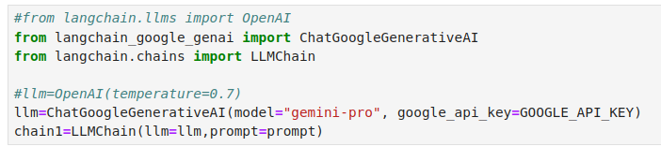
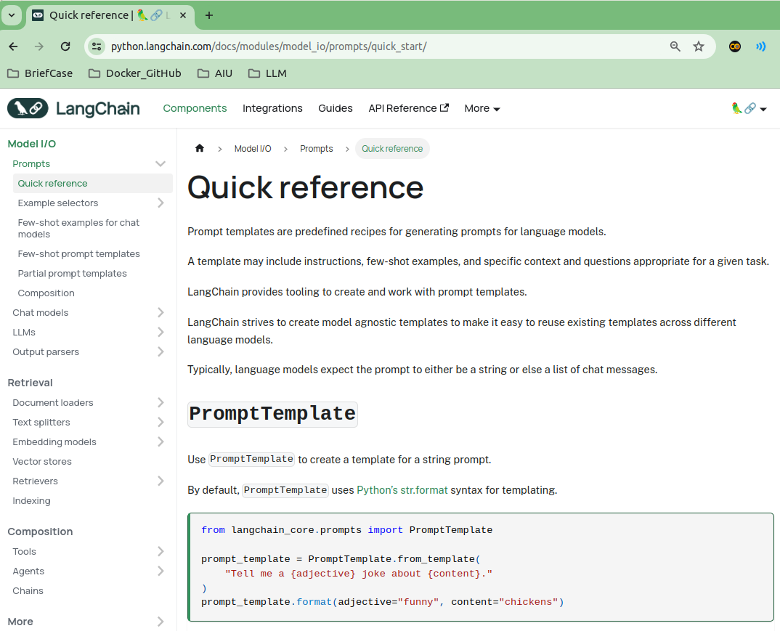
03.04 LLM Model and LLMChain
https://www.youtube.com/watch?v=t2bSApmPzU4&list=PLZoTAELRMXVORE4VF7WQ_fAl0L1Gljtar&index=3
LLM Model and LLMChain (5:11-07:00/17:18)
We
1. Load the Google Gemini Model: Higher temperature is more creative and diversify. Teh default temperature = 0.7.
2. Create chain with LLM model and Prompt.
LLMChain has a lot of prompt examples.
We can read and use them.

Slide 7
03.05 LLMChain Run

Slide 8
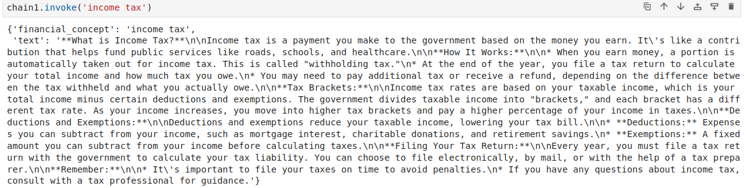
03.05 LLMChain Run
https://www.youtube.com/watch?v=t2bSApmPzU4&list=PLZoTAELRMXVORE4VF7WQ_fAl0L1Gljtar&index=3
LLMChain Run (7:01-08:10/17:18)
We run LLMChain with invoke(‘income tax’).

Slide 9
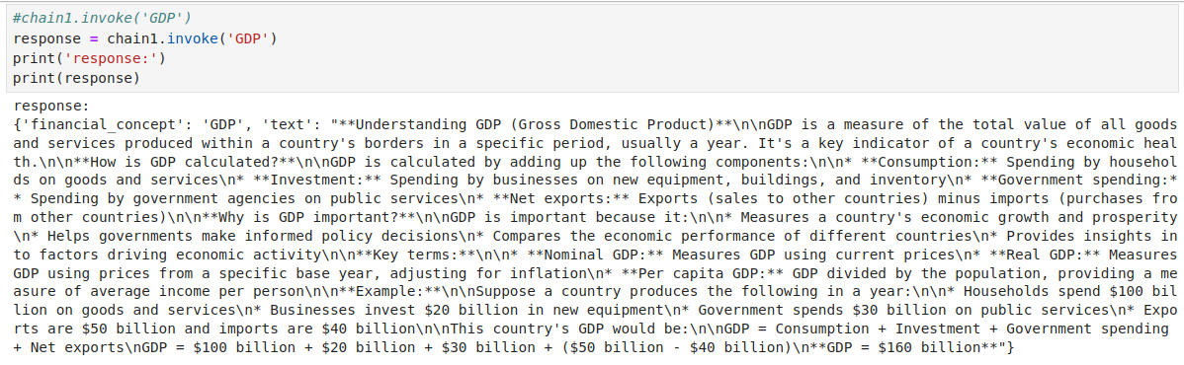
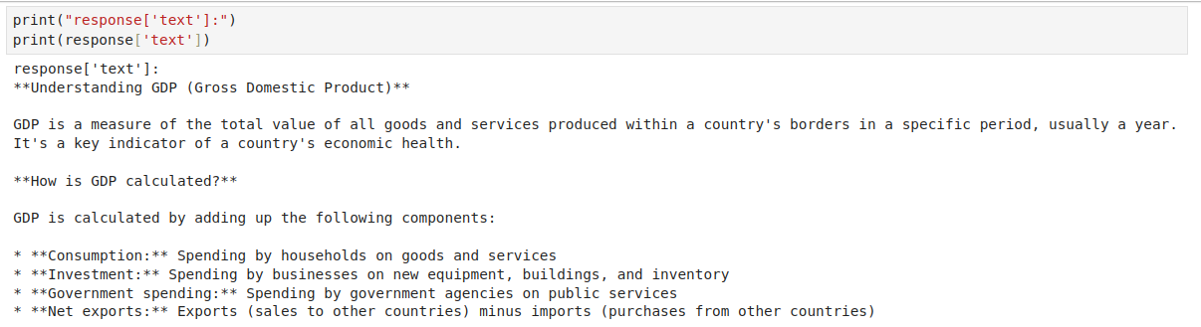
03.05 LLMChain Run
https://www.youtube.com/watch?v=t2bSApmPzU4&list=PLZoTAELRMXVORE4VF7WQ_fAl0L1Gljtar&index=3
LLMChain Run (8:11-08:30/17:18)
We can check GDP with LLMChain with invoke(‘GDP’).

Slide 10
03.06 Language Translation

Slide 11
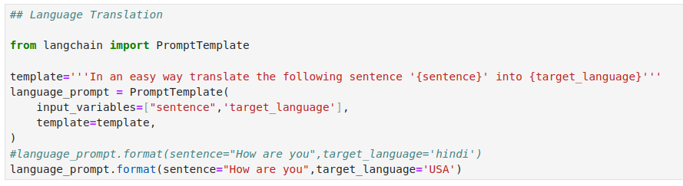
03.06 Language Translation
https://www.youtube.com/watch?v=t2bSApmPzU4&list=PLZoTAELRMXVORE4VF7WQ_fAl0L1Gljtar&index=3
Language Translation (8:31-11:30/17:18)
We can create a template with two parameters: {sentence} and {target_language}
Input variables: {‘sentence’, ‘target_language’}

Slide 12
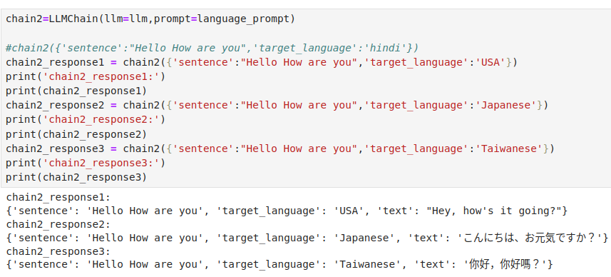
03.06 Language Translation
https://www.youtube.com/watch?v=t2bSApmPzU4&list=PLZoTAELRMXVORE4VF7WQ_fAl0L1Gljtar&index=3
Language Translation (11:31-13:30/17:18)
We can create a template with two parameters: {sentence} and {target_language}
Input variables: {‘sentence’, ‘target_language’}

Slide 13
03.07 Few Shots Prompt

Slide 14
03.07 Few Shots Prompt
https://www.youtube.com/watch?v=t2bSApmPzU4&list=PLZoTAELRMXVORE4VF7WQ_fAl0L1Gljtar&index=3
Few Shots Prompt (8:31-8:50/17:18)
What is the “Few Shots Prompt”?
The goal of few-shot prompt templates are to dynamically select examples for Model to learn and ask LLM model based on the few shots examples.

Slide 15
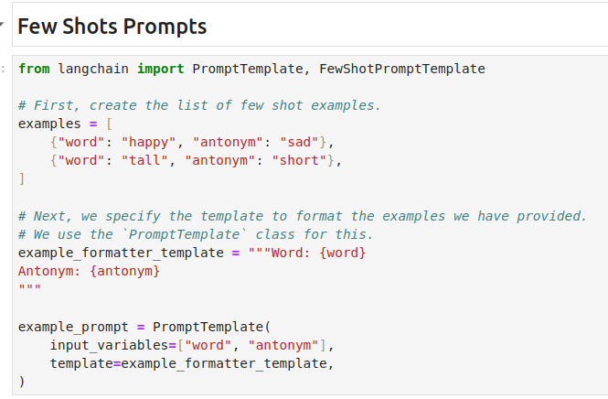
03.07 Few Shots Prompt
https://www.youtube.com/watch?v=t2bSApmPzU4&list=PLZoTAELRMXVORE4VF7WQ_fAl0L1Gljtar&index=3
Few Shots Prompt (8:51-14:10/17:18)
Here, we define “antonym” and ask Gemini to learn with few shots.
1. Create dictionary list {key: value} of shot
2. Create template format with dictionary list.
3. Create Prompt Template: Input variables and template format.

Slide 16
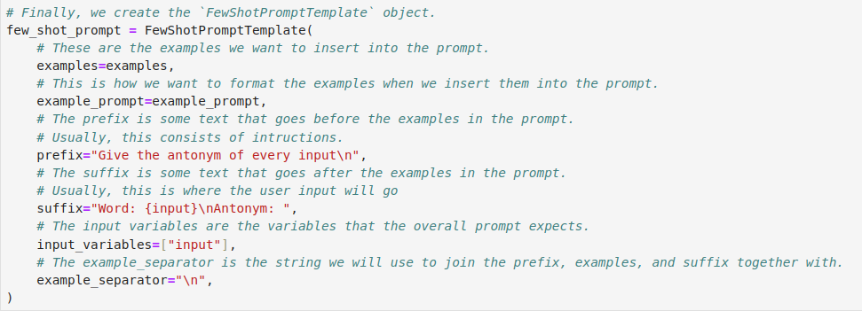
03.07 Few Shots Prompt
https://www.youtube.com/watch?v=t2bSApmPzU4&list=PLZoTAELRMXVORE4VF7WQ_fAl0L1Gljtar&index=3
Few Shots Prompt (14:11-15:10/17:18)
We create few shot prompt template.
1. examples: use defined examples
2. example_prompt: use defined exmaple_prompt
3. prefix:
4. suffix: dictionary format.
5. separator:

Slide 17
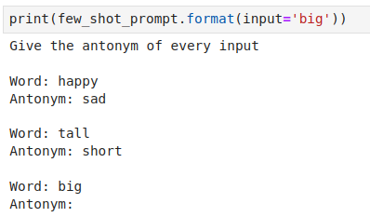
03.07 Few Shots Prompt
https://www.youtube.com/watch?v=t2bSApmPzU4&list=PLZoTAELRMXVORE4VF7WQ_fAl0L1Gljtar&index=3
Few Shots Prompt (15:11-16:00/17:18)
Print few shots prompt with input: ‘big’.

Slide 18
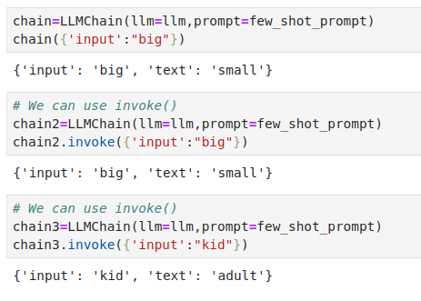
03.07 Few Shots Prompt
https://www.youtube.com/watch?v=t2bSApmPzU4&list=PLZoTAELRMXVORE4VF7WQ_fAl0L1Gljtar&index=3
Few Shots Prompt (16:01-17:18/17:18)
Now, LLM has learn from few shots prompt.
We can ask LLM more questions based on the few shots prompt.

Slide 19
End

