Slide 1

11 LC Gemini
Peter H. Chen

Slide 2
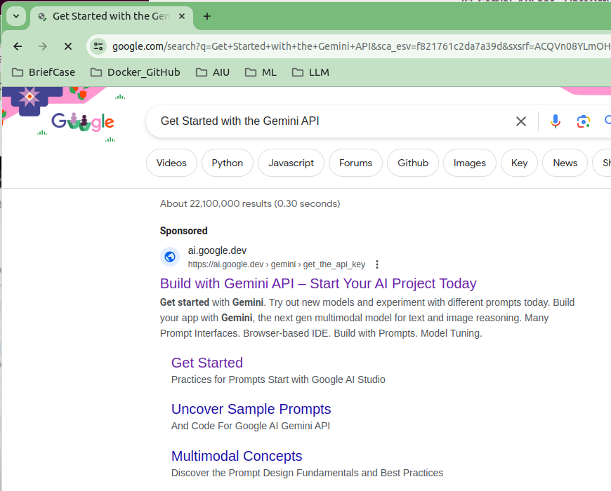
11 LC Gemini
https://www.youtube.com/watch?v=W0rNUAfqGFc&list=PLZoTAELRMXVNbDmGZlcgCA3a8mRQp5axb&index=2
Gemini API (00:00-00:10/28:32)
Google search “Get Started with the Gemini API”
Click “Build with Gemini API – Start Your AI Project Today”

Slide 3
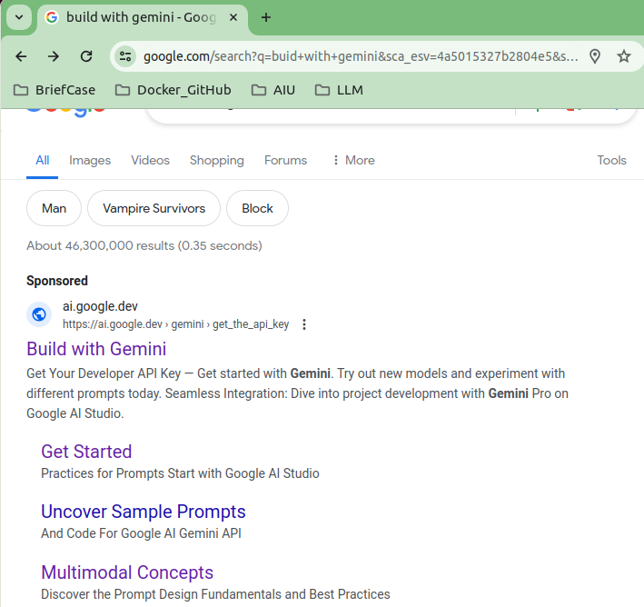
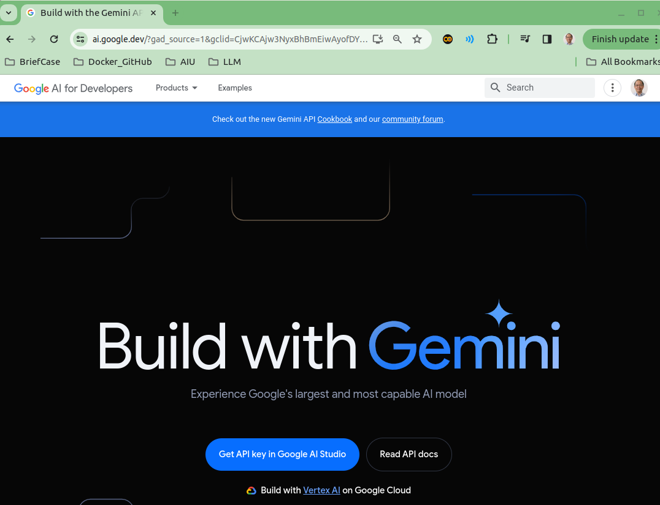
11 LC Gemini
https://www.youtube.com/watch?v=W0rNUAfqGFc&list=PLZoTAELRMXVORE4VF7WQ_fAl0L1Gljtar&index=11
LC Gemini (00:11-01:00/28:32)
We discussed LangChain Gemini.
There are may sites for Gemini. We search “Build with Gemini.”
Due to AI market shift, many data scientist transfer into LLM (Large Language Model) projects.
https://ai.google.dev/

Slide 4
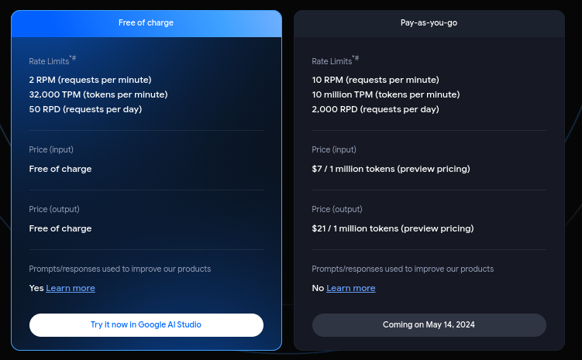
11 LC Gemini
https://www.youtube.com/watch?v=W0rNUAfqGFc&list=PLZoTAELRMXVORE4VF7WQ_fAl0L1Gljtar&index=11
LC Gemini (01:01-02:20/28:32)
Google Gemini is LLM belong to Google. There are many projects can be done in Gemini.
Gemini comes with two different landscapes: Free and Priced.
The free one has a rate limitation: we can have 2 RPM (2 Requests Per Minutes), 32,000 TPM (Tokens Per Minutes), and 50 RPD (Requests Per Day).
We can start to implement projects and check how powerful Gemini-pro is before we want to pay for the projects, such as, prompt template, embedding, DF reader, text summarization, image to text, chatbot, etc.
After the prototype the project, next step, we can start use in industries with charge.
https://ai.google.dev/pricing

Slide 5
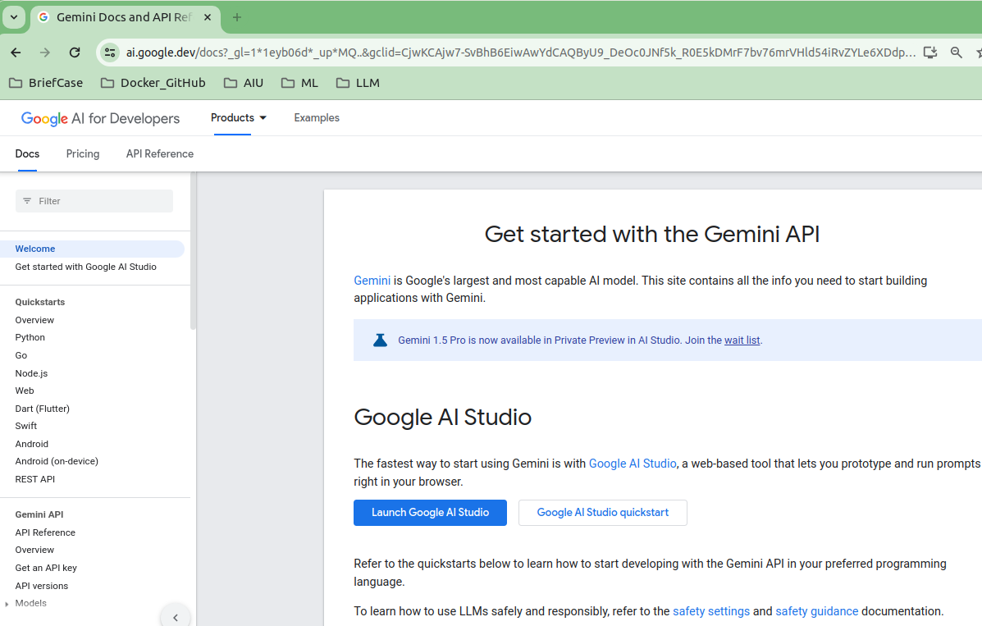
11 LC Gemini
https://www.youtube.com/watch?v=W0rNUAfqGFc&list=PLZoTAELRMXVNbDmGZlcgCA3a8mRQp5axb&index=2
Gemini API (02:21-03:30/28:32)
Gemini is Google’s largest and mist capable AI Model.
Click “Welcome” on the left had side, we have “Get started with the Gemini API”.

Slide 6
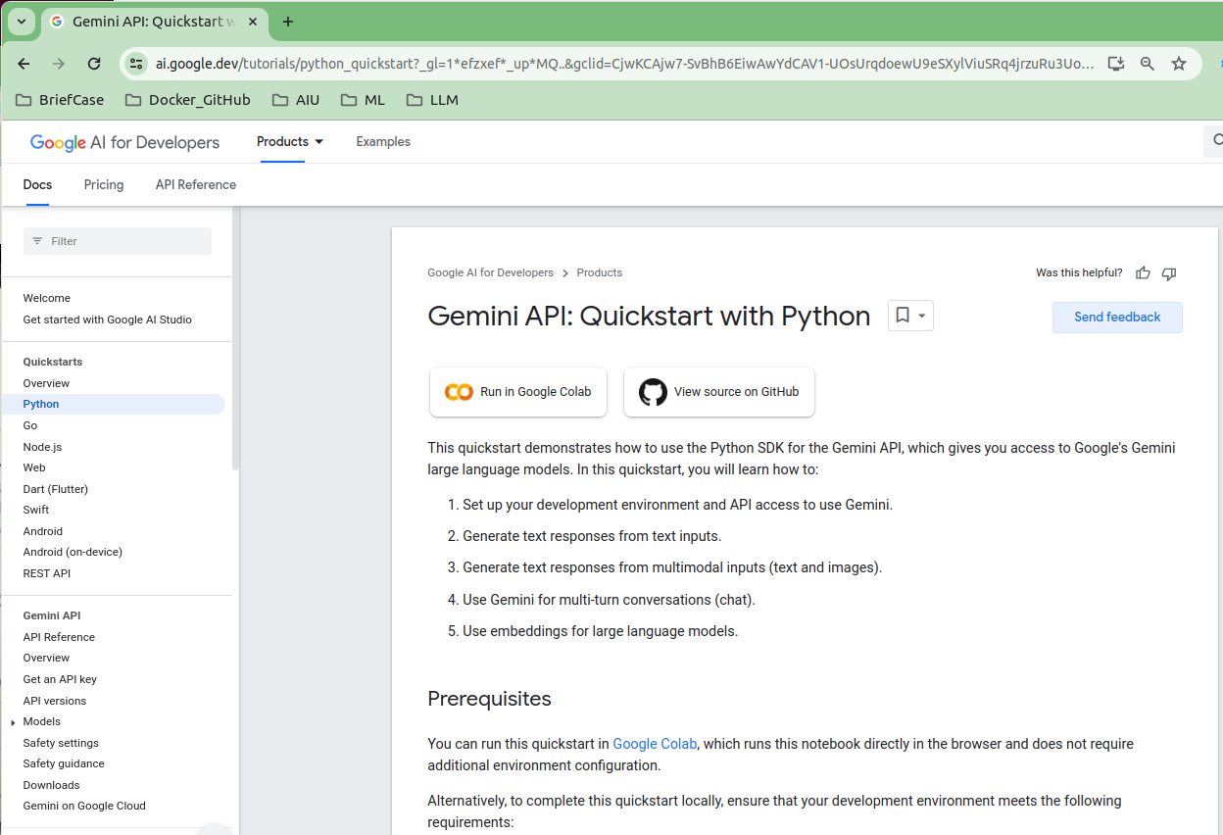
11 LC Gemini
https://www.youtube.com/watch?v=W0rNUAfqGFc&list=PLZoTAELRMXVNbDmGZlcgCA3a8mRQp5axb&index=2
Gemini API (03:31-03:32/28:32)
We start with Python. Click “Python” on the left hand side.

Slide 7
11 LC Gemini
https://www.youtube.com/watch?v=W0rNUAfqGFc&list=PLZoTAELRMXVNbDmGZlcgCA3a8mRQp5axb&index=2
Gemini API (03:32-03:33/28:32)
1. We start with Python. Click “Python” on the left hand side.
11. We click “Run in Google Colab”.
1
2

Slide 8
11.01 Gemini API Overview

Slide 9
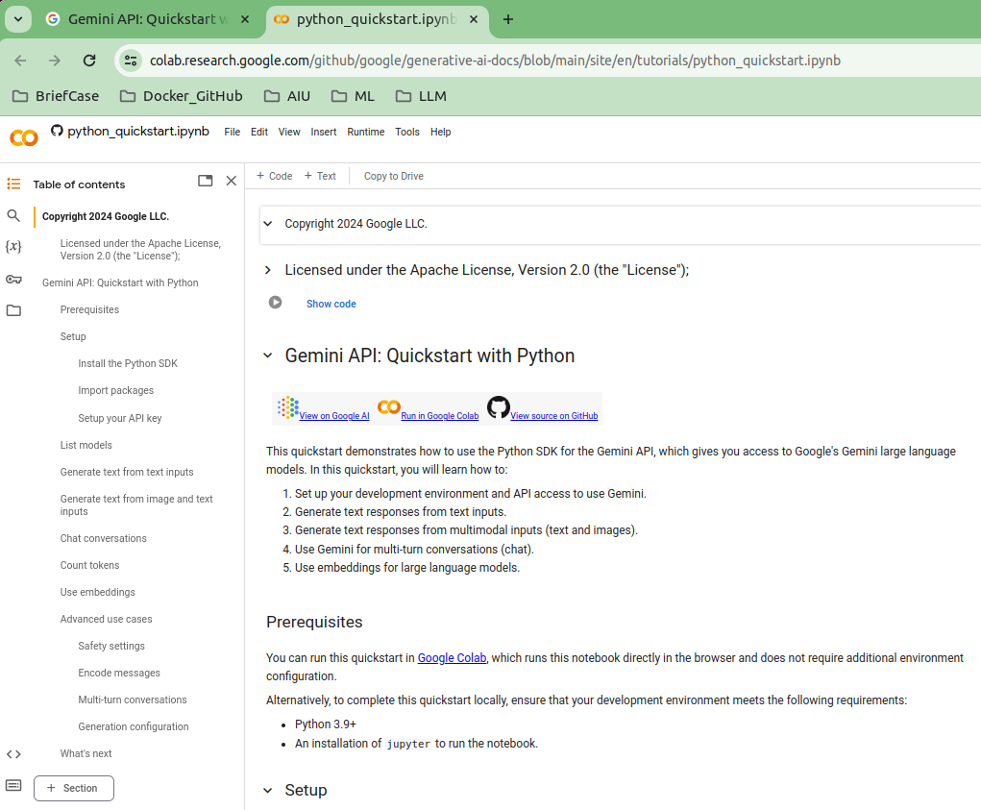
11.01 Gemini API Overview
https://www.youtube.com/watch?v=W0rNUAfqGFc&list=PLZoTAELRMXVNbDmGZlcgCA3a8mRQp5axb&index=2
Gemini API Overview (03:33-03:34/28:32)
We are in the “Gemini API: Quickstart with Python” with jupyter notebook now.

Slide 10
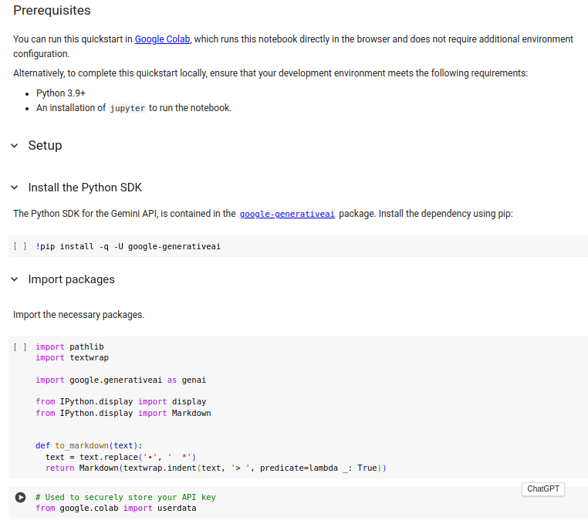
11.01 Gemini API Overview
https://www.youtube.com/watch?v=W0rNUAfqGFc&list=PLZoTAELRMXVNbDmGZlcgCA3a8mRQp5axb&index=2
Gemini API Overview (03:35-03:36/28:32)
Scroll down, we can see setup and import package.

Slide 11
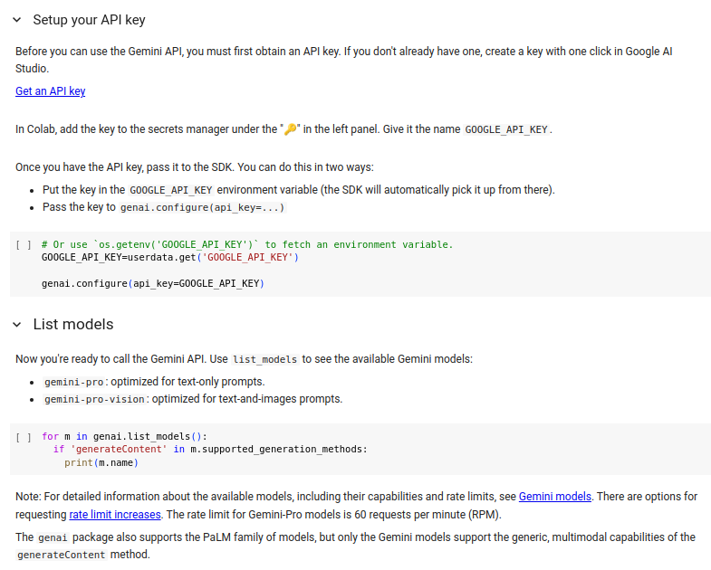
11.01 Gemini API Overview
https://www.youtube.com/watch?v=W0rNUAfqGFc&list=PLZoTAELRMXVNbDmGZlcgCA3a8mRQp5axb&index=2
Gemini API Overview (03:37-03:38/28:32)
Scroll down again, we can see Setup API Key and list Models

Slide 12
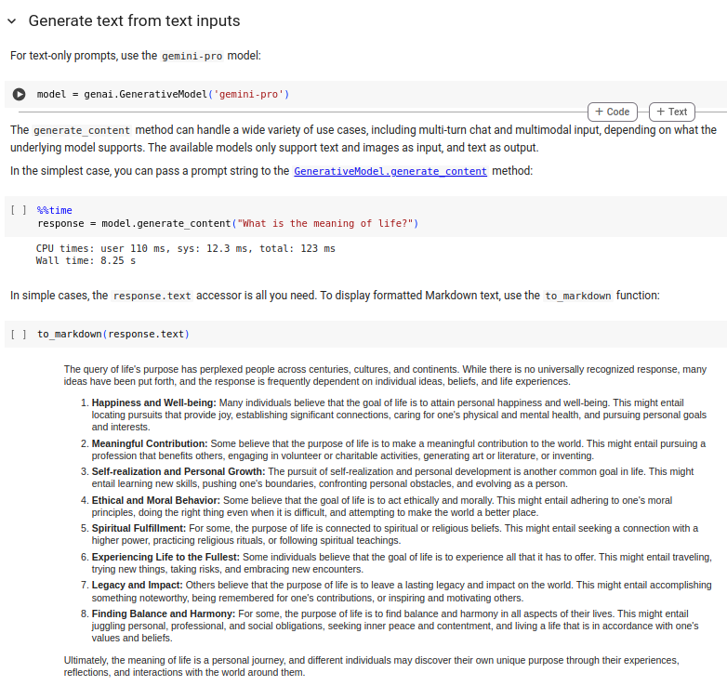
11.01 Gemini API Overview
https://www.youtube.com/watch?v=W0rNUAfqGFc&list=PLZoTAELRMXVNbDmGZlcgCA3a8mRQp5axb&index=2
Gemini API Overview (03:39-03:40/28:32)
Generate response.

Slide 13
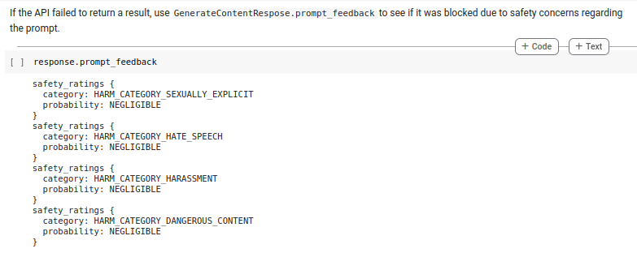
11.01 Gemini API Overview
https://www.youtube.com/watch?v=W0rNUAfqGFc&list=PLZoTAELRMXVNbDmGZlcgCA3a8mRQp5axb&index=2
Gemini API Overview (03:41-03:42/28:32)
Failed to response categories.

Slide 14
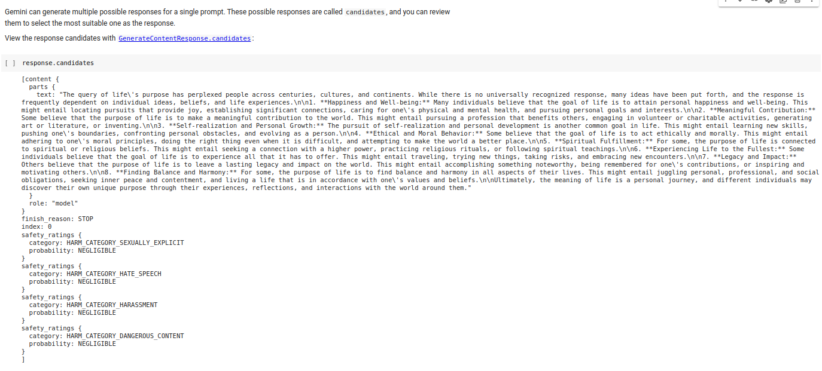
11.01 Gemini API Overview
https://www.youtube.com/watch?v=W0rNUAfqGFc&list=PLZoTAELRMXVNbDmGZlcgCA3a8mRQp5axb&index=2
Gemini API Overview (03:43-03:44/28:32)
Multiple responses.

Slide 15
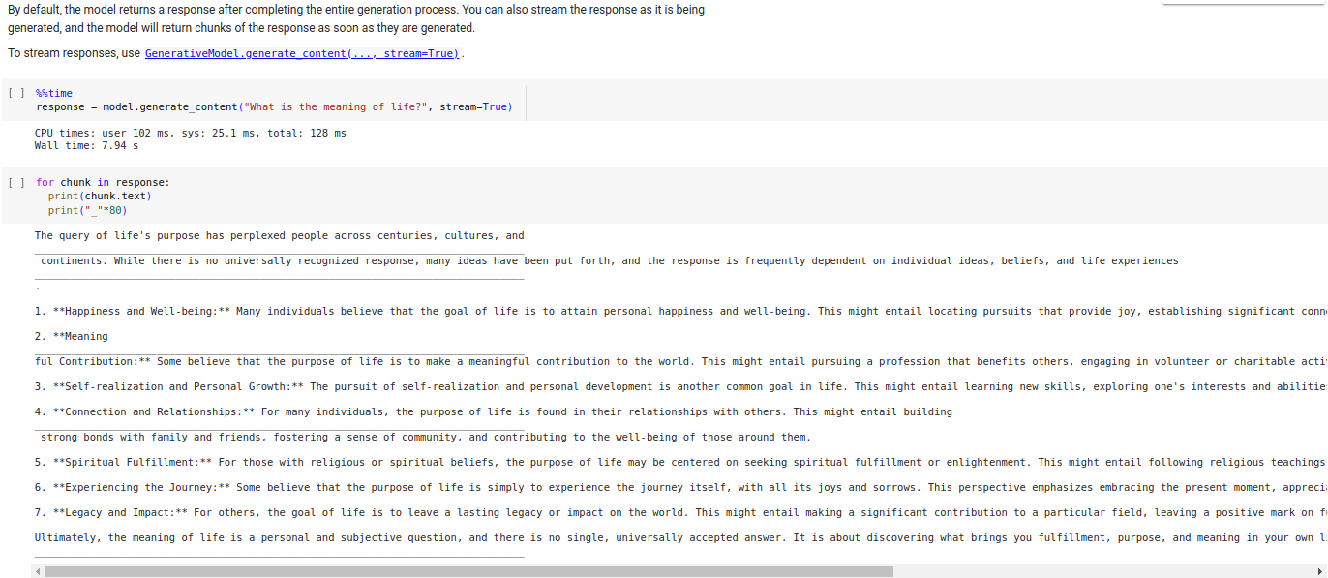
11.01 Gemini API Overview
https://www.youtube.com/watch?v=W0rNUAfqGFc&list=PLZoTAELRMXVNbDmGZlcgCA3a8mRQp5axb&index=2
Gemini API Overview (03:45-03:46/28:32)
Streaming response.

Slide 16
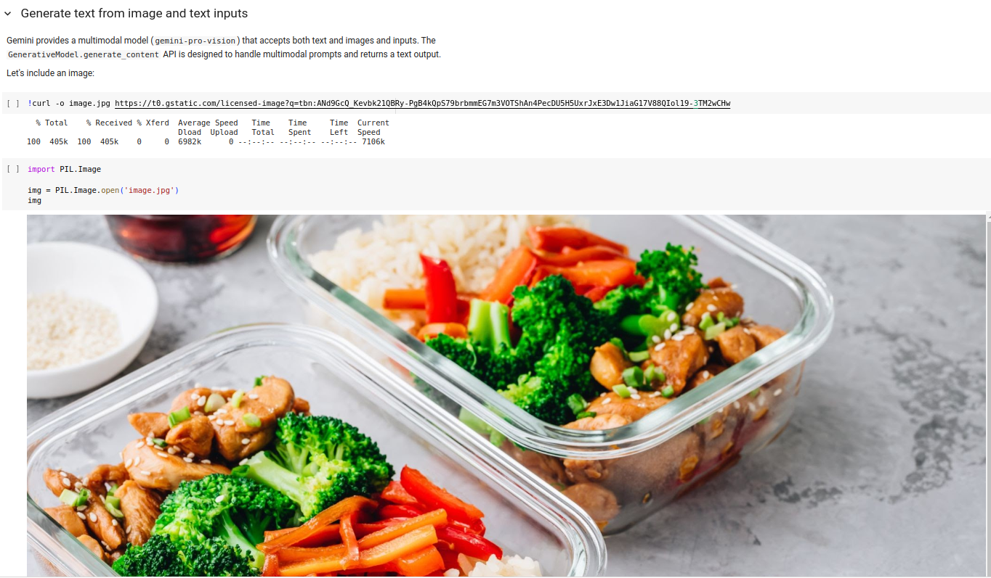
11.01 Gemini API Overview
https://www.youtube.com/watch?v=W0rNUAfqGFc&list=PLZoTAELRMXVNbDmGZlcgCA3a8mRQp5axb&index=2
Gemini API Overview (03:47-03:48/28:32)
Generate Text from images.

Slide 17
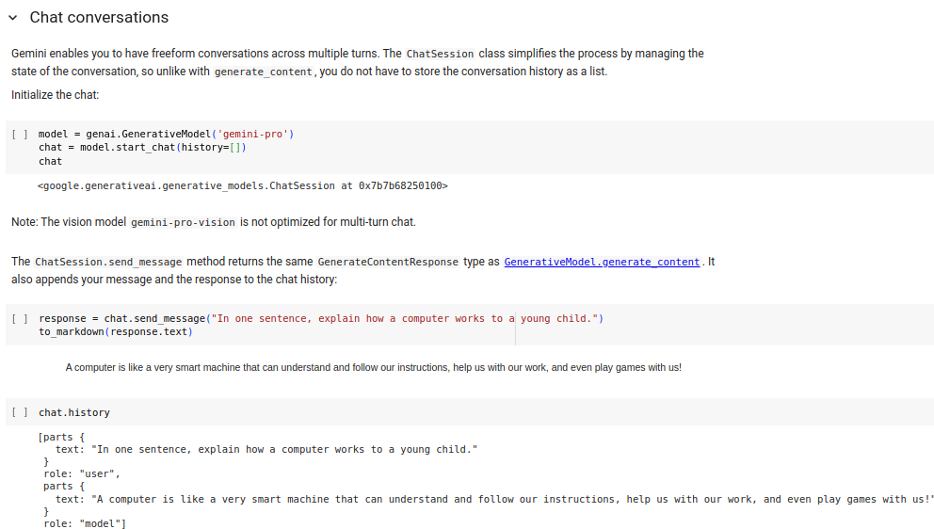
11.01 Gemini API Overview
https://www.youtube.com/watch?v=W0rNUAfqGFc&list=PLZoTAELRMXVNbDmGZlcgCA3a8mRQp5axb&index=2
Gemini API Overview (03:49-03:50/28:32)
Chat Conversation

Slide 18
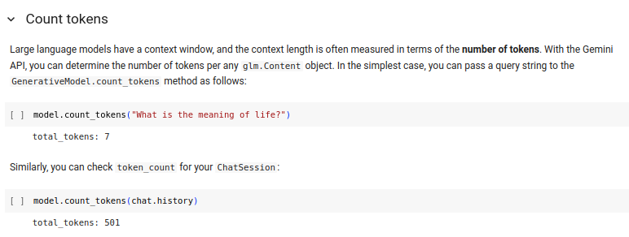
11.01 Gemini API Overview
https://www.youtube.com/watch?v=W0rNUAfqGFc&list=PLZoTAELRMXVNbDmGZlcgCA3a8mRQp5axb&index=2
Gemini API Overview (03:51-03:52/28:32)
Count Token

Slide 19
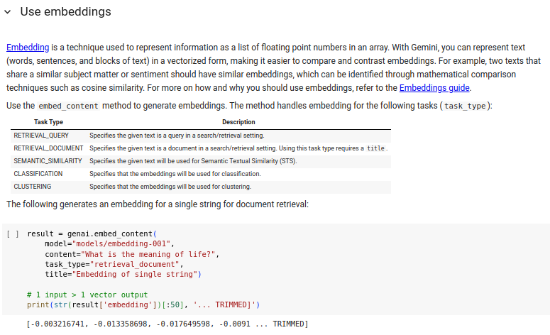
11.01 Gemini API Overview
https://www.youtube.com/watch?v=W0rNUAfqGFc&list=PLZoTAELRMXVNbDmGZlcgCA3a8mRQp5axb&index=2
Gemini API Overview (03:53-03:54/28:32)
Use Embedding

Slide 20
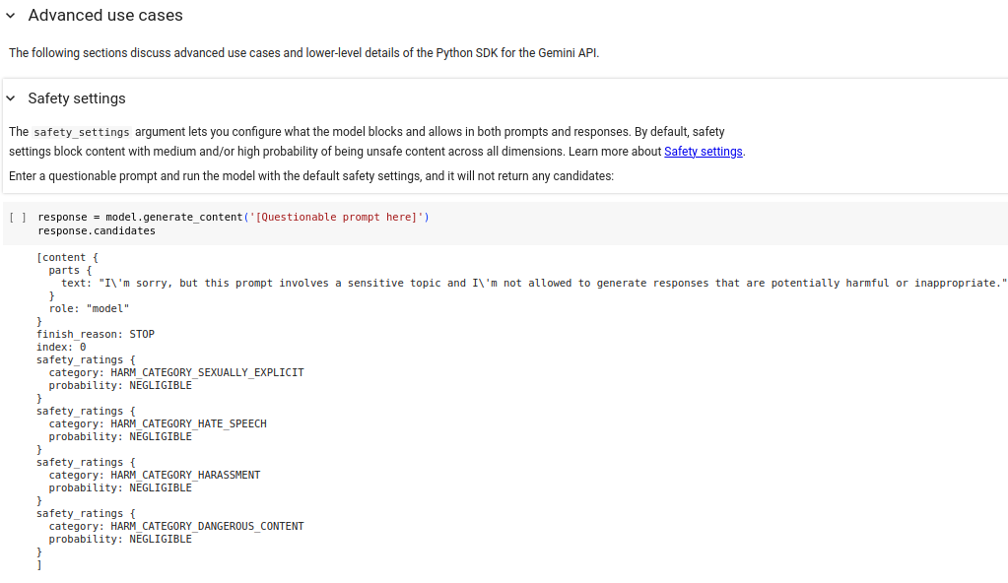
11.01 Gemini API Overview
https://www.youtube.com/watch?v=W0rNUAfqGFc&list=PLZoTAELRMXVNbDmGZlcgCA3a8mRQp5axb&index=2
Gemini API Overview (03:55-03:56/28:32)
Advanced use cases.

Slide 21
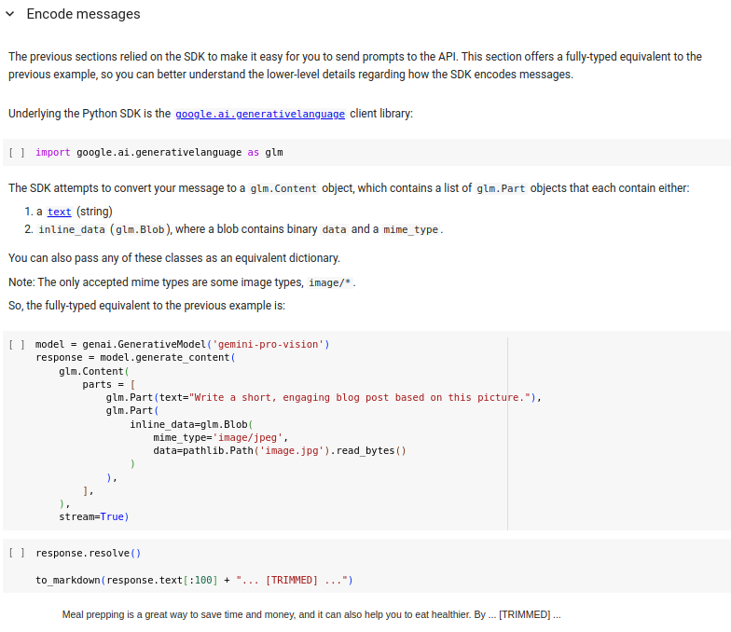
11.01 Gemini API Overview
https://www.youtube.com/watch?v=W0rNUAfqGFc&list=PLZoTAELRMXVNbDmGZlcgCA3a8mRQp5axb&index=2
Gemini API Overview (03:57-03:58/28:32)
Encode messages.

Slide 22
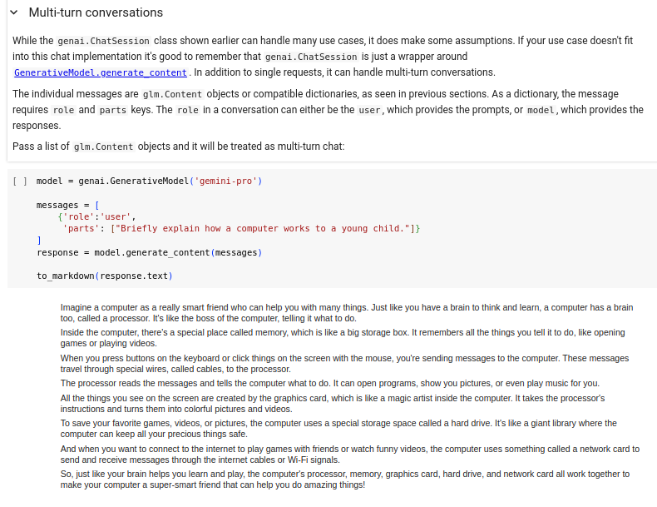
11.01 Gemini API Overview
https://www.youtube.com/watch?v=W0rNUAfqGFc&list=PLZoTAELRMXVNbDmGZlcgCA3a8mRQp5axb&index=2
Gemini API Overview (03:59-04:00/28:32)
Multi-Turn Conversation

Slide 23
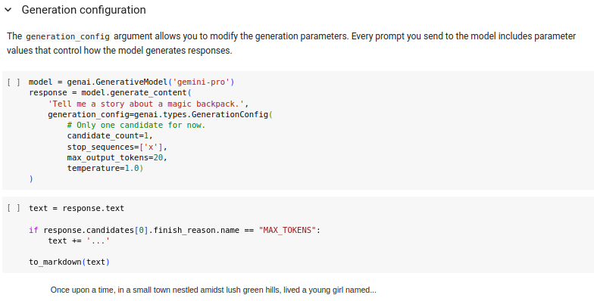
11.01 Gemini API Overview
https://www.youtube.com/watch?v=W0rNUAfqGFc&list=PLZoTAELRMXVNbDmGZlcgCA3a8mRQp5axb&index=2
Gemini API Overview (04:01-04:02/28:32)
Generation Configuration

Slide 24
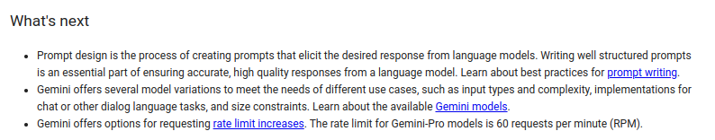
11.01 Gemini API Overview
https://www.youtube.com/watch?v=W0rNUAfqGFc&list=PLZoTAELRMXVNbDmGZlcgCA3a8mRQp5axb&index=2
Gemini API Overview (04:03-04:40/28:32)
What is next.

Slide 25
End

