Slide 1

2 Vector Database
Peter H. Chen

Slide 2
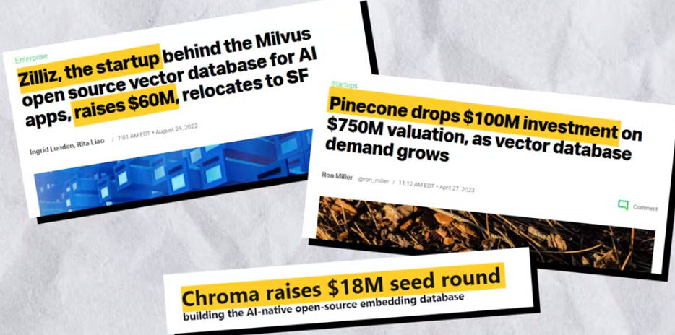
2 Vector Database
https://www.youtube.com/watch?v=72XgD322wZ8&list=PLeo1K3hjS3uu0N_0W6giDXzZIcB07Ng_F&index=2
Vector Database (00:00-00:05/6:53)
There are some AI startups companies that raised millions of dollars of funding, such as,
1. Zilliz: Raised $60M,
2. Pinecone: Raised $100M, and
3. Chroma: $18M.

Slide 3

2 Vector Database
https://www.youtube.com/watch?v=72XgD322wZ8&list=PLeo1K3hjS3uu0N_0W6giDXzZIcB07Ng_F&index=2
Vector Database (00:06-00:08/6:53)
These startup AI companies have one product in common: Vector Database.
Let’s try to understand what is Vector Database.

Slide 4
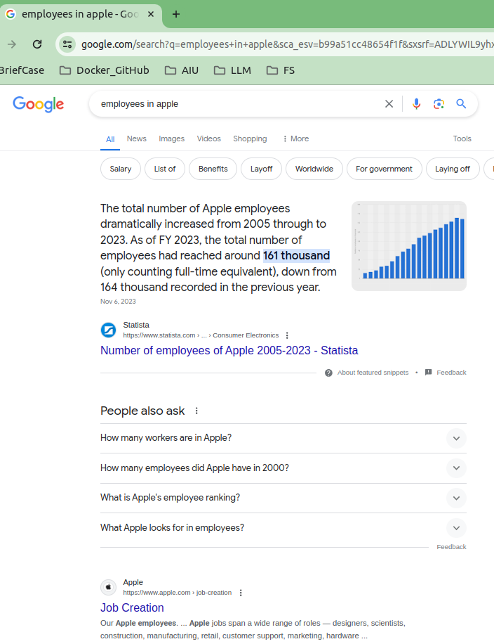
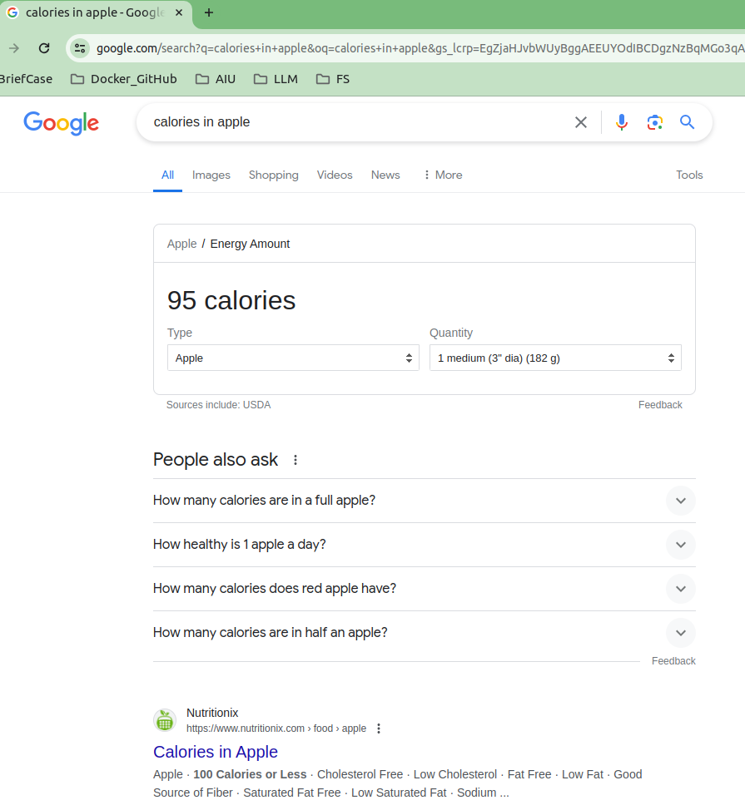
2 Vector Database
https://www.youtube.com/watch?v=72XgD322wZ8&list=PLeo1K3hjS3uu0N_0W6giDXzZIcB07Ng_F&index=2
Vector Database (00:11-00:25/6:53)
When we do the Google search
1. Calories in Apple versus
2. Employees in Apple
The first search, apple means fruit and the second search, apple is a company.
Do you aware of how Google know the user intention of search?
1
2

Slide 5
2 Vector Database
https://www.youtube.com/watch?v=72XgD322wZ8&list=PLeo1K3hjS3uu0N_0W6giDXzZIcB07Ng_F&index=2
Vector Database (00:26-00:30/6:53)
What is Homograph (same-written, 同形異義語), Homophone (same-sound, 同音異義語), and Homonym (同形異義語), ?
1. Homograph: A a word that has the same spelling as another word but has a different sound and a different meaning:
  1.1 lead (to go in front of)/lead (a metal)
  1.2 wind (to follow a course that is not straight)/wind (a gust of air)
  1.3 bass (low, deep sound)/bass (a type of fish)
2. A homophone is a word that has the same sound as another word but has a different meaning. Homophones may or may not have the same spelling. Here are some examples:
  2.1 to/two/too
  2.2 there/their/they're
  2.3 pray/prey
3. Homonym means either:
  3.1 A word that is spelled like another but has a different sound and meaning (homograph); a word that sounds like another but has a different spelling and meaning (homophone) OR
  3.2 A word that is spelled and pronounced like another but has a different meaning (homograph and homophone)
https://www.dictionary.com/e/homograph-vs-homophone-vs-homonym/

Slide 6
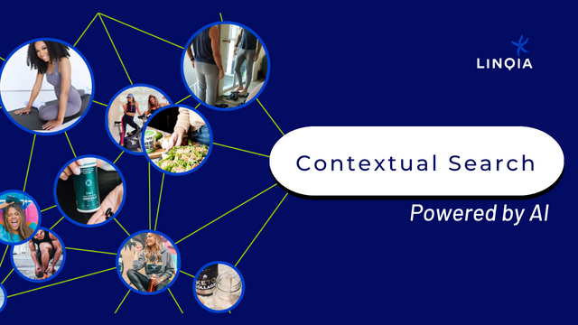

2 Vector Database
https://www.youtube.com/watch?v=72XgD322wZ8&list=PLeo1K3hjS3uu0N_0W6giDXzZIcB07Ng_F&index=2
Vector Database (00:31-00:40/6:53)
How the Google does your search and give you the answer?
Google uses the technique called “Semantic Search” and “Contextual Search”
Semantic Search and contextual search consider not only the exact keyword matching but also understand the exact meaning of words of user query.
What is difference between the Semantic Search and Context search?
1. Semantic search considers the meaning of words in the same sentence, for example, calories of Apple and Employees of Apple.\
2. Contextual search considers the relationship between the current and previous sentences relationship. For example, Homonym words can have many meanings. Homonyms need previous sentences to figure out the meaning, for example,
  2.1 ”The bark is big”: We needs previous sentence “there is a tree” or “there is a dog” to know “the bark of tree” or “the bark from dog”
  2.2 “The bank is nice”: We need previous sentence “There is a river” or “Bank of America is secure.” to know “the river bank is nice” or “Bank of America is nice”
https://www.yourdictionary.com/articles/examples-homonyms
1
2

Slide 7
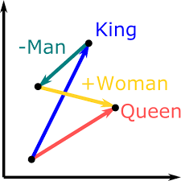
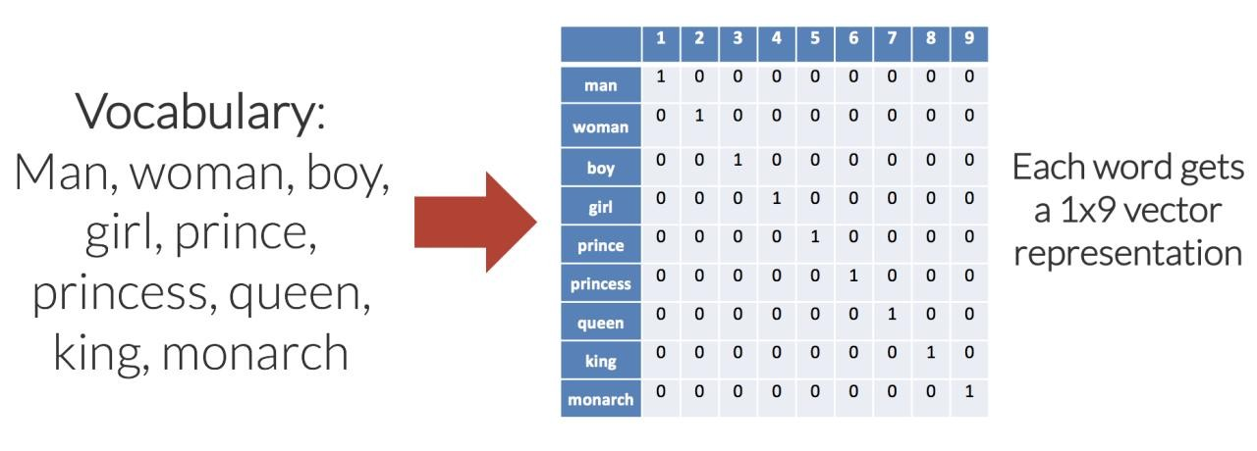
2 Vector Database
https://www.youtube.com/watch?v=72XgD322wZ8&list=PLeo1K3hjS3uu0N_0W6giDXzZIcB07Ng_F&index=2
Vector Database (00:41-00:50/6:53)
For doing Semantic Search or Contextual Search, internally, we uses the concept of Word Embedding (嵌入), Sentence Embedding, and Document Embedding.
1. What is embedding?
Embedding is a Numerical Representation of text.
2. What is one-hot-encoding?
Make each word has unique representation for set operation, such as, King – man + woman = Queen
https://medium.com/geekculture/encoding-text-for-nlp-tasks-84696bce83e6

Slide 8
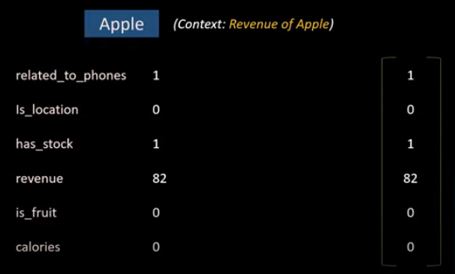
2 Vector Database
https://www.youtube.com/watch?v=72XgD322wZ8&list=PLeo1K3hjS3uu0N_0W6giDXzZIcB07Ng_F&index=2
Vector Database (00:51-01:30/6:53)
Let see how embedding work?
What is the word “Apple” (Revenue of Apple) into a numeric representation?
We have several properties related to “Apple”.
Here, we have Apple revenue of “82 Billion dollar”.
The sequence numbers as a result and that is nothing but a vector.
So, this vector is a word embedding for the word Apple (in “Revenue of Apple”).

Slide 9
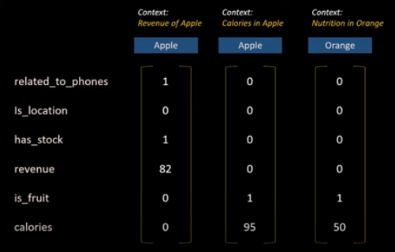
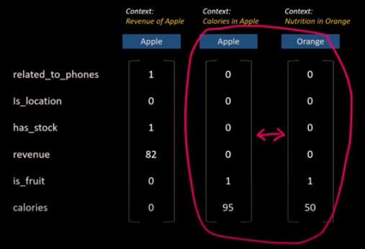
2 Vector Database
https://www.youtube.com/watch?v=72XgD322wZ8&list=PLeo1K3hjS3uu0N_0W6giDXzZIcB07Ng_F&index=2
Vector Database (01:31-01:50/6:53)
When you have different embedding for different words (or sentence).
Looking at them bidding are different.
You can say the second apple and the third word orange are similar because when you look at the values. The values are almost the same. There are some values which are not matching.
But if you compare the first column and second column, the values are very different.
Second column and third column are very similar.

Slide 10

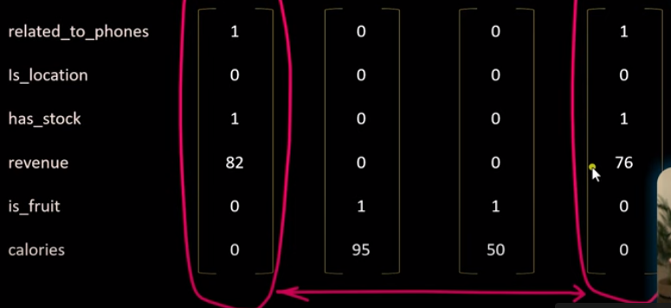
2 Vector Database
https://www.youtube.com/watch?v=72XgD322wZ8&list=PLeo1K3hjS3uu0N_0W6giDXzZIcB07Ng_F&index=2
Vector Database (01:55-02:30/6:53)
If we look at fourth column “Employees in Samsung”, the values of fourth column values are very similar to the values of first column “Revenue of Apple”.
The similarity of first column and fourth column are very closed.

Slide 11
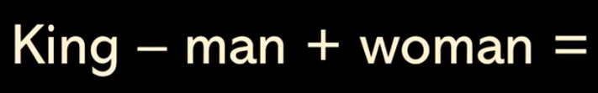

2 Vector Database
https://www.youtube.com/watch?v=72XgD322wZ8&list=PLeo1K3hjS3uu0N_0W6giDXzZIcB07Ng_F&index=2
Vector Database (01:55-02:24/6:53)
In NLP, we can perform “King – Man + Woman = Queen”

Slide 12
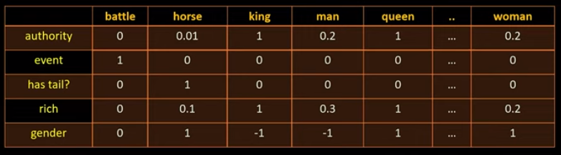
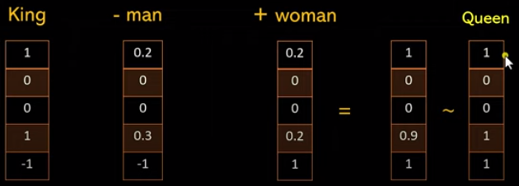
2 Vector Database
https://www.youtube.com/watch?v=72XgD322wZ8&list=PLeo1K3hjS3uu0N_0W6giDXzZIcB07Ng_F&index=2
Vector Database (02:25-02:55/6:53)
We can do the set operation for the columns:
“King” column – “man” column + “woman” column
≈ (almost equal to) “Queen” column.

Slide 13
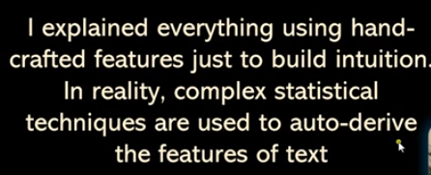
2 Vector Database
https://www.youtube.com/watch?v=72XgD322wZ8&list=PLeo1K3hjS3uu0N_0W6giDXzZIcB07Ng_F&index=2
Vector Database (02:58-03:00/6:53)
In reality, we have more complex statistical techniques to do the operation.

Slide 14
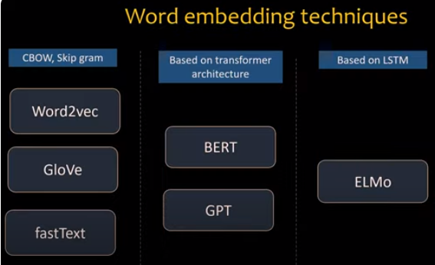
2 Vector Database
https://www.youtube.com/watch?v=72XgD322wZ8&list=PLeo1K3hjS3uu0N_0W6giDXzZIcB07Ng_F&index=2
Vector Database (03:09-03:15/6:53)
The word embedding techniques for operation are as below:
1. CBOW (Continuous Bag of Words) Architecture: model predicts a target word based on the context of the surrounding words in a sentence or text.
  1.1 Word2Vec (by Tomas Milkolov at Google)
  1.2 GloVe (Global Vectors for word representation by Stanford): unsupervised learning algorithm for generating word embeddings by aggregating global word-word co-occurrence matrix from a corpus.
  1.3 fastText (Open Source Library by Facebook AI Research Lab)
2. Transformer Architecture:
  2.1 BERT (Bidirectional Encoder Representations from Transformers by Google)
  2.2 GPT (Generative Pre-trained Transformers by OpenAI)
3. LSTM Architecture:
  ELMo (Embeddings from Language Model by Allen Institute for AI): A word embedding method for representing a sequence of words as a corresponding sequence of vectors.

Slide 15
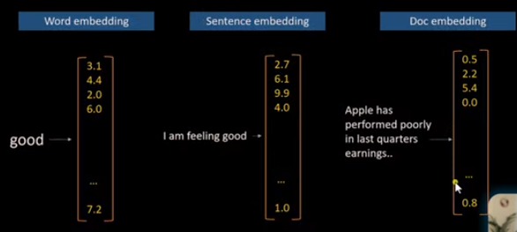
2 Vector Database
https://www.youtube.com/watch?v=72XgD322wZ8&list=PLeo1K3hjS3uu0N_0W6giDXzZIcB07Ng_F&index=2
Vector Database (03:17-03:20/6:53)
You can have word, sentence, or document embedding.

Slide 16
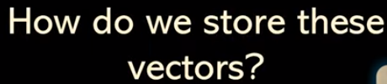
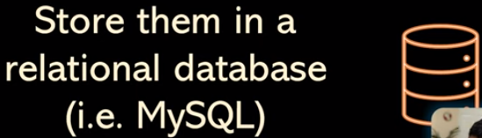
2 Vector Database
https://www.youtube.com/watch?v=72XgD322wZ8&list=PLeo1K3hjS3uu0N_0W6giDXzZIcB07Ng_F&index=2
Vector Database (03:21-03:30/6:53)
You may have billions of embedding vectors.
You need to store somewhere. How do you store them?
You need to store them in the relational database.

Slide 17
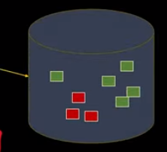
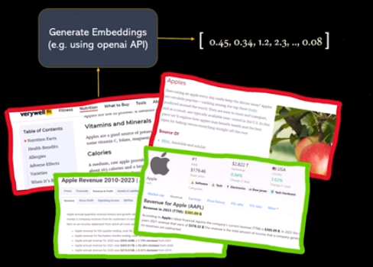
2 Vector Database
https://www.youtube.com/watch?v=72XgD322wZ8&list=PLeo1K3hjS3uu0N_0W6giDXzZIcB07Ng_F&index=2
Vector Database (03:31-04:00/6:53)
You have some information, you use OpenAI to generate embedding and store in the database.
1. several “Revenue for Apple”
2. several “Fruit for Apple”.

Slide 18
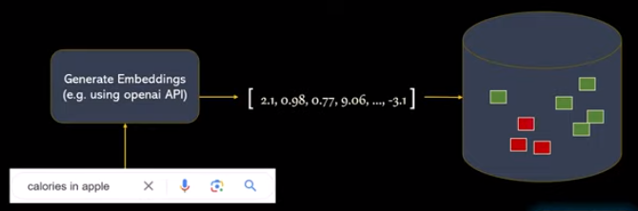
2 Vector Database
https://www.youtube.com/watch?v=72XgD322wZ8&list=PLeo1K3hjS3uu0N_0W6giDXzZIcB07Ng_F&index=2
Vector Database (04:01-04:10/6:53)
Now, you have a “search query”: “calories in apple”
You also generate embedding for that sentence.
Then, you try to compare this generated embedding to the store embedding.

Slide 19
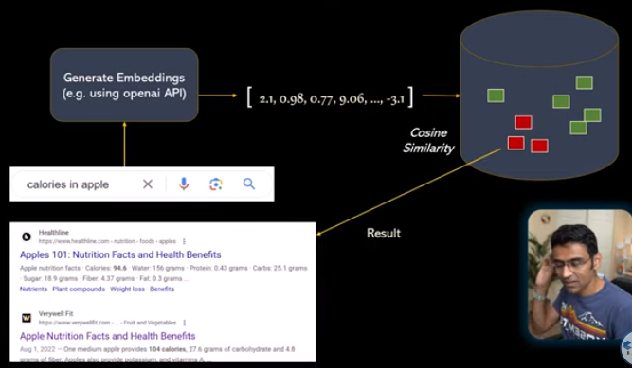
2 Vector Database
https://www.youtube.com/watch?v=72XgD322wZ8&list=PLeo1K3hjS3uu0N_0W6giDXzZIcB07Ng_F&index=2
Vector Database (04:11-04:20/6:53)
We use the similarity to match the answer.
In reality, we have billions of records in you database.
Which one should we pick?

Slide 20
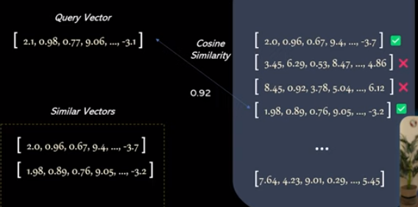
2 Vector Database
https://www.youtube.com/watch?v=72XgD322wZ8&list=PLeo1K3hjS3uu0N_0W6giDXzZIcB07Ng_F&index=2
Vector Database (04:21-05:20/6:53)
We match the closes one.
However, there are too billion of records.
It takes too long to match.
We cannot handle delay and computational requirements.
We need something smart. How can we do this in a traditional database.
Well, we use a index database.
It helps you search faster.

Slide 21
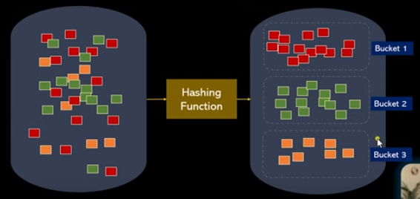
2 Vector Database
https://www.youtube.com/watch?v=72XgD322wZ8&list=PLeo1K3hjS3uu0N_0W6giDXzZIcB07Ng_F&index=2
Vector Database (05:26-05:30/6:53)
We use hashing function to separate the huge data into several smaller buckets.

Slide 22
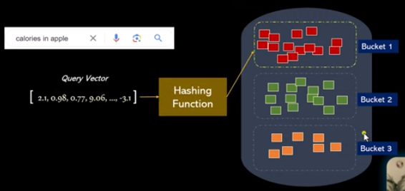
2 Vector Database
https://www.youtube.com/watch?v=72XgD322wZ8&list=PLeo1K3hjS3uu0N_0W6giDXzZIcB07Ng_F&index=2
Vector Database (05:31-06:00/6:53)
Then, we have search query “calories in apple”.
Then, we go through the same hashing function.
Within the bucket, we use linear search in bucket 1. We don’t search in bucket 2 and bucket 3.

Slide 23
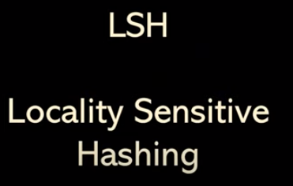
2 Vector Database
https://www.youtube.com/watch?v=72XgD322wZ8&list=PLeo1K3hjS3uu0N_0W6giDXzZIcB07Ng_F&index=2
Vector Database (06:01-06:06/6:53)
This is called LSH (Locality Sensitivity Hashing).

Slide 24
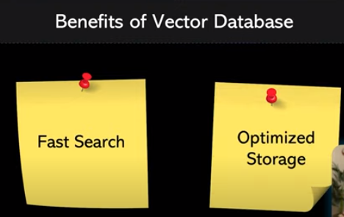
2 Vector Database
https://www.youtube.com/watch?v=72XgD322wZ8&list=PLeo1K3hjS3uu0N_0W6giDXzZIcB07Ng_F&index=2
Vector Database (06:10-06:30/6:53)
Vector database:
1. will help you search faster.
2. will help you optimized storage.

Slide 25
2 Vector Database
https://www.youtube.com/watch?v=72XgD322wZ8&list=PLeo1K3hjS3uu0N_0W6giDXzZIcB07Ng_F&index=2
Vector Database (06:20-06:53/6:53)
Summary:
1. Semantic query.
2. Word, sentence, document embedding: Embedding frameworks: Word2Vec, BERT, GPT, ElMo).
3. Hashing Search
2
3

Slide 26
End

