Slide 1

1.07 Streamlit
Peter H. Chen

Slide 2
1.07 Streamlit
https://www.youtube.com/watch?v=nAmC7SoVLd8&list=PLeo1K3hjS3uu0N_0W6giDXzZIcB07Ng_F&index=1
Streamlit (18:01-18:30/46:07)
1. Create Conda environment if you don’t have
> conda create --name gemini
2. conda activate gemini
(gemini) >

Slide 3
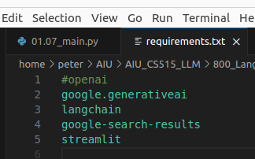
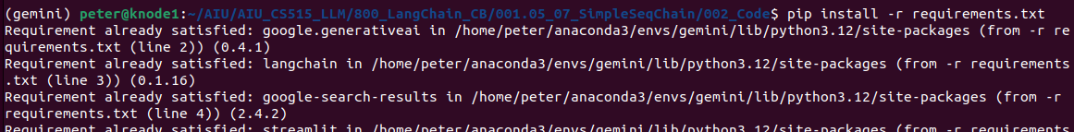
1.07 Streamlit
https://www.youtube.com/watch?v=nAmC7SoVLd8&list=PLeo1K3hjS3uu0N_0W6giDXzZIcB07Ng_F&index=1
Streamlit (18:31-19:00/46:07)
1. Requirements.txt
a. google.generativeai: Google LLM Model Gemini
b. langchain: LangChain for tools integration
c. google-search-results: Google real-time search platform
d. streamlit: GUI
2. Install requirements.txt
> pip install -r requirements.txt
1
2

Slide 4
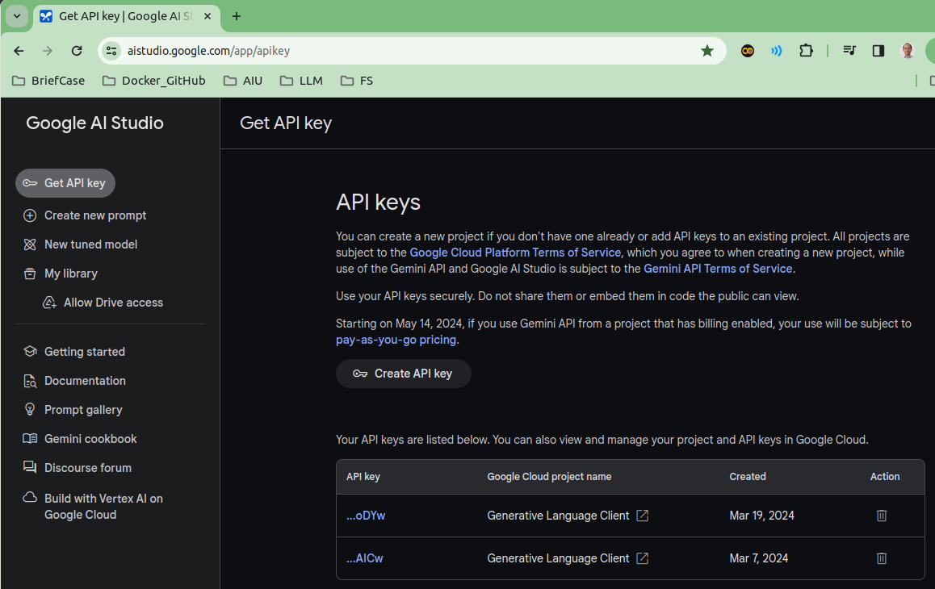
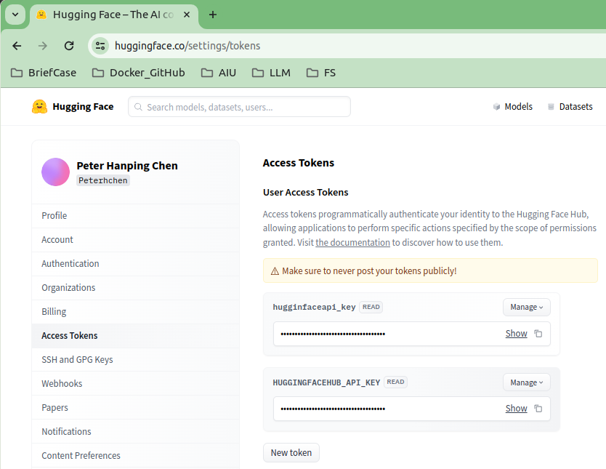
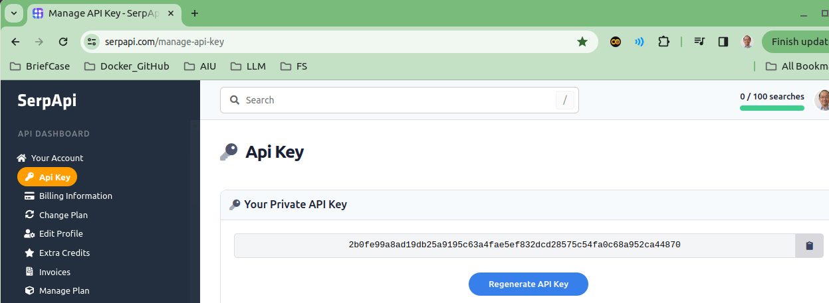
1.07 Streamlit
https://www.youtube.com/watch?v=nAmC7SoVLd8&list=PLeo1K3hjS3uu0N_0W6giDXzZIcB07Ng_F&index=1
Streamlit (18:01-19:30/46:07)
Create API Key and copy to “.env” file.
1. GOOGLE_API_KEY: Google Gemini API Key (https://aistudio.google.com/app/apikey)
2. HUGGINGFACEHUB_API_KEY: LangChain LLMChain API Key (https://huggingface.co/settings/tokens)
3. GOOGLE_SERP_API_KEY: Google Serp (Real-time Search Platform) API Key (https://serpapi.com/manage-api-key)
1
2
3

Slide 5
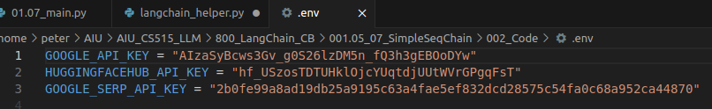
1.07 Streamlit
https://www.youtube.com/watch?v=nAmC7SoVLd8&list=PLeo1K3hjS3uu0N_0W6giDXzZIcB07Ng_F&index=1
Streamlit (19:31-20:00/46:07)
Create created API Key and copy to “.env” file.

Slide 6
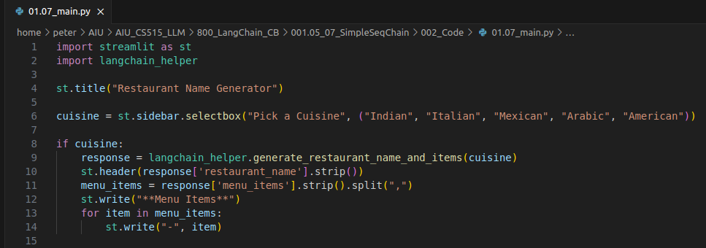
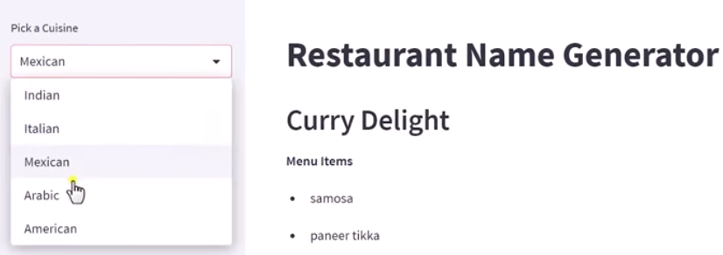
1.07 Streamlit
https://www.youtube.com/watch?v=nAmC7SoVLd8&list=PLeo1K3hjS3uu0N_0W6giDXzZIcB07Ng_F&index=1
Streamlit (20:01-21:30/46:07)
1. Create sidebar
2. Get response
3. Display Menu Items

Slide 7
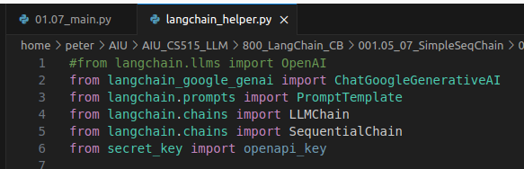
1.07 Streamlit
https://www.youtube.com/watch?v=nAmC7SoVLd8&list=PLeo1K3hjS3uu0N_0W6giDXzZIcB07Ng_F&index=1
Streamlit (21:31-22:00/46:07)
Import Libraries.

Slide 8
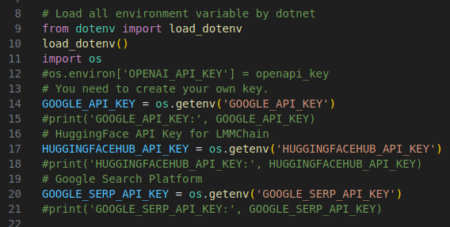
1.07 Streamlit
https://www.youtube.com/watch?v=nAmC7SoVLd8&list=PLeo1K3hjS3uu0N_0W6giDXzZIcB07Ng_F&index=1
Streamlit (22:01-22:30/46:07)
Load API Key:
1. Google API Key
2. Hugging Face API Key
3. Google serp (Real-time Search Platform) API Key

Slide 9
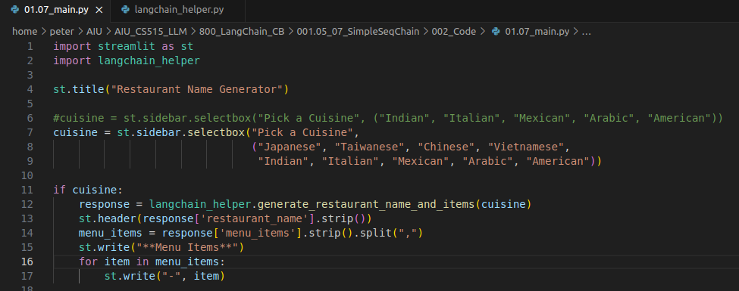
1.07 Streamlit
https://www.youtube.com/watch?v=nAmC7SoVLd8&list=PLeo1K3hjS3uu0N_0W6giDXzZIcB07Ng_F&index=1
Streamlit (22:31-23:00/46:07)
> code 01.07_main.py
Create cuisine list: Japanese, Taiwanese, Chinese, Vietnamese, Indian, Italian, Mexican, Arabic, American

Slide 10
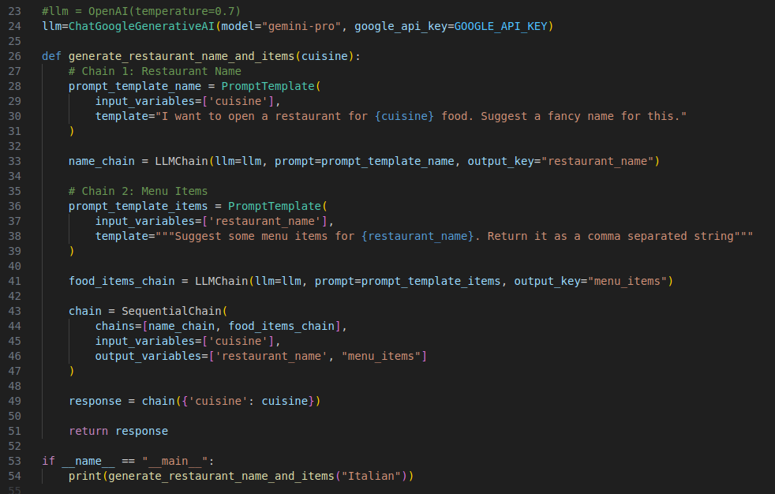
1.07 Streamlit
https://www.youtube.com/watch?v=nAmC7SoVLd8&list=PLeo1K3hjS3uu0N_0W6giDXzZIcB07Ng_F&index=1
Streamlit (23:01-26:30/46:07)
1. Load LLM Gemini Model
2. name_chain:
2.1 Input {Cuisine}: Japanese, Chinese, Vietnamese, India, Italian, Mexican, Arabic, American, etc.
2.2 Generate Output: {Restaurant name}
3. food_name_chain:
3.1 Input {Restaurant Name}
3.2 Output: Menu Items
4. Sequence Chain: [name_chain, food_items_chain]
5. response = chain({‘cuisne’: cuisine})
6. Return response

Slide 11
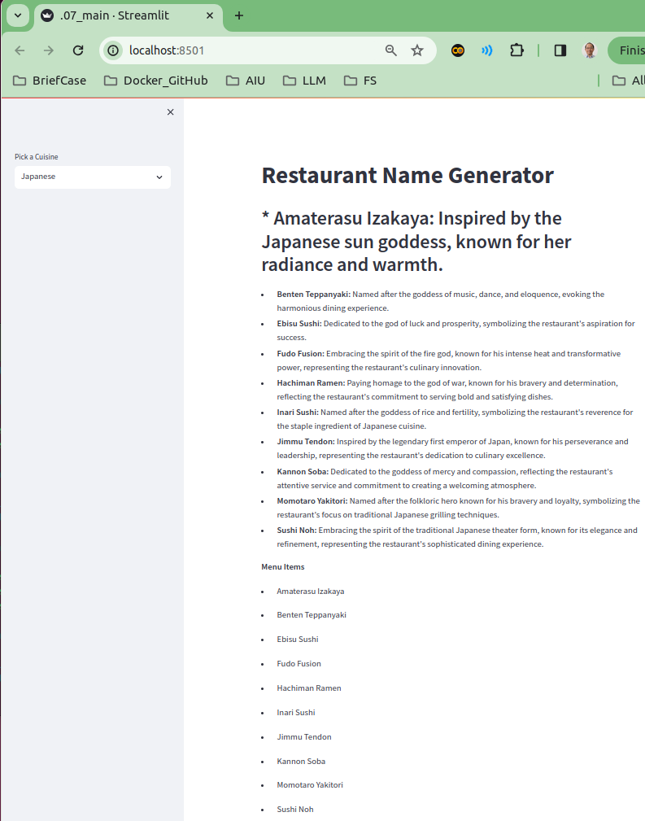
1.07 Streamlit
https://www.youtube.com/watch?v=nAmC7SoVLd8&list=PLeo1K3hjS3uu0N_0W6giDXzZIcB07Ng_F&index=1
Streamlit (26:31-26:40/46:07)
> streamlit run 01.07_main.py

Slide 12
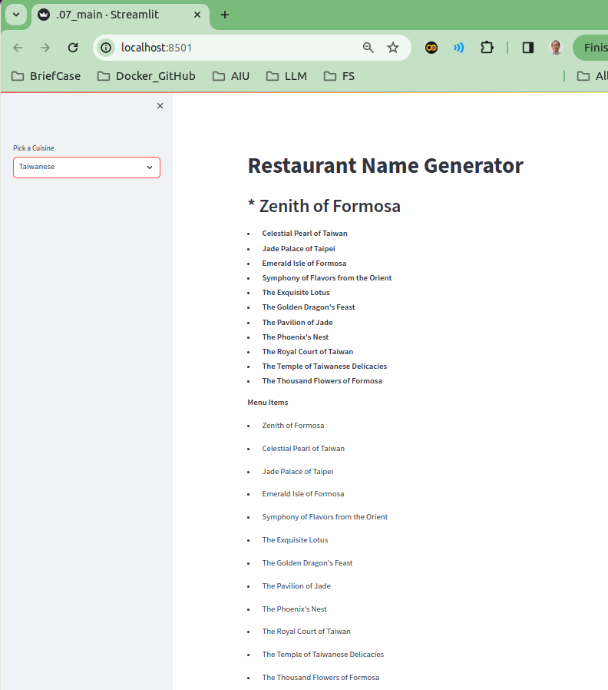
1.07 Streamlit
https://www.youtube.com/watch?v=nAmC7SoVLd8&list=PLeo1K3hjS3uu0N_0W6giDXzZIcB07Ng_F&index=1
Streamlit (26:41-26:50/46:07)
Select “Taiwanese”

Slide 13
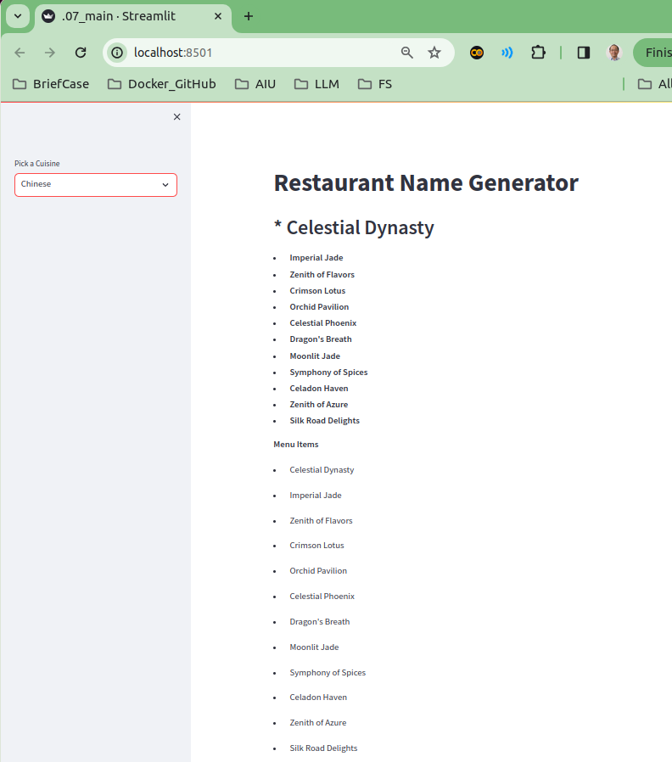
1.07 Streamlit
https://www.youtube.com/watch?v=nAmC7SoVLd8&list=PLeo1K3hjS3uu0N_0W6giDXzZIcB07Ng_F&index=1
Streamlit (26:51-27:00/46:07)
Select “Chinese”

Slide 14
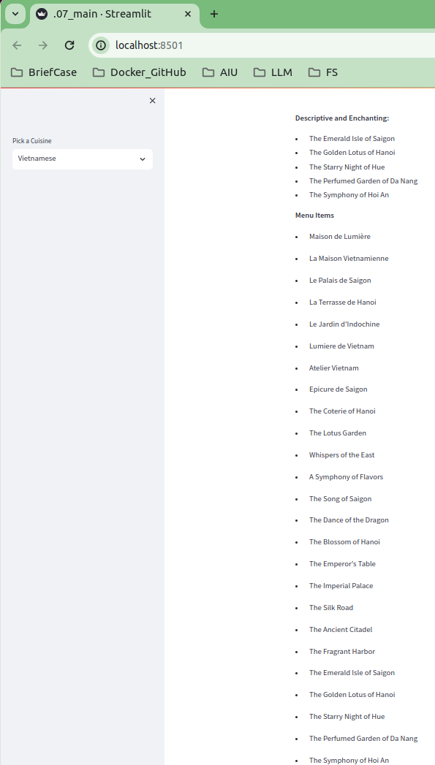
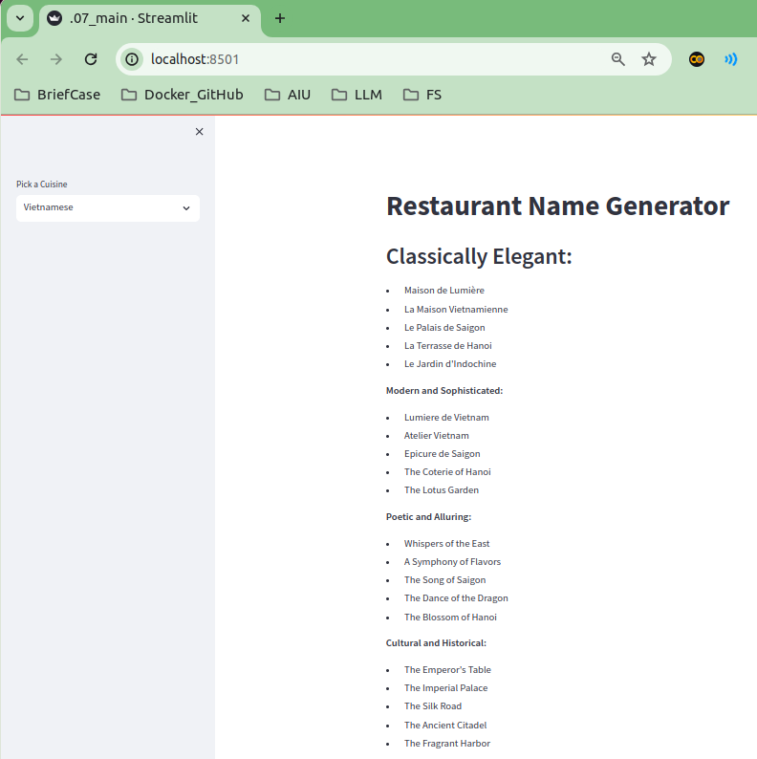
1.07 Streamlit
https://www.youtube.com/watch?v=nAmC7SoVLd8&list=PLeo1K3hjS3uu0N_0W6giDXzZIcB07Ng_F&index=1
Streamlit (27:01-27:10/46:07)
Select “Vietnamese”

Slide 15
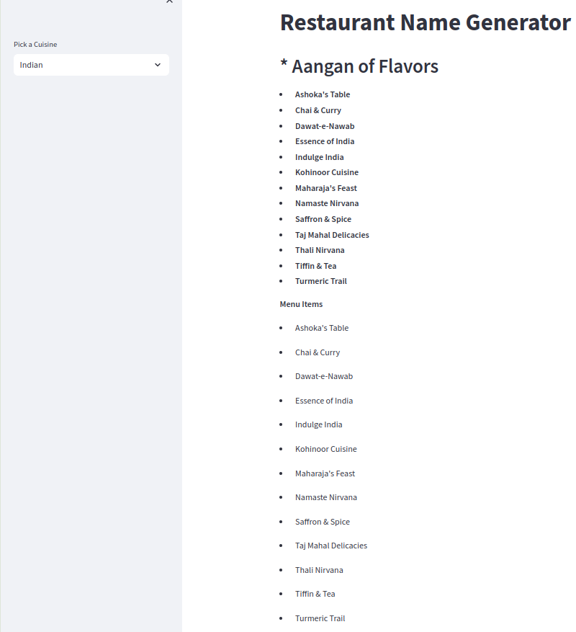
1.07 Streamlit
https://www.youtube.com/watch?v=nAmC7SoVLd8&list=PLeo1K3hjS3uu0N_0W6giDXzZIcB07Ng_F&index=1
Streamlit (27:11-27:20/46:07)
Select “Indian”

Slide 16
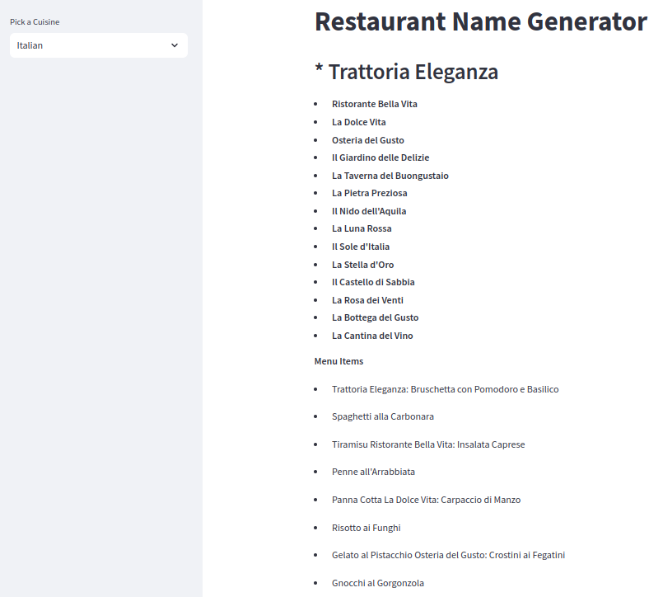
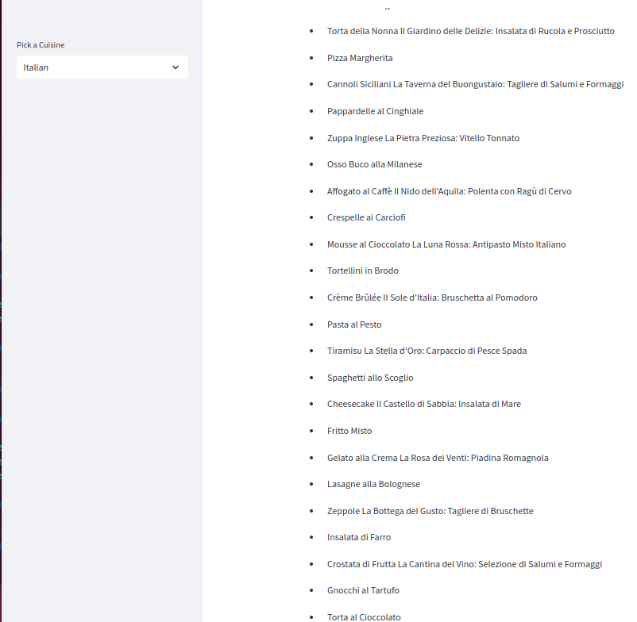
1.07 Streamlit
https://www.youtube.com/watch?v=nAmC7SoVLd8&list=PLeo1K3hjS3uu0N_0W6giDXzZIcB07Ng_F&index=1
Streamlit (27:21-27:30/46:07)
Select “Italian”

Slide 17
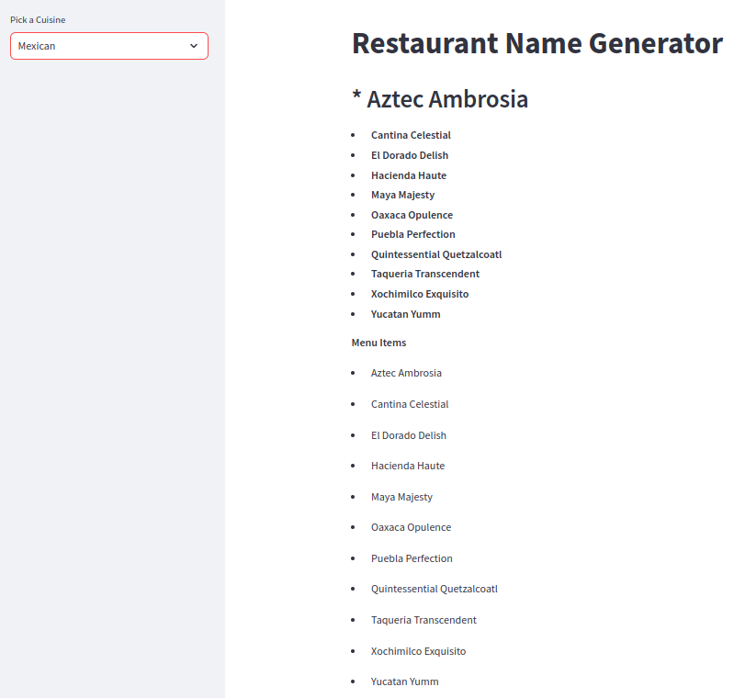
1.07 Streamlit
https://www.youtube.com/watch?v=nAmC7SoVLd8&list=PLeo1K3hjS3uu0N_0W6giDXzZIcB07Ng_F&index=1
Streamlit (27:31-27:35/46:07)
Select “Mexican”

Slide 18
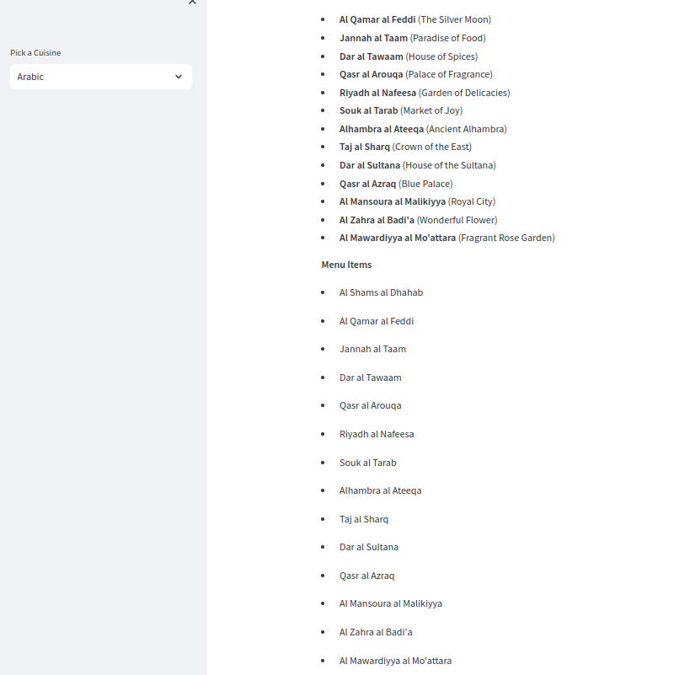
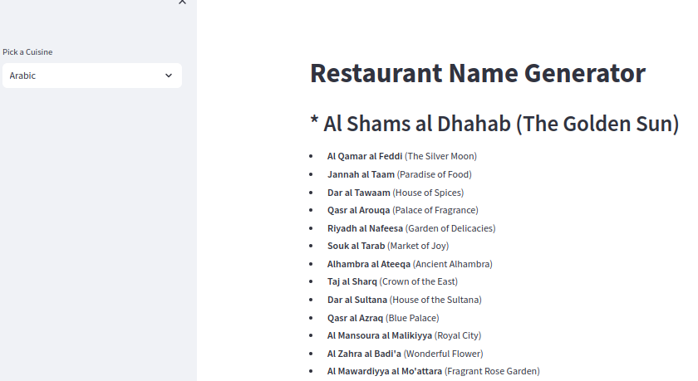
1.07 Streamlit
https://www.youtube.com/watch?v=nAmC7SoVLd8&list=PLeo1K3hjS3uu0N_0W6giDXzZIcB07Ng_F&index=1
Streamlit (27:36-27:37/46:07)
Select “Arabic”

Slide 19
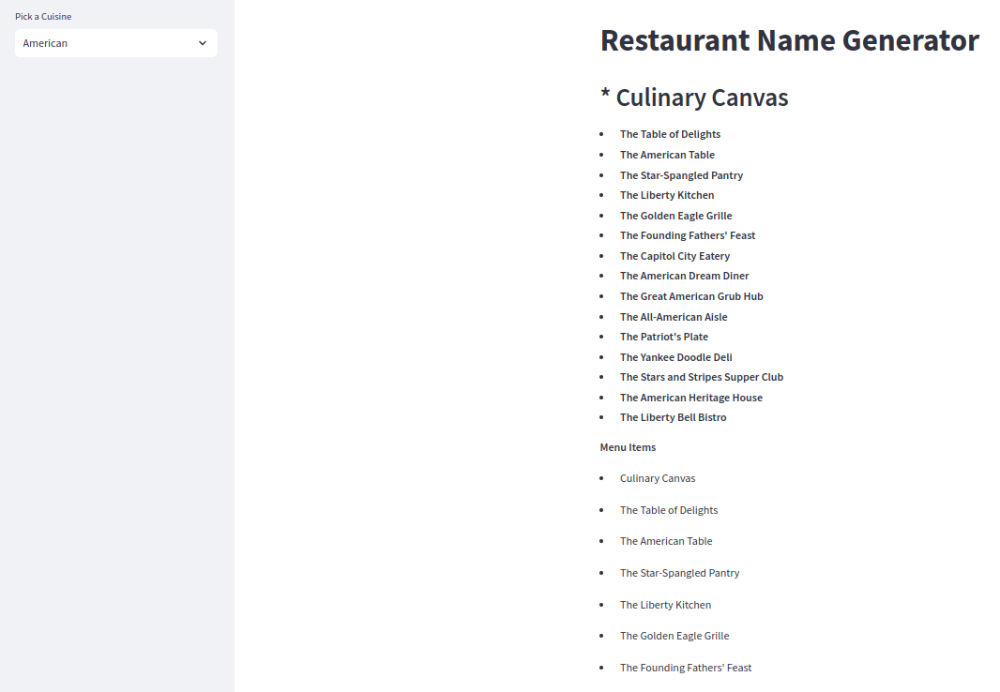
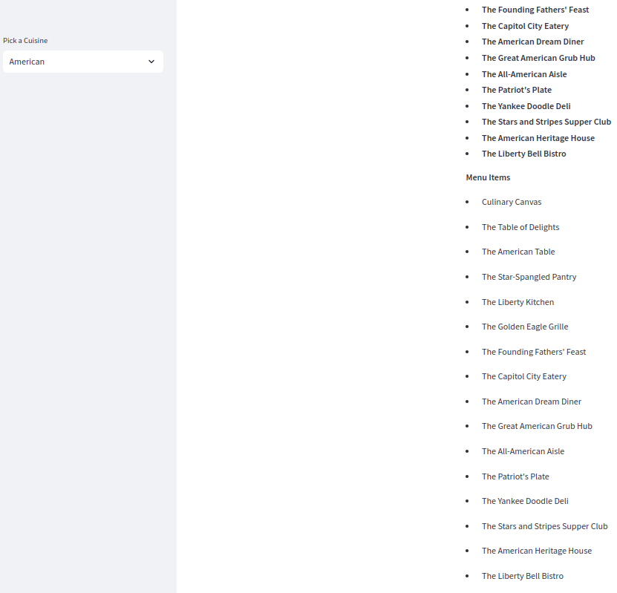
1.07 Streamlit
https://www.youtube.com/watch?v=nAmC7SoVLd8&list=PLeo1K3hjS3uu0N_0W6giDXzZIcB07Ng_F&index=1
Streamlit (27:38-27:40/46:07)
Select “American”

Slide 20
End

