Slide 1

4.12 Simple Sequential Chain
Peter H. Chen

Slide 2
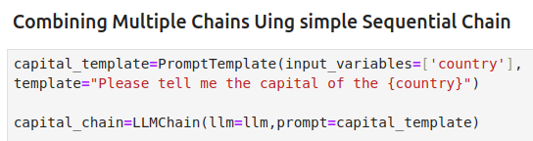
4.12 Simple Sequential Chain
https://www.youtube.com/watch?v=qMIM7dECAkc&list=PLZoTAELRMXVORE4VF7WQ_fAl0L1Gljtar&index=5
Simple Sequential Chain (34:01-37:00/1:18:23)
We discussed the Simple and Simple Sequential Chain in LangChain.
Question:
If I have multiple chains, for example, 3 chains or 4 chains, how can we combine them together?
Here, we combine multiple chains using simple Simple Sequential Chain.
1. Create multiple chains
2. Create multiple prompt templates.
Here, we
1. Create capital_templates with input variable [‘country’] and template =”tell me about the capital of {country}”.
2. Create capital_chain with LLMChain(llm=llm, prompt=capital_template)

Slide 3
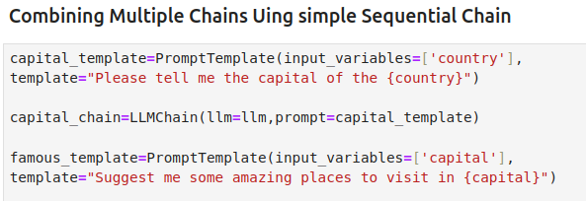
4.12 Simple Sequential Chain
https://www.youtube.com/watch?v=qMIM7dECAkc&list=PLZoTAELRMXVORE4VF7WQ_fAl0L1Gljtar&index=5
Simple Sequential Chain (37:01-38:30/1:18:23)
Now, we want to create another prompt.
How to do that?
We create famous_template with input variables =[‘capital’] and template = “Suggest some places to visit in {capital}”

Slide 4
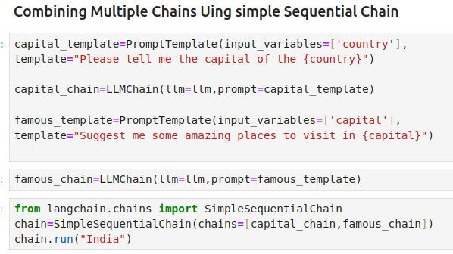
4.12 Simple Sequential Chain
https://www.youtube.com/watch?v=qMIM7dECAkc&list=PLZoTAELRMXVORE4VF7WQ_fAl0L1Gljtar&index=5
Simple Sequential Chain (37:01-38:30/1:18:23)
Now, we want to chain the multiple template together.
1. We create another chain call “famous_chain”.
Now, we have capital_chain and famous_chain.
We can use SimpleSequentialChain() to chain capital_chain and famous_chain together.

Slide 5
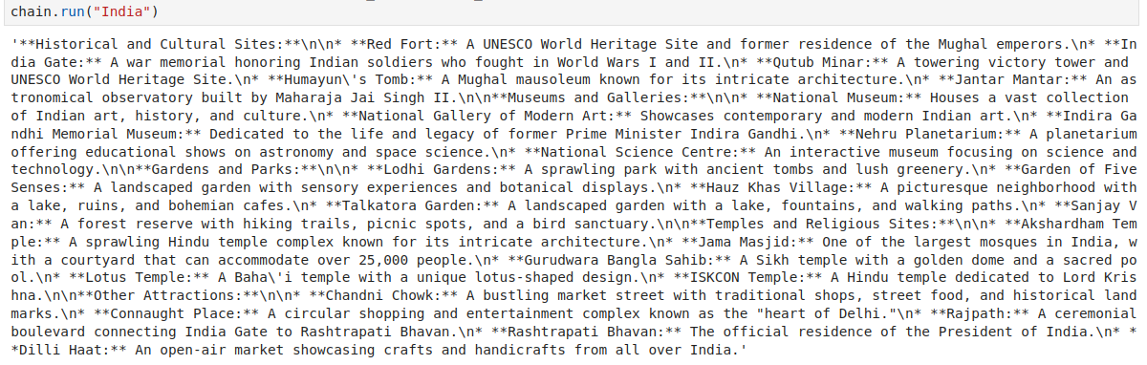
4.12 Simple Sequential Chain
https://www.youtube.com/watch?v=qMIM7dECAkc&list=PLZoTAELRMXVORE4VF7WQ_fAl0L1Gljtar&index=5
Simple Sequential Chain (38:31-40:10/1:18:23)
Run capital_chain and famous_chain together.

Slide 6
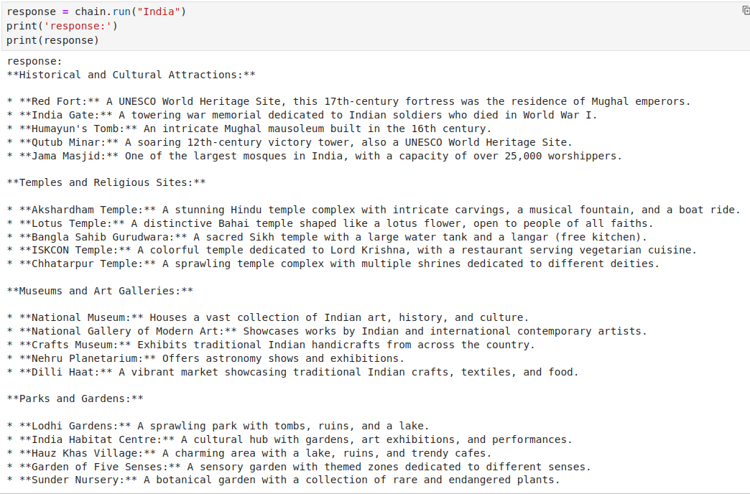
4.12 Simple Sequential Chain
https://www.youtube.com/watch?v=qMIM7dECAkc&list=PLZoTAELRMXVORE4VF7WQ_fAl0L1Gljtar&index=5
Simple Sequential Chain (40:11-40:20/1:18:23)
Save result and print.

Slide 7
4.12 Simple Sequential Chain
https://www.youtube.com/watch?v=qMIM7dECAkc&list=PLZoTAELRMXVORE4VF7WQ_fAl0L1Gljtar&index=5
Simple Sequential Chain (40:21-40:22/1:18:23)
Input “USA” for capital_chain and famous_chain.

Slide 8
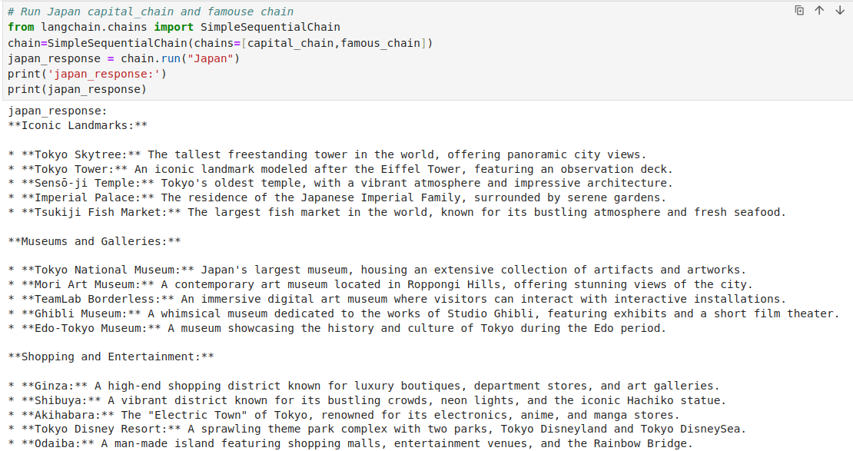
4.12 Simple Sequential Chain
https://www.youtube.com/watch?v=qMIM7dECAkc&list=PLZoTAELRMXVORE4VF7WQ_fAl0L1Gljtar&index=5
Simple Sequential Chain (40:23-40:24/1:18:23)
Test “Japan” for capital_chain and famous_chain.

Slide 9
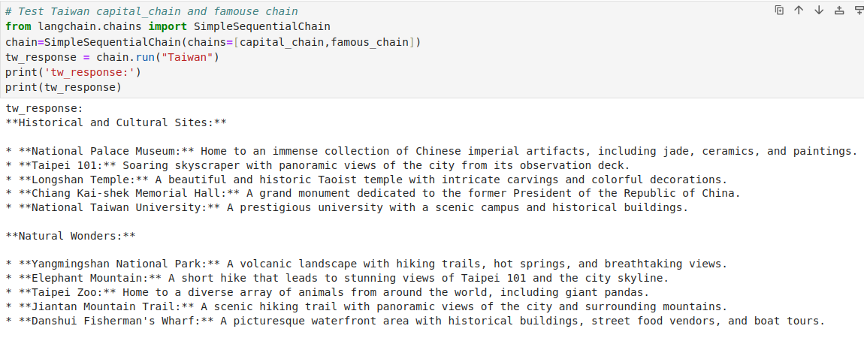
4.12 Simple Sequential Chain
https://www.youtube.com/watch?v=qMIM7dECAkc&list=PLZoTAELRMXVORE4VF7WQ_fAl0L1Gljtar&index=5
Simple Simple Sequential Chain (40:23-41:20/1:18:23)
Test “Taiwan” for capital_chain and famous_chain.

Slide 10
4.12 Simple Sequential Chain
https://www.youtube.com/watch?v=qMIM7dECAkc&list=PLZoTAELRMXVORE4VF7WQ_fAl0L1Gljtar&index=5
Simple Simple Sequential Chain (41:21-41:30/1:18:23)
Here, we only see the last output.
We give
1. one input {country} for capital_chain and generate output {capital}, then
2. we input {capital} for famous_chain and generate final response.
If we want to see the information between the chain, we need to to use buffer memory.

Slide 11
4.13 Sequential Chain

Slide 12
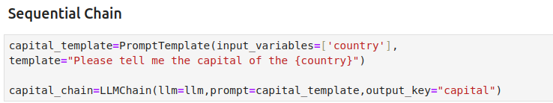
4.13 Sequential Chain
https://www.youtube.com/watch?v=qMIM7dECAkc&list=PLZoTAELRMXVORE4VF7WQ_fAl0L1Gljtar&index=5
Sequential Chain (41:41-43:00/1:18:23)
We will use chat model of Google Gemini later on.
Now, we will see the LLM Sequential Chain from LangChain.
For LangChain Sequential Chain, we need both input variables and output key.
Below, we create the capital_chain with capital template, input variables, and output key.

Slide 13
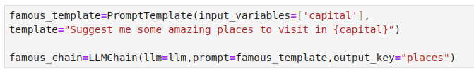
4.13 Sequential Chain
https://www.youtube.com/watch?v=qMIM7dECAkc&list=PLZoTAELRMXVORE4VF7WQ_fAl0L1Gljtar&index=5
Sequential Chain (43:01-45:00/1:18:23)
We create the famous_chain with famous template, input variables, and output key.
s

Slide 14
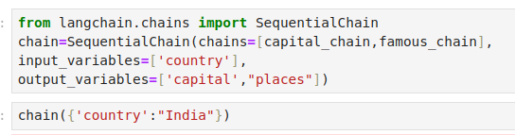
4.13 Sequential Chain
https://www.youtube.com/watch?v=qMIM7dECAkc&list=PLZoTAELRMXVORE4VF7WQ_fAl0L1Gljtar&index=5
Sequential Chain (45:01-45:30/1:18:23)
Create the entire chain for capital chain and famous chain.

Slide 15
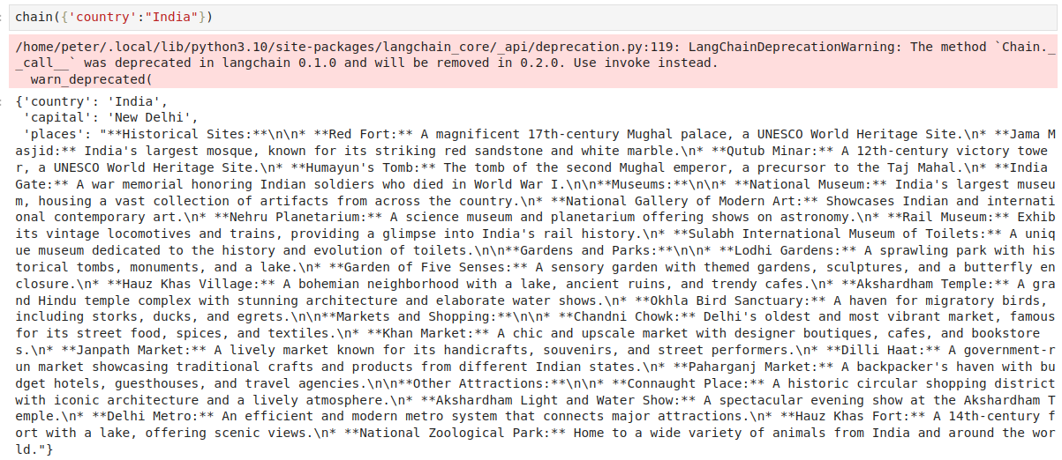
4.13 Sequential Chain
https://www.youtube.com/watch?v=qMIM7dECAkc&list=PLZoTAELRMXVORE4VF7WQ_fAl0L1Gljtar&index=5
Sequential Chain (45:31-46:00/1:18:23)
Now, we run the entire chain.

Slide 16
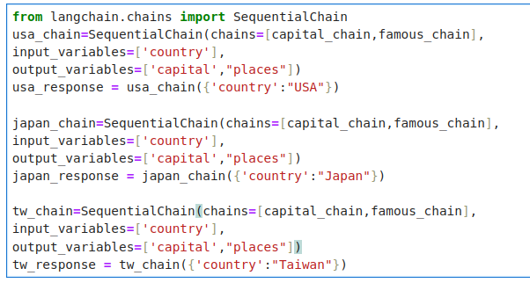
4.13 Sequential Chain
https://www.youtube.com/watch?v=qMIM7dECAkc&list=PLZoTAELRMXVORE4VF7WQ_fAl0L1Gljtar&index=5
Sequential Chain (46:01-46:10/1:18:23)
Now, we test for USA, Japan, and Taiwan.

Slide 17
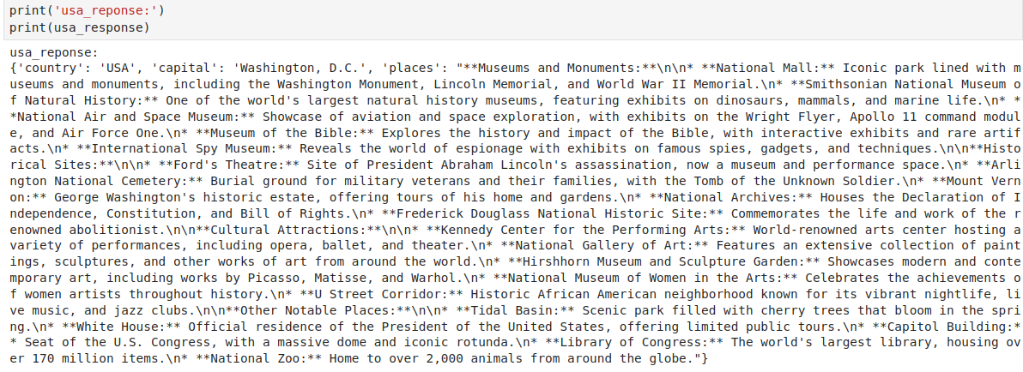
4.13 Sequential Chain
https://www.youtube.com/watch?v=qMIM7dECAkc&list=PLZoTAELRMXVORE4VF7WQ_fAl0L1Gljtar&index=5
Sequential Chain (46:01-46:10/1:18:23)
Print USA response

Slide 18
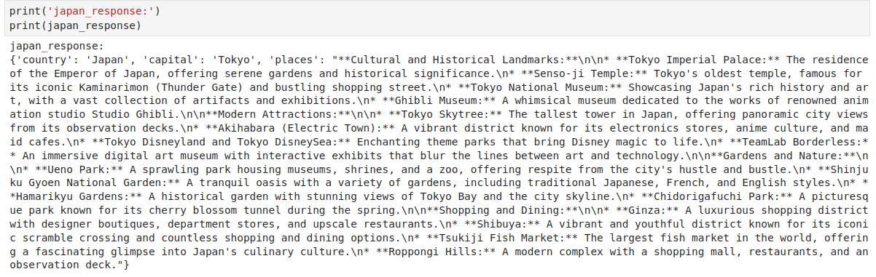
4.13 Sequential Chain
https://www.youtube.com/watch?v=qMIM7dECAkc&list=PLZoTAELRMXVORE4VF7WQ_fAl0L1Gljtar&index=5
Sequential Chain (46:11-46:15/1:18:23)
Print Japan response

Slide 19
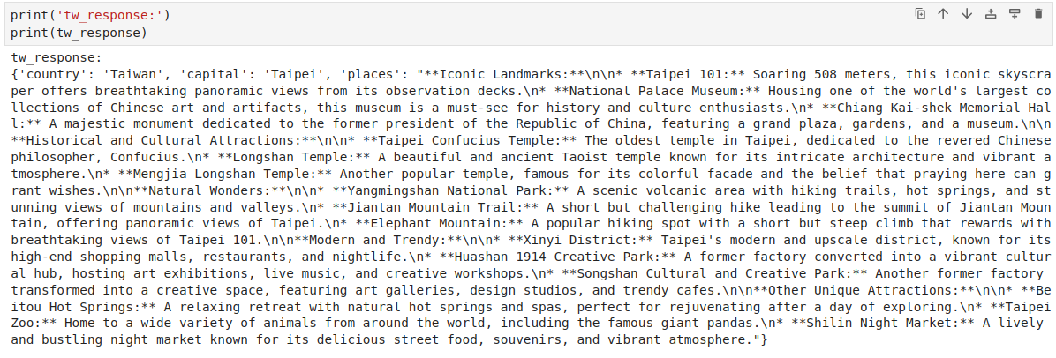
4.13 Sequential Chain
https://www.youtube.com/watch?v=qMIM7dECAkc&list=PLZoTAELRMXVORE4VF7WQ_fAl0L1Gljtar&index=5
Sequential Chain (46:11-46:15/1:18:23)
Print Taiwan response

Slide 20
End

