Slide 1

37 GRU
Peter H. Chen

Slide 2
37 GRU
https://www.youtube.com/watch?v=tOuXgORsXJ4&list=PLeo1K3hjS3uu7CxAacxVndI4bE_o3BDtO&index=37
GRU (0:00-0:15/8:14)
GRU (Gated Recurrent Unit) is invented in 2014. GRU is newer than LSTM (Long/Short Term Memory).
https://en.wikipedia.org/wiki/Gated_recurrent_unit
Gated recurrent unit (GRU) are a gating mechanism in recurrent neural networks.
GRU is like a long short-term memory (LSTM) with a gating mechanism to input or forget certain features, but lacks a context vector or output gate, resulting in fewer parameters than LSTM.
GRU performance on certain tasks of polyphonic music modeling, speech signal modeling, and natural language processing are similar to that of LSTM.
GRU
(Gated Recurrent Unit)

Slide 3

37 GRU
https://www.youtube.com/watch?v=tOuXgORsXJ4&list=PLeo1K3hjS3uu7CxAacxVndI4bE_o3BDtO&index=37
GRU (0:17-0:20/8:14)
RNN suffered Short-Term Memory problem.

Slide 4
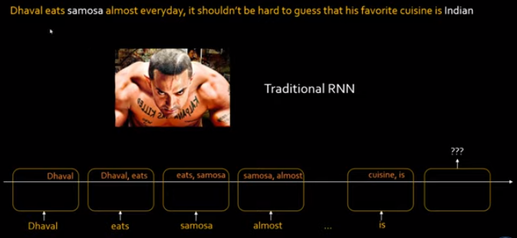
37 GRU
https://www.youtube.com/watch?v=tOuXgORsXJ4&list=PLeo1K3hjS3uu7CxAacxVndI4bE_o3BDtO&index=37
GRU (0:21-1:00/8:14)
Because RNN does not have memory to keep track of the past keywords, RNN can only make prediction based on nearby keywords and cannot make the correct prediction based on the past keywords.
Traditional RNN has short term memory. We input the statements. We only know the last two keywords. RNN cannot make correct prediction based on these two words. RNN has to remember “samosa (咖哩角)” to make correct prediction “Indian (Food)”.

Slide 5
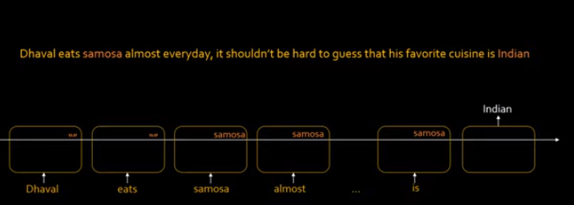
37 GRU
https://www.youtube.com/watch?v=tOuXgORsXJ4&list=PLeo1K3hjS3uu7CxAacxVndI4bE_o3BDtO&index=37
GRU (1:04-1:30/8:14)
If we have the input sequences and meaningful keyword “samosa (咖哩角)” as below, then we can make the correct prediction “Indian (Food)”.
In the LSTM (Long/Short Term Memory), we scan the keywords and store the meaningful keyword “samosa (咖哩角)” in the list.

Slide 6
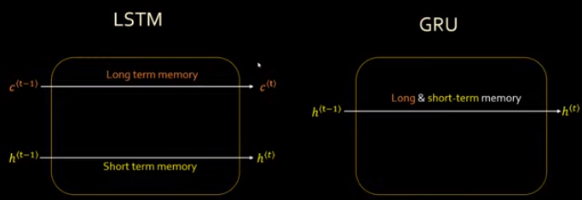
37 GRU
https://www.youtube.com/watch?v=tOuXgORsXJ4&list=PLeo1K3hjS3uu7CxAacxVndI4bE_o3BDtO&index=37
GRU (1:51-2:10/8:14)
In, LSTM, in stead of short term RNN memory, we add long term memory cell.
GRU (Gated Recurrent Unit), is a lightweight version of LSTM.
GRU combined the long and short term memory together into GRU hidden state.
Below, we see the basic difference:
1. LSTM has two states: memory cell state (Long term memory) and neural network hidden state (short term memory).
2. GRU combines both long and short term memory.

Slide 7
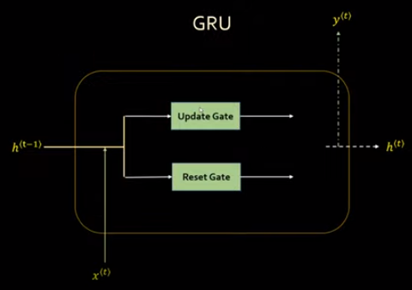
37 GRU
https://www.youtube.com/watch?v=tOuXgORsXJ4&list=PLeo1K3hjS3uu7CxAacxVndI4bE_o3BDtO&index=37
GRU (2:14-2:50/8:14)
LSTM has three components: Forget Gate, Input gate, Output Gate.
GRU architecture contains two components: Reset Gate and Update Gate.
Update Gate: How much of past memory to retain.
Reset Gate: How much of past memory to forget.
Update gate
How much of past memory to retain
Reset gate
How much of past memory to forget

Slide 8

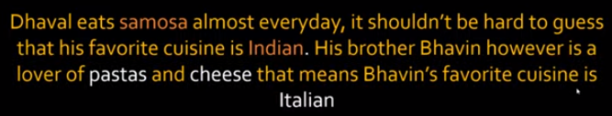
37 GRU
https://www.youtube.com/watch?v=tOuXgORsXJ4&list=PLeo1K3hjS3uu7CxAacxVndI4bE_o3BDtO&index=37
GRU (2:57-3:40/8:14)
We have the short statement for Indian (Food) and longer statement for Italian (Food) as below.

Slide 9
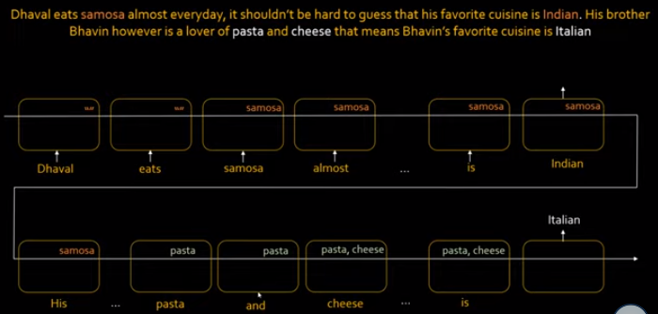
37 GRU
https://www.youtube.com/watch?v=tOuXgORsXJ4&list=PLeo1K3hjS3uu7CxAacxVndI4bE_o3BDtO&index=37
GRU (4:10-4:45/8:14)
At beginning, we have keyword “samosa”, and prediction “Indian”.
Then, we have “pasta” and then “pasta, cheese” and prediction “Italian”.

Slide 10
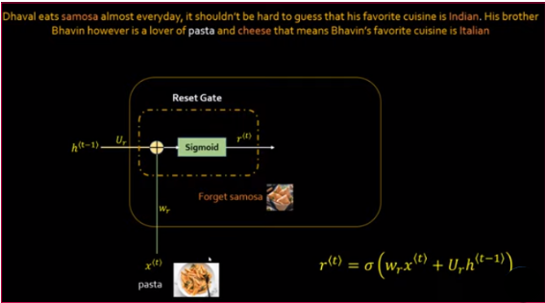
37 GRU
https://www.youtube.com/watch?v=tOuXgORsXJ4&list=PLeo1K3hjS3uu7CxAacxVndI4bE_o3BDtO&index=37
GRU (4:50-5:10/8:14)
The Rest Gate contain the sigmoid function to forget the “samosa”.
The r(t) is the function that provides the reset value.

Slide 11
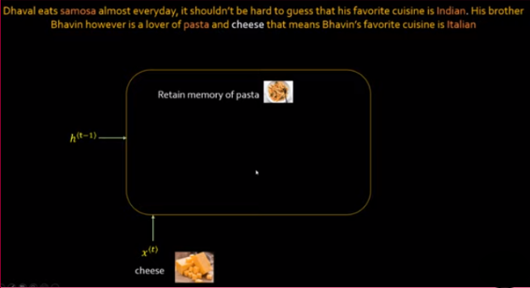
37 GRU
https://www.youtube.com/watch?v=tOuXgORsXJ4&list=PLeo1K3hjS3uu7CxAacxVndI4bE_o3BDtO&index=37
GRU (4:50-5:20/8:14)
Below, the Rest Gate
1. Clean up the “samosa” and
2. store “pasta”

Slide 12
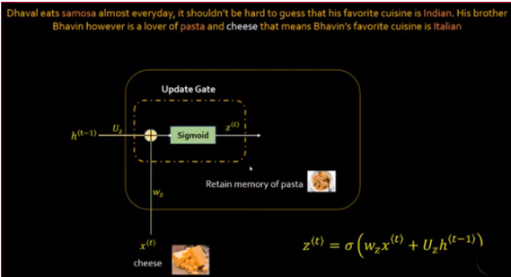
37 GRU
https://www.youtube.com/watch?v=tOuXgORsXJ4&list=PLeo1K3hjS3uu7CxAacxVndI4bE_o3BDtO&index=37
GRU (5:27-5:50/8:14)
Below, the “Update Gate” is similar to “Reset Gate”.
We have sigmoid function z(t) instead of r(t).
1. Input “cheese”.
2. Add “cheese” to “pasta”.

Slide 13
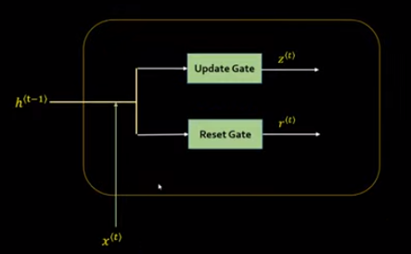
37 GRU
https://www.youtube.com/watch?v=tOuXgORsXJ4&list=PLeo1K3hjS3uu7CxAacxVndI4bE_o3BDtO&index=37
GRU (6:07-6:15/8:14)
So far, we have Reset Gate and Update Gate.
The Rest Gate output is r(t) and Update Gate output is z(t).
How to use the output r(t) and output z(t)?

Slide 14
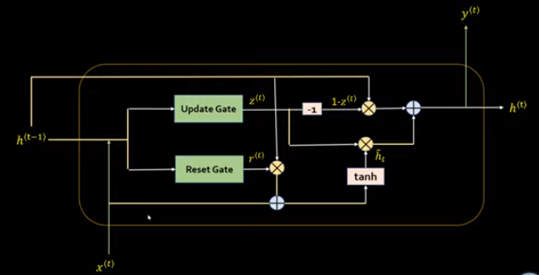
37 GRU
https://www.youtube.com/watch?v=tOuXgORsXJ4&list=PLeo1K3hjS3uu7CxAacxVndI4bE_o3BDtO&index=37
GRU (6:19-6:25/8:14)
Below diagram show the relation of y(t)/h(t) and r(t)/z(t).

Slide 15
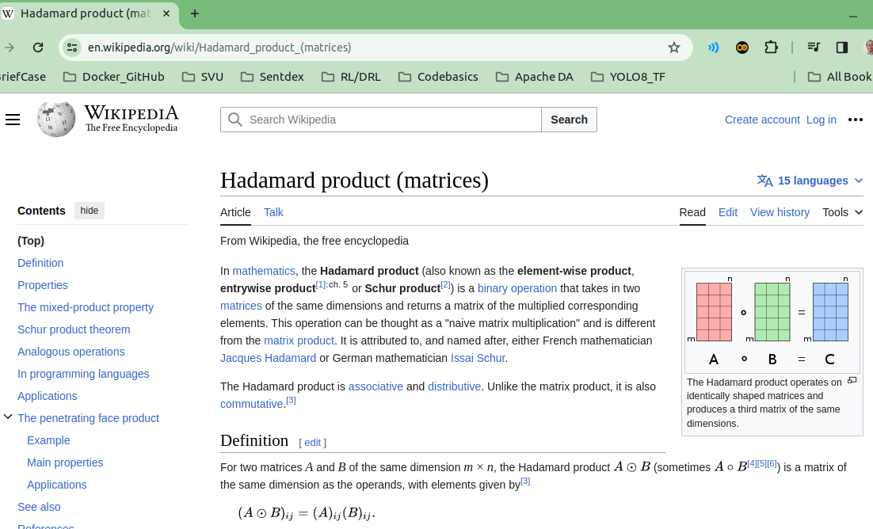
37 GRU
https://www.youtube.com/watch?v=tOuXgORsXJ4&list=PLeo1K3hjS3uu7CxAacxVndI4bE_o3BDtO&index=37
GRU (6:32-6:40/8:14)
The Hadamard product has element-wise product for binary operation.

Slide 16
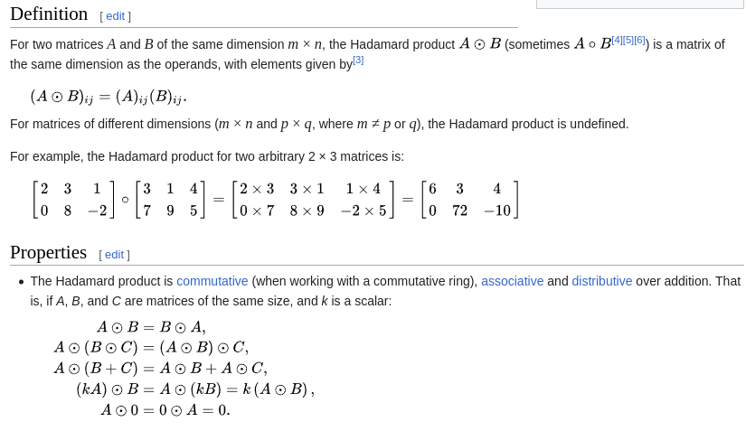
37 GRU
https://www.youtube.com/watch?v=tOuXgORsXJ4&list=PLeo1K3hjS3uu7CxAacxVndI4bE_o3BDtO&index=37
GRU (6:44-6:50/8:14)
Example of Hadamard product for element-wise binary operation.

Slide 17
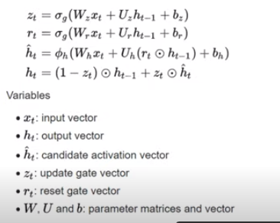
37 GRU
https://www.youtube.com/watch?v=tOuXgORsXJ4&list=PLeo1K3hjS3uu7CxAacxVndI4bE_o3BDtO&index=37
GRU (6:59-7:20/8:14)
https://en.wikipedia.org/wiki/Gated_recurrent_unit
Math equation for GRU (Gated Recurrent Unit).

Slide 18
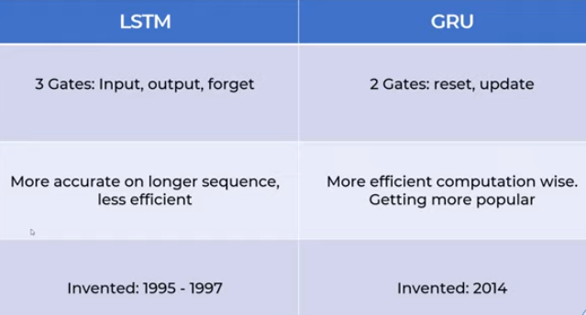
37 GRU
https://www.youtube.com/watch?v=tOuXgORsXJ4&list=PLeo1K3hjS3uu7CxAacxVndI4bE_o3BDtO&index=37
GRU (7:27-8:00/8:14)
LSTM (Long/Short Term Memory) vs. GRU (Gated Recurrent Unit) comparison:
1. LSTM (1995-1997)
1.a LSTM has 3-Gates: Forget Gate, Input Gate, Output Gate
1.b More accurate for long sequences, less efficient
2. GRU (2014)
2.a GRU has 2-Gates: Reset Gate, Update Gate.
2.b More efficient in computation and more popular.

Slide 19
End

