Slide 1

38 Bidirectional RNN
Peter H. Chen

Slide 2
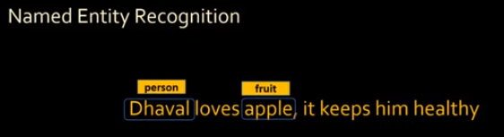
38 Bidirectional RNN
https://www.youtube.com/watch?v=atYPhweJ7ao&list=PLeo1K3hjS3uu7CxAacxVndI4bE_o3BDtO&index=38
Bidirectional RNN (0:00-0:30/5:49)
In NER (Named Entity Recognition) to classify Person (Dhaval) and Fruit (Apple).
What is NER (Named Entity Recognition)?
1. NER is a form of natural language processing (NLP) that involves extracting and identifying essential information from text.
2. The information that is extracted and categorized is called entity.
3. NER can be any word or a series of words that consistently refers to the same thing.

Slide 3
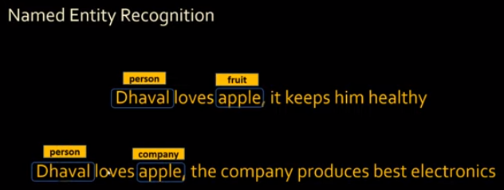
38 Bidirectional RNN
https://www.youtube.com/watch?v=atYPhweJ7ao&list=PLeo1K3hjS3uu7CxAacxVndI4bE_o3BDtO&index=38
Bidirectional RNN (0:34-0:50/5:49)
Below is another sentence, here “apple” is not a fruit. “Apple” is a company.
When you read the first part of the sentence, you will not know Apple is a company.

Slide 4
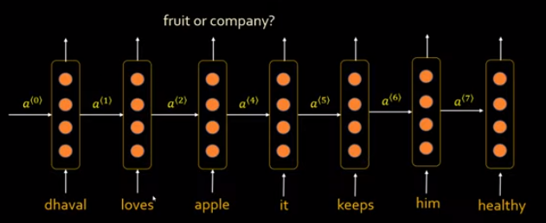
38 Bidirectional RNN
https://www.youtube.com/watch?v=atYPhweJ7ao&list=PLeo1K3hjS3uu7CxAacxVndI4bE_o3BDtO&index=38
Bidirectional RNN (0:53-1:30/5:49)
Below is another sentence, here “apple” is not a fruit. “Apple” is a company.
When you read the first part of the sentence, you do not know Apple is a fruit or Apple is a company.
For simple RNN which is one direction.

Slide 5
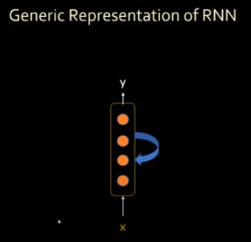
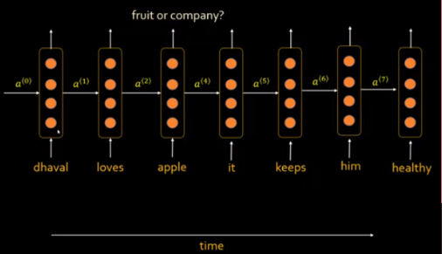
38 Bidirectional RNN
https://www.youtube.com/watch?v=atYPhweJ7ao&list=PLeo1K3hjS3uu7CxAacxVndI4bE_o3BDtO&index=38
Bidirectional RNN (1:32-2:30/5:49)
The generic Representation of Simple RNN is as left below.
It is a simple neural network. We feed in word by word to this network.
When we unroll in time, we have right below.

Slide 6
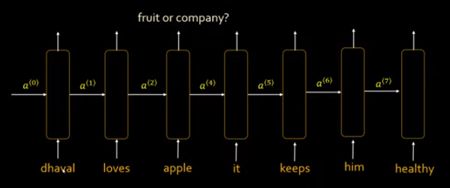
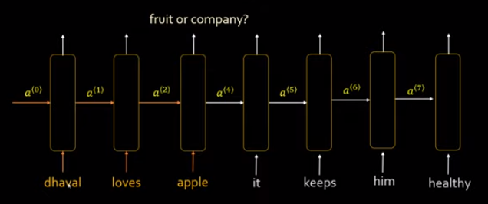
38 Bidirectional RNN
https://www.youtube.com/watch?v=atYPhweJ7ao&list=PLeo1K3hjS3uu7CxAacxVndI4bE_o3BDtO&index=38
Bidirectional RNN (2:32-3:20/5:49)
When we move RNN, we have the empty box.
It can be a LSTM cell or GRU cell inside the network.
When it is single direction RNN, then the output for word “apple” will be influenced by those colored words.
But if we want to make the prediction, we need the words after “apple” in the future.

Slide 7
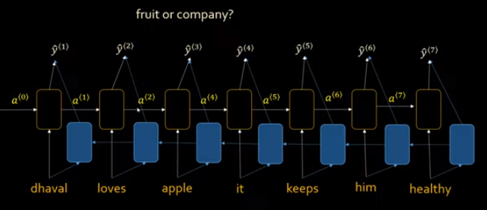
38 Bidirectional RNN
https://www.youtube.com/watch?v=atYPhweJ7ao&list=PLeo1K3hjS3uu7CxAacxVndI4bE_o3BDtO&index=38
Bidirectional RNN (3:33-3:50/5:49)
If we add another layer (with blue color cells) which processes the words from right to left.

Slide 8
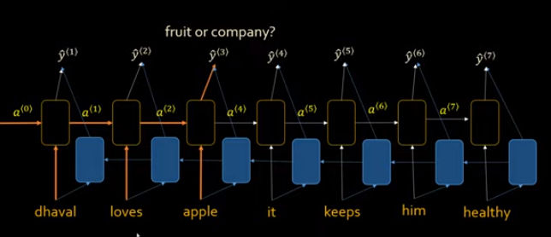
38 Bidirectional RNN
https://www.youtube.com/watch?v=atYPhweJ7ao&list=PLeo1K3hjS3uu7CxAacxVndI4bE_o3BDtO&index=38
Bidirectional RNN (3:33-4:20/5:49)
When we read the words from left to right.
The output ŷ: that output is a function of a(1) and a(2) (result of previous words)

Slide 9
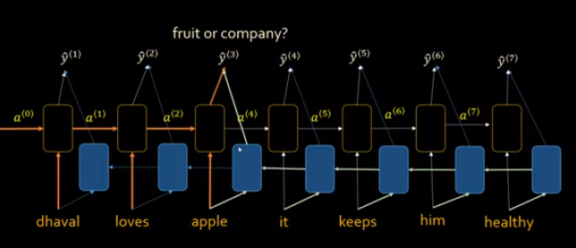
38 Bidirectional RNN
https://www.youtube.com/watch?v=atYPhweJ7ao&list=PLeo1K3hjS3uu7CxAacxVndI4bE_o3BDtO&index=38
Bidirectional RNN (4:29-5:49/5:49)
Now, we read from right to left.
We have the new lines influence of your future words as well.
We have the activation function result from left to right and from right to left.
We can make the correct decision ŷ based on both direction.

Slide 10
End

