Slide 1

03.03 Load Google API Key
Peter H. Chen

Slide 2
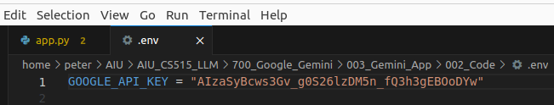
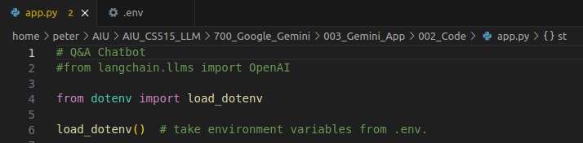
03.03 Load Google API Key
https://www.youtube.com/watch?v=CC6qMpqgUMU&list=PLZoTAELRMXVNbDmGZlcgCA3a8mRQp5axb&index=3
Load Google API Key (05:57-06:30/26:27)
1. We created GOOGLE_API_KEY in the “.env” file.
Now, we will create app.py for chatBot Q&A.
We are going to read the GOOGLE_API_KEY variable
2. Import the dotenv library and import function load_dotenv()
3. load_dotenv(): load all the environment variables from “.env” file.
1
2
3

Slide 3
03.04 Import Libraries

Slide 4
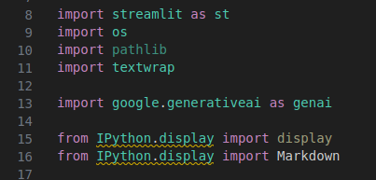
03.04 Import Libraries
https://www.youtube.com/watch?v=CC6qMpqgUMU&list=PLZoTAELRMXVNbDmGZlcgCA3a8mRQp5axb&index=3
Import Libraries (05:57-07:55/26:27)
1. Import streamlit for GUI.
2. import os for getting environment variable.
3. import generative AI for gemini model
We also can use langchain for “gemini-pro” and “gemini-pro-vision”.
Here, we use simple generative AI.
4. import os for getting the environment variable GOOGLE_API_KEY.
5. import textwrap for text processing.

Slide 5
03.05 Configure API Key for Gemini

Slide 6
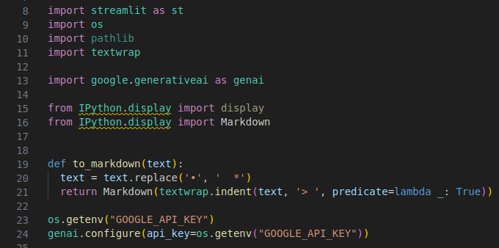
03.05 Configure API Key for Gemini
https://www.youtube.com/watch?v=CC6qMpqgUMU&list=PLZoTAELRMXVNbDmGZlcgCA3a8mRQp5axb&index=3
Configure API Key for Gemini (07:56-08:30/26:27)
We configure the API Key for Google Gemini Framework.
We use os.getenv(‘GOOGLE_API_KEY’) to the environment variable GOOGLE_API_KEY.
> genai.configure (api_key = os.getenv (“GOOGLE_API_KEY”)

Slide 7
03.06 Load Gemini Model

Slide 8
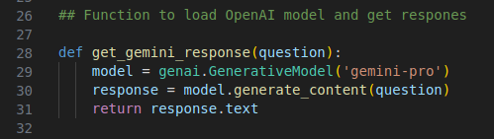
03.06 Load Gemini Model
https://www.youtube.com/watch?v=CC6qMpqgUMU&list=PLZoTAELRMXVNbDmGZlcgCA3a8mRQp5axb&index=3
Load Gemini Model (08:31-10:40/26:27)
We create a function and pass in parameter question
1. Use generative AI to create gemini-pro model
2. Use model.generative_content (question) and get the response
3. return the response.txt.

Slide 9
End

