Slide 1

03.07 Create Gemini GUI
Peter H. Chen

Slide 2
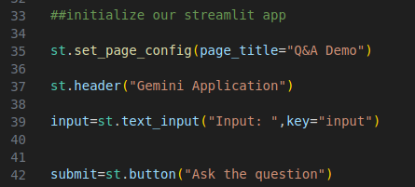
03.07 Create Gemini GUI
https://www.youtube.com/watch?v=CC6qMpqgUMU&list=PLZoTAELRMXVNbDmGZlcgCA3a8mRQp5axb&index=3
Create Gemini GUI (10:41-11:00/26:27)
Now, we create the GUI with three fields.
1. Create page title “Q&A Demo”
2. Create header “Gemini Application”.
3. Tex input label “Input” and return “input”.

Slide 3
03.08 Create Submit Button

Slide 4
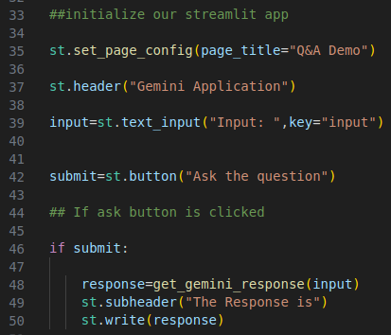
03.08 Create Submit Button
https://www.youtube.com/watch?v=CC6qMpqgUMU&list=PLZoTAELRMXVNbDmGZlcgCA3a8mRQp5axb&index=3
Create Submit Button (11:01-11:10/26:27)
Create the submit button.
> submit = st.button (“Ask the question”)

Slide 5
03.09 Submit and Response

Slide 6
03.09 Submit and Response
https://www.youtube.com/watch?v=CC6qMpqgUMU&list=PLZoTAELRMXVNbDmGZlcgCA3a8mRQp5axb&index=3
Submit and Response (11:11-12:30/26:27)
If submit button is clicked,
> response = get_gemini_response (input)
> st.subheader(“The Response is”)
> st.write (response)

Slide 7
End

