Slide 1

03.10 Run Gemini App
Peter H. Chen

Slide 2
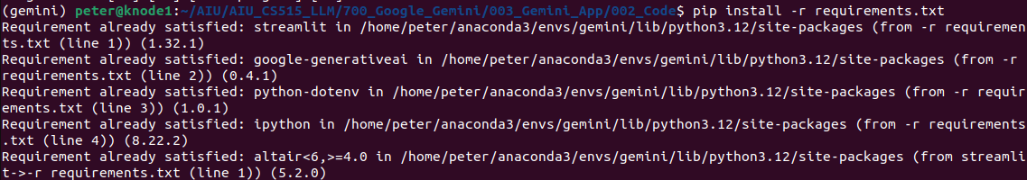
03.10 Run Gemini App
https://www.youtube.com/watch?v=CC6qMpqgUMU&list=PLZoTAELRMXVNbDmGZlcgCA3a8mRQp5axb&index=3
Run Gemini App (12:41-13:10/26:27)
Open terminal:
(base) > conda activate gemini
(gemini) > pip install -r requirements.txt
If there is no “ipython” installation, then
(gemini) > pip install ipython

Slide 3
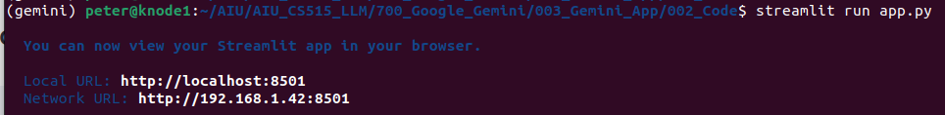
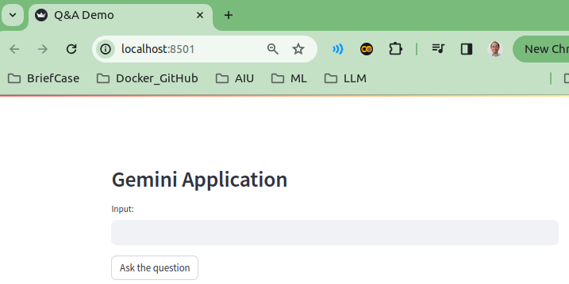
03.10 Run Gemini App
https://www.youtube.com/watch?v=CC6qMpqgUMU&list=PLZoTAELRMXVNbDmGZlcgCA3a8mRQp5axb&index=3
Run Gemini App (12:41-13:10/26:27)
Run gemini App:
> streamlit run app.py
>> http://192.168.1.42:8501
>> “192.168” is used for private IP Address. It avoids the conflicts with public Internet Address.
>> TCP uses port “8501” to establish the connection and exchange streams of data.

Slide 4
03.11 Test Input Question

Slide 5
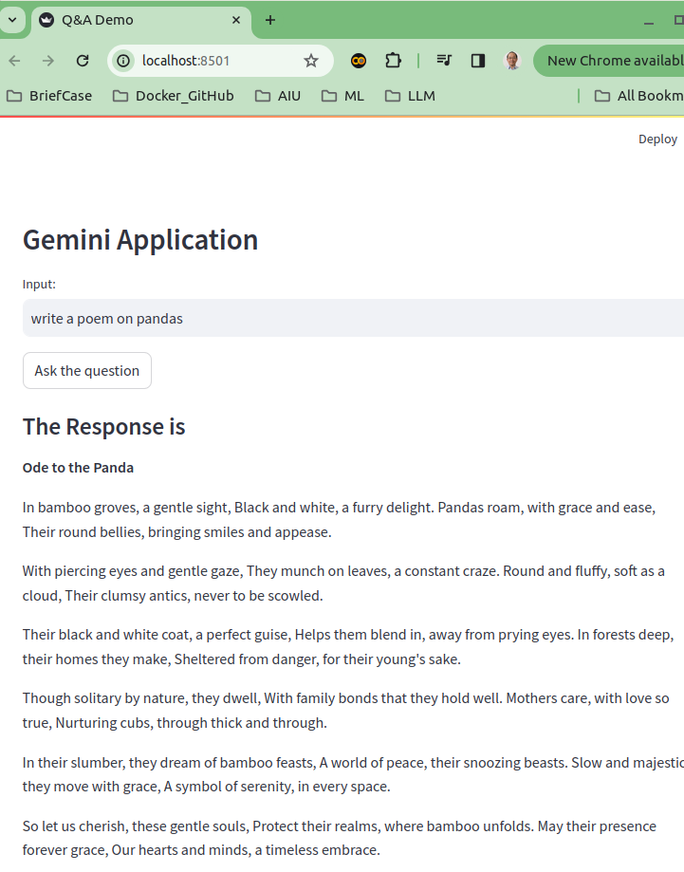
03.11 Test Input Question
https://www.youtube.com/watch?v=CC6qMpqgUMU&list=PLZoTAELRMXVNbDmGZlcgCA3a8mRQp5axb&index=3
Test Input Question (13:11-14:10/26:27)
Test Input Question: “write a poem on pandas”.
Ore (颂): the “song” of poem.
It is impressed.

Slide 6
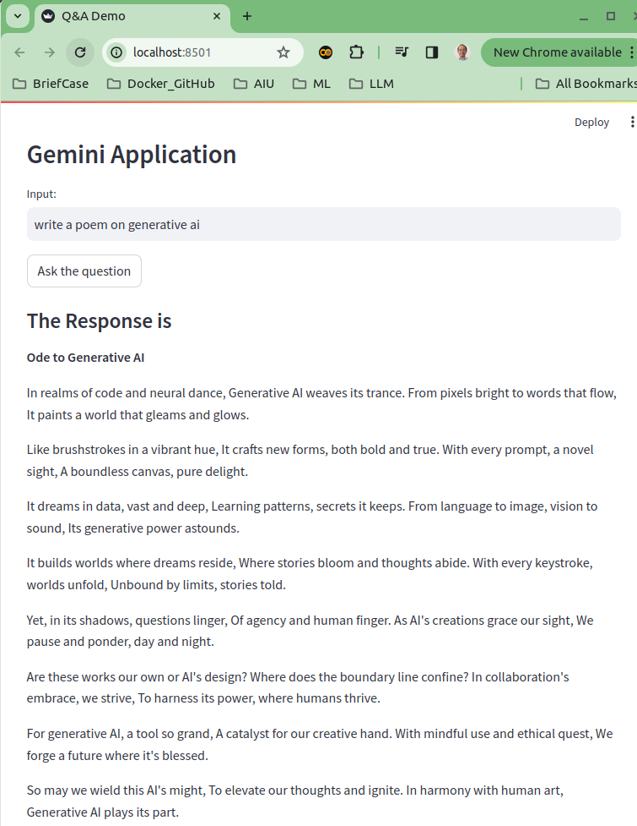
03.11 Test Input Question
https://www.youtube.com/watch?v=CC6qMpqgUMU&list=PLZoTAELRMXVNbDmGZlcgCA3a8mRQp5axb&index=3
Test Input Question (14:11-14:30/26:27)
Input questions: “write a poem on generative ai”
The response is good.

Slide 7
End

