Slide 1

6.17 Test PDF to Gemini
Peter H. Chen

Slide 2
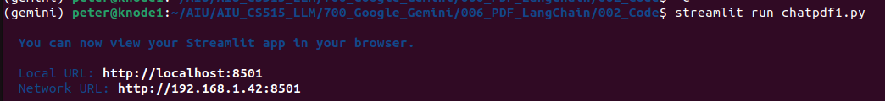
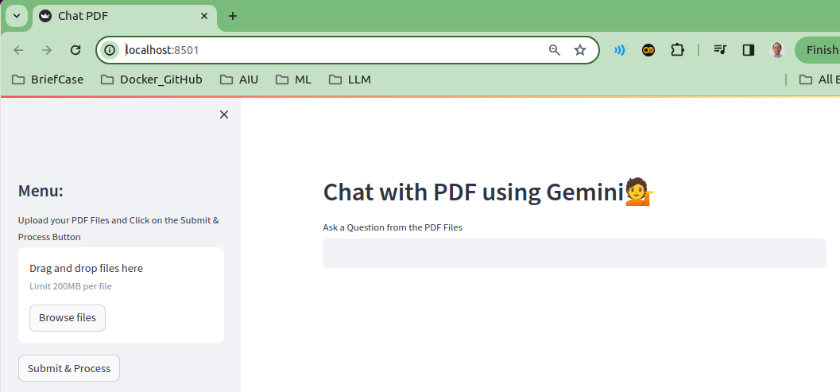
6.17 Test PDF to Gemini
https://www.youtube.com/watch?v=uus5eLz6smA&list=PLZoTAELRMXVNbDmGZlcgCA3a8mRQp5axb&index=6
Test PDF to Gemini (27:01-27:20/29:20)
> streamlit run chatpdf1.py

Slide 3
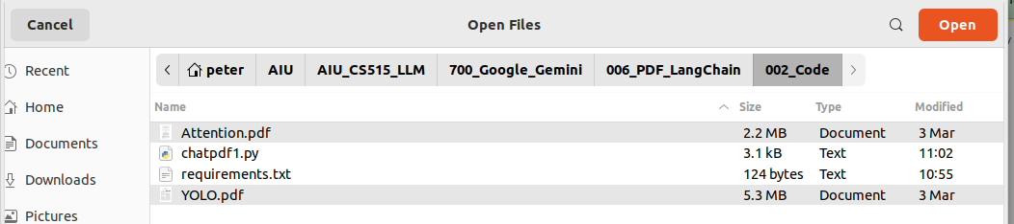
6.17 Test PDF to Gemini
https://www.youtube.com/watch?v=uus5eLz6smA&list=PLZoTAELRMXVNbDmGZlcgCA3a8mRQp5axb&index=6
Test PDF to Gemini (27:21-27:30/29:20)
Click “Browse files” button to upload “Attention.pdf” and “YOLO.pdf”

Slide 4
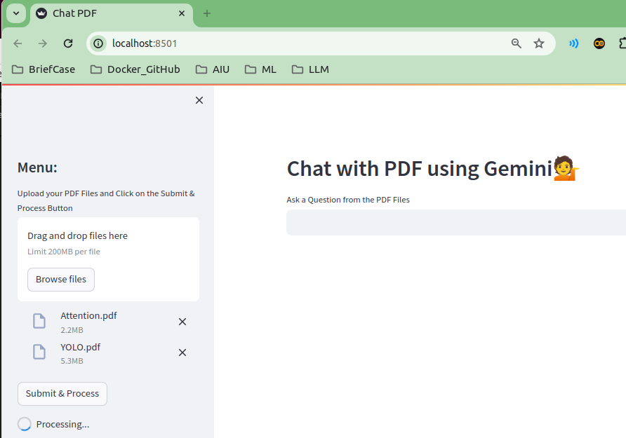
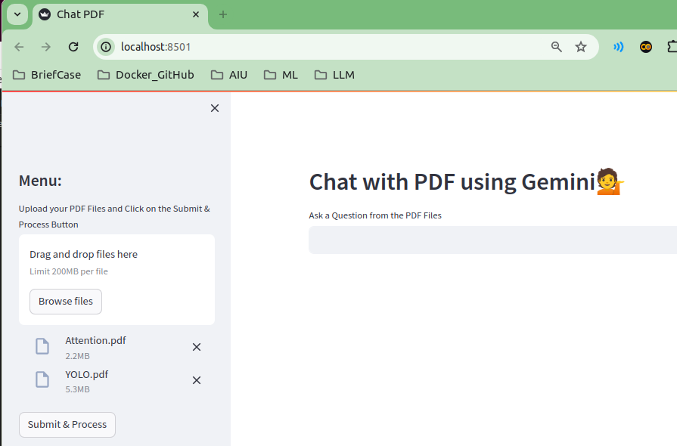
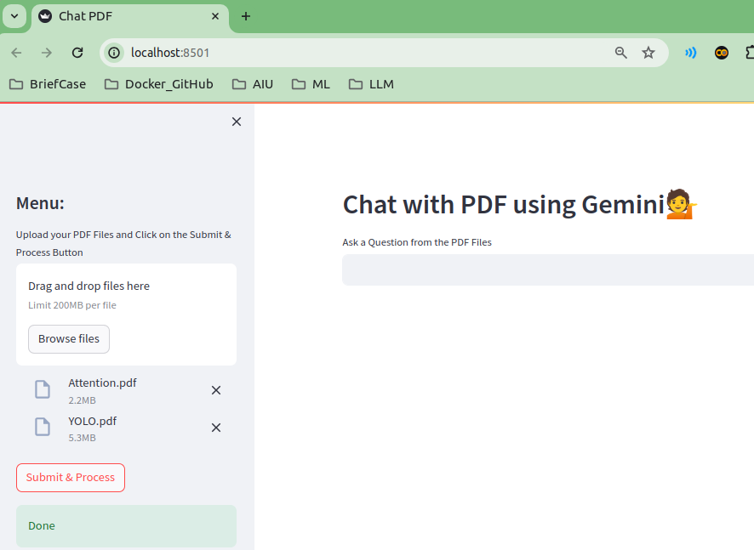
6.17 Test PDF to Gemini
https://www.youtube.com/watch?v=uus5eLz6smA&list=PLZoTAELRMXVNbDmGZlcgCA3a8mRQp5axb&index=6
Test PDF to Gemini (27:51-28:30/29:20)
1. After we load the file, we click “Submit & Process”
2. “Processing…”
3. Done

Slide 5
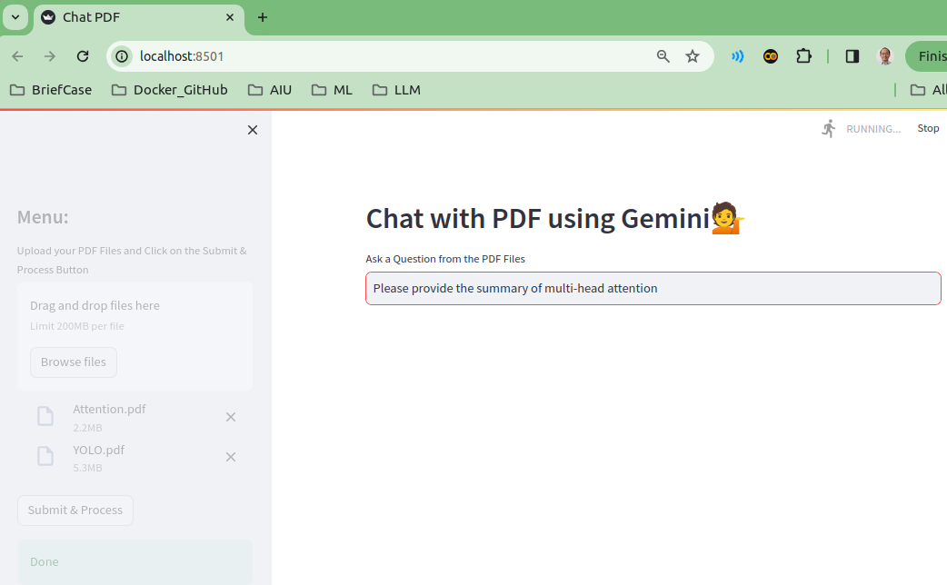
6.17 Test PDF to Gemini
https://www.youtube.com/watch?v=uus5eLz6smA&list=PLZoTAELRMXVNbDmGZlcgCA3a8mRQp5axb&index=6
Test PDF to Gemini (28:31-29:30/29:20)
Now, we open Attention.pdf and see which question (Multi-Head Attention) we are interested.
Quesiton: “Please provide the summary of multi-head attention”

Slide 6
End

