Slide 1

05 LC: Flan20B
Peter H. Chen

Slide 2
05 LC: Flan20B
https://www.youtube.com/watch?v=VW5LBavIfY4&list=PL8motc6AQftk1Bs42EW45kwYbyJ4jOdiZ&index=5
LC: Flan20B (00:00-00:01/10:54)
Some Terminology :
1. What is Flan-T5?
T5 (Text-To-Text Transfer Transformer): T5 is a series of LLM (Large Language Models) developed by Google AI. Introduced in 2019, T5 models are trained on a massive dataset of text and code using a text-to-text framework. The T5 models are capable of performing the text-based tasks that they were pretrained for.
2. What is relation of Gemini and Flan-T5?
Google LLM Gemini is a transformer based on Google T5 model. Gemini model is pre-trained on approximately 800k code/description pairs and then fine-tuned on 10k higher-level explanations that were synthetically generated. Gemini is capable of summarization/ explaining short to medium code snippets in: Python.
https://www.quora.com/Which-is-better-the-OpenAI-GPT-3-or-the-Google-Flan-T5

Slide 3
05 LC: Flan20B
https://www.youtube.com/watch?v=VW5LBavIfY4&list=PL8motc6AQftk1Bs42EW45kwYbyJ4jOdiZ&index=5
LC: Flan20B (00:01-00:30/10:54)
1. What is difference between GPT-3 and Flan-T5?
1.1 GPT-3 is a massive, generative language model with over 175 billion parameters. It can perform a variety of tasks such as language translation, question-answering, and text completion with high accuracy. However, it requires a lot of computational resources to run and is not optimized for specific NLP tasks.
1.2 Flan-T5, on the other hand, is a smaller, fine-tuned version of the T5 architecture, designed for specific NLP tasks such as text classification, summarization, and translation. It is more computationally efficient than GPT-3 and can perform these tasks with high accuracy, but it may not be as versatile as GPT-3 in generating human-like text.
We discuss the Google Flan-T5.
Since Google LLM/Gemini is based on Google Transformer Flan-T5, we can use LangChain instead of Flan-T5.

Slide 4
05.01 Install Libraries

Slide 5
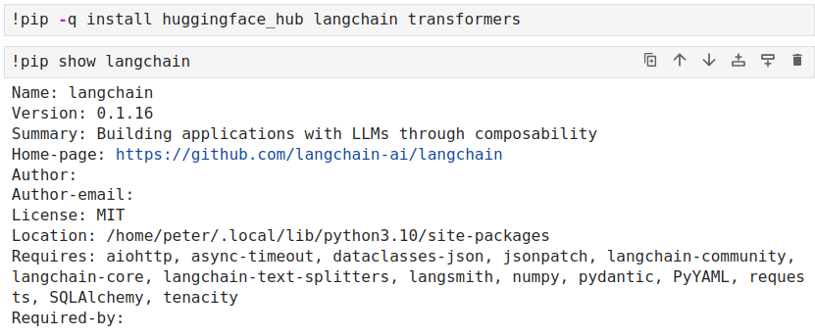
05.01 Install Libraries
https://www.youtube.com/watch?v=VW5LBavIfY4&list=PL8motc6AQftk1Bs42EW45kwYbyJ4jOdiZ&index=5
Install Libraries (00:31-01:00/10:54)
Install the libraries
1. huginngface_hub: HuggingFace Hub
2. langchain: LangChain
3. transformers: Transformers

Slide 6
05.02 HuggingFace API Key

Slide 7
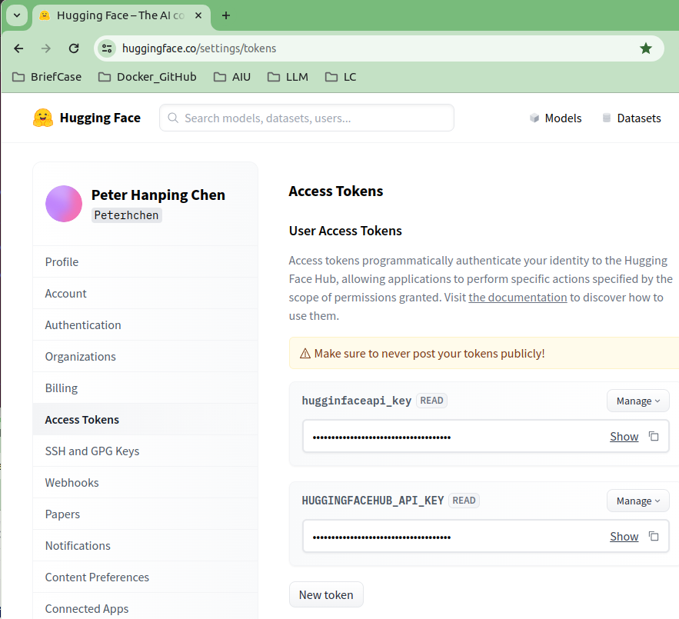

05.02 HuggingFace API Key
https://www.youtube.com/watch?v=VW5LBavIfY4&list=PL8motc6AQftk1Bs42EW45kwYbyJ4jOdiZ&index=5
Install Libraries (01:01-01:30/10:54)
1. Go to HuggingFace.co
2. Crete the HuggingFace API Token.
3. Copy token and Paste into your code.
os.environ[“HUGGINGFACEHUB_API_TOKEN”] = “...”
https://huggingface.co/settings/tokens

Slide 8
05.03 Import HuggingFace Library

Slide 9
05.03 Import HuggingFace Library
https://www.youtube.com/watch?v=VW5LBavIfY4&list=PL8motc6AQftk1Bs42EW45kwYbyJ4jOdiZ&index=5
Import HuggingFace Library (01:31-02:00/10:54)

Slide 10
05.04 Load Flan-t5 Models

Slide 11
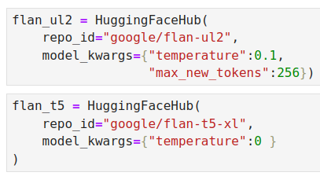
05.04 Load Flan-t5 Models
https://www.youtube.com/watch?v=VW5LBavIfY4&list=PL8motc6AQftk1Bs42EW45kwYbyJ4jOdiZ&index=5
Load Flah-t5 Model (02:01-02:30/10:54)

Slide 12
05.05 Conversation with Buffer Memory

Slide 13
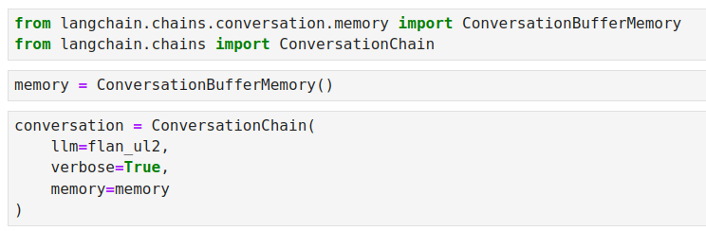
05.05 Conversation with Buffer Memory
https://www.youtube.com/watch?v=VW5LBavIfY4&list=PL8motc6AQftk1Bs42EW45kwYbyJ4jOdiZ&index=5
Conversation with Buffer Memory (02:31-03:00/10:54)

Slide 14
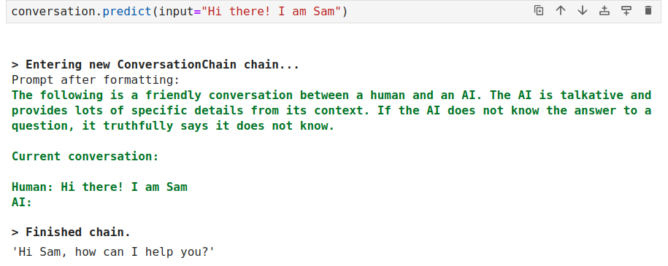
05.05 Conversation with Buffer Memory
https://www.youtube.com/watch?v=VW5LBavIfY4&list=PL8motc6AQftk1Bs42EW45kwYbyJ4jOdiZ&index=5
Conversation with Buffer Memory (03:01-03:30/10:54)

Slide 15
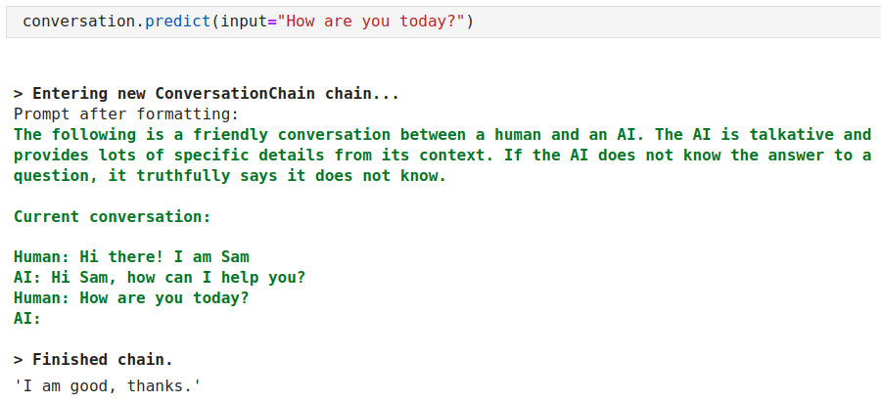
05.05 Conversation with Buffer Memory
https://www.youtube.com/watch?v=VW5LBavIfY4&list=PL8motc6AQftk1Bs42EW45kwYbyJ4jOdiZ&index=5
Conversation with Buffer Memory (03:31-04:30/10:54)

Slide 16
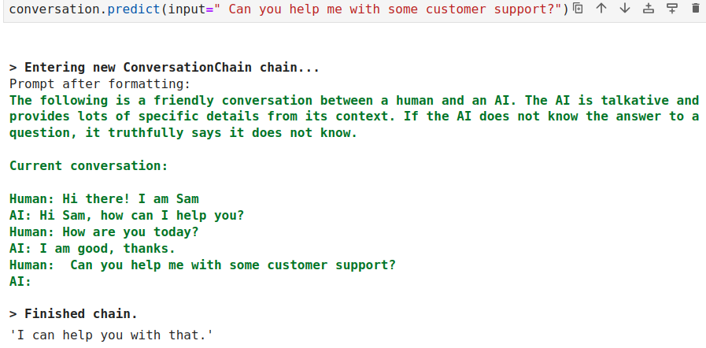
05.05 Conversation with Buffer Memory
https://www.youtube.com/watch?v=VW5LBavIfY4&list=PL8motc6AQftk1Bs42EW45kwYbyJ4jOdiZ&index=5
Conversation with Buffer Memory (04:31-05:30/10:54)

Slide 17
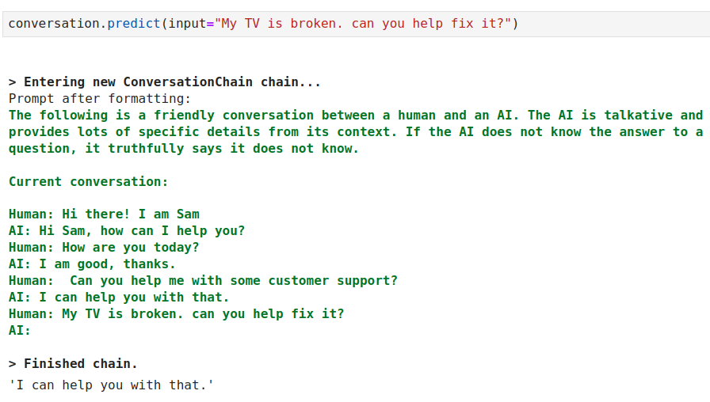
05.05 Conversation with Buffer Memory
https://www.youtube.com/watch?v=VW5LBavIfY4&list=PL8motc6AQftk1Bs42EW45kwYbyJ4jOdiZ&index=5
Conversation with Buffer Memory (0531-06:30/10:54)

Slide 18
05.06 Count Tokens

Slide 19
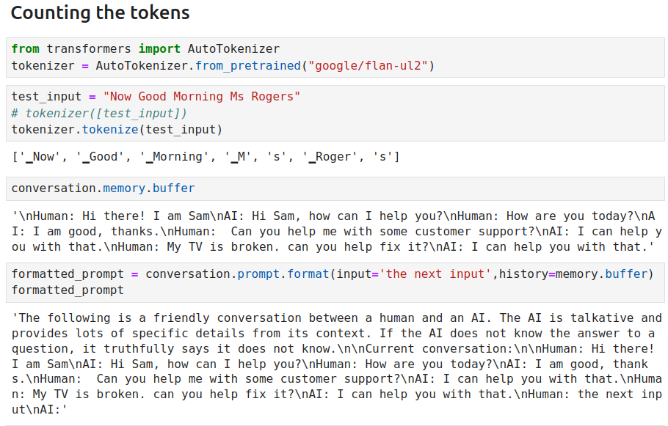
05.06 Count Tokens
https://www.youtube.com/watch?v=VW5LBavIfY4&list=PL8motc6AQftk1Bs42EW45kwYbyJ4jOdiZ&index=5
Count Tokens (06:31-07:30/10:54)

Slide 20
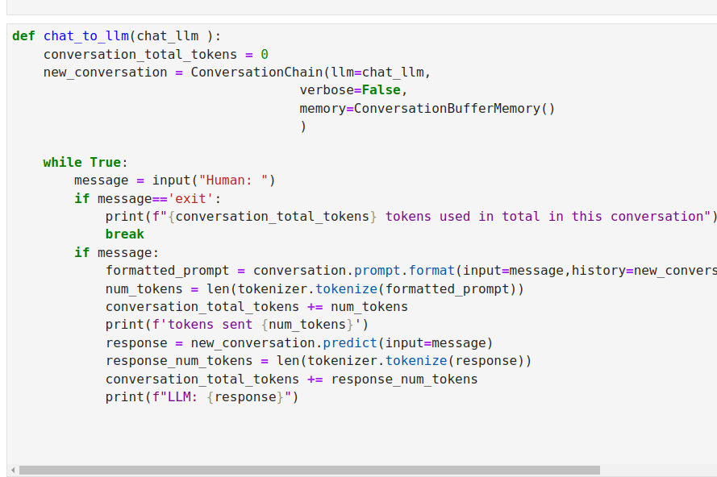
05.06 Count Tokens
https://www.youtube.com/watch?v=VW5LBavIfY4&list=PL8motc6AQftk1Bs42EW45kwYbyJ4jOdiZ&index=5
Count Tokens (07:31-08:30/10:54)

Slide 21
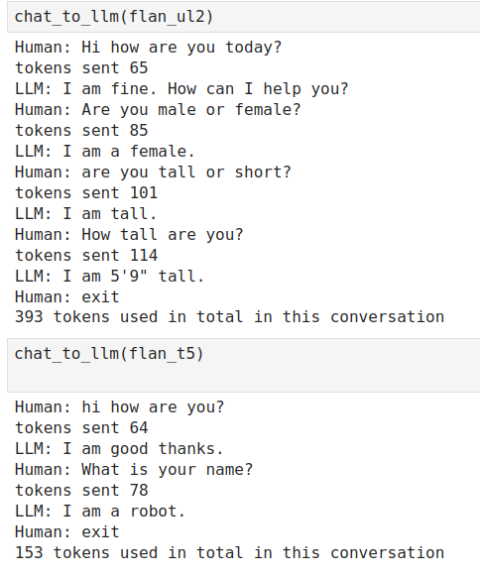
05.06 Count Tokens
https://www.youtube.com/watch?v=VW5LBavIfY4&list=PL8motc6AQftk1Bs42EW45kwYbyJ4jOdiZ&index=5
Count Tokens (08:31-09:30/10:54)

Slide 22
05.07 Summary Memory

Slide 23
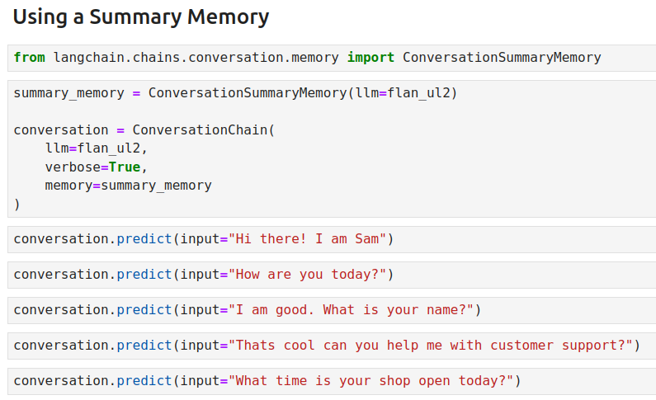
05.07 Flan-t5: Summary Memory
https://www.youtube.com/watch?v=VW5LBavIfY4&list=PL8motc6AQftk1Bs42EW45kwYbyJ4jOdiZ&index=5
Flan-t5: Summary Memory (09:31-10:54/10:54)

Slide 24
End

