Slide 1

4.14 Chat Model
Peter H. Chen

Slide 2
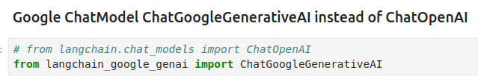
4.14 Chat Model
https://www.youtube.com/watch?v=qMIM7dECAkc&list=PLZoTAELRMXVORE4VF7WQ_fAl0L1Gljtar&index=5
Chat Model (46:21-47:20/1:18:23)
We use the Chat Model.
We will use LangChain which integrate the Google ChatModel ChatGoogleGenerativeAI.

Slide 3
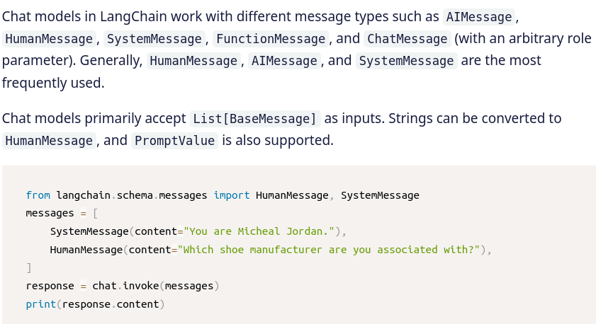
4.14 Chat Model
https://www.youtube.com/watch?v=qMIM7dECAkc&list=PLZoTAELRMXVORE4VF7WQ_fAl0L1Gljtar&index=5
Chat Model (47:21-48:20/1:18:23)
When we chat with LangChain, we use HumanMessage and SystemMessage.
The LangChain schema library provide Chat Messages.
Here, we use Human Message and System Message.
Chat models in LangChain work with different message types, such as, AIMessage, HumanMessage, SystemMessage, FunctionMessage, and ChatMessage (with an arbitrary role parameter).
1. AI Message: Input for Google Chat Model (Generative AI).
2. Human Message: User question.
3. System Message: Specify for Lang Chain Tool.
In generally, HumanMessage, AIMessage, and SystemMessage are the most frequently used.
https://nanonets.com/blog/langchain/

Slide 4
4.14 Chat Model
https://www.youtube.com/watch?v=qMIM7dECAkc&list=PLZoTAELRMXVORE4VF7WQ_fAl0L1Gljtar&index=5
Chat Model (48:21-49:30/1:18:23)
Create the chat LLM from LangChain Google Chat Model.

Slide 5

4.14 Chat Model
https://www.youtube.com/watch?v=qMIM7dECAkc&list=PLZoTAELRMXVORE4VF7WQ_fAl0L1Gljtar&index=5
Chat Model (49:31-51:00/1:18:23)
We give the
1. SystemMessage: Input to LangChain tool
2. HumanMessage: Input from User
3. AIMessage: Input to Google Chat Model (Generative AI).

Slide 6
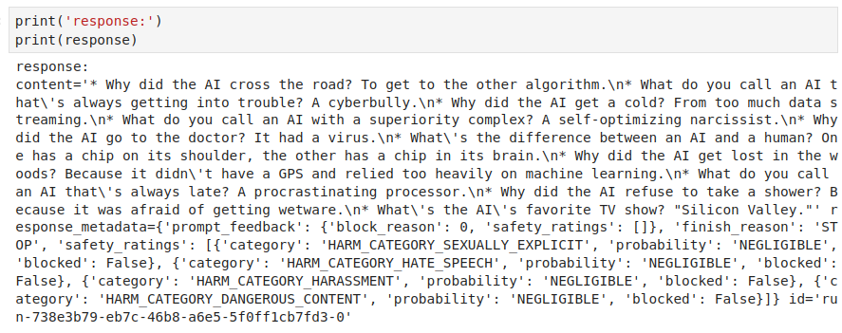
4.14 Chat Model
https://www.youtube.com/watch?v=qMIM7dECAkc&list=PLZoTAELRMXVORE4VF7WQ_fAl0L1Gljtar&index=5
Chat Model (51:01-51:30/1:18:23)
Check the output.

Slide 7
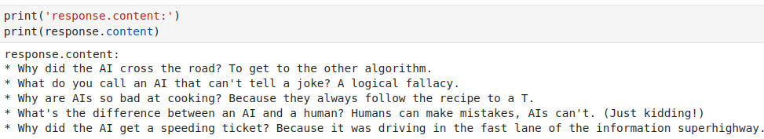
4.14 Chat Model
https://www.youtube.com/watch?v=qMIM7dECAkc&list=PLZoTAELRMXVORE4VF7WQ_fAl0L1Gljtar&index=5
Chat Model (51:31-52:30/1:18:23)
Check the content.

Slide 8
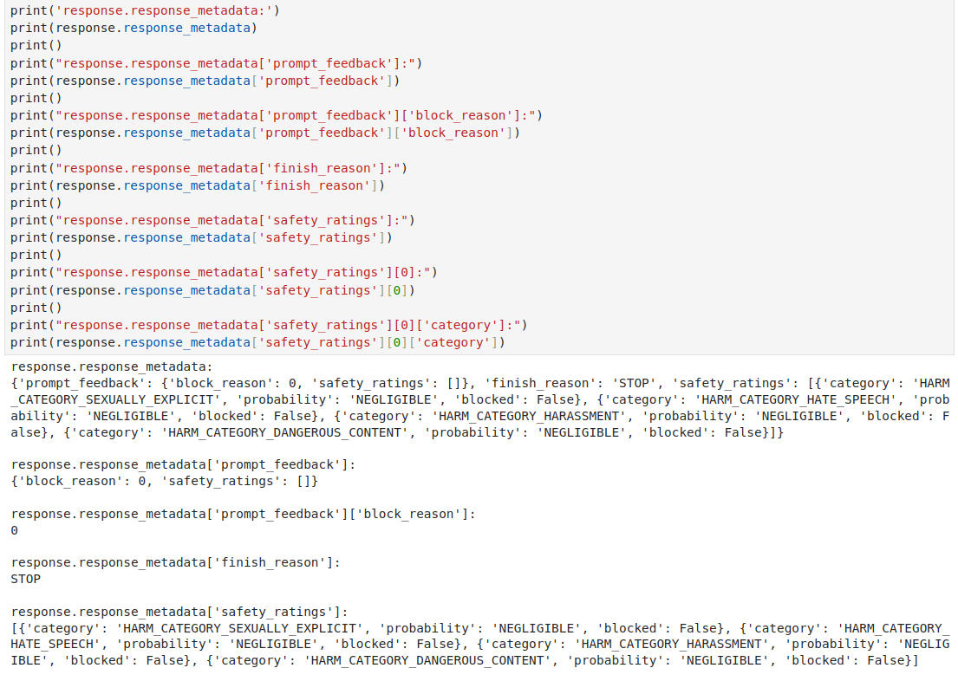
4.14 Chat Model
https://www.youtube.com/watch?v=qMIM7dECAkc&list=PLZoTAELRMXVORE4VF7WQ_fAl0L1Gljtar&index=5
Chat Model (51:31-53:10/1:18:23)
Check the internal messages from LangChain System message, AI Message from Google chat Model, and Human Message.

Slide 9
End

