Slide 1

5 Multi-Language Translation
Peter H. Chen

Slide 2
5 Multi-Language Translation
https://www.youtube.com/watch?v=-ny5_RSMV6k&list=PLZoTAELRMXVNbDmGZlcgCA3a8mRQp5axb&index=5
Multi-Language Translation (00:00-01:00/25:58)
We have the invoices written in Taiwanese, Japanese, Hindi, Korean, Vietnamese, etc.
1. Input image: invoice image
2. Prompt a message to user to upload the image
3. Ask Gemini-pro-vision:
3.1 Company name,
3.2 Company address,
3.3 Name on invoice
3.4 Name amount of invoice,
3.5 other information, etc.

Slide 3
5 Multi-Language Translation
https://www.youtube.com/watch?v=-ny5_RSMV6k&list=PLZoTAELRMXVNbDmGZlcgCA3a8mRQp5axb&index=5
Multi-Language Translation (01:01-02:10/25:58)
We use Gemini-pro-vision for MLIE (Multi-Language Invoice Extractor).
Gemini performs very well in many projects.
Here, we use Gemini-pro to create multi-language invoice extractor.
We will discuss the following topics:
1. MLIE (Multi-Language Invoice Extractor) Introduction
2. Create environment using “pip install -r requirements.txt”
3. Create GUI
4. Load Image
5. Question and Answer on the Invoice

Slide 4
5.1 MLIE Demo

Slide 5
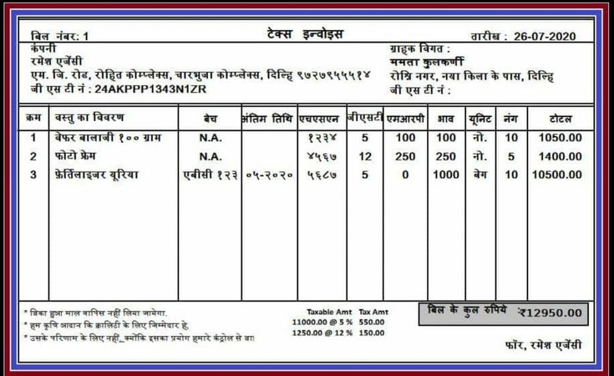
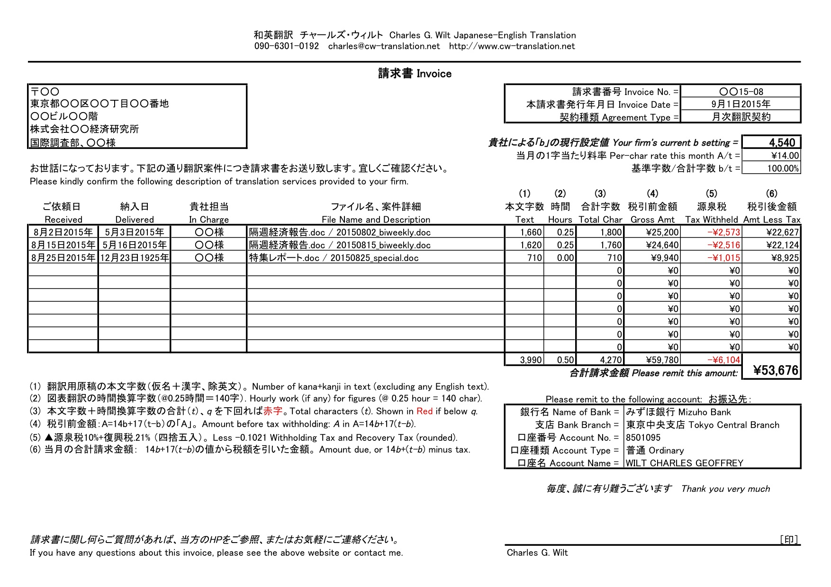
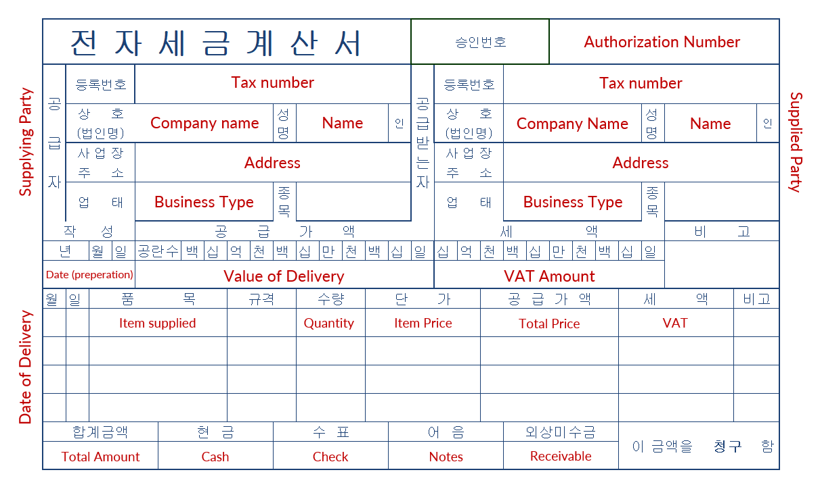
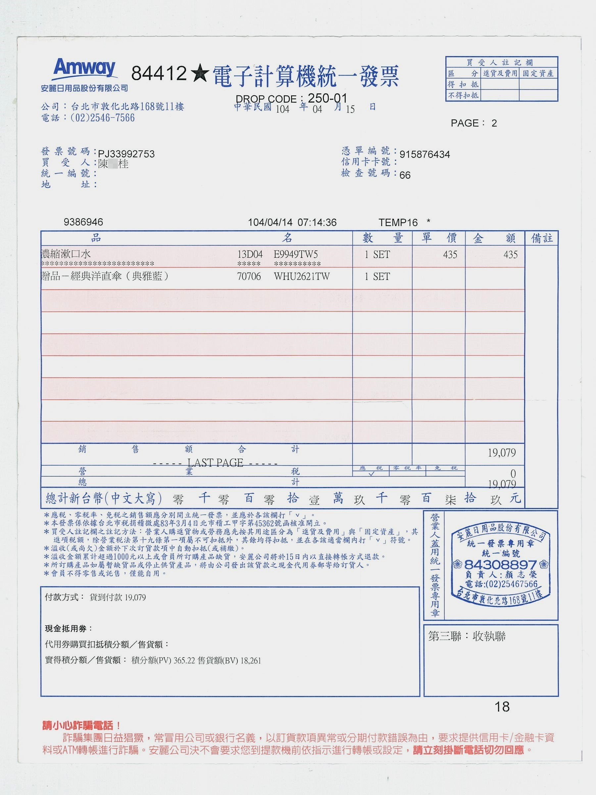
5.1 MLIE Demo
https://www.youtube.com/watch?v=-ny5_RSMV6k&list=PLZoTAELRMXVNbDmGZlcgCA3a8mRQp5axb&index=5
MLIE Demo (02:11-02:50/25:58)
We have Invoices written in different languages, such as, Hindi, Japanese, Korean, and Taiwan Language.
The invoice is in “jpg” format.
1. Some company name in India
2. Address in India
3. Invoice ID.

Slide 6
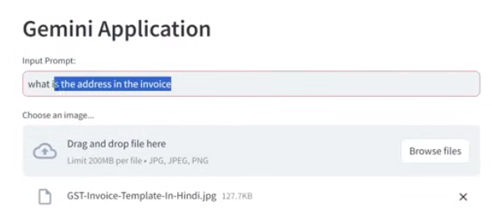
5.1 MLIE Demo
https://www.youtube.com/watch?v=-ny5_RSMV6k&list=PLZoTAELRMXVNbDmGZlcgCA3a8mRQp5axb&index=5
MLIE Demo (02:51-04:00/25:58)
We will
1. Drop the invoice into the Gemini Application
2. Ask what is the date in the invoice
3. What is the address in the invoice
The google-pro can extract the information from the invoice.

Slide 7
End

