Slide 1

5.02 Install Environment
Peter H. Chen

Slide 2
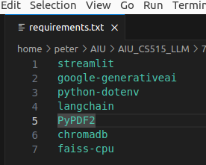
5.02 Install Environment
https://www.youtube.com/watch?v=-ny5_RSMV6k&list=PLZoTAELRMXVNbDmGZlcgCA3a8mRQp5axb&index=5
Install Environment (04:01-05:20/25:58)
We start with requirements.txt.
1. streamlit: GUI
2. google-generativeai: Google Gemini-pro Model
3. python-dotenv: Load Google API Key from “.env” file
4. langchain: langchain for jpeg to text translation.
5. PyPDF2: Python Load PDF and translate into text.
6. chromadb: Vector Embedding Database
7. faiss-cpu: Dimension Reduction.

Slide 3
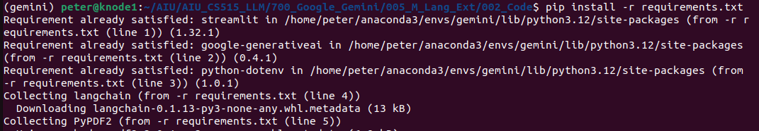
5.02 Install Environmen
https://www.youtube.com/watch?v=-ny5_RSMV6k&list=PLZoTAELRMXVNbDmGZlcgCA3a8mRQp5axb&index=5
Install Environment (04:01-05:20/25:58)
Install the requirements.txt in conda environment “gemini”
(base) > conda activate gemini
(gemini) > pip install -r requirements.txt

Slide 4
5.03 Google API Key

Slide 5
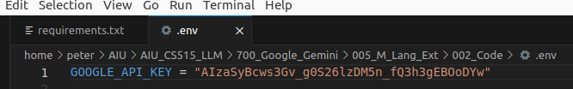
5.03 Google API Key
https://www.youtube.com/watch?v=-ny5_RSMV6k&list=PLZoTAELRMXVNbDmGZlcgCA3a8mRQp5axb&index=5
Google API Key (05:21-05:30/25:58)
We already have Google API Key in hidden file “.env”.
This is the Google API Key for Gemini.

Slide 6
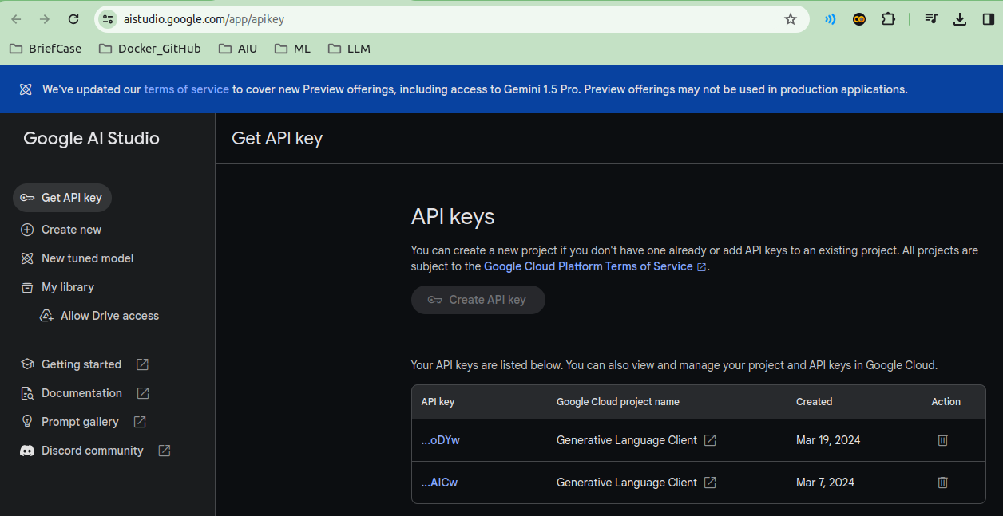
5.03 Google API Key
https://www.youtube.com/watch?v=-ny5_RSMV6k&list=PLZoTAELRMXVNbDmGZlcgCA3a8mRQp5axb&index=5
Google API Key (05:21-06:50/25:58)
Gemini is free open-source framework for 60 QPM (Query Per Minute)
Below is the web site for creating the Google API Key.
https://aistudio.google.com/app/apikey

Slide 7
End

