Slide 1

5.07 Load Gemini Model
Peter H. Chen

Slide 2
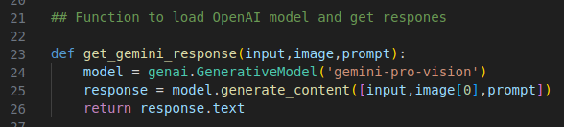
5.07 Load Gemini Model
https://www.youtube.com/watch?v=-ny5_RSMV6k&list=PLZoTAELRMXVNbDmGZlcgCA3a8mRQp5axb&index=5
Load Gemini Model (09:51-13:20/25:58)
1. We need vision to read the image.
2. We define get_gemini_response (input, image, prompt): pass in input, image, and prompt.
2.1 Input: predefined input prompt message to user.
2.2 image: invoice image
2.3 prompt: User type in prompt to Gemini what user want, such as, company name, address, etc.
3. Load model name: genai.GenerativeModel (‘gemini-pro-vision’)
4. response = model.generate_content ([input, image[0], prompt]): we provide three information (input, image, and prompt) for the array.
5. Finally, we return the response.text

Slide 3
5.08 Create GUI

Slide 4
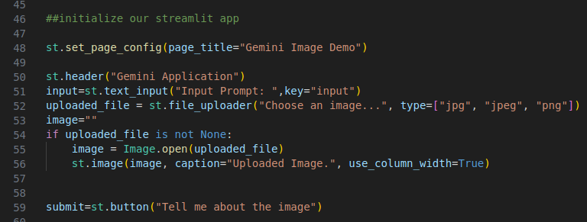
5.08 Create GUI
https://www.youtube.com/watch?v=-ny5_RSMV6k&list=PLZoTAELRMXVNbDmGZlcgCA3a8mRQp5axb&index=5
Create GUI (13:21-15:40/25:58)
Now, we create the GUI.
1. Set up the Page title: “Gemini Image Demo” (“Multi-Language Invoice Extractor”)
2. Create header: ”Gemini Application” (“Multi-Language Invoice Extractor”)
3. Create Input Label and Text field.
4. Create File Loader for Image files in “jpg”, “jpeg”, “png” format.
5. Upload the image file.
6. Create Submit button: “Tell me about the image” (“Tell me about the Invoice”)

Slide 5
5.09 Define Prompt Message

Slide 6
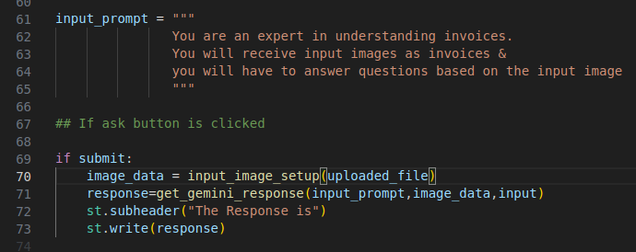
5.09 Define Prompt Message
https://www.youtube.com/watch?v=-ny5_RSMV6k&list=PLZoTAELRMXVNbDmGZlcgCA3a8mRQp5axb&index=5
Define Prompt Message (15:41-18:00/25:58)
1. Define the input prompt message to user:
1.1 input invoice image
1.2 input question and submit the image.

Slide 7
5.10 Function to Load Image

Slide 8
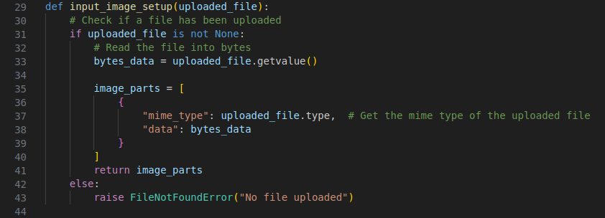
5.10 Function to Load Image
https://www.youtube.com/watch?v=-ny5_RSMV6k&list=PLZoTAELRMXVNbDmGZlcgCA3a8mRQp5axb&index=5
Function to Load Image (18:01-19:30/25:58)
Define the function to load image.

Slide 9
5.11 Submit Processing

Slide 10
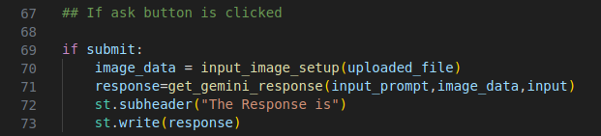
5.11 Submit Processing
https://www.youtube.com/watch?v=-ny5_RSMV6k&list=PLZoTAELRMXVNbDmGZlcgCA3a8mRQp5axb&index=5
Submit Processing (19:31-21:10/25:58)
Submit processing
1. Load the input image
2. Passed in pre-defined prompt message to user, image, and user input.
3. Display the message.

Slide 11
End

