Slide 1

2.13 LC: Gemini/Prompt
Peter H. Chen

Slide 2
2.13 LC: Gemini/Prompt
https://www.youtube.com/watch?v=_FpT1cwcSLg&list=PLZoTAELRMXVORE4VF7WQ_fAl0L1Gljtar&index=2
LC: Gemini/Prompt (17:21-18:30/43:22)
Now, we want to create more complicated example (example1.py) with LangChain, Gemini, and Prompt engineering.

Slide 3
2.14 Import Library

Slide 4
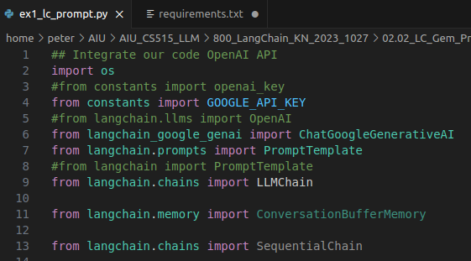
2.14 Import Library
https://www.youtube.com/watch?v=_FpT1cwcSLg&list=PLZoTAELRMXVORE4VF7WQ_fAl0L1Gljtar&index=2
Import Library (17:21-19:00/43:22)
Now, we import the library for prompt engineering. The prompt interconnect between different link of tools in different tool chains. We need to send the output of link to another input of the tool link. The prompt is used for private search and real-time search.
1. import os
2. import GOOGLE_API_KEY
3. import LLM Modes: ChatGoogleGenerativeAI
4. import PromptTemplate: prompt engineering
5. import LLMChain: LangChain Tool Chain
6. import streamlit: GUI
7. os.environ [“GOOGLE_API_KEY”] = GOOGLE_API_KEY: Set environment variable for for gemini Model.

Slide 5
2.15 Streamlit GUI

Slide 6

2.15 Streamlit GUI
https://www.youtube.com/watch?v=_FpT1cwcSLg&list=PLZoTAELRMXVORE4VF7WQ_fAl0L1Gljtar&index=2
Streamlit GUI (19:01-19:30/43:22)
Create GUI for Input Text.

Slide 7
2.16 Define Prompt Template

Slide 8
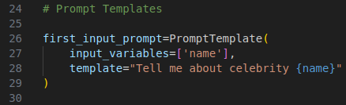
2.15 Define Prompt Template
https://www.youtube.com/watch?v=_FpT1cwcSLg&list=PLZoTAELRMXVORE4VF7WQ_fAl0L1Gljtar&index=2
Define Prompt Template (19:31-23:00/43:22)
Now, we create the prompt. The prompts are used to sequence of tool links (from the output of the previous tool link to the input of the next tool link).
First, we need to define the prompt template which define the format that users want.
The input variables are defined in the {} of the template.
In LangChain, each tool is called a link.
Each link (tool) has its input and output.
We need to create memory for placeholder to hold the information from the output of the previous link to the next input of link.
We search for ‘name’ of celebrity.
Tell me about celebrity {name}: Tell me about the celebrity of ‘Tom Cruise’.

Slide 9
2.16 Create LLMChain

Slide 10
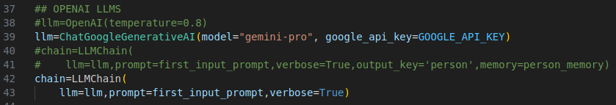
2.16 Create LLMChain
https://www.youtube.com/watch?v=_FpT1cwcSLg&list=PLZoTAELRMXVORE4VF7WQ_fAl0L1Gljtar&index=2
Create Memory (23:01-24:30/43:22)
Whenever, we use the prompt, we need to import the LLMChain to create the Chain for LLM Model.
1. Create the LLM Model.
2. Create Chain with LLM Model: We input the input prompt.

Slide 11
2.17 Display LangChain Response

Slide 12
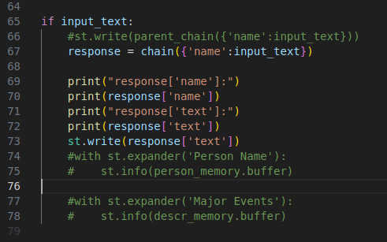
2.17 Display LangChain Response
https://www.youtube.com/watch?v=_FpT1cwcSLg&list=PLZoTAELRMXVORE4VF7WQ_fAl0L1Gljtar&index=2
Display LangChain Response (23:01-24:30/43:22)

Slide 13
2.18 streamlit run ex1_lc_prompt.py

Slide 14
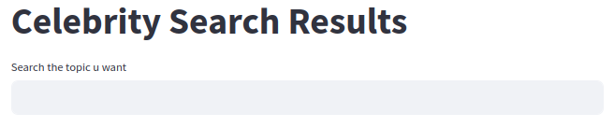
2.18 streamlit run ex1_lc_prompt.py
https://www.youtube.com/watch?v=_FpT1cwcSLg&list=PLZoTAELRMXVORE4VF7WQ_fAl0L1Gljtar&index=2
Streamlit run ex1_lc_prompt.py (24:31-25:30/43:22)
> streamlit run ex1_lc_prompt.py

Slide 15
2.19 Test: steph Curry

Slide 16
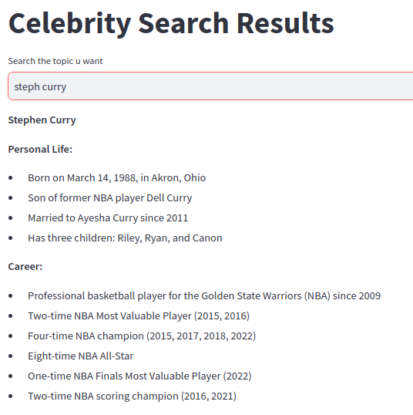
2.19 Test: Steph Curry
https://www.youtube.com/watch?v=_FpT1cwcSLg&list=PLZoTAELRMXVORE4VF7WQ_fAl0L1Gljtar&index=2
Test: Steve Curry (25:31-26:30/43:22)

Slide 17
End

