Slide 1

3.5 FAISS
Peter H. Chen

Slide 2
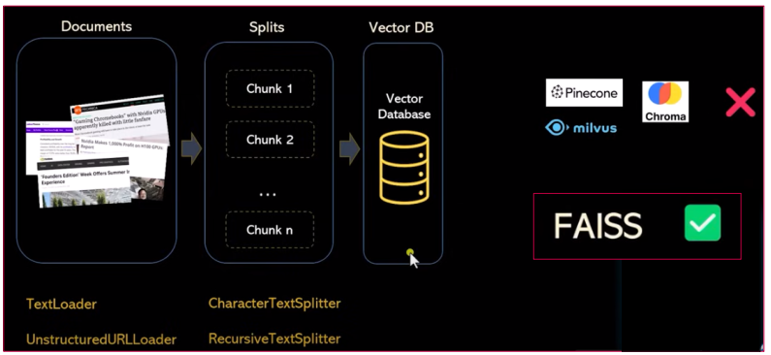
3.5 FAISS
https://www.youtube.com/watch?v=MoqgmWV1fm8&list=PLeo1K3hjS3uu0N_0W6giDXzZIcB07Ng_F&index=3
FAISS (33:21-33:40/1:14:33)
We have read in the document into text and split text into tokens.
Now, we need to do the vector database.
There are a lot of open source tools: Pinecone, milvus, Chroma, etc. for vector database. But we are not going to use these tools.
We are going to use FAISS (Facebook AI Similarity Search) from Facebook.
FAISS is a lightweight in memory Vector Database.

Slide 3
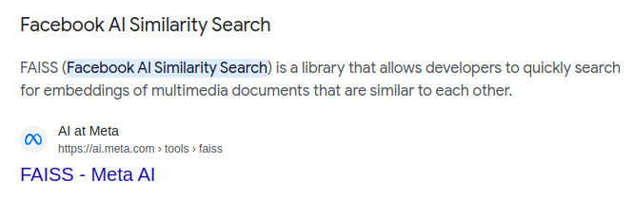
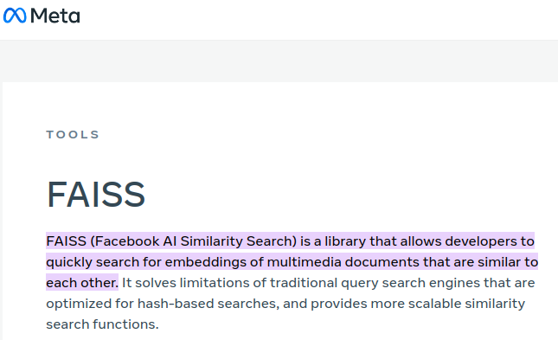
3.5 FAISS
https://www.youtube.com/watch?v=MoqgmWV1fm8&list=PLeo1K3hjS3uu0N_0W6giDXzZIcB07Ng_F&index=3
FAISS (33:41-33:50/1:14:33)
FAISS (Facebook AI Similarity Search) is a library from Facebook.
FAISS allow you to do the fast search of set vectors that you have.

Slide 4
3.5 FAISS
https://www.youtube.com/watch?v=MoqgmWV1fm8&list=PLeo1K3hjS3uu0N_0W6giDXzZIcB07Ng_F&index=3
FAISS (33:51-34:00/1:14:33)
If your project is smaller and requirement are lightweight, you can use FAISS for embeddings for fast search of vector database.

Slide 5
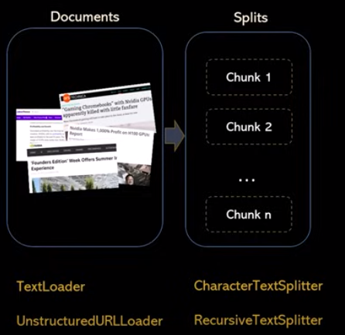
3.5 FAISS
https://www.youtube.com/watch?v=MoqgmWV1fm8&list=PLeo1K3hjS3uu0N_0W6giDXzZIcB07Ng_F&index=3
FAISS (34:01-34:10/1:14:33)
We have a chunks of tokens created by recursive text splitter.

Slide 6
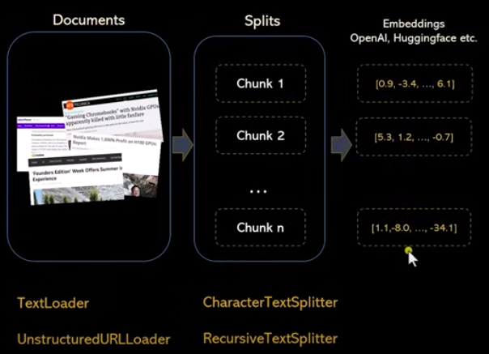
3.5 FAISS
https://www.youtube.com/watch?v=MoqgmWV1fm8&list=PLeo1K3hjS3uu0N_0W6giDXzZIcB07Ng_F&index=3
FAISS (34:11-34:30/1:14:33)
We converted these chunks of tokens into embeddings with one-hot-encoding.
Embeddings is a a must step.
We can use Google Gemini embedding, openAI embedding, HuggingFace embedding, etc. There are a lot fo embedding tools in the HuggingFace. We can use anyone of them.
Then, we are going to store these embeddings of one-hot-encoding into a vector data base.

Slide 7
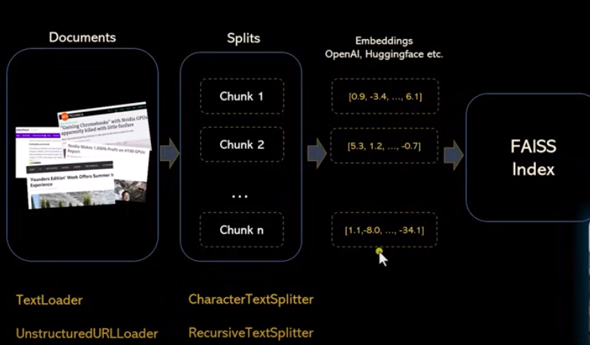
3.5 FAISS
https://www.youtube.com/watch?v=MoqgmWV1fm8&list=PLeo1K3hjS3uu0N_0W6giDXzZIcB07Ng_F&index=3
FAISS (34:31-34:40/1:14:33)
When we store embeddings into vector database.
We can choose Pinecone, milvus, Chroma, etc. to store these embeddings into vector database for our project.
Here, we will store these embeddings into FAISS Index. FAISS index is like the in-memory structure. We can do faster in the vector.

Slide 8
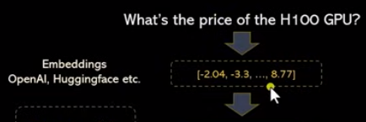
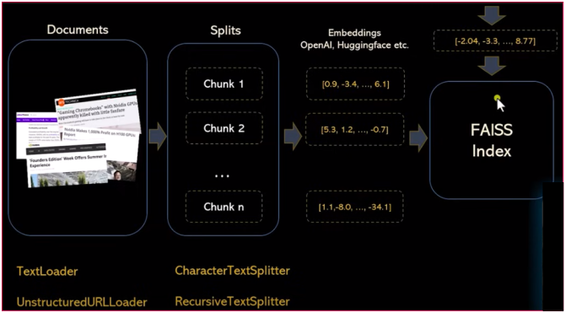
3.5 FAISS
https://www.youtube.com/watch?v=MoqgmWV1fm8&list=PLeo1K3hjS3uu0N_0W6giDXzZIcB07Ng_F&index=3
FAISS (34:41-35:00/1:14:33)
If you have input question to Google Gemini “What is the price of H100 GPU?”
We will first again, convert that question into embedding using using one-hot-encoding in memory, then we will give it to FAISS index.

Slide 9
3.5 FAISS
https://www.youtube.com/watch?v=MoqgmWV1fm8&list=PLeo1K3hjS3uu0N_0W6giDXzZIcB07Ng_F&index=3
FAISS (35:01-35:20/1:14:33)
For example, we already created these chunks are 1 millions vectors.
FAISS will efficiently perform the Similarity Search for a given vector and
FAISS will tell you the answer out of those 1 million vectors.

Slide 10
3.5 FAISS
https://www.youtube.com/watch?v=MoqgmWV1fm8&list=PLeo1K3hjS3uu0N_0W6giDXzZIcB07Ng_F&index=3
FAISS (35:01-35:20/1:14:33)
For example,
1. We have created these chunks are 1 millions vectors.
2. FAISS will efficiently perform the Similarity Search for a given vector and
FAISS will tell you the answer out of those 1 million vectors.
2
1

Slide 11
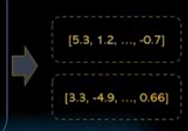
3.5 FAISS
https://www.youtube.com/watch?v=MoqgmWV1fm8&list=PLeo1K3hjS3uu0N_0W6giDXzZIcB07Ng_F&index=3
FAISS (35:21-35:30/1:14:33)
For example,
1. We have created these chunks are 1 millions vectors.
2. FAISS will efficiently perform the Similarity Search for a given vector and
3. Out of those 1 million vectors, FAISS will tell you how many of those vectors are similar.
3
1
2

Slide 12
3.5.1 Install FAISS

Slide 13

3.5.1 Install FAISS
https://www.youtube.com/watch?v=MoqgmWV1fm8&list=PLeo1K3hjS3uu0N_0W6giDXzZIcB07Ng_F&index=3
Install FAISS (35:31-35:30/1:14:33)
We will see how FAISS work in Jupyter Notebook.

Slide 14
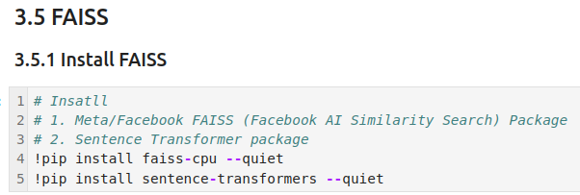
3.5.1 Install FAISS
https://www.youtube.com/watch?v=MoqgmWV1fm8&list=PLeo1K3hjS3uu0N_0W6giDXzZIcB07Ng_F&index=3
Install FAISS (35:31-35:40/1:14:33)
Install
1. faiss-cpu: FAISS CPU Mode
2. sentence-transformers: Python library for one-hot-encoding embeddings of sentence, text, and image.

Slide 15
3.5.2 Read CSV File

Slide 16

3.5.2 Read CSV File
https://www.youtube.com/watch?v=MoqgmWV1fm8&list=PLeo1K3hjS3uu0N_0W6giDXzZIcB07Ng_F&index=3
Read CSV File (35:41-35:50/1:14:33)
Install Panda and setup Pandas display width to 100 characters with.
1. Panda.
2. We increase the panda display column so that we can see more columns of data.

Slide 17
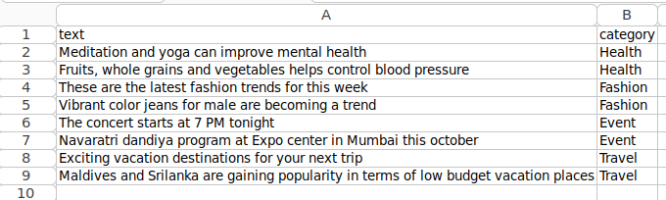
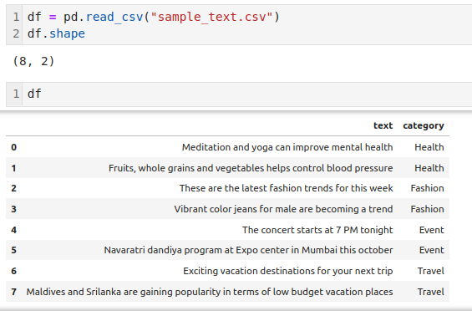
3.5 FAISS
https://www.youtube.com/watch?v=MoqgmWV1fm8&list=PLeo1K3hjS3uu0N_0W6giDXzZIcB07Ng_F&index=3
FAISS (35:51-36:10/1:14:33)
1. Install Pandas Row/Column Library
2. Set display with to 100.
3. read in sample dataset.
Note:
1. We can browse the data but do not overwrite to other csv (text format) binary format.
2. Overwrite CSV file to other binary format may not read from panda readers.

Slide 18
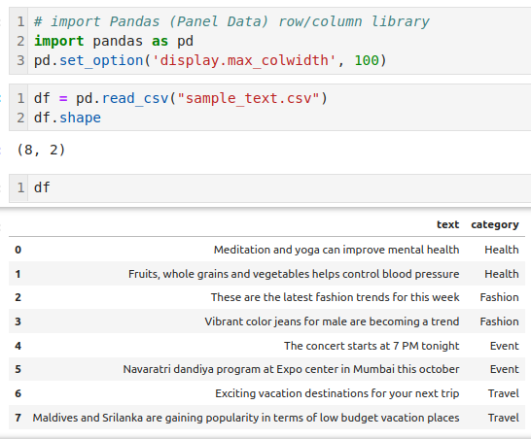
3.5 FAISS
https://www.youtube.com/watch?v=MoqgmWV1fm8&list=PLeo1K3hjS3uu0N_0W6giDXzZIcB07Ng_F&index=3
FAISS (36:01-36:20/1:14:33)
read in sample dataset.
Note:
Do not save the csv (text format) into other binary.
The other binary format and maybe not readable from panda readers.

Slide 19
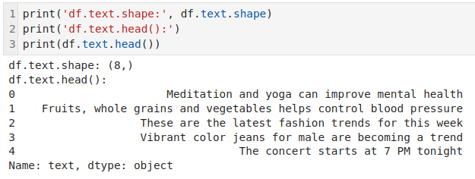
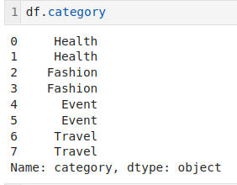
3.5 FAISS
https://www.youtube.com/watch?v=MoqgmWV1fm8&list=PLeo1K3hjS3uu0N_0W6giDXzZIcB07Ng_F&index=3
FAISS (36:21-36:30/1:14:33)
We display the
1. df.text and
2. df.category
1
2

Slide 20
3.5.3 Create Embedding

Slide 21
3.5.3 Create Embedding
https://www.youtube.com/watch?v=MoqgmWV1fm8&list=PLeo1K3hjS3uu0N_0W6giDXzZIcB07Ng_F&index=3
Create Embedding (36:21-36:32/1:14:33)
Step 1: Create Embedding from the CSV Text
3
4
1
2
5

Slide 22
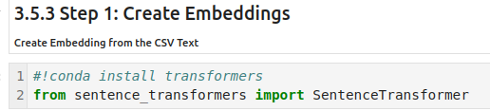
3.5.3 Create Embedding
https://www.youtube.com/watch?v=MoqgmWV1fm8&list=PLeo1K3hjS3uu0N_0W6giDXzZIcB07Ng_F&index=3
Create Embedding (36:33-37:00/1:14:33)
Step 1: Create Embedding from the CSV Text
We import SentenceTransformer library:
We are going to use sentence_transformer to transform the sample text into Embedding (Vectors of probability distribution of one-hot-encoding).

Slide 23
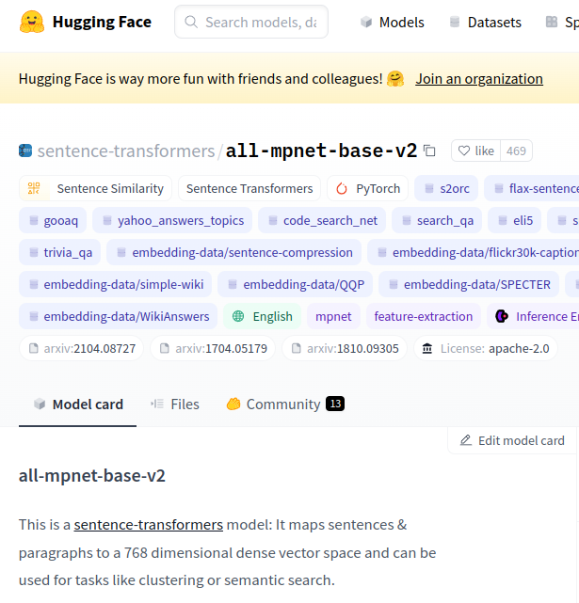

3.5.3 Create Embedding
https://www.youtube.com/watch?v=MoqgmWV1fm8&list=PLeo1K3hjS3uu0N_0W6giDXzZIcB07Ng_F&index=3
Create Embedding (37:01-37:30/1:14:33)
Step 1: Create Embedding from the CSV Text
1. HuggingFace implement the “all-mpnet-base-v2” encoder.
> encoder = SentenceTransformer (“all-mpnet-base-v2”)
>> MPNet (Mask Language Model and Permuted Language Model) is a Pre-Train Method.
The encoder is a array of column which store the entire vector.
2. We are going to use the model “all-mpnent-based-v2” for sentence transformer to encode the sentence from dataset.

Slide 24
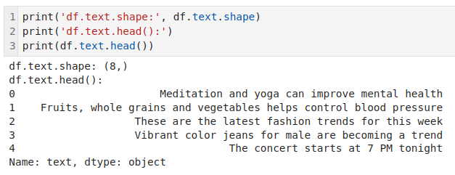
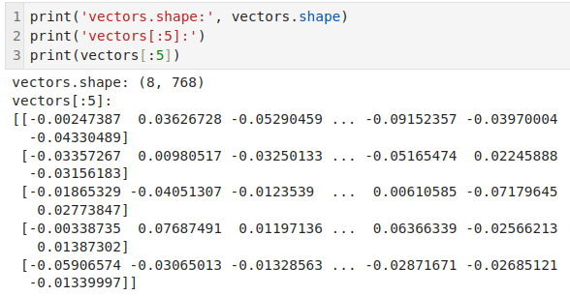
3.5.3 Create Embedding
https://www.youtube.com/watch?v=MoqgmWV1fm8&list=PLeo1K3hjS3uu0N_0W6giDXzZIcB07Ng_F&index=3
Create Embedding (37:31-38:00/1:14:33)
Step 1: Create Embedding from the CSV Text
We use sentence transformer to encode the Pandas data frame to generate the index vector.
The encoder is a array of column which store the entire vector.
1. The text object: 8 (rows) x 2 (columns)
2. The encoder vectors (vectors of probability distribution of one-hot-encoding): 8 x 768

Slide 25
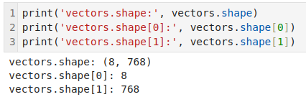
3.5.3 Create Embedding
https://www.youtube.com/watch?v=MoqgmWV1fm8&list=PLeo1K3hjS3uu0N_0W6giDXzZIcB07Ng_F&index=3
Create Embedding (38:01-38:20/1:14:33)
Step 1: Create Embedding from the CSV Text
Check
1. Embedding vectors shape: 8 x 768
2. Embedding vectors shape[0]: 8
2. Embedding vectors shape[1]: 768

Slide 26
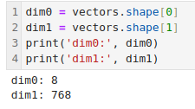
3.5.3 Create Embedding
https://www.youtube.com/watch?v=MoqgmWV1fm8&list=PLeo1K3hjS3uu0N_0W6giDXzZIcB07Ng_F&index=3
Create Embedding (38:21-38:30/1:14:33)
Step 1: Create Embedding from the CSV Text
Check:
1. Embedding vector dimension 0.
2. Embedding vector dimension 1.

Slide 27
3.5.4 Build FAISS Index for Vector

Slide 28
3.5.4 Build FAISS Index for Vector
https://www.youtube.com/watch?v=MoqgmWV1fm8&list=PLeo1K3hjS3uu0N_0W6giDXzZIcB07Ng_F&index=3
Build FAISS Index for Vector (38:31-38:32/1:14:33)
Step 2: Build FAISS index vector database.
3
4
1
2
5

Slide 29
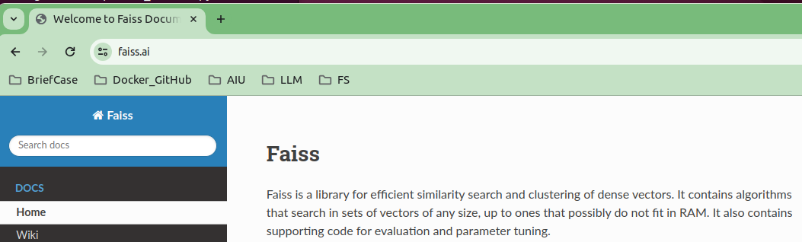
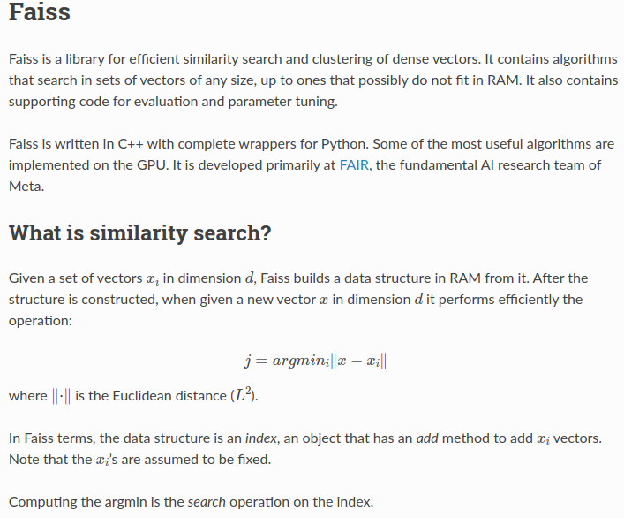
3.5.4 Build FAISS Index for Vector
https://www.youtube.com/watch?v=MoqgmWV1fm8&list=PLeo1K3hjS3uu0N_0W6giDXzZIcB07Ng_F&index=3
Build FAISS Index for Vector (38:33-38:40/1:14:33)
Step 2: Create a FAISS index for vectors
Search for “faiss.ai” for the details of FAISS.
FAISS is a library for efficient similarity search of dense vectors.
https://faiss.ai/

Slide 30
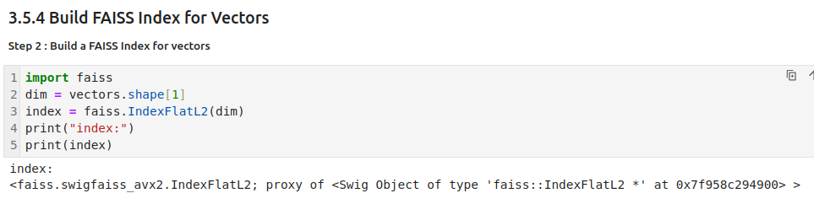
3.5.4 Build FAISS Index for Vector
https://www.youtube.com/watch?v=MoqgmWV1fm8&list=PLeo1K3hjS3uu0N_0W6giDXzZIcB07Ng_F&index=3
Build FAISS Index for Vector (38:40-39:00/1:14:33)
Step 2: Create a FAISS index for vectors
We build FAISS Index for vectors with dimension of column of Embedding Vectors (vector of probability distribution of one-hot-encoding).
https://faiss.ai/

Slide 31
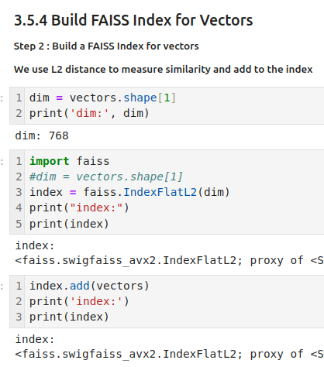
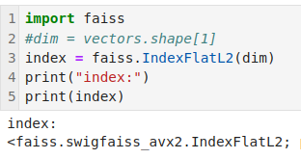
3.5.4 Build FAISS Index for Vector
https://www.youtube.com/watch?v=MoqgmWV1fm8&list=PLeo1K3hjS3uu0N_0W6giDXzZIcB07Ng_F&index=3
Build FAISS Index for Vector (39:01-39:20/1:14:33)
Step 2: Create a FAISS index for vectors
https://faiss.ai/

Slide 32
3.5.5 User Input Question Embedding

Slide 33
3.5.5 User Question Embedding
https://www.youtube.com/watch?v=MoqgmWV1fm8&list=PLeo1K3hjS3uu0N_0W6giDXzZIcB07Ng_F&index=3
User Question Embedding (39:11-39:12/1:14:33)
Step 3: User Question Embedding
3
4
1
2
5

Slide 34
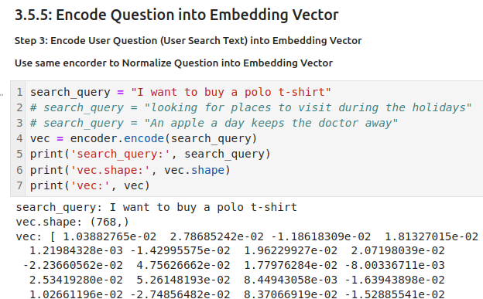
3.5.5 User Question Embedding
https://www.youtube.com/watch?v=MoqgmWV1fm8&list=PLeo1K3hjS3uu0N_0W6giDXzZIcB07Ng_F&index=3
Encode Question into Embedding (39:13-40:00/1:14:33)
Step 3: Encode User Question (Search Text) into Embedding Vector.
https://faiss.ai/

Slide 35
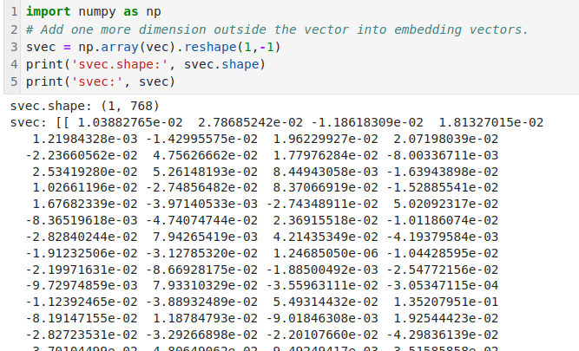
3.5.5 User Question Embedding
https://www.youtube.com/watch?v=MoqgmWV1fm8&list=PLeo1K3hjS3uu0N_0W6giDXzZIcB07Ng_F&index=3
Encode Question into Embedding (40:01-41:30/1:14:33)
We add extra/additional dimension for the index search string. This is the requirement for search string.
We put a vector outside the vec, i.e., [vec].
https://faiss.ai/

Slide 36
3.5.5 User Input Question Normalization

Slide 37
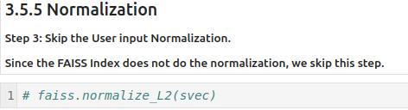
3.5.5 User Input Question Normalization
https://www.youtube.com/watch?v=MoqgmWV1fm8&list=PLeo1K3hjS3uu0N_0W6giDXzZIcB07Ng_F&index=3
User Input Question Normalization (41:31-41:32/1:14:33)
Step 4: Skip user Input Normalization.
We skip the user input normalization Since the FAISS Index vector database does not do the normalization.
https://faiss.ai/
3
4
1
2
5

Slide 38
3.5.7 Similarity Search

Slide 39
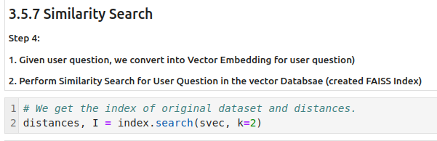
3.5.7 Similarity Search
https://www.youtube.com/watch?v=MoqgmWV1fm8&list=PLeo1K3hjS3uu0N_0W6giDXzZIcB07Ng_F&index=3
Similarity Search (41:33-42:00/1:14:33)
Now, we want to find
1. the location of search string in the dataset.
2. how much similarities between the found location of dataset and the search string.
https://faiss.ai/

Slide 40
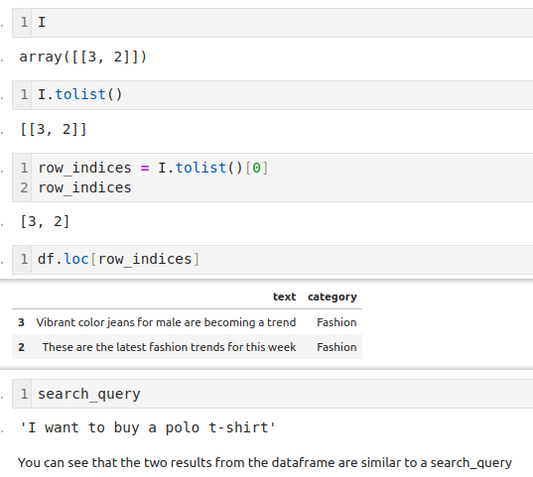
3.5.7 Similarity Search
https://www.youtube.com/watch?v=MoqgmWV1fm8&list=PLeo1K3hjS3uu0N_0W6giDXzZIcB07Ng_F&index=3
Similarity Search (42:01-43:00/1:14:33)
Conclusion:
1. In the FAISS database, the text string are totally different from the user input quesiton
2. But we still can find the answer with the Similarity Search.
https://faiss.ai/

Slide 41
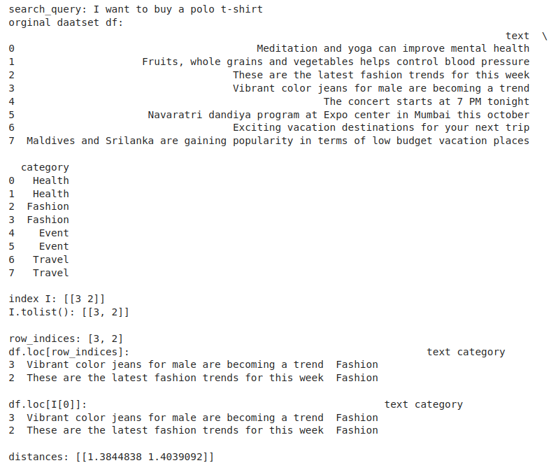
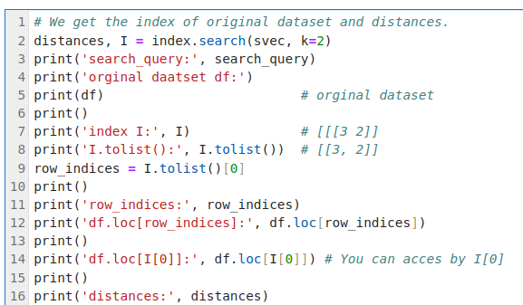
3.5.7 Similarity Search
https://www.youtube.com/watch?v=MoqgmWV1fm8&list=PLeo1K3hjS3uu0N_0W6giDXzZIcB07Ng_F&index=3
Similarity Search (43:01-44:00/1:14:33)
Put all the similarity search code together.
https://faiss.ai/

Slide 42
3.5.8 Summary

Slide 43
3.5.8 Summary
https://www.youtube.com/watch?v=MoqgmWV1fm8&list=PLeo1K3hjS3uu0N_0W6giDXzZIcB07Ng_F&index=3
Summary (44:01-44:50/1:14:33)
Summary of Similarity Search of FAISS:
1. search_query = "I want to buy a polo t-shirt"
The search_query does not contain any match keyword in the dataset.
2. This query is a semantic query.
Therefore, row 2, 3 is the semantic matched results, no the key words matched results.
Conclusion:
1. In the FAISS database, the text string are totally different from the user input quesiton
2. But we still can find the answer with the Similarity Search.

Slide 44
End

