Slide 1

5 RAG/SQL
Peter H. Chen

Slide 2






5 RAG/SQL
https://www.youtube.com/watch?v=wFdFLWc-W4k
RAG/SQL (00:00-00:10/30:02)
We discussed:
1. LLM Gemini and
2. Convert Text into SQL Query
3. Retrieve data from SQL Database.
We use generative AI to solve common problems in different domains.

Slide 3
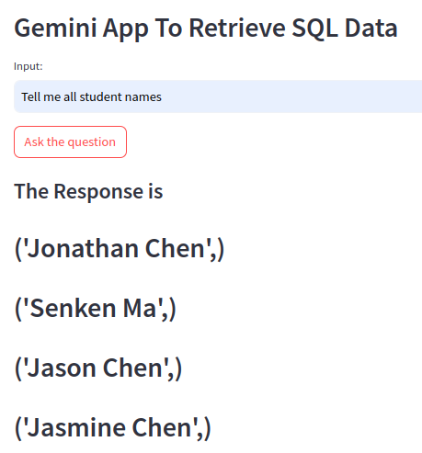
5 RAG/SQL
https://www.youtube.com/watch?v=wFdFLWc-W4k
RAG/SQL (00:11-01:10/30:02)
We have a student database. We will discuss how to create the database later on.
Quesiton: “Tell me all the students name”
Answer: “Jonathan Chen”, “Senken Ma”, “Jason Chen”, etc.

Slide 4
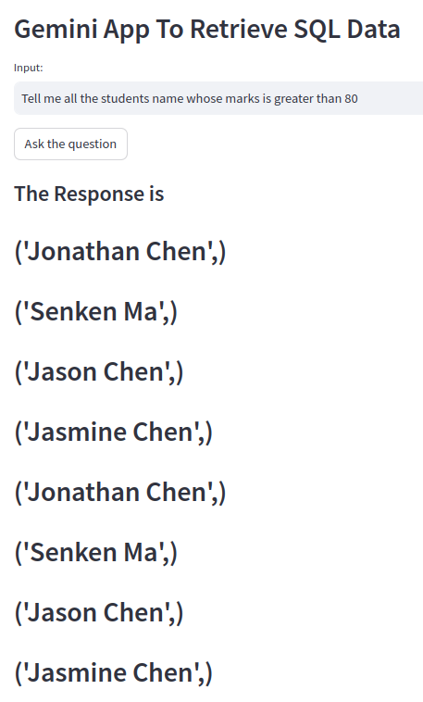
5 RAG/SQL
https://www.youtube.com/watch?v=wFdFLWc-W4k
RAG/SQL (00:11-01:10/30:02)
We have a student database. We will discuss how to create the database later on.
Quesiton: “Tell me all the students name”
Answer: “Jonathan Chen”, “Senken Ma”, “Jason Chen”, etc.

Slide 5
5.1 Conda Environment

Slide 6
5.1 Conda Environment
https://www.youtube.com/watch?v=wFdFLWc-W4k
Conda Environment (02:11-02:30/30:02)
Conda creates Python environment and data science field.
1. Conda create environment:
(base) > conda create --name gemini
2. Conda activate Gemini
(base) > conda activate gemini
(gemini) >
https://docs.anaconda.com/free/anaconda/install/linux/

Slide 7
5.2 Files

Slide 8
5.2 Files
https://www.youtube.com/watch?v=wFdFLWc-W4k
Files (02:31-05:30/30:02)
We will need prepare:
1. requirements.txt: Specify packages we need
2. “.env” file: contains Google API Key.
For application coding:
1. app.py: Create Application. This application will interact with database.
2. sqlite.py: Create SQL database.

Slide 9
5.3 Agenda

Slide 10
5.3 Agenda
https://www.youtube.com/watch?v=wFdFLWc-W4k
Agenda (05:31-06:00/30:02)
Agenda: Application for Texts (in Human Language) to SQL with LLM Gemini
Architectural flow:
Prompt --> LLM --> Gemini-pro --> SQL Query --> SQL Database --> Response
Implementation:
1. sqlite.py: Insert some records with Python Programming
2. app.py: LLM Application with Gemini-pro --> SQL Database

Slide 11
5.3 Agenda
https://www.youtube.com/watch?v=wFdFLWc-W4k
Agenda (06:01-06:30/30:02)
Agenda: Application for Texts (in Human Language) to SQL with LLM Gemini
Architectural flow:
1. Prompt --> 2. LLM --> 3. Gemini-pro --> 4. SQL Query --> 5. SQL Database --> 6. Response
We have Human Question, i.e., Texts/Sentences in Natural Language.
1. The user quesiton is combined into custom prompt. The custom prompt tell gemini to convert into SQL Query.
The human question, such as, “How many students in our class?”, or “tell me which student is highest grade, second highest”, etc.
2., 3. Then, We use LLM Gemini in this application. Based on prompt and Gemini, we get the SQL query.
4., 5. We use SQL Query for SQL Database.
6. Finally, we get the response.

Slide 12
5.3 Agenda
https://www.youtube.com/watch?v=wFdFLWc-W4k
Agenda (06:31-07:30/30:02)
Implementation:
Step 1. sqlite.py: Insert some records with Python Programming
Step 2. app.py: LLM Application with Gemini-pro --> SQL Database
Two important steps in the implementation:
Step 1: We use SQLite. SQLite is lightweight for iPhone and without too much in installation, setup, server/client command operation, security issues, etc. We only use SQLite for local mode only.
We will insert some records. This record insertions we will do are entirely in Python Programming.
Step 2: We use LLM Gemini-pro. With the prompt and LLM, we retrieve the data from SQL database.

Slide 13
5.4 Requirements

Slide 14
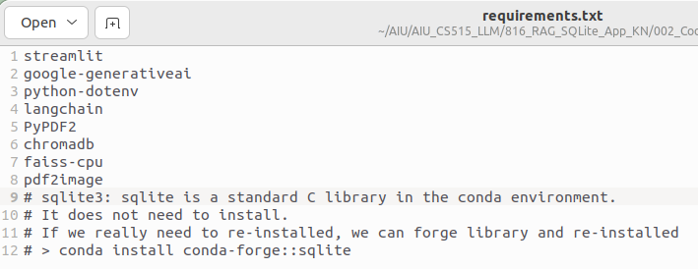
5.4 Requirements
https://www.youtube.com/watch?v=wFdFLWc-W4k
Requirements (07:31-08:30/30:02)
In requiremenets.txt,
1. streamlit: GUI
2. google-generativeai: Google Gemini
3. python-dotenv: Load defined environment variable for Google API Key in “.env” file.
# We only need to install the above three libraries for this application.
# sqlite3: sqlite is a standard C library in the conda environment.
# It does not need to install.
# If we really need to re-installed, we can forge library and re-installed
# > conda install conda-forge::sqlite

Slide 15
5.5 sqlite.py

Slide 16
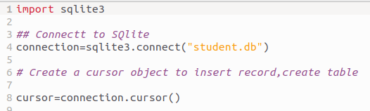
5.5 sqlite.py
https://www.youtube.com/watch?v=wFdFLWc-W4k
sqlite.py (08:31-09:30/30:02)
1. Import sqlite3: sqlite3 is C library include in conda environment.
> import sqlite3
2. Connect to sqlite: Create the connection of database
> connection = sqlite3.connect(“student.db”)
3. Create a cursor object:
cursor is a database object stored in temp memory and used to work with data.
We use cursors to manipulate data, one row at a time.
A cursor uses a SQL SELECT statement to fetch a rowset from a database.
We read and manipulate one row at a time.
> cursor = connection.cursor()
1
2
3

Slide 17
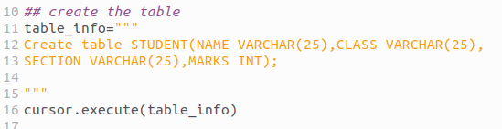
5.5 sqlite.py
https://www.youtube.com/watch?v=wFdFLWc-W4k
sqlite.py (09:31-11:20/30:02)
1. We create a table. The table information (table_info) contains four important fields (Columns):
  a. NAME: Name of students with 25 characters.
  b. CLASS: Name of class with 25 alpha numeric values.
  c. SECTION: What section the student belong to.
  d. MARKS: Integer value.
2. Now, we can create table.
> cursor.execute (table_info)
1
2

Slide 18
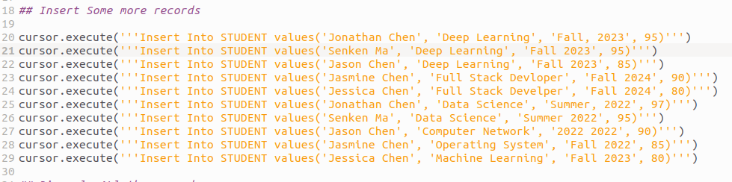
5.5 sqlite.py
https://www.youtube.com/watch?v=wFdFLWc-W4k
sqlite.py (11:21-12:30/30:02)
Insert some more records with columns: Name, class, section, marks.
We use cursor.execute (‘’’Insert into STUDENT values (‘Krish’, ‘Data Science’, ‘A’, 90)’’’)
Once executed, the records are created.

Slide 19
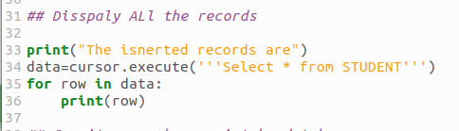
5.5 sqlite.py
https://www.youtube.com/watch?v=wFdFLWc-W4k
sqlite.py (11:31-12:30/30:02)
Display all the records.
> Print the insert information
> data = cursor.execute (‘’’ Select * from STUDENT’’’)
> for row in data:
> print (row)

Slide 20

5.5 sqlite.py
https://www.youtube.com/watch?v=wFdFLWc-W4k
sqlite.py (13:21-14:10/30:02)
Close the connection.
1. Commit: commit
2. Close: close the connection.
1
2

Slide 21
5.6 Run sqlite.py

Slide 22
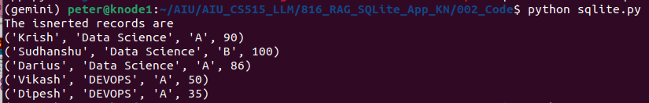

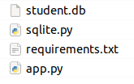
5.6 Run sqlite.py
https://www.youtube.com/watch?v=wFdFLWc-W4k
Run sqlite.py (14:11-14:30/30:02)
1. Run sqlite.py, we can see the inserted records:
> python sqlite.py
2. We also can see the “student.db” is created.
1
2
> python sqlite.py

Slide 23
5.6 Run sqlite.py
https://www.youtube.com/watch?v=wFdFLWc-W4k
Run sqlite.py (14:31-14:40/30:02)
We have completed the first step of implementation.
Implementation:
1. sqlite.py: Insert some records with Python Programming
2. app.py: LLM Application with Gemini-pro --> SQL Database

Slide 24
5.7 App

Slide 25
5.7 App
https://www.youtube.com/watch?v=wFdFLWc-W4k
App (14:41-15:00/30:02)
Now, we are going to create the RAG (Retrieval Augmented Generative) sqlite App.
Whenever we give a prompt, the prompt should be able to convert into SQL Query.
Then, we can retrieve the data out of database.
Implementation:
1. sqlite.py: Insert some records with Python Programming
2. app.py: LLM Application with Gemini-pro --> SQL Database

Slide 26
5.7.1 App: Load API Key

Slide 27
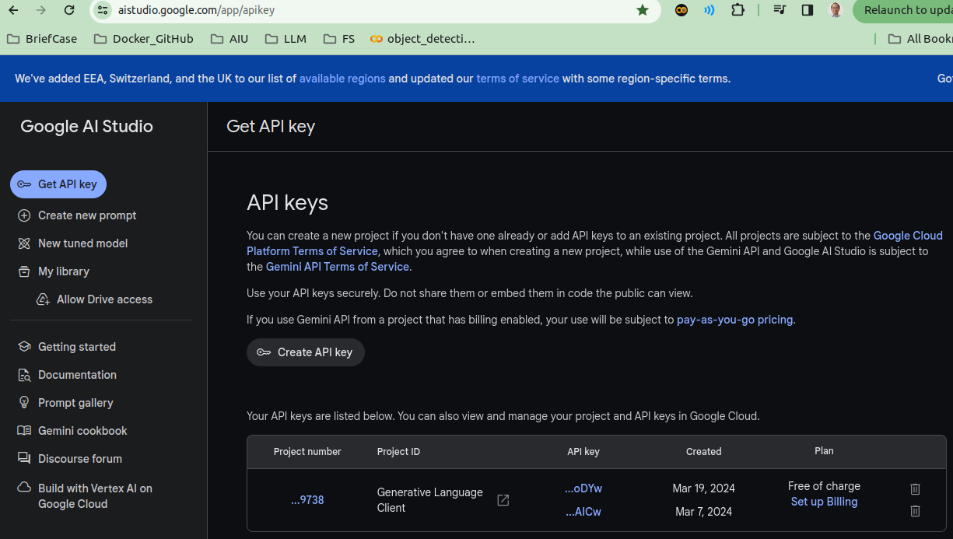
5.7.1 App: Load API Key
https://www.youtube.com/watch?v=wFdFLWc-W4k
App: Load API Key (15:01-15:30/30:02)
1. Create API Key (https://aistudio.google.com/app/apikey)
2. Copy API Key and paste into “.env” file.
1
2

Slide 28

5.7.1 App: Load API Key
https://www.youtube.com/watch?v=wFdFLWc-W4k
Gemini/SQL App: Load API Key (15:31-16:00/30:02)
Load the all the environment variables: GOOGLE_API_KEY = “Google API Key”

Slide 29
5.7.2 App: Import Package

Slide 30
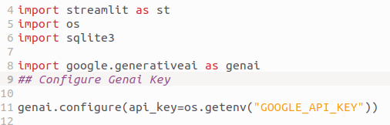
5.7.2 App: Import Package
https://www.youtube.com/watch?v=wFdFLWc-W4k
App: Import Package (16:01-17:30/30:02)
1. streamlit: GUI
2. os: get defined environment variables: GOOGLE_API_KEY.
3. sqlite3: import SQL C-Library sqlite version 3.

Slide 31
5.7.3 App: Configure Gemini Model

Slide 32
5.7.3 App: Configure Gemini Model
https://www.youtube.com/watch?v=wFdFLWc-W4k
App: Configure Gemini Model (16:01-18:20/30:02)
4. google.generativeai: Google Gemini Model
5. Configure Google Gemini Model with Google API Key (GOOGLE_API_KEY).
1
2

Slide 33
5.7.4 App: Get Gemini Response

Slide 34
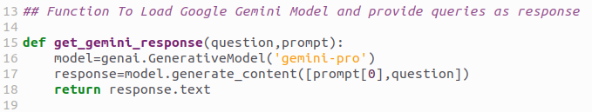
5.7.4 App: Get Gemini Response
https://www.youtube.com/watch?v=wFdFLWc-W4k
App: Get Gemini Response (18:21-20:40/30:02)
We translate the Human Natural Language to SQL Query:
1. Load Gemini Model and get the SQL Query response.
2. Get the User Question
3. Prompt: Define how the Gemini going to behave.
We may have many prompts. Here, we only have one prompt, i.e., prompt[0].
We will explain prompt and few shots later on.
4. Get Gemini response with prompt and user input quesiton
5. return response
2
3
1
4
5

Slide 35
5.7.5 App: Query SQL Database

Slide 36
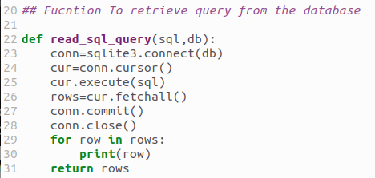
5.7.5 App: Query SQL Database
https://www.youtube.com/watch?v=wFdFLWc-W4k
App: Query SQL Response (20:41-23:10/30:02)
Now, we Query Data from SQL Database
1. Get Object Connection
2. Get cursor
3. Execute SQL query and get cursor of data object into the memory.
4. Get row in cursor object in the memory
5. close the connection.
6. print rows in data.
7. return rows.

Slide 37
5.7.6 App: Define Prompt

Slide 38
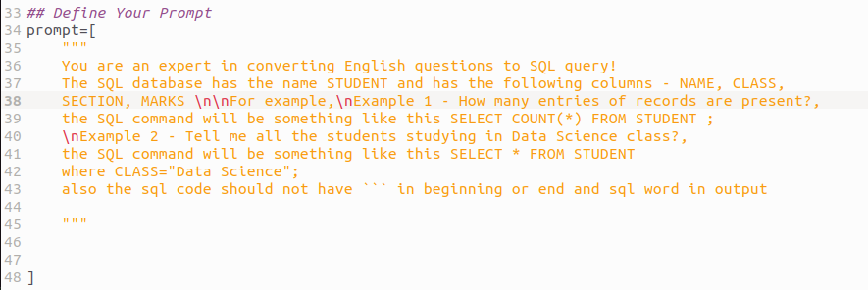
5.7.6 App: Define Prompt
https://www.youtube.com/watch?v=wFdFLWc-W4k
App: Define Prompt (23:11-24:30/30:02)
Now, we define the prompt.
Prompt is very important to tell Gemini to convert human natural language to SQL.
Here, we give two examples (few-shots learning) for Gemini.

Slide 39
5.7.7 App: GUI

Slide 40
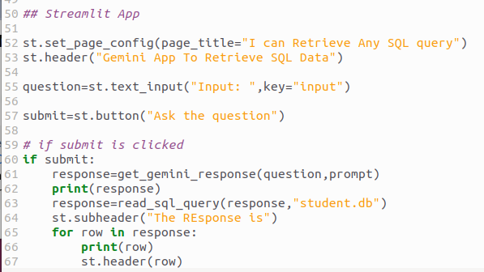
5.7.7 App: GUI
https://www.youtube.com/watch?v=wFdFLWc-W4k
App: GUI (24:31-26:40/30:02)
Now, we create GUI.
1. Create page
2. Create header
3. Create Quesiton
4. Create input button
5. Get response
6. Loop for response and display data.

Slide 41
5.8 Test Gemini/SQL

Slide 42
5.8 Test Gemini/SQL
https://www.youtube.com/watch?v=wFdFLWc-W4k
Test Gemini/SQL (26:41-27:30/30:02)
> streamlit run app.py
Questions: “Tell me all the student names is greater then 80”

Slide 43
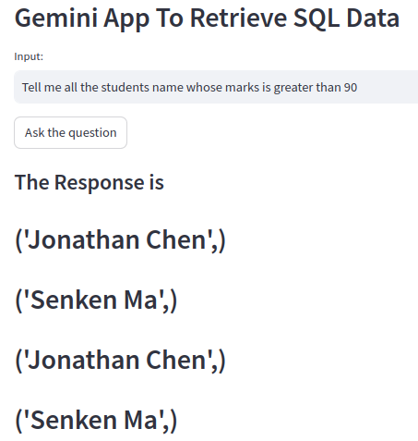
5.8 Test Gemini/SQL
https://www.youtube.com/watch?v=wFdFLWc-W4k
Test Gemini/SQL (27:31-28:30/30:02)
Question: Tell me all the student names whose marks is greater than 90”

Slide 44
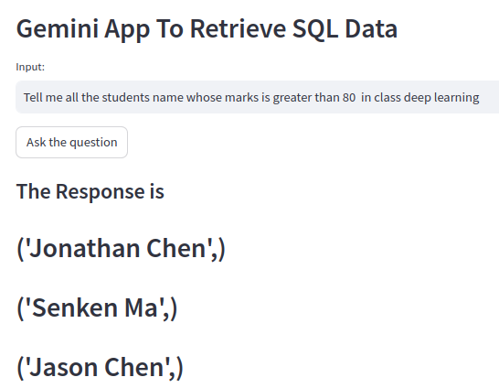
5.8 Test Gemini/SQL
https://www.youtube.com/watch?v=wFdFLWc-W4k
Test Gemini/SQL (28:31-29:30/30:02)
Question: “Tell me all the student names whose marks is greater than 80 in class deep learning”

Slide 45
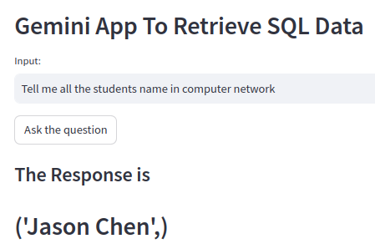
5.8 Test Gemini/SQL
https://www.youtube.com/watch?v=wFdFLWc-W4k
Test Gemini/SQL (29:31-30:02/30:02)
> streamlit run app.py

Slide 46
End

