Slide 1

2 LangChain Started
Peter H. Chen

Slide 2
2 LangChain Started
https://www.youtube.com/watch?v=_FpT1cwcSLg&list=PLZoTAELRMXVORE4VF7WQ_fAl0L1Gljtar&index=2
LangChain Started (00:00-01:00/43:22)
We will be using LangChain for application development.
1. First, we will go through the OpenAI chatGPT-3 and chatGPT-4 examples. We will understand ChatGPT-3 and Chat-GPT4,
2. Second, we use open-source Google/Gemini to replace OpenAI/GPT,
3. Create custom LLM Model: How to create Custom LLM/Gemini Model?​
4. Add Google real-time search platform,
5. Add private information in SQL database
What is exactly LangChain help us?
How do we use LangChain to train the our own custom data?
This can take a lot of GPU VRAM.

Slide 3
2.01 LangChain Quickstart

Slide 4
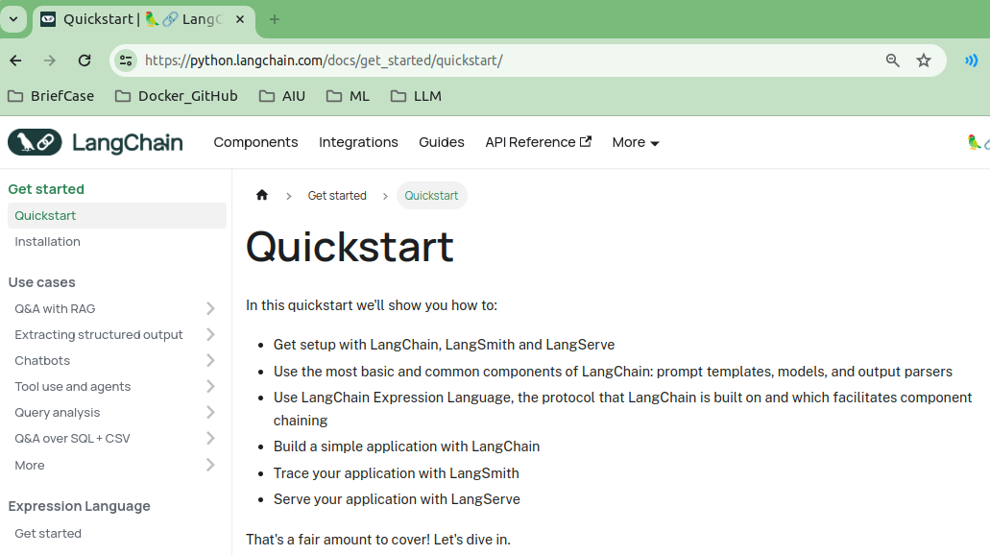
2.01 LangChain Quickstart
https://www.youtube.com/watch?v=_FpT1cwcSLg&list=PLZoTAELRMXVORE4VF7WQ_fAl0L1Gljtar&index=2
LangChain Quickstart (01:01-01:10/43:22)
Google Search “LangChain Quickstart Guide”.
LangChain includes LangChain, LangSmith, and LangServe.
Basic LangChain include prompt templates, models, and output parsers.
Use LangChain expression language and component chaining.
Build application with LangChain, trace application with LangSmith, serve application with LangServe.
https://python.langchain.com/docs/get_started/quickstart/

Slide 5
2.02 LangChain Installation

Slide 6
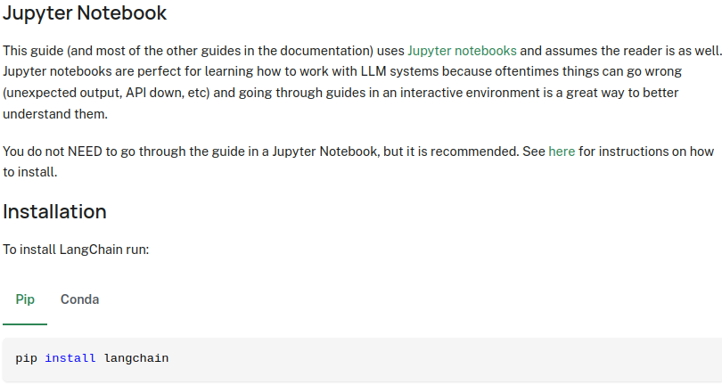
2.02 LangChain Installation
https://www.youtube.com/watch?v=_FpT1cwcSLg&list=PLZoTAELRMXVORE4VF7WQ_fAl0L1Gljtar&index=2
LangChain Installation (01:18-01:30/43:22)
To install LangChain:
> pip install langchain
https://python.langchain.com/docs/get_started/quickstart/

Slide 7
2.03 ChatGPT

Slide 8
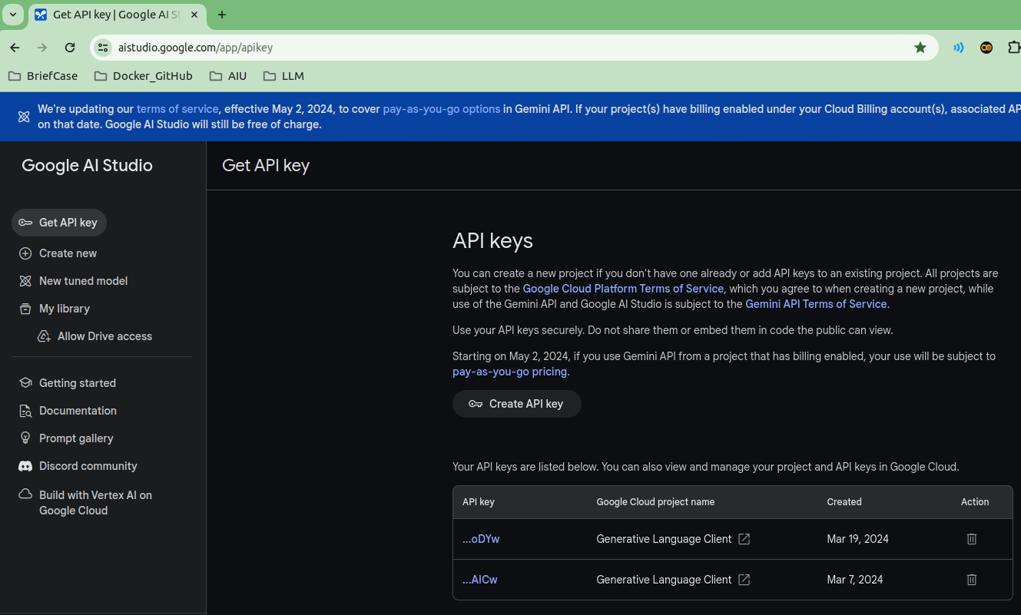
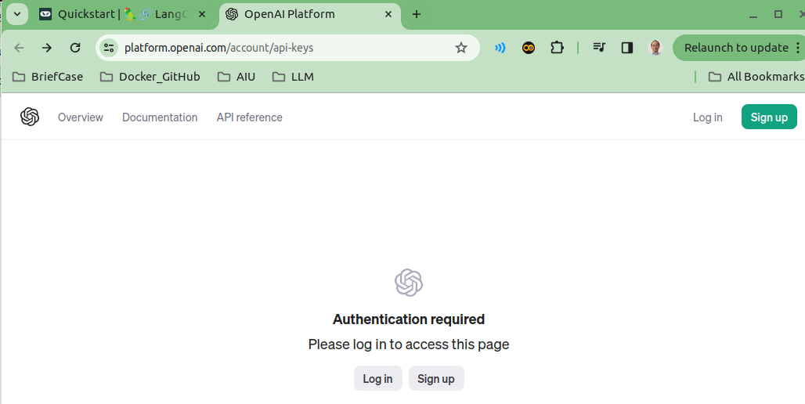
2.03 ChatGPT
https://www.youtube.com/watch?v=_FpT1cwcSLg&list=PLZoTAELRMXVORE4VF7WQ_fAl0L1Gljtar&index=2
ChatGPT (01:37-02:30/43:22)
LangChain default quick start use OpenAI/GPT.
We will use Google/Gemini to replace openAI/GPT.
OpenAI/GPT is trained by 2021 data. If our question for answer is after 2023, then we will get errors since GPT was trained by 2021 which is before 2023.
openAI/GPT
Google/Gemini

Slide 9
2.04 LangChain

Slide 10
2.04 LangChain
https://www.youtube.com/watch?v=_FpT1cwcSLg&list=PLZoTAELRMXVORE4VF7WQ_fAl0L1Gljtar&index=2
LangChain (02:31-04:20/43:22)
What is LangChain can help for the real-time (2023) question and answer?
Google/Gemini and OpenAI/chatGPT will not do the real time for us.
1. We can use Google Bard or serp (Google real-time search platform).
2. We also can integrate our private database.
3. We create our own chatBot with real-time wiki information, etc.
LangChain will help
1. Create our own custom LLM Model.
2. Create our own custom database.
3. integrate various tools and API.
We create environment from scratch.

Slide 11
2.05 Create API Key

Slide 12
2.05 Create API Key
https://www.youtube.com/watch?v=_FpT1cwcSLg&list=PLZoTAELRMXVORE4VF7WQ_fAl0L1Gljtar&index=2
Create API Key (04:21-05:30/43:22)
First, we create the API Key for Google/Gemini.
Google Gemini is free but only allow 120 RPM (Requests Per Minutes).
120 RPM is enough for single personal use. For company projects, it is not enough for multiple access.
You can click “Create API Key” to create your own API Key and save for your application development.

Slide 13
End

