Slide 1

2.06 Create Environment
Peter H. Chen

Slide 2
2.06 Create Environment
https://www.youtube.com/watch?v=_FpT1cwcSLg&list=PLZoTAELRMXVORE4VF7WQ_fAl0L1Gljtar&index=2
Create Environment (05:31-07:00/43:22)
First, we create environment. We use the previously created name “gemini” for LangChain.
> conda create --name gemini
> conda activate gemini

Slide 3
2.07 Install Requirements

Slide 4
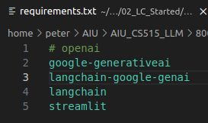
2.07 Install Requirements
https://www.youtube.com/watch?v=_FpT1cwcSLg&list=PLZoTAELRMXVORE4VF7WQ_fAl0L1Gljtar&index=2
Install Requirements (07:01-09:20/43:22)
> code requirements.txt:
1. # openai: Replace openai with google gemini
2. google-generativeai: Google gemini
3. langchain-google-gemini: langchain google gemini interface
4. langchain: langchain functions
5. streamlit: GUI
6. Install all the required libraries.
> pip install -r requirements.txt

Slide 5
2.08 Gemini API Key

Slide 6
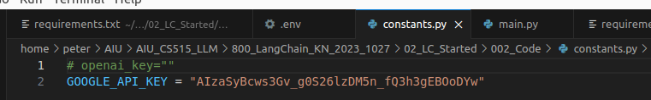
2.08 Gemini API Key
https://www.youtube.com/watch?v=_FpT1cwcSLg&list=PLZoTAELRMXVORE4VF7WQ_fAl0L1Gljtar&index=2
Gemini API Key (09:21-10:30/43:22)
We can create constants.py or “.env”
Below, we use constants.py.
We copy and paste the google api key below.
> GOOGLE_API_KEY = “...”

Slide 7
End

