Slide 1

2.09 Import Library
Peter H. Chen

Slide 2
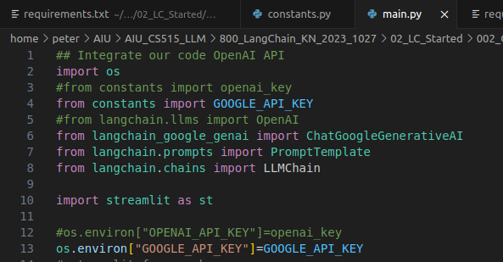
2.09 Import Library
https://www.youtube.com/watch?v=_FpT1cwcSLg&list=PLZoTAELRMXVORE4VF7WQ_fAl0L1Gljtar&index=2
Import Library (10:31-13:00/43:22)
1. import os
2. import GOOGLE_API_KEY
3. import LLM Modes: ChatGoogleGenerativeAI
4. import promptTemplate
5. import LLMChain
6. import streamlit
7. os.environ[“GOOGLE_API_KEY”] = GOOGLE_API_KEY: Set environment variable for for gemini Model.

Slide 3
2.10 Streamlit GUI

Slide 4

2.10 Streamlit GUI
https://www.youtube.com/watch?v=_FpT1cwcSLg&list=PLZoTAELRMXVORE4VF7WQ_fAl0L1Gljtar&index=2
Streamlit GUI (13:01-13:30/43:22)
Title: LangChain Demo with Gemini API.
input_text: Search for the topic you want

Slide 5
2.11 Load Gemini Model

Slide 6
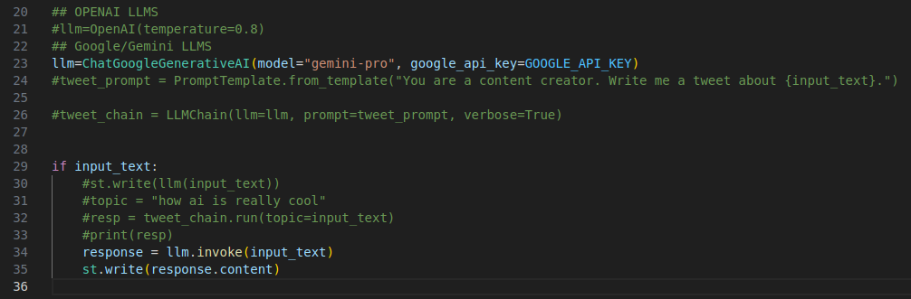
2.11 Load Gemini Model
https://www.youtube.com/watch?v=_FpT1cwcSLg&list=PLZoTAELRMXVORE4VF7WQ_fAl0L1Gljtar&index=2
Load Gemini Model (13:51-16:10/43:22)
1. Load LangChain LLM Gemini Model
2. Get response = llm.invoke (input_text)
2. Display the answer response.content with LangChain LLM Model.

Slide 7
End

