Slide 1

2.12 Test LC: Gemini
Peter H. Chen

Slide 2
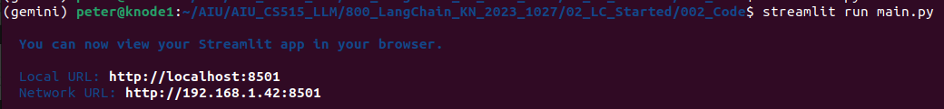
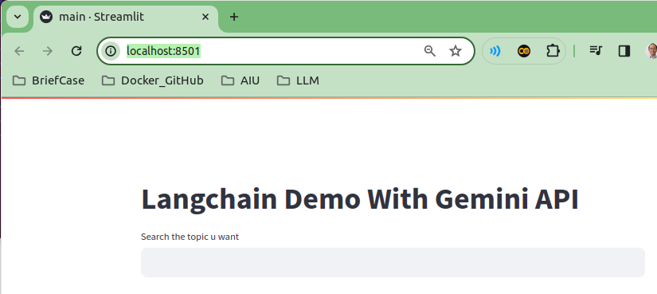
2.12 Test LC: Gemini
https://www.youtube.com/watch?v=_FpT1cwcSLg&list=PLZoTAELRMXVORE4VF7WQ_fAl0L1Gljtar&index=2
Test LC: Gemini (16:21-17:30/43:22)
> streamlit run main.py

Slide 3
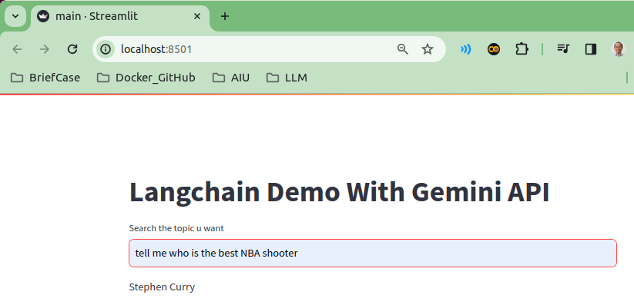
2.12 Test LC: Gemini
https://www.youtube.com/watch?v=_FpT1cwcSLg&list=PLZoTAELRMXVORE4VF7WQ_fAl0L1Gljtar&index=2
Test LC: Gemini (16:21-17:10/43:22)
Question: “Tell me who is the best NBA shooter”?
Answer: “Steve Curry”

Slide 4
2.12 Test LC: Gemini
https://www.youtube.com/watch?v=_FpT1cwcSLg&list=PLZoTAELRMXVORE4VF7WQ_fAl0L1Gljtar&index=2
Test LC: Gemini (17:11-17:20/43:22)
This is the simplest question and answer without prompt.

Slide 5
End

