Slide 1

04 LC: Conversation/Memory
Peter H. Chen

Slide 2
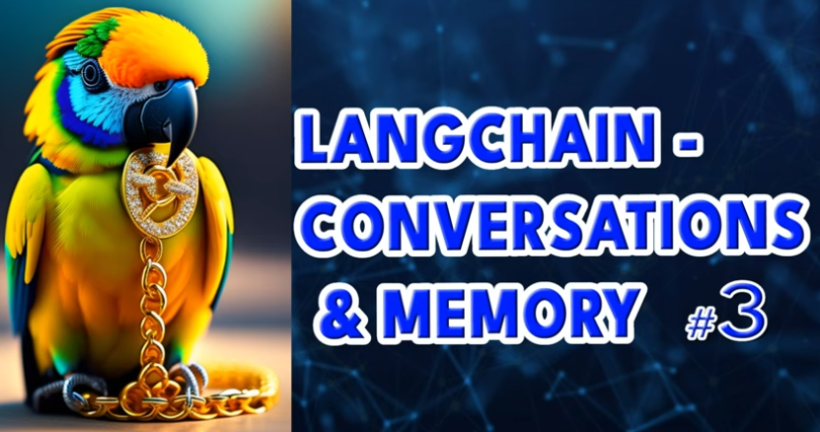
04 LC: Conversation/Memory
https://www.youtube.com/watch?v=X550Zbz_ROE&list=PL8motc6AQftk1Bs42EW45kwYbyJ4jOdiZ&index=4
LC: Conversation/Memory (00:00-00:10/20:27)
We discuss the LangChain: Conversation and memory.
4

Slide 3
04.01 Why Memory

Slide 4

04.01 Why Memory
https://www.youtube.com/watch?v=X550Zbz_ROE&list=PL8motc6AQftk1Bs42EW45kwYbyJ4jOdiZ&index=4
Why Memory (00:11-00:20/20:27)
Why Memory is so important when you build a chat agent?

Slide 5
04.02 Conversational Reference

Slide 6

04.02 Conversational Reference
https://www.youtube.com/watch?v=X550Zbz_ROE&list=PL8motc6AQftk1Bs42EW45kwYbyJ4jOdiZ&index=4
Conversational Reference (00:21-00:50/20:27)
Why Memory is so important when you build a chat agent?
People look at Chat agents like they are human.
They need the chat agent response like a human being.
They want to abbreviate when they refer back that they were spoken earlier on of the conversation.
These can be places, times, etc.

Slide 7

04.01 LC: Memory
https://www.youtube.com/watch?v=X550Zbz_ROE&list=PL8motc6AQftk1Bs42EW45kwYbyJ4jOdiZ&index=4
LC: Memory (00:51-01:30/20:27)
People also need:
The co-reference resolution across the actual conversation.
So, if people talk about a person with the person’s name. Later on, they always refer the person with he or she.
For the LLM (Large Language Model) to pick up who is person, we need to give LLM the memory so that LM can go back to figure out who is the person, what is the topic people are referring to during the conversation chains.

Slide 8
04.03 Transformers Have No Memory

Slide 9

04.03 Transformers Have No Memory
https://www.youtube.com/watch?v=X550Zbz_ROE&list=PL8motc6AQftk1Bs42EW45kwYbyJ4jOdiZ&index=4
Transformers Have No Memory (00:41-02:10/20:27)
As we discussed before, LLM (Large Language Model) themselves do not have a memory.
When we pass in the prompt into the LLM, we have get a response based on the prompt you passed in.
In the past, people have tried to build transformer with memory into them.
Up to date, nothing is really enough for people to use as the conversational chatBot.
Hopefully, in future, transformer model can have built-in memory.
Then, LLM (Large Language Model) will be able to retain memory internally.

Slide 10
End

