Slide 1

04.04 Two Options in LLM Memory
Peter H. Chen

Slide 2



04.04 Two Options in LLM Memory
https://www.youtube.com/watch?v=X550Zbz_ROE&list=PL8motc6AQftk1Bs42EW45kwYbyJ4jOdiZ&index=4
Two Options in LLM Memory (02:11-02:40/20:27)
We have two options in OpenAI LLM/GPT.
1. Put memory back ins the Prompt (LC Prompt Memory).
2. Have an external Loop up (LC Summary Memory): we can put the memory in the database or external lookup information, and then bring the memory back into the prompt.

Slide 3
04.05 Option 1: LC Prompt Memory

Slide 4
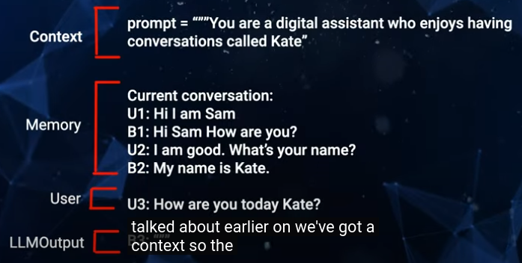
04.05 Option 1: LC Prompt Memory
https://www.youtube.com/watch?v=X550Zbz_ROE&list=PL8motc6AQftk1Bs42EW45kwYbyJ4jOdiZ&index=4
Option 1: LC Prompt Memory (02:41-03:30/20:27)
First, we look at Option 1 (Put memory in LC Prompt Memory): We put memory straight back into the prompt.
We have an context prompt: “The chatBot name is Kate” tell the LLM what is going on already. The current conversation in the external memory: User1 “Hi, I am Sam”. Bot1: “Hi Sam …”, User2: “What is your name?”, Bot2: “May name is Kate”. User 3: “...Kate”
LLM Output: “Based on previous information (prompt, external memory, user3), ...”
The LLM track back the prompt, external memory, and user new request to answer.
OpenAI uses 4096 token for the span. This may not good enough to hold the conversation.

Slide 5
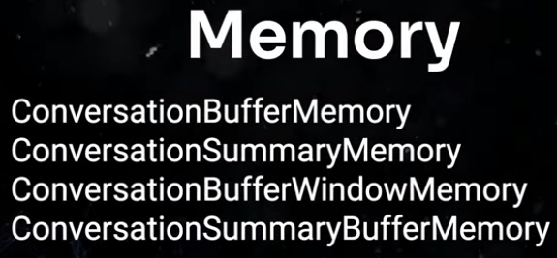

04.05 Option 1: LC Prompt Memory
https://www.youtube.com/watch?v=X550Zbz_ROE&list=PL8motc6AQftk1Bs42EW45kwYbyJ4jOdiZ&index=4
Option 1: LC Prompt Memory (03:31-04:00/20:27)
LangChain has other ways to do the Prompt memory.
1. Conversation Buffer Memory: LangChain put the conversation into the prompt.
2. Conversation Summary Memory: LangChain the conversation into the summary.
3. Conversation Buffer Window Memory: LangChain Provide the limit of window of last few encounters.
4. Conversation Summary Buffer Memory:

Slide 6
04.07 Option 2: External Way for Memory

Slide 7
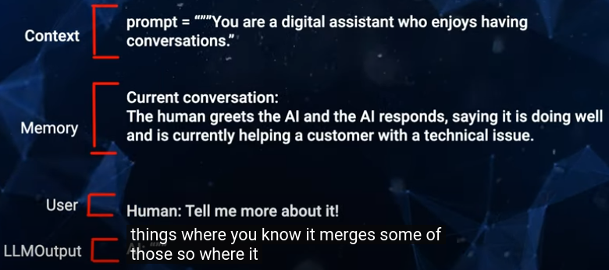
04.07 Option 2: External Way for Memory
https://www.youtube.com/watch?v=X550Zbz_ROE&list=PL8motc6AQftk1Bs42EW45kwYbyJ4jOdiZ&index=4
Option 2: External Way for Memory (04:01-04:30/20:27)
Second, we look at the Option 2: LC Summary Memory Example.
This is more externally way to do it.

Slide 8
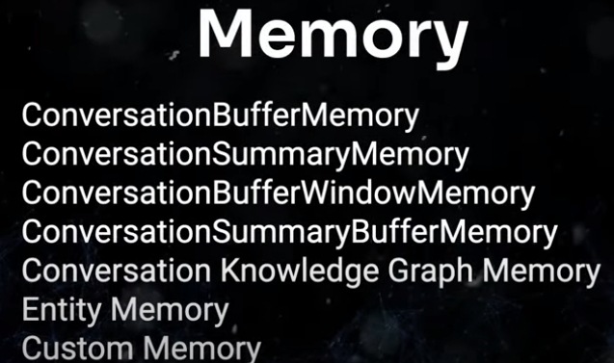
04.07 Option 2: External Way for Memory
https://www.youtube.com/watch?v=X550Zbz_ROE&list=PL8motc6AQftk1Bs42EW45kwYbyJ4jOdiZ&index=4
Option 2: External Way for Memory (04:31-05:10/20:27)
Below LangChain has more externally way to handle the memory.
1. Conversation into Knowledge graph memory
2. Put the conversation in entity memory
3. Put the conversation in custom memory: User write their own system memory.

Slide 9
End

