Slide 1

04.05 LC Memory with Gemini
Peter H. Chen

Slide 2
04.05 LC Memory with Gemini
https://www.youtube.com/watch?v=X550Zbz_ROE&list=PL8motc6AQftk1Bs42EW45kwYbyJ4jOdiZ&index=4
LC Memory with Gemini (05:11-06:30/20:27)
We migrate LC Conversational Memory from Open AI/GPT into Google/Gemini.

Slide 3
04.06 Install LC/Gemini

Slide 4
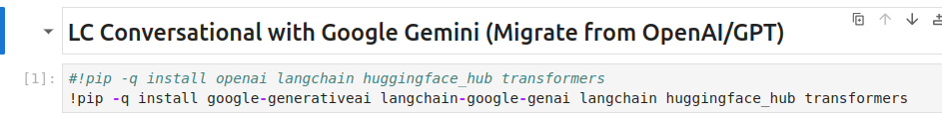
04.06 Install LC/Gemini
https://www.youtube.com/watch?v=X550Zbz_ROE&list=PL8motc6AQftk1Bs42EW45kwYbyJ4jOdiZ&index=4
Install LC/ Gemini (06:31-07:00/20:27)
We install LangChain and Gemini.

Slide 5
04.07 Get Gemini API Key

Slide 6
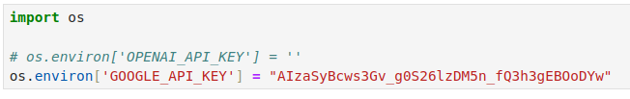
04.07 Get Gemini API Key
https://www.youtube.com/watch?v=X550Zbz_ROE&list=PL8motc6AQftk1Bs42EW45kwYbyJ4jOdiZ&index=4
Get Gemini API Key (07:01-07:30/20:27)

Slide 7
End

